Slide 1
Agile

Slide 2
Index:
1)What is Agile frame work
2)Different Frameworks used in Agile
3)Scrum architecture
4)Keyswords used in scrum architecture
Agile Framework:
→Agile framework helps deliver product on time.
→Increase productivity.
→Responds to the change.
Frameworks used in agile are:
→Scrum
→Extreme programming
→Crystal
→Lean Kaban
→Agile unified process
→Adaptive systems management

Slide 3
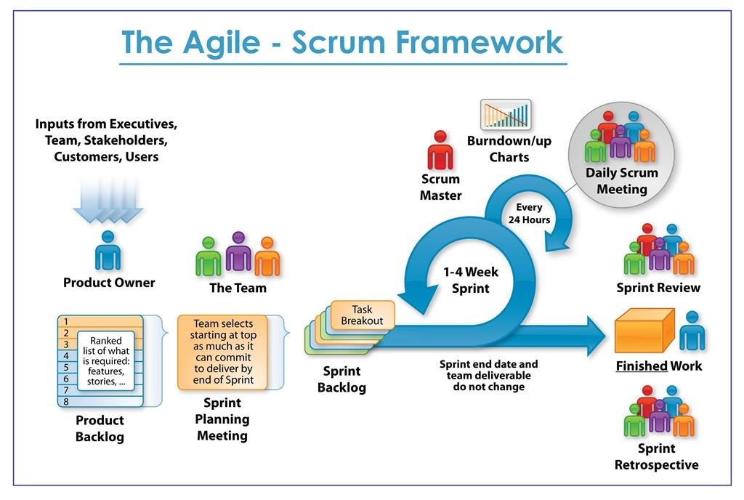
Scrum Architecture:
Keywords:
→Product backlog
→Sprint planning meeting
→Sprint backlog
→Daily stand-up meetings
→Sprint
→Sprint Review

Slide 4
Product Backlog:
→List of requirements prioritised by business value.
→The Agile product backlog in scrum is prioritised features list.
→It contains short description of all functionality desired in the product.
Sprint planning Meeting:
How much we can deliver by end of the sprint.
Sprint Backlog:
→Backlog tasks expanded by teams.
→The sprint backlog is the output of the sprint planning meeting.
→It is essential the list of tasks that the scrum team needs to complete during the sprint.
→Sprint backlog is the set of product backlog items selected for sprint+plan for delivery product.
Sprint:
→Sprint is nothing but a time box.
→Sprint have consistent duration for development. It has one month or 15 days duration.
→A new sprint starts immediately after the previous sprint.
→No changes are made for the sprint goal.
→Quality goals do not decrease.
→No change in duration or deliverables.

Slide 5
Daily Stand-up meeting:
→What did you do since last scrum meeting?
→Do you have any obstacles?
→what will you do before and next meeting?
Sprint Reviews:
→The entire team, including both the scrum master and product owner should be participated.
→We can conduct up to an hour.
→They will discuss what happened in the iteration and identifies action for improving going to forward.
→It is an opportunity for improvement for next sprint.

