Slide 1
Ansible

Slide 2
Configuration Management:
It is an automation platform that configures and manages infra.
Configuration management tool turns infra into code.
So your code would be testable, reputable and version able.
Infra Refers To The Composite Of:
Hardware
Software
Network
People
Process
After Configuration Management:
Increase uptime
Improve performance
Prevent errors
Reduce cost
Configuration Management Tools:
Chef
Puppet
Ansible

Slide 3
Why Ansible:
Ansible Is An Automation Engine That Automates Software Provisioning, Configuration Management And Application Deployment.
Manages Infra Whether It Is On Premises Or In The Cloud.
It Turns Your Infra As Code.
You Only Need To Tell The Desired Configuration Should Be, Not How To Achieve It.
Through Automation Get Desired State Of Server.
Important Points:
Agntless
Push Based
Idem Potency
Open Source
Enterprise (Tower)
Provisioning
Orchestration
Python Based
Adhoc And Playbook
Repository(galaxy)
Ansible Advantages:
Agent Less
Relies On SSH
Uses Python
Push Mechanism

Slide 4
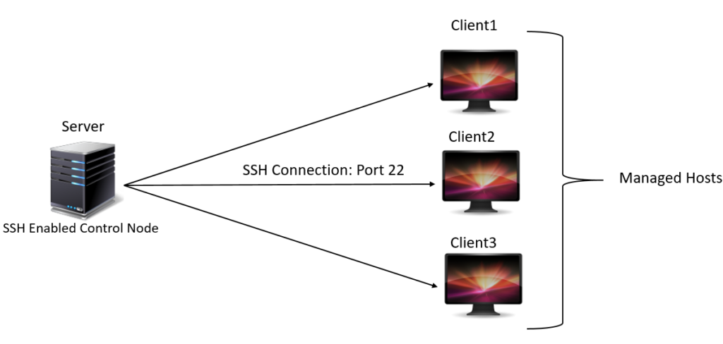
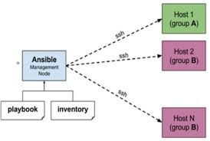
Ansible Architecture:
Node should be Linux family.
Inventory files consists of list of hosts or nodes.

Slide 5
Ansible Server or manager or Controller:
Where you are writing the code.
Ansible Node:
Where you are applying the code.
Playbook:
Ansible playbooks are a way to send commands to remote computers.
Playbooks consist of one or more plays, or groups of tasks.
Each playbook is composed of one or more plays in a list.
Task is nothing but a call to run an ansible module.
Playbooks are divided into 3 sections.
a)Target section:
Defines hosts against which playbooks takes has to be executed.
b)Variable section:
Defines variables.
c)Task section:
List of all modules that we need to run in an order.
Inventory:
Ansible recognizes system listed in Ansible inventory file, which location is /etc/ansible/hosts.
In invnetory file mention privateip.
[groupname]
machineip

Slide 6
YAML:
YAML files have begin with "---" nd ends with "..."
All members of a list are lines beginning at the same indentation level starting with a "-"
Installation of Ansible:
Step1:
Mention all the node ips's in /etc/hosts and viseversa
Step2:
a)Server:
Launch RHEL-7 only(need not install ansible in nodes)
yum install wget
wget https://d1.fedoraproject.org/pub/epel/epel-release-latest7.nparch.rpm
rpm -ivh epel-release-latest7.noarch.rpm
sudo yum -y update
sudo yum install git python python-pip open-ssl ansible
ansible --version
b)Inventory(Only in server)
Mention the node ips in inventory file i.e., /etc/ansible/hosts
c)Test environment setup(For all nodes and server)
Sudo adduser ansible
Sudo passwd ansible
Sudo visudo
ansible ALL=(ALL) NOPASSWD:ALL

Slide 7
d)To establish ssh connection:
To establish ssh connection among all nodes make the below changes
permitRootLogin yes(uncomment line set to yes)
passwordAuthentication yes(uncomment line set to "yes")
e)Generating ssh keys:
[ ] cd /etc/anible
[ ] ssh-keygen
[ ] cd
[ ] cd .ssh/
[ ] cat id_rsa.pub
Go to target server and copy the pub key in authenticationkeys.
Check it is working or not
[ ] ssh targetserverip
Adhoc Command in ansible:
Adhoc commands in ansible allow you to execute simple tasks at the command line against one or all your hosts.
Adhoc commands conists of two parameters. The host group defines on what machines to run the task against and the ansible module to run.
[] ansible -m ping all
Adhoc commands in Ansible also allow you to run commands in parallel.
Adhoc commands in Ansible is something that you might type, do something really quick but you don't want to save for later.

Slide 8
If you don't want to use ssh-keygen, you can use --ask-pass(-k).
Adhoc commnads are commands which can be run individually to perform quick functions.
Theses adhoc commands are not used for configuration management and deployment.
Then why do we use adhoc commands?
Some times we are required to perform some simple tsks. so we need not to write big playbooks in such cases we will go with adhoc commands.
Practical:
[ ] ansible serverip -k -m yum -a "name=httpd" state=installed"
[ ] ansible serverip -k -m copy -a "src=index.html dest=/var/www/html"
[ ] ansible serverip -k -m service -a "name=httpd state=started“
Ansible playbooks:
1)Writting Ansible firt playbook:
- hosts: webserver
remote_user: root
become: yes
tasks:
- name: install httpd
yum: name=httpd state=installed
- name: creates index.html file
copy: src=index.html dest=/var/www/html
- name: restart httpd
service: name=httpd state=started

Slide 9
Executing Playbook:
a)Check the syntax
[ ] ansible-playbook playbookname --syntax
b)Dry run
[ ] ansible-playbook playbookname --check
c)Executing playbook
[ ] ansible-playbook playbookname
d)Command to run in failure systems:
[ ] anible-playbook playbookname --limit@webserver.retry
This command used to rerun ansible playbook only in failed systems.
2)Ansible variable:
variables is nothing but a piece of memory.
4 ways to create variables
We can mention inside playbook:
hosts: webserver
remote_user: root
become: yes
vars:
pkg: httpd
tasks:
- name: install httpd
yum: name={{pkg}} state=installed
- name: creates index.html file

Slide 10
copy: src=index.html dest=/var/www/html
- name: restart httpd
service: name={{pkg}} state=started
a)Playbook
- hosts: webserver
remote_user: root
become: yes
vars_files:
- abc.yml
tasks:
- name: install httpd
yum: name={{pkg}} state=installed
- name: creates index.html file
copy: src=index.html dest=/var/www/html
- name: restart httpd
service: name={{pkg}} state=started
b)File:
[]vi abc.yml
pkg: httpd
c)Interactive Mode:
- hosts: webserver
remote_user: root

Slide 11
become: yes
vars_prompt:
- name: pkg
prompt: enter package name
private: no
tasks:
- name: install httpd
yum: name={{pkg}} state=installed
- name: creates index.html file
copy: src=index.html dest=/var/www/html
- name: restart httpd
service: name={{pkg}} state=started
d)Command mode:
- hosts: "{{hosts}}"
remote_user: root
become: yes
vars:
pkg: httpd
tasks:
- name: install httpd
yum: name={{pkg}} state=installed
- name: creates index.html file
copy: src=index.html dest=/var/www/html
- name: restart httpd
service: name={{pkg}} state=started

Slide 12
Command:
By using command mode we can call the hosts.
[] ansible-playbook playbookname -e "hosts=webserver"
3)Handlers:
Consists the ability to notify when something happens.
In ansible order of execution is sequential.
whenever change is happened, restart service. In this case we will use handlers with notify option.
Playbook:
- hosts: webserver
remote_user: root
become: yes
tasks:
- name: install httpd
yum: name=httpd state=installed
- name: creates index.html file
copy: src=index.html dest=/var/www/html
notify: retart httpd
- name: restart httpd
service: name=httpd state=started
handlers:
- name: restart httpd
service: name=httpd state=restarted

Slide 13
4)Ansible behaviour(ignore_errors):
Default behavior of ansible is sequential. If one task fails rest of the tasks won't execute.
To overcome this we have to use ignore errors.
If one task fails, we can make it other tasks to be executed.
Playbook:
- hosts: web server
remote user: root
become: yes
tasks:
- name: install httpd
yum: name=httpd state=installed
- name: creates index.htmll file
copy: src=index.html dest=/var/www/html
ignore_errors: yes
- name: restart httpd
service: name=httpd state=started
5)Ansible Forks:
Ansible playbook can run in 5 target machines at a time. This is the default behaviour of ansible. If you want to run play book in 100 machines at a time you can achieve it by using the following.

Slide 14
a)Adhoc level:
[] ansible playbook webserver.yml --forks=10
(or)
b)Global level:
[] vi /etc/ansible/ansible.cfg
forks=10
6)Ansible setup module:
Setup module will collect all the information about node like network information, platform information etc.
[] anible targetmachineip -m setup
7)Ansible Template:
Template in Ansible is a file which contains all your configuration parameters but dynamic values.
Anibl uses jinja2 template to enable dynnamic expression and access to varables.
Template will substitute the value.
Playbook:
a)[] vi template.yml
- hosts: webserver
remote_user: root
become: yes
tasks:
- name: create xyz file
template: src=xyz.j2 dest=/root/xyz

Slide 15
b)[] vi xyz.j2
system name is {{ansible_nodename}}
8)Ansible Loops:
Loops are used to perform iterative task.
Often you want to do many things in one task, such as create a lot of users, install a lot of packages or repeat a polling tep unti a crtain result is reached.
Playbook:
- hosts: webserver
remote_user: root
become: yes
tasks:
- name: installing multiple packages
yum: name={{item}} state=installed
with_items:
- httpd
- curl
- wget
9)Ansible Security:
Ansible allows keeping sensitive data uch as pasword or keys in encrypted files, rather than as plaintext in your playbook.

Slide 16
Commands:
[ ]anible-vault encrypt vault.yml
[ ]ansible-playbook vault.yml --as-vault-pass
[ ]ansible-vault edit vault.yml
[ ]ansible-vault rekey vault.yml
[ ]ansible-vault descrypt vault.yml
Playbook:
- hosts: webserver
remote_user: root
become: yes
vars:
password: pavani
tasks:
- name: install httpd
yum: name=httpd state=installed
- name: creates index.html file
copy: src=index.html dest=/var/www/html
- name: restart httpd
service: name=httpd state=started
10)Anible Registry:
Ansible registers are used when you want to capture the output of a task to a variable.
You can then use the value of these registers for different scenarios like a conditional statement, logging etc.
The variables will contain the value returned by the task.

Slide 17
Playbook:
- hosts: webserver
remote_user: root
become: yes
tasks:
- name: install httpd
yum: name=httpd state=installed
- name: creates index.html file
copy: src=index.html dest=/var/www/html
- name: restart httpd
service: name=httpd state=started
register: output
- debug:
msg: "{{output}}“
11)Ansible tags:
Tags are used to control of executing the tasks in playbook.
Tags help Ansible tasks to be selected from a play-book. If you need to play(execute) only certain specific tasks you can specify the tags needed while executing the ansible-playbook command.
Tags can also be used to exclude certain tasks in a play!
If you want to run certain taks from play-book then use tags.
By uing tag we can skip the particular task also.

Slide 18
Playbook:
- hosts: webserver
remote_user: root
become: yes
tasks:
- name: install httpd
yum: name=httpd state=installed
tags:
- install
- name: creates index.html file
copy: src=index.html dest=/var/www/html
tags:
- configure
- name: restart httpd
service: name=httpd state=started
tags:
- service
Method1:
[ ]ansible-playbook tags.yml --tag "install,configure"
[ ]ansible-playbook tags.yml --skip-tags "install,configure“
Method2:
[ ]ansible-playbook webserver.yml --start-at-task="create index.html file"
Method3:
[ ]ansible-playbook webserver.yml --step

Slide 19
13)Ansible Include:
Includes a file with a list of plays or tasks to be executed in the current playbook.
Playbook:
- hosts: webserver
remote_user: root
become: yes
tasks:
- include: install.yml
- include: config.yml
- include: service.yml
14)Ansible when statement:
Sometimes you will want to skip a particular step on a particular host due to operating system is a particular version etc. This can be achieved by usinng ansible when cluase.
Playbook:
- hosts: webserver
remote_user: root
become: yes

Slide 20
Tasks:
- name: install httpd
yum: name=httpd state=installed
when: ansible_os_family== "Redhat"
- name: install apache2
apt: name=apache2 state=installed
when: ansible_os_family== "Debian"
- name: creates index.html file
copy: src=index.html dest=/var/www/html
- name: restart httpd
service: name=httpd state=started
15)Ansible Roles:
Role is nothing but a structure . It contains collection of variables, files,tasks,templates and modules.
Role is nothing but breaking a playbook into multiple files.
Roles are useful for writing compplex playbooks and makes them easier to reuse.
Roles are not playbooks.
There is no way to directly execute role.
With ansible two techiniques for reusing a set of configuration management tasks that is include and roles.
Use ansible-galaxy init <rolename>. It will create role in our present working directory.

Slide 21
Roles Directory Structure:
Tasks
Handlers
Defaults
Vars
Files
Templates
Meta
Uses Of Roles:
Reuse
Easy to maintain
Tasks:
Contains main list of tasks
Handlers:
Handlers are just like regular tasks in Ansible playbook but are only works if the tak contains notify option and also indicates that is changed somthing.
For example, if config file is changed, we have to restart the service. That time we will use handlers.
For handlers, service restart are the most common usage.
Defaults:
It is allow you to set default variables for the dependent roles.
Role depedencies automatically pull in ther roles.
Vars:
Variables for the roles.

Slide 22
6. Templates:
Contains the templates which can be deployed via this role.
7. Meta:
Define some meta data for this role.
Role for Webserver:
Playbook:
- hosts: webserver
remote_user: root
become: yes
roles:
- webserver
Commands:
[ ]cd /etc/ansible/roles
[ ]ansible-galaxy init rolename
It will generate directory structure.
a)[ ]cd rolename
[ ]cd tasks
[ ]vi main.ym
# tasks file for webserver
- name: install httpd
yum: name=httpd state=present
- name: creates index.html

Slide 23
copy: src=index.html dest=/var/www/html
notify: restart httpd
b)[]cd handlers
[]vi main.yml
# handlers file for webserver
- name: restart service
service: name=httpd state=restarte
c)[]cd files
[]vi index.ml
17)Ansible Tower:
It is web based solution that makes ansible very easy to use for all kinds of IT teams.
Inventory can be mnaged graphically.
It supports for auto scalling.
By using tower we can mange playbook, invenory without using CLI.

Slide 24
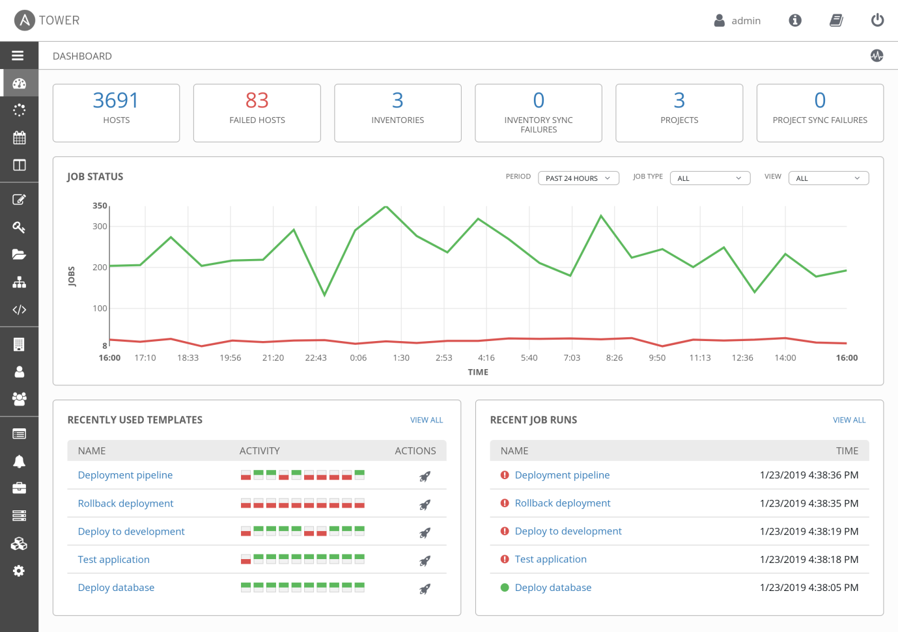
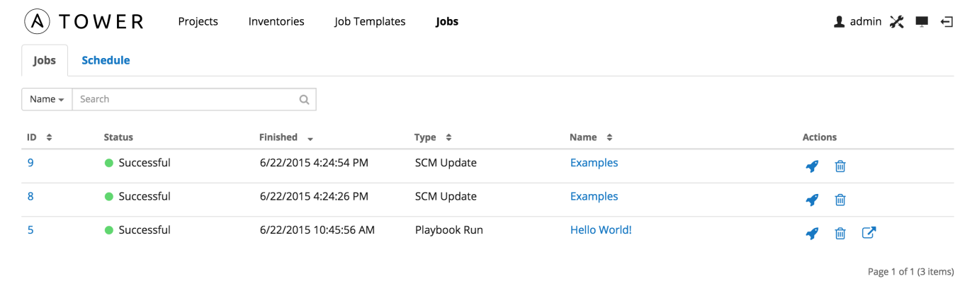
18)Anible Galaxy:
Anible galaxy refers to the galaxy website where users can share roles.
It is free site for finding, downloading and sharing roles.

