Slide 1

Department of Automation and Applied Informatics
By
Bikash Kumar Mahanti
O8F1L9

Slide 2

Recommendation of movies using Bert
(Bidirectional Encoder Representations from Transformers)

Slide 3

Introduction
Enhancing Movie Recommendations
Using BERT Model
Data-Driven Approach
Limitations of Traditional Recommendation Systems
Improving Accuracy and Personalization with BERT

Slide 4

Technologies Used
Google-colab
Movie lens data sets

Slide 5

Challenges in Movie Recommendations
Core Issues: Long-term Dependencies and Sequential Patterns in User Behavior
Challenges in Traditional Systems:
Difficulty in Capturing User's Evolving Preferences
Inability to Recognize Complex Behavioral Sequences
Impact: Compromised Accuracy and Personalization in Movie Recommendations
Necessity: Adoption of More Advanced Models for Enhanced Recommendations

Slide 6

Understanding BERT Model
• Model Type: BERT (Bidirectional Encoder Representations from Transformers)
• Category: Natural Language Processing (NLP)
• Key Feature: Bidirectional contextual understanding of text
• Strength: Captures intricate contextual relationships in language, suitable for various NLP tasks
• Application: Ideal for Movie
Recommendation Tasks

Slide 7

Data-Driven Approach
Approach: Data-Driven
Data Utilization:
User Interaction Data
Movie Attributes
Contextual Information
Training: BERT
Purpose: To Harness Historical User Behavior
Outcome: Accurate Prediction of User Preferences

Slide 8
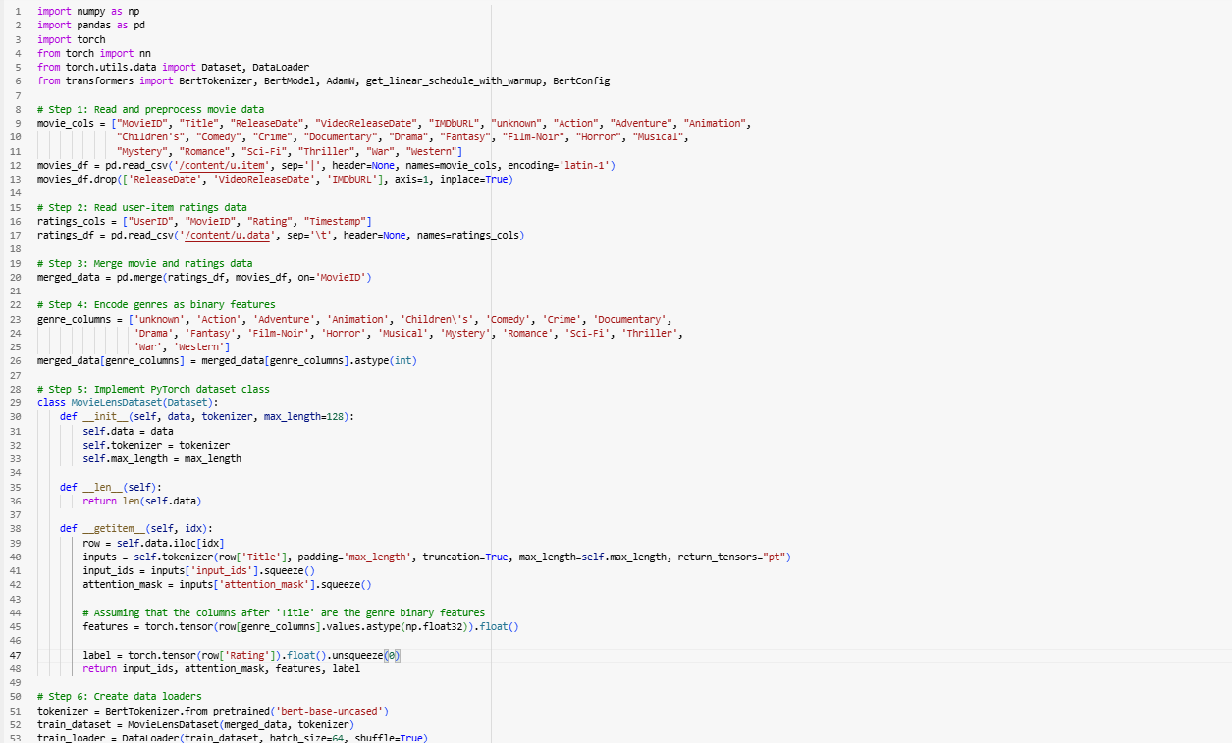
Data-Driven Approach

Slide 9

Training the
BERT Model
Training Process: BertWithGenreFeatures Model
Input Data:
Historical User Interactions
Movie Attributes
Objective: Learning and Adapting Parameters
Method: Iterative Process
Goal: Optimize for Accurate Movie Recommendations

Slide 10
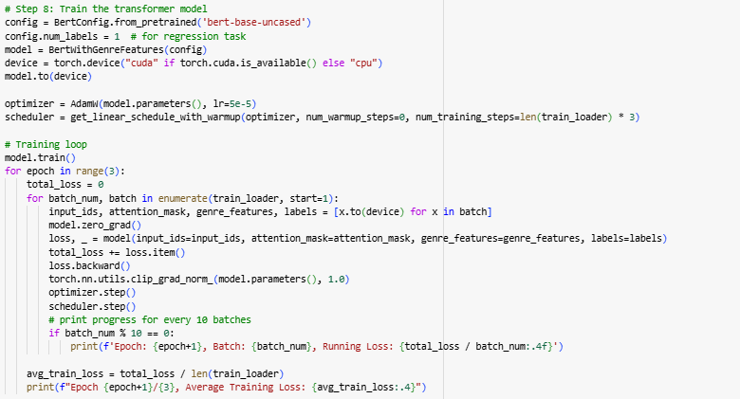
Training the
BERT Model

Slide 11

Evaluating Recommendation
Performance
Performance Measurement: BERT-based Recommendations
Key Metrics:
Precision 70%
Recall 70%
Accuracy 85%
Insights Gained:
Accuracy of Recommendations
Coverage of Movie Selection

Slide 12
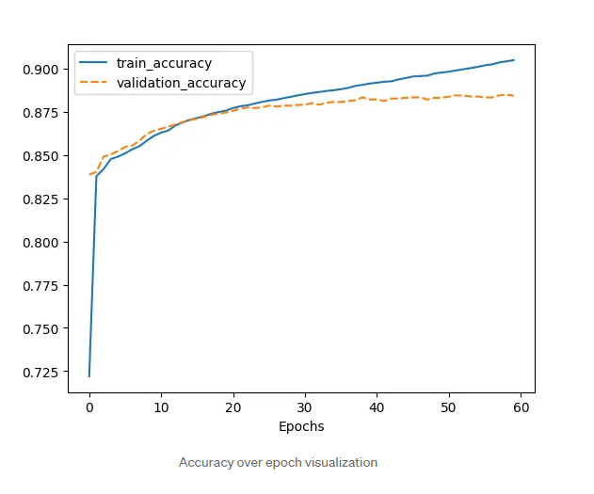
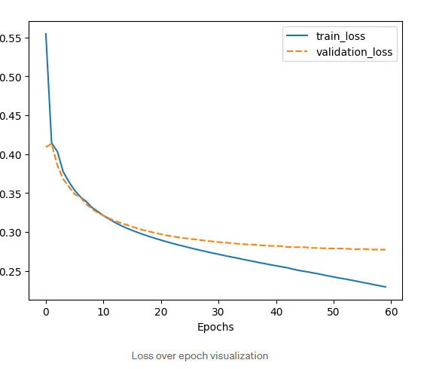
Evaluating Recommendation
Performance

Slide 13

Personalization and User Engagement
Function of BERT Model:
Personalized Movie
Recommendations
Key Features:
Captures Individual Preferences
Adapts to Evolving User Behavior
Benefits:
Enhanced User Engagement
Increased User Satisfaction with Recommendations

Slide 14
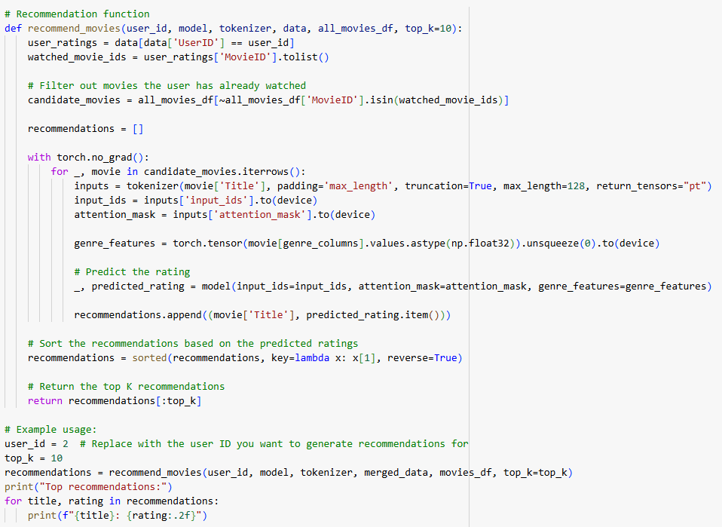
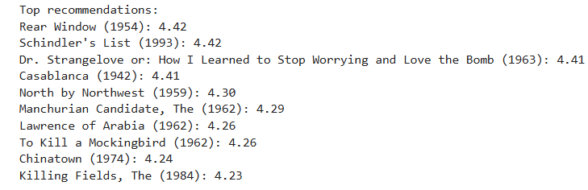
Personalization and User Engagement

Slide 15
Conclusion
In conclusion, leveraging BERT models for movie recommendations offers a promising path towards accurate, personalized, and engaging user experiences. The potential for further advancements in data-driven approaches signals a bright future for movie recommendation systems.

Slide 16
Thanks!
Do you have any questions? @Bikash Kumar Mahanti
Supervisor: Grad-Gyenge László György

