Slide 2
CONVOLUTIONAL NEURAL NETWORK

Slide 3
CONVOLUTIONAL NEURAL NETWORK
CNNs are very effective in areas such as image recognition and classification
Application of CNNs
Images you want to find features
Machine translation
Sentiment analysis
Sentence classification
They are feature-location invariant
Notes:
CNN have revolutionized computer vision and NLP, computer audition, reinforcement learning and many other areas.
They extend neural networks primarily by introducing a new kind of layer, designed to improve the network’s ability to cope with variations in position, scale, and viewpoint.

Slide 4
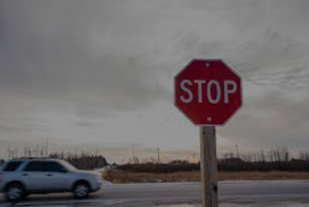
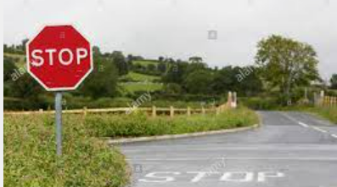
WHY CNN?
Notes:
Despite these improvements, it’s still impractical for the network to be able to memorize the nearly endless set of permutations which would fully characterize a dataset of diverse images. In order to capture that much information, we’d need too many neurons for what we can practically afford to store or train. The advantage of convnets is that they will allow us to capture these permutations in a more efficient way.
Suppose I show you a picture of a car that you’ve never seen before. Chances are you’ll be able to identify it as a car by observing that it is a permutation of the various properties of cars. In other words, the picture contains some combination of the parts that make up most cars, including a windshield, wheels, doors, and exhaust pipe. By recognizing each of the smaller parts and adding them up, you realize that this picture is of a car, despite having never encountered this precise combination of those parts.
A convnet tries to do something similar: learn the individual parts of objects and store them in individual neurons, then add them up to recognize the larger object. This approach is advantageous for two reasons. One is that we can capture a greater variety of a particular object within a smaller number of neurons. For example, suppose we memorize 10 templates for different types of wheels, 10 templates for doors, and 10 for windshields. We thus capture 10∗10∗10=100010∗10∗10=1000 different cars for the price of only 30 templates.
This is much more efficient than keeping around 1000 separate templates for cars, which contain much redundancy within them. But even better, we can reuse the smaller templates for different object classes. Wagons also have wheels. Houses also have doors. Ships also have windshields. We can construct a set of many more object classes as various combinations of these smaller parts, and do so very efficiently.

Slide 5
CNNS – HOW DO THEY WORK?
Inspired by the biology of the visual cortex
Local receptive fields are a group of neurons that only respond to a part of what your eyes see (subsampling)
They overlap each other to cover the entire visual field (convolutions)
They feed into a higher layer that identifies increasingly complex images
Some receptive fields identify horizontal lines, lines at different angles etc
There would be a layer that identifies shapes, which might feed into the layer which identifies objects. For color images, extra layers of red, green and blue
Notes:
CNN are not very different from the neural networks we have discussed so far. They improve the functionality of neural network by introducing another layer called a convolutional layer to the mix
We can interpret the set of weights as a feature detector which is trying to detect the presence of a particular feature. We can visualize these feature detectors, as we did previously for MNIST and CIFAR. In a 1-layer fully-connected layer, the “features” are simply the image classes themselves, and thus the weights appear as templates for the entire classes

Slide 6
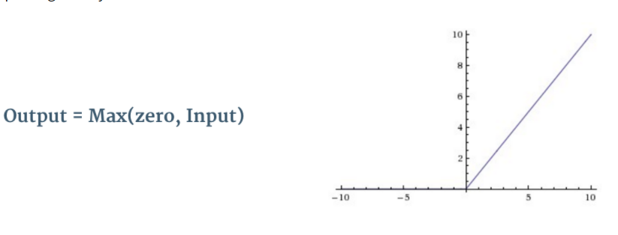
BUILDING BLOCKS OF CNN
There are four main operations in CNN:
Convolution
The primary purpose of convolution is to extract features from the input image. It preserves the spatial relationship between pixels
Non-Linearity (ReLU)
Pooling or Sub Sampling
Classification (Fully Connected Layer)
Notes:
In convolutional layers, we have a collection of smaller feature detectors called convolutional filters which we individually slide along the entire image and perform the same weighted sum operation as before, on each subregion of the image. Essentially, for each of these small filters, we generate a map of responses–called an activation map–which indicate the presence of that feature across the image.

Slide 7
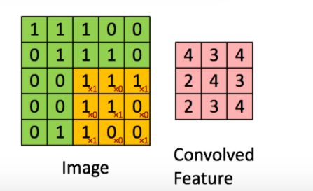
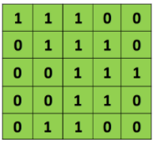
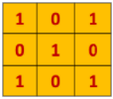
CONVOLUTION
Filter
Image
Notes:
In convolutional layers, we instead have a collection of smaller feature detectors called convolutional filters
which we individually slide along the entire image and perform the same weighted sum operation as before, on each subregion of the image. Essentially, for each of these small filters, we generate a map of responses–called an activation map–which indicates the presence of that feature across the image.
the filters are just collections of weights, just like all of the other weights we’ve discussed in previous chapters
They are parameters which are learned during the process of training.

Slide 8
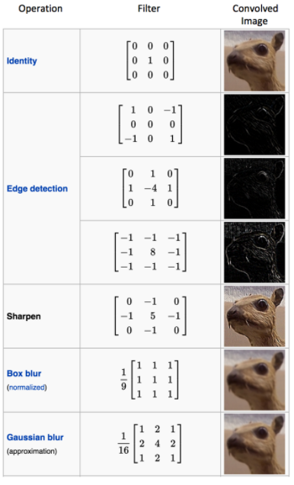
Notes:
The resulting activation map (on the right) shows the presence of the feature map -- or roughly patterns in the input which resemble the filter itself.
since we have 7 filters generating 25∗25 sized maps, we have 8∗25∗25=5000 neurons in the next layer.

Slide 9
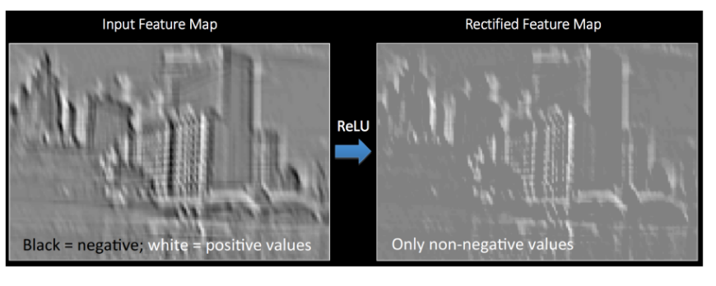
RELU

Slide 10
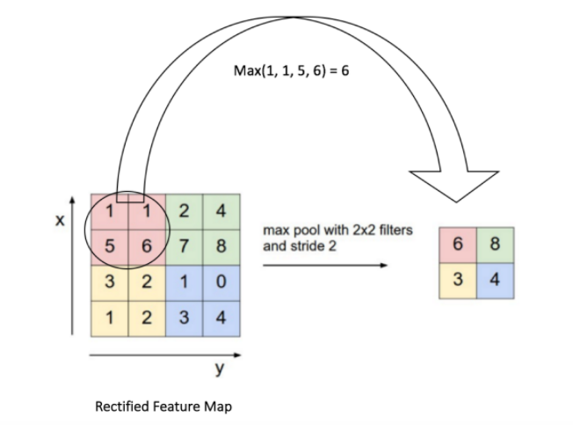
THE POOLING STEP
Spatial Pooling (also called subsampling or downsampling) reduces the dimensionality of each feature map but retains the most important information.
Spatial Pooling can be of different types: Max, Average, Sum etc.
In case of Max Pooling, we define a spatial neighborhood (for example, a 2×2 window) and take the largest element from the rectified feature map within that window.
Notes:
The pooling operation is used to downsample the activation maps, usually by a factor of 2 in both dimensions. The most common way of doing this is max pooling which merges the pixels in adjacent 2x2 cells by taking the maximum value among them. The figure below shows an example of this.

Slide 11
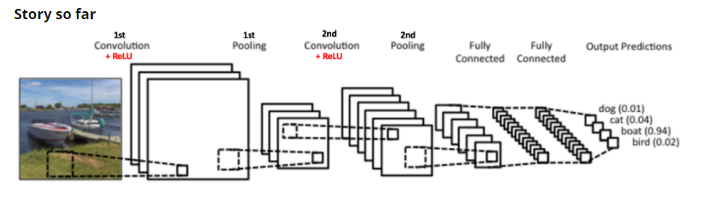
WHY POOLING?
Makes the input representations (feature dimension) smaller and more manageable
Reduces the number of parameters and computations in the network, therefore, controlling overfitting
Makes the network invariant to small transformations, distortions and translations in the input image (a small distortion in the input will not change the output of Pooling – since we take the maximum/average value in a local neighbourhood).
Helps us arrive at an almost scale-invariant representation of our image. This is very powerful since we can detect objects in an image no matter where they are located
Notes:
The advantage of pooling is that it gives us a way to compactify the amount of data without losing too much information, and create some invariance to translational shift in the original image. The operation is also very cheap since there are no weights or parameters to learn.
Recently, pooling layers have begun to gradually fall out of favor. Some architectures have incorporated the downsampling operation into the convolutional layers themselves by using a stride of 2 instead of 1, making the convolutional filters skip over pixels, and result in activation maps half the size. These “all-convolutional nets” have some important advantages and are becoming increasingly common, but have not yet totally eliminated pooling in practice.

Slide 12
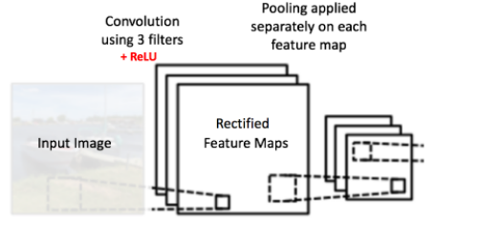
SO FAR…
Notes:
In this sense, we can think of the original image as a volume of data. Let’s consider the previous example. Our original image is 28 x 28 pixels and is grayscale (1 channel). Thus it is a volume whose dimensions are 28x28x1. In the first convolutional layer, we convolved it with 8 filters whose dimensions are 5x5x1. This gave us 8 activation maps of size 24x24. Thus the output from the convolutional layer is size 24x24x8. After max-pooling it, it’s 12x12x8.
We can think of the stacked activation maps as a sort-of “image.”
In typical neural networks, we frequently have multiple convolutional (and pooling layers) arranged in a sequence.

Slide 13
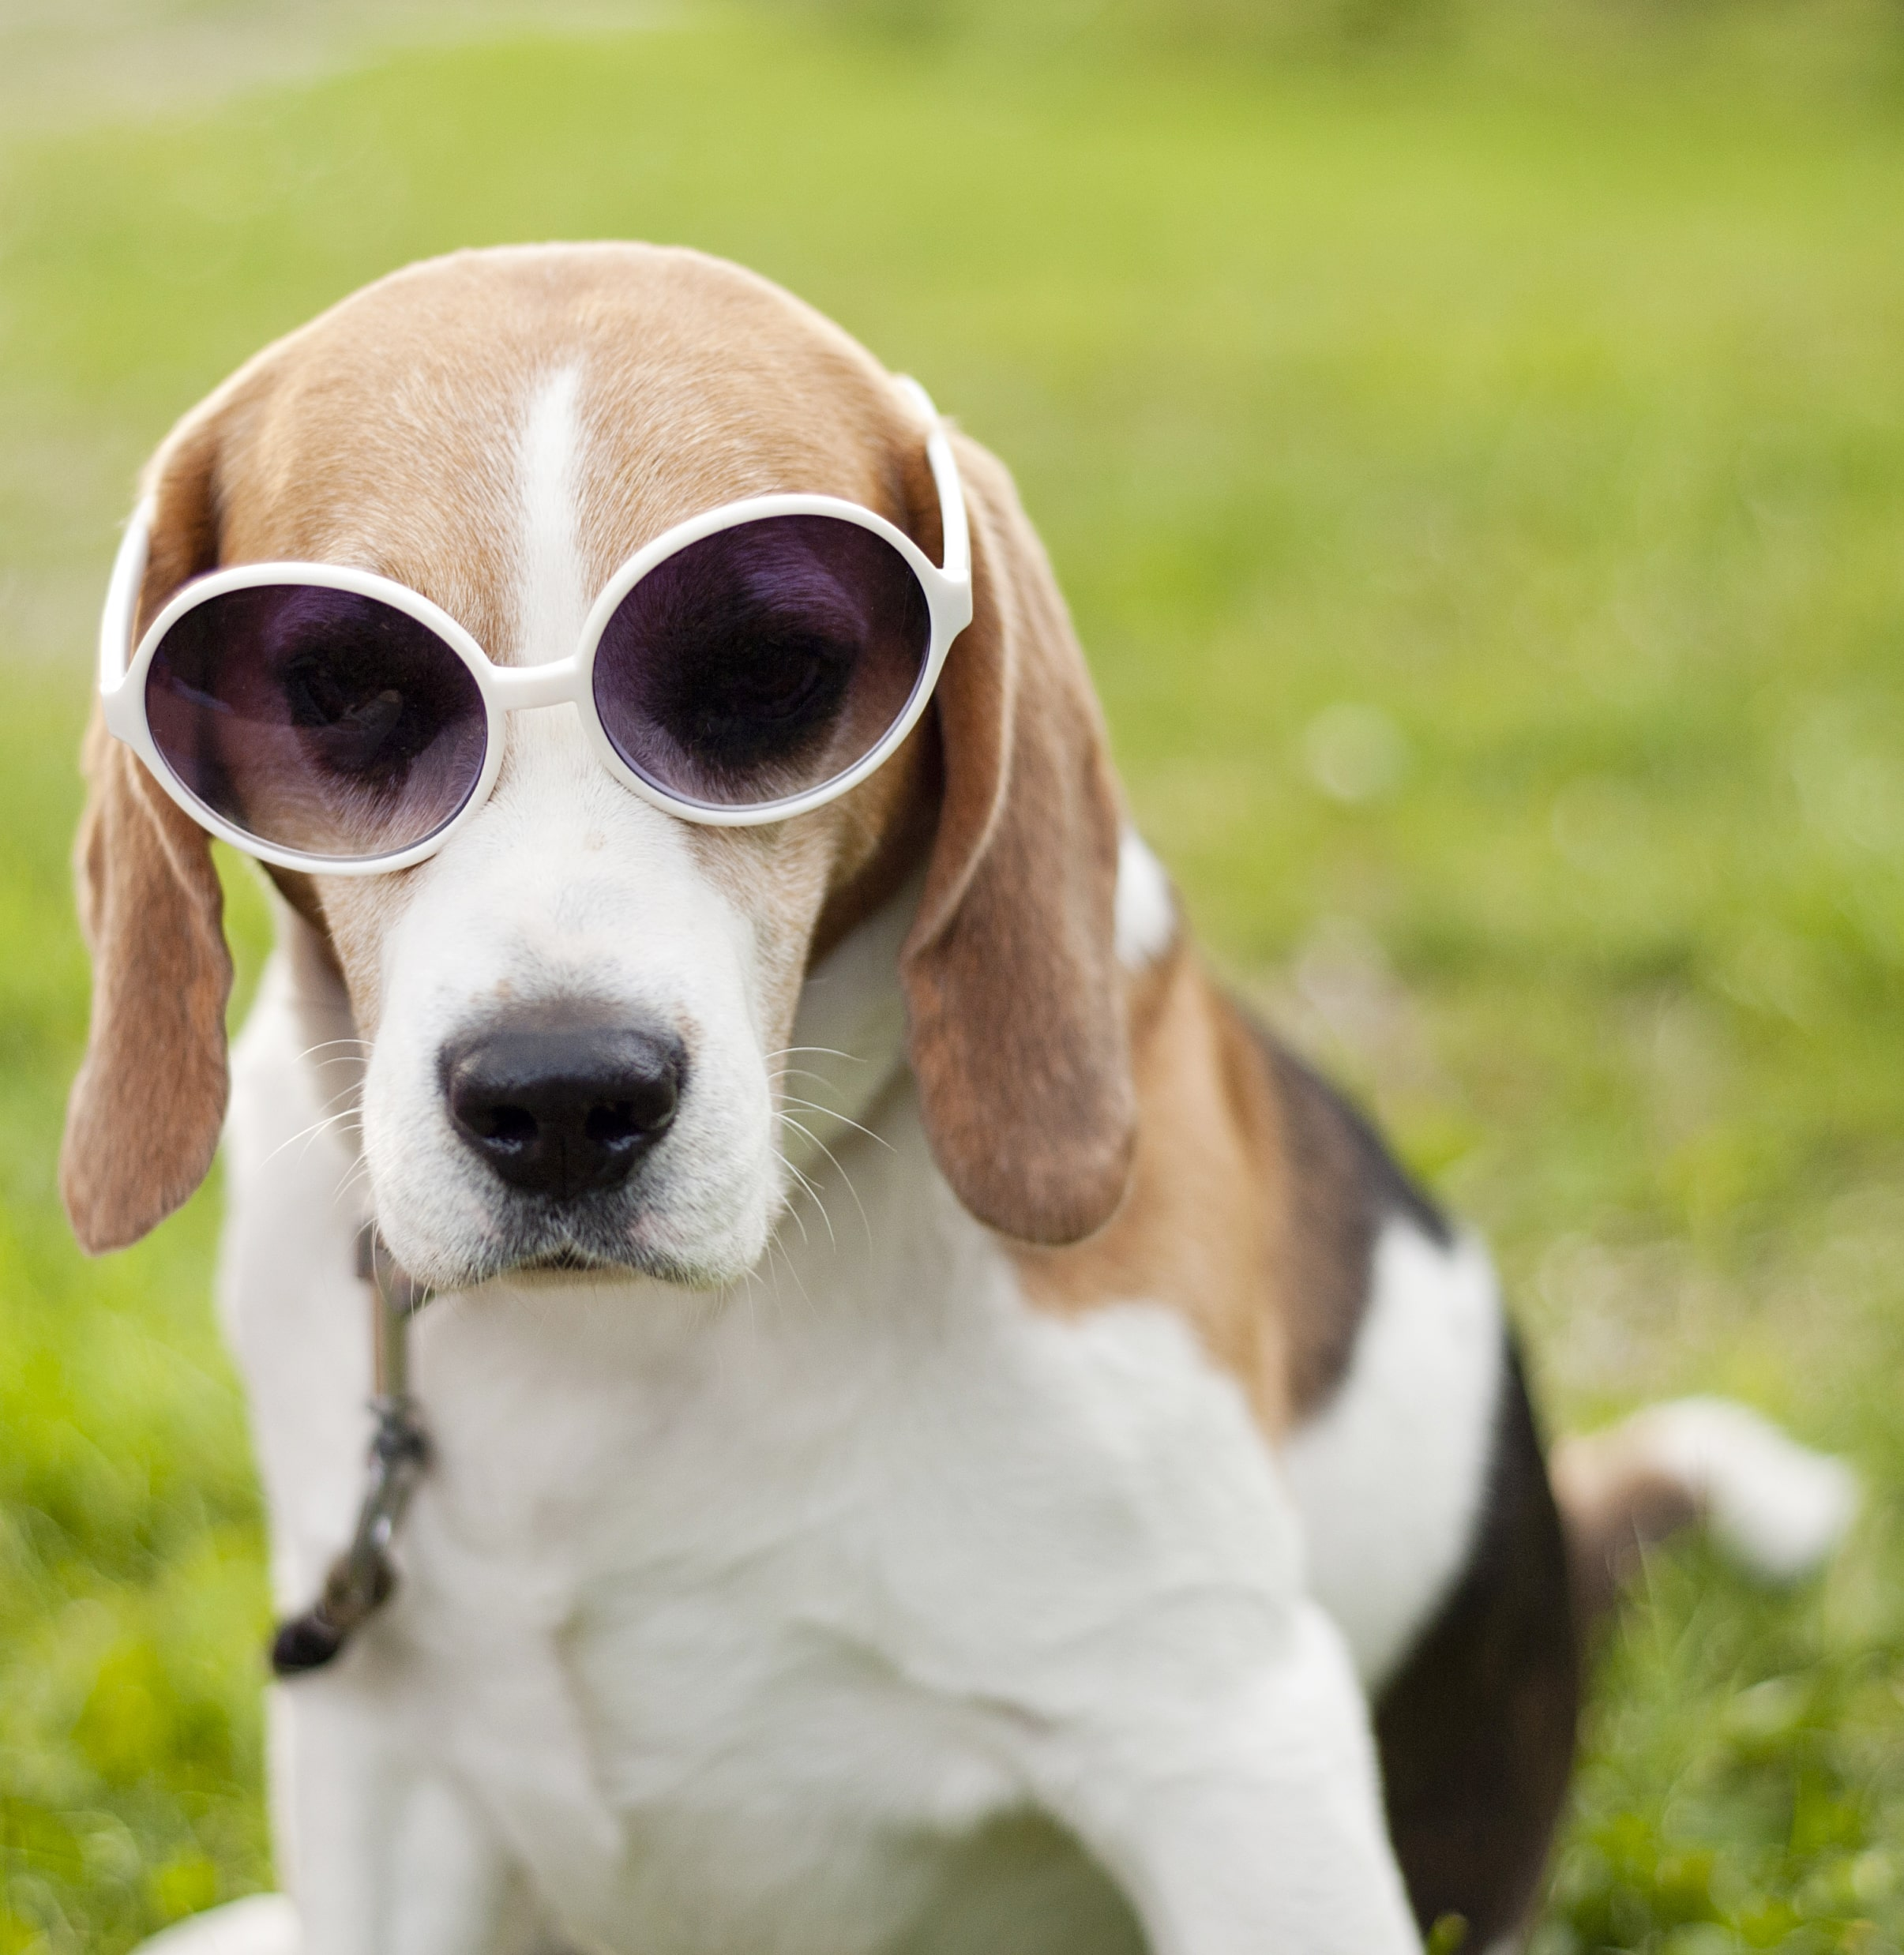
IT ALL ADDS UP!
Image size: 32*32*3
Put it through a convolutional layer consisting of 20 filters of size 7*7*3
Output would be 26*26*20
we attach another convolutional layer consisting of 30 new feature detectors, each of which are sized 5x5x20.
a new activation map of size 22x22
Since there are 30 of them, that means we’ll have a new volume of size 22x22x30.
Notes:
The size in the x and y dimensions is 26 because there are 26x26 possible positions to slide a 7x7 filter into inside of a 32x32 image, and its depth is 20 because there are 20 filters.
Whereas the values in the 32x32x3 volume simply represent the intensity of red, green, and blue in every pixel of the image, the values in the 26x26x20 volume represent the intensity of 20 different feature detectors over a small region centered at each pixel.

Slide 14
FULLY CONNECTED LAYER
The Fully Connected layer is a traditional Multi Layer Perceptron that uses a softmax activation function in the output layer.
The term “Fully Connected” implies that every neuron in the previous layer is connected to every neuron in the next layer.
The output from the convolutional and pooling layers represent high-level features of the input image. The purpose of the Fully Connected layer is to use these features for classifying the input image into various classes based on the training dataset.

Slide 15
CNN STEPS
Step1: We initialize all filters and parameters/weights with random values
Step2: The network takes a training image as input, goes through the forward propagation step (convolution, ReLU and pooling operations along with forward propagation in the Fully Connected layer) and finds the output probabilities for each class.
Lets say the output probabilities for the image above are [0.2, 0.4, 0.1, 0.3]
Since weights are randomly assigned for the first training example, output probabilities are also random.
Step3: Calculate the total error at the output layer (summation over all 4 classes)
Total Error = ∑ ½ (target probability – output probability) ²

Slide 16
CNN STEPS
Step4: Use Backpropagation to calculate the gradients of the error with respect to all weights in the network and use gradient descent to update all filter values/weights and parameter values to minimize the output error.
The weights are adjusted in proportion to their contribution to the total error.
When the same image is input again, output probabilities might now be [0.1, 0.1, 0.7, 0.1], which is closer to the target vector [0, 0, 1, 0].
Network has learnt to classify this particular image correctly by adjusting its weights/filters such that the output error is reduced.
Parameters like a number of filters, filter sizes, the architecture of the network etc. have all been fixed before Step 1 and do not change during training process – only the values of the filter matrix and connection weights get updated.
Step5: Repeat steps 2-4 with all images in the training set.

Slide 17
CNNS WITH KERAS
Source data must be of appropriate dimensions
width*length*color channel
Conv2D layer type does the actual convolution on a 2D image
MaxPooling2D layers can be used to reduce a 2D layer down by taking maximum value in a given block
Flatten layers will convert the 2D layer to a 1D layer for passing into a flat hidden layer of neurons
Typical usage:
Conv2D->MaxPooling2D->Dropout->Flatten->Dense->Dropout->Softmax

Slide 18
CONFIGURATION OF CNN
Lots of hyperparameters
Kernel sizes
Many layers with different number of units
Amount of pooling in addition to the usual stuff like number of layers, choice of optimizer

Slide 19
SPECIALIZED CNN ARCHITECTURES
Defines specific arrangement of layers, padding and hyperparameters
LeNet-5
Good for handwriting recognition
AlexNet
Image classification, deeper than LeNet
GoogLeNet
Even deeper, but with better performance
Introduces inception modules(groups of convolution layers)
ResNet
Even deeper, maintains performance via skip connections

