Slide 1
Intraday
Volume Lab
Next-minute volume forecasting
Bikash Kushwaha
Python research portfolio
Synthetic demonstration with fictional instruments
Notes:
Intraday Volume Lab is a maintained Python research portfolio edition by Bikash Kushwaha. The demonstration uses fictional ALPHA and BETA instruments and establishes workflow reproducibility, rather than real-market forecasting performance.
Sources:
https://github.com/BikashCoder31/intraday-volume-lab/blob/main/README.md
https://github.com/BikashCoder31/intraday-volume-lab/blob/main/SOURCE_ACKNOWLEDGEMENTS.md

Slide 2
Forecasting objective
Predict interval volume in shares from information already available.
Previous 15 complete
one-minute bars
Next-minute
volume in shares
Causal windows
Training target
A window stays inside one instrument and one local session.
log1p(shares), standardized using training data only.
02
Notes:
Each example uses the previous 15 consecutive complete minute bars to predict the immediately following minute. The target is interval volume rather than the cumulative session counter. The target transformation is log1p followed by a scaler fitted only to the training partition.
Sources:
https://github.com/BikashCoder31/intraday-volume-lab/blob/main/docs/DATA.md
https://github.com/BikashCoder31/intraday-volume-lab/blob/main/volume_lab.py

Slide 3
Project architecture
One shared Python module supports the notebook and command line.
Tick files
JSON lines
Validate
and combine
Recover
minute volume
Build causal
windows
Split dates
and fit scalers
Train CNN
and evaluate
Save artifacts
and export report
Python / TensorFlow / pandas / scikit-learn / Matplotlib / Jupyter / pytest / Ruff
03
Notes:
Read the first row from left to right. The validated feature windows feed the lower training row. The date split, training-only preprocessing, training/evaluation, and report export run in that order. volume_lab.py owns numerical logic. Intraday_Volume_Lab.ipynb provides the narrative, while tools/export_report.py creates the static HTML. Stack: Python, TensorFlow/Keras, NumPy, pandas, scikit-learn, Matplotlib, Jupyter, pytest, Ruff. Vercel hosts pre-exported static files only.
Sources:
https://github.com/BikashCoder31/intraday-volume-lab/blob/main/README.md
https://github.com/BikashCoder31/intraday-volume-lab/blob/main/volume_lab.py
https://github.com/BikashCoder31/intraday-volume-lab/blob/main/tools/export_report.py

Slide 4
Dataset and chronological evaluation
Synthetic data: ALPHA and BETA across eight short sessions.
1,936
960
720
tick records
complete minute bars
forecasting windows
Partition | Dates in January 2026 | Session dates | Windows
Training | 05-09 | 5 | 450
Validation | 12 | 1 | 90
Test | 13-14 | 2 | 180
Explicit timezone and units. Daily resets and feed gaps handled before window creation.
04
Notes:
Counts refer to the included synthetic sample. Each session lasts 60 minutes. Epoch seconds convert from UTC to Asia/Kolkata before calendar-date grouping. Exact duplicate records are removed. Counter differences recover interval volume. Unknown partial minutes and resumed partial minutes after missing feed minutes are discarded. All instruments share whole-date boundaries; scalers fit training samples only.
Sources:
https://github.com/BikashCoder31/intraday-volume-lab/blob/main/docs/DATA.md
https://github.com/BikashCoder31/intraday-volume-lab/blob/main/docs/results/synthetic-demo.json
https://github.com/BikashCoder31/intraday-volume-lab/blob/main/Intraday_Volume_Lab.ipynb

Slide 5
Model and input features
Three input branches feed a single volume regression output.
Conv1D 64 / 32
Layer normalization
Flatten
15 bars x 5 features
Concatenate
Dropout 0.2
Dense 128 / 64
One output
6 context summaries
Dense 32
Layer normalization
Instrument ID
Embedding dimension 8
Adam learning rate 0.0005. MSE loss. Fixed seed 42.
05
Notes:
Sequential features: close, interval volume, spread, bid/ask imbalance, and high-low range. Context features: mean close, close standard deviation, summed window volume, mean spread, mean imbalance, and window range. The architecture uses two Conv1D layers, layer normalization, flattening, a Dense(32) context branch, an eight-dimensional symbol embedding, dropout, Dense(128), Dense(64), and a single scaled log-volume output. This context branch is not a CMEM estimator.
Sources:
https://github.com/BikashCoder31/intraday-volume-lab/blob/main/volume_lab.py
https://github.com/BikashCoder31/intraday-volume-lab/blob/main/docs/DATA.md

Slide 6
Persistence performs better in this run
Held-out synthetic test set: 180 windows after five training epochs.
Metric | CNN | Persistence
MAE | 165.19 | 94.79
RMSE | 220.78 | 128.84
R2 | 0.619 | 0.870
This short demonstration verifies the workflow.
It does not establish real-market forecasting performance.
06
Notes:
The displayed numbers come directly from the recorded synthetic run. MAE and RMSE use original share units. Lower errors favor persistence. R2 values use three decimals. Persistence predicts the last observed minute volume. The separate JSON also includes log-volume metrics and SMAPE. No historical research scores are substituted. Run ID: e6d8efd4da9249249b41685cc62209ed
Sources:
https://github.com/BikashCoder31/intraday-volume-lab/blob/main/docs/results/synthetic-demo.json
https://github.com/BikashCoder31/intraday-volume-lab/blob/main/docs/figures/predictions.png

Slide 7
Testing and limitations
30 passing tests
Research boundaries
Interval volume and daily resets
Eight synthetic dates
Causal windows and date boundaries
Five training epochs
Scalers fitted on training only
No real-market dataset
Model save and reload
No live inference or CMEM estimator
Windows CPU and Ubuntu CI passed. Ruff checks formatting and imports.
07
Notes:
The full pytest suite includes a short TensorFlow CPU training/save/reload test. GitHub Actions on Ubuntu runs dependency installation, Ruff lint, Ruff formatting, and pytest. The project also validates data schema, timestamp units, timezone errors, zero-volume metrics, and matching notebook/artifact run IDs. The local dependency stack emits upstream Keras/NumPy deprecation warnings without failing assertions. Overnight sessions and unbounded tick histories require further work.
Sources:
https://github.com/BikashCoder31/intraday-volume-lab/blob/main/docs/VERIFICATION.md
https://github.com/BikashCoder31/intraday-volume-lab/blob/main/tests/test_volume_lab.py
https://github.com/BikashCoder31/intraday-volume-lab/blob/main/.github/workflows/checks.yml

Slide 8
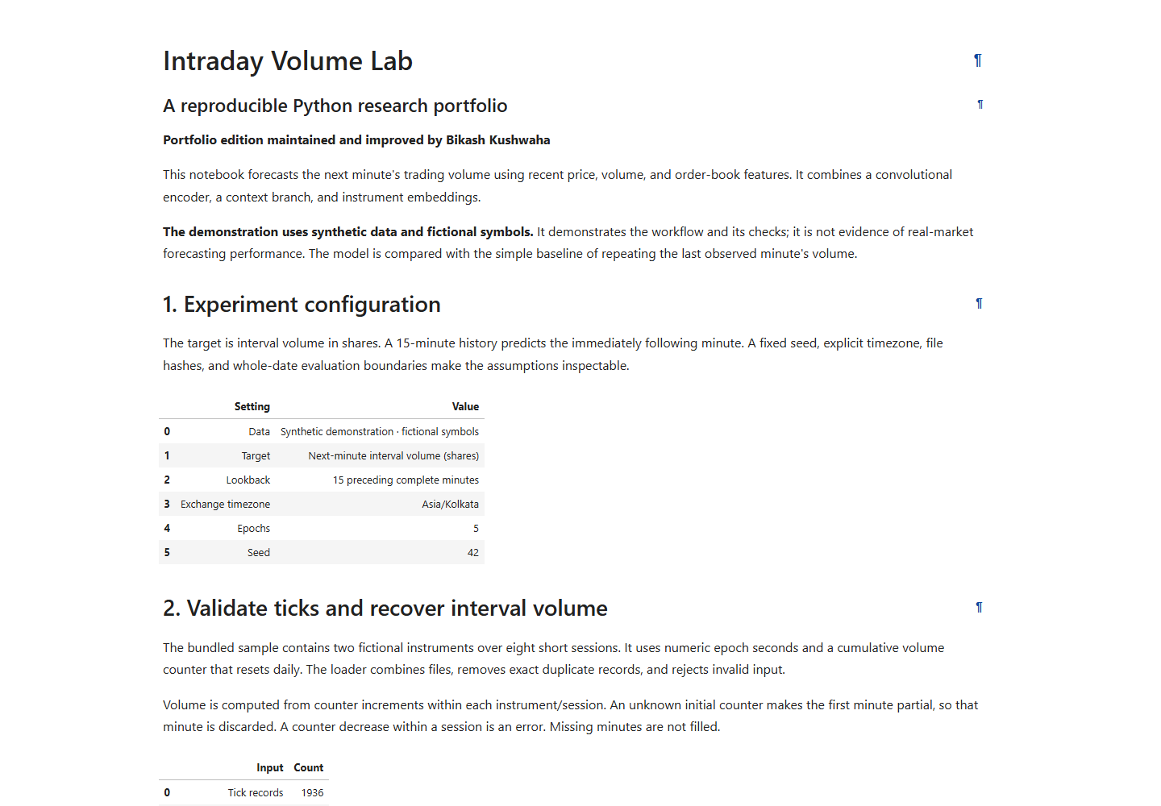
Run the project and explore the report
Local workflow
Use Python 3.12.
Create .venv and install
requirements-lock.txt.
Run the tests and notebook.
Export the static report.
GitHub repository
BikashCoder31/intraday-volume-lab
intraday-volume-lab.vercel.app
Complete commands and data policy are in the README.
08
Notes:
The screenshot shows the deployed static report. Complete setup commands use the project virtual environment interpreter as documented in README.md. Execute all notebook cells in order before calling tools/export_report.py. Vercel serves the pre-exported site folder and does not retrain the model. GitHub: https://github.com/BikashCoder31/intraday-volume-lab
Live report: https://intraday-volume-lab.vercel.app
Sources:
https://github.com/BikashCoder31/intraday-volume-lab/blob/main/README.md
https://github.com/BikashCoder31/intraday-volume-lab/blob/main/docs/PUBLISHING.md
https://github.com/BikashCoder31/intraday-volume-lab/blob/main/docs/screenshots/01-report-overview.png

