Slide 1
MyBud
Student Assistant
A Django application for five everyday student tasks
Bikash Kushwaha
Hosted portfolio edition | October 2026
Notes:
MyBud is a Django student assistant maintained by Bikash Kushwaha. The public demo uses Vercel native Django in Singapore and Neon PostgreSQL. Its assistant experience uses disclosed canned samples, local Python syntax parsing and image validation; no live Gemini requests run. Live Gemini is optional.
Project source references:
README.md
SOURCE_ACKNOWLEDGEMENTS.md
https://github.com/BikashCoder31/mybud-student-assistant
https://mybud-student-assistant.vercel.app

Slide 2
Five tools in one student workspace
A consistent dark blue interface connects each task to a clear result.
Tool | Input | Result
Chat | A question or study prompt | Assistant response
Code review | A code snippet | Explanations and review suggestions
Recipes | Ingredients and optional image | Recipe ideas
Travel | Destination and trip duration | A day-by-day itinerary
Expenses | Category, amount and budget | Saved records and monthly totals
The four assistant tools share a provider. Expenses use persistent database storage.
02
Notes:
The table describes implemented tool contracts. Sample mode returns clearly labelled demonstration content without model inference. The code tool also parses Python syntax without executing the code. The expense tracker performs actual database operations.
Project source references:
main/urls.py
main/views.py
main/services/
main/models.py

Slide 3
Django coordinates the application
Browser forms and JSON requests reach one server-side application.
Browser
HTML / CSS / JavaScript
Django
Vercel server
Assistant provider
Sample or live Gemini
Django session
Browser ownership
Neon / SQLite
Hosted / local
Hosted in Singapore with Neon PostgreSQL and TLS. Local development retains SQLite.
03
Notes:
Django validates browser requests and dispatches assistant tasks through the provider. A session key owns expense and budget records. Production uses Vercel native Django in Singapore and Neon PostgreSQL through a pooled TLS DATABASE_URL; migrations used a direct connection. Local development defaults to SQLite. Secrets stay on the server and mutating requests require CSRF protection.
Project source references:
project/settings.py
project/urls.py
main/urls.py
main/views.py
main/models.py
docs/DEPLOYMENT.md

Slide 4
Sample mode and live AI are explicit
Default sample mode
Optional live Gemini
Works without an API key.
Returns disclosed sample content.
Also checks Python syntax locally.
No model inference runs.
Uses the google-genai client.
Requires a server-side API key.
The model is configurable.
Responses depend on the provider.
Assistant output needs review. A working sample does not establish live model quality.
04
Notes:
Sample responses are demonstrations, not local inference. Live mode calls the selected Gemini model using the official google-genai package. This presentation records local sample-mode verification. It does not claim an authenticated live-provider test unless the verification document explicitly records one.
Project source references:
main/services/
.env.example
docs/VERIFICATION.md
https://googleapis.github.io/python-genai/

Slide 5
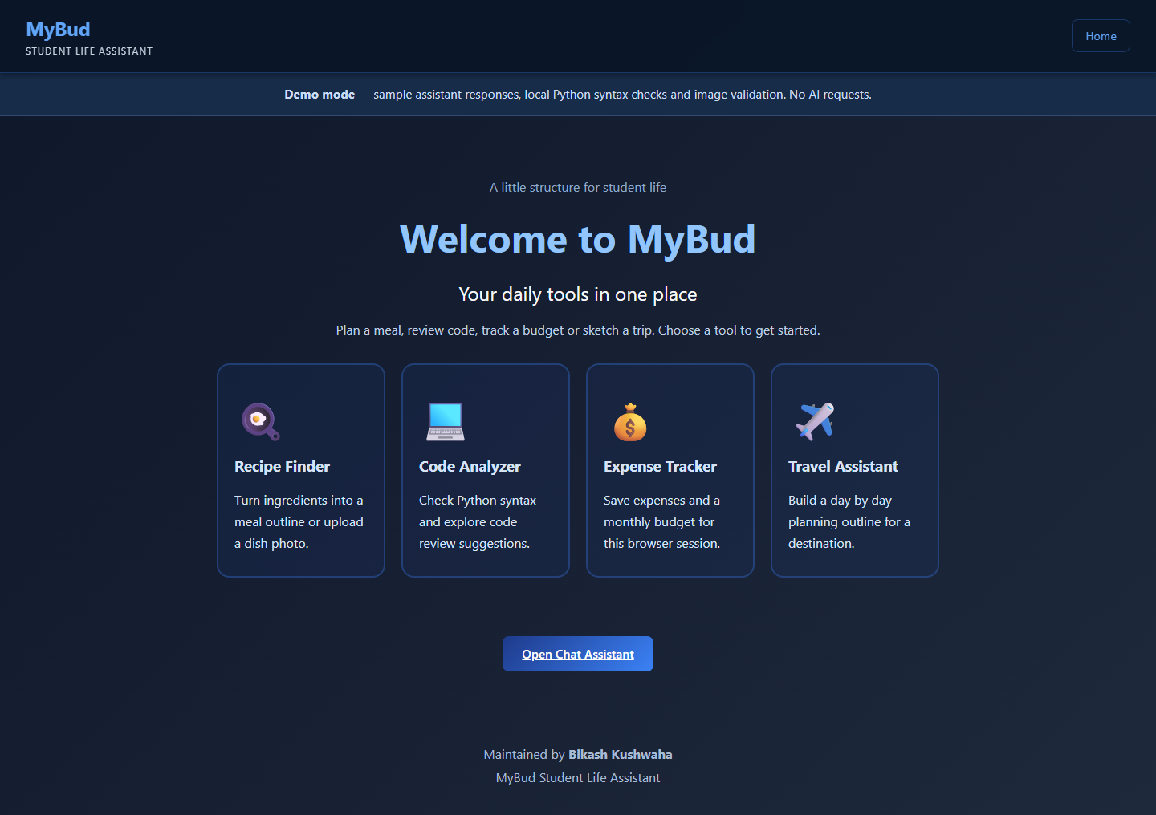
The dashboard makes each tool discoverable
One entry point
Open a task, enter the relevant details, and review the result.
The preserved dark blue style keeps the tools visually consistent.
05
Notes:
The screenshot is captured from the running application in the verified local sample configuration. The dashboard links to the five implemented tools. It is application evidence, not a generated mockup.
Project source references:
docs/screenshots/01-home.png
templates/
static/

Slide 6
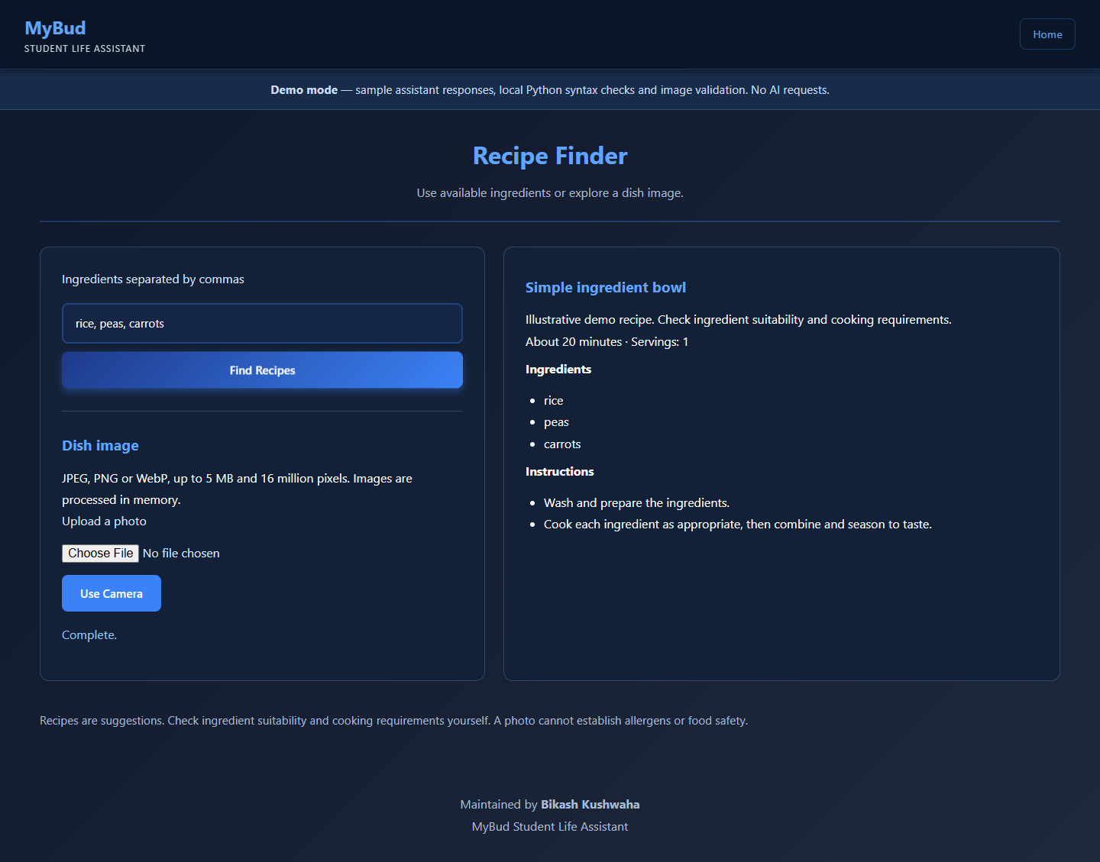
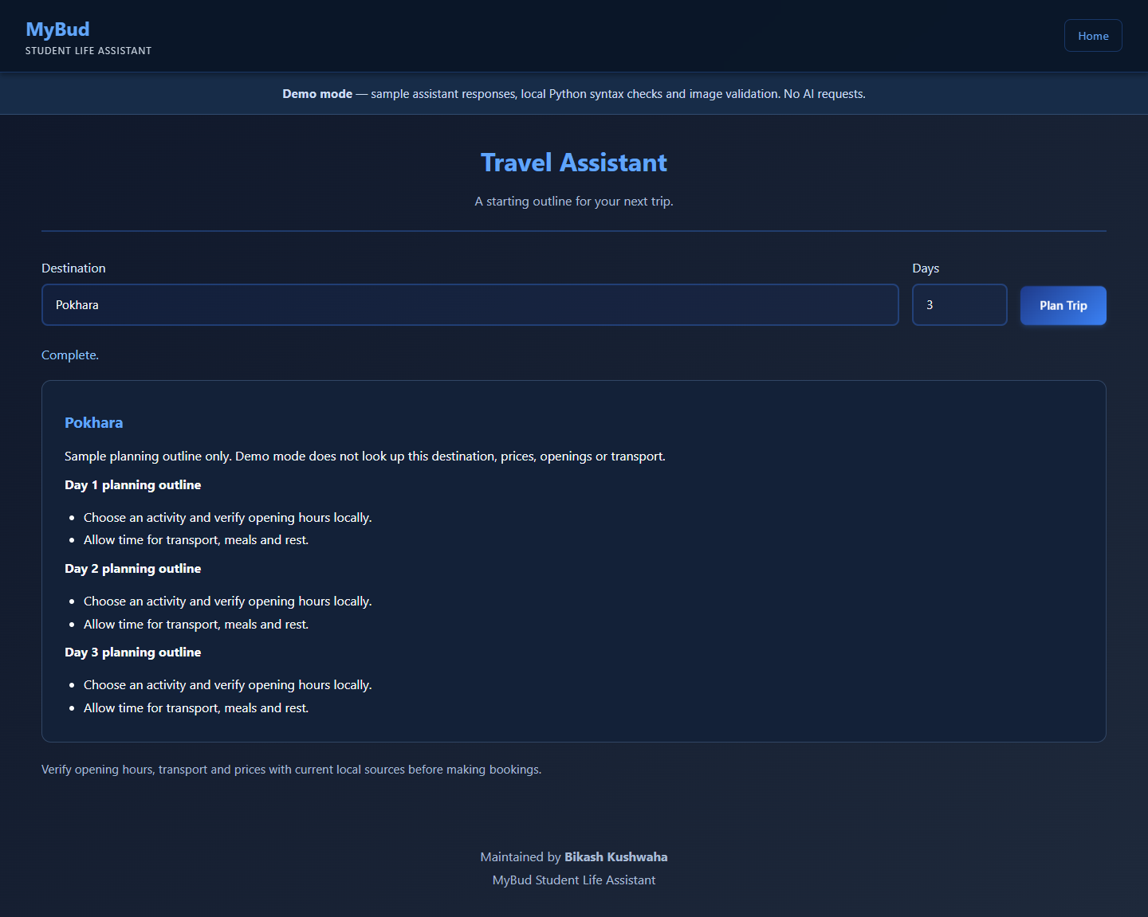
Recipes and travel show structured results
Recipe suggestions
Travel itinerary
Ingredients and an optional image are validated before submission.
Destination and trip duration organize a readable day-by-day plan.
06
Notes:
These screenshots are captured application evidence from local demo mode. Hosted mode uses the same templates, with a 3 MB image cap compared with the local default of 5 MB. Images are validated, not classified, in demo mode. The travel tool renders an itinerary using supplied trip details.
Project source references:
docs/screenshots/04-recipes.png
docs/screenshots/05-travel.png
main/views.py
main/services/

Slide 7
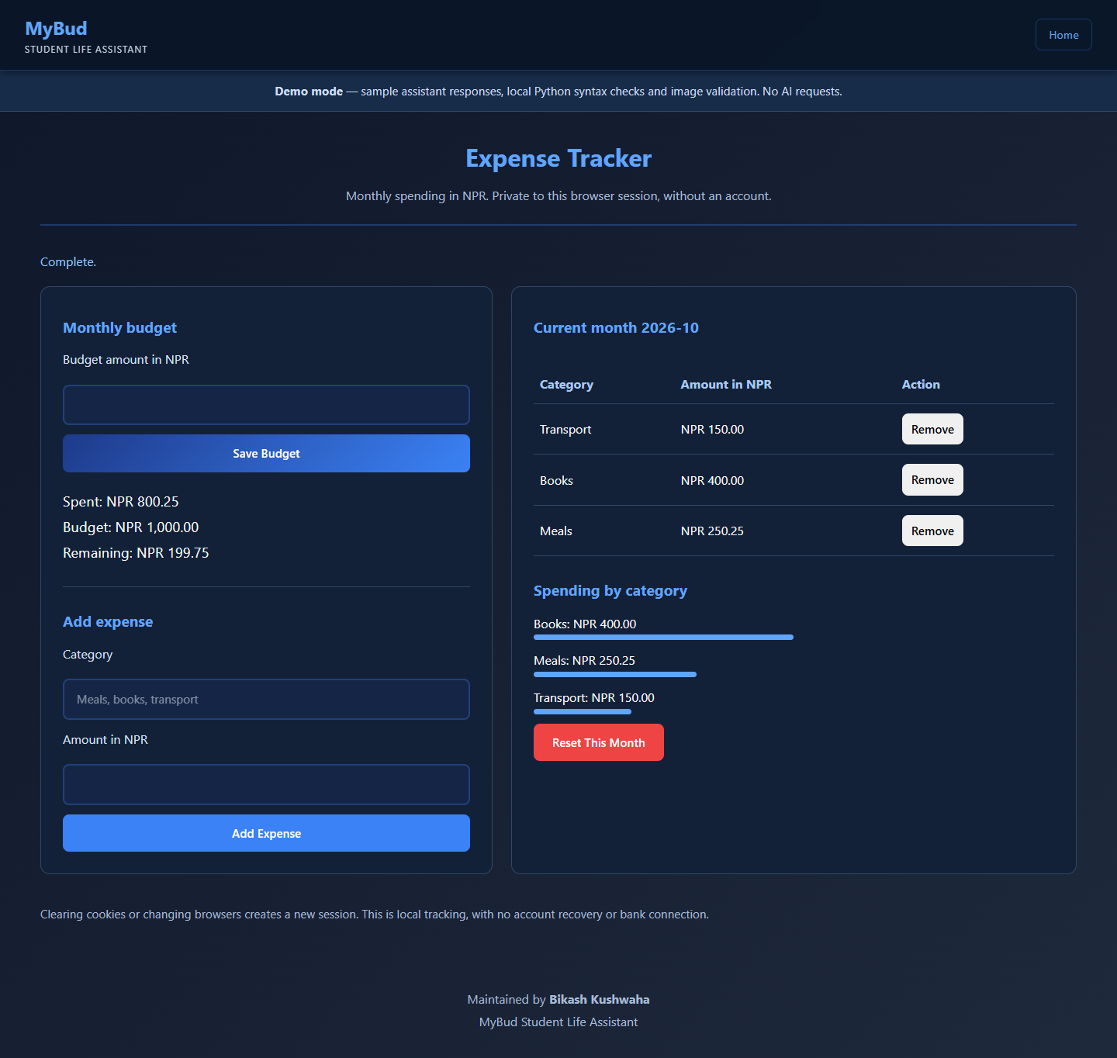
Expenses persist across page reloads
Captured NPR month summary
Measure | NPR
Budget | 1,000.00
Spent | 800.25
Remaining | 199.75
Add and delete saved entries.
Set or reset the monthly budget.
Amounts use Decimal validation.
Ownership follows the current browser session. Account login and cross-device sync are outside scope.
07
Notes:
The native table transcribes captured local demonstration entries: Meals NPR 250.25, Books NPR 400.00, Transport NPR 150.00; total NPR 800.25 against budget NPR 1000.00, leaving NPR 199.75. Production stores records in Neon PostgreSQL; local mode uses SQLite. The same session ownership rules apply. Losing a browser session loses access to its prior records.
Project source references:
docs/screenshots/02-expenses.png
main/models.py
main/views.py
main/tests.py

Slide 8
Verification covers the deployed app
28 tests passed locally and in GitHub Actions
Area | Recorded evidence
Backend and CI | 28 tests plus Ruff lint and format checks passed
Django checks | No system-check issues; no migration drift
Hosted storage | Neon PostgreSQL with TLS; migrations completed
Public browser QA | All tools, uploads, expenses and session isolation
Responsive checks | Six routes at desktop and mobile widths
No authenticated live-provider call was run. Live request contracts use mocked provider responses.
08
Notes:
28 tests passed locally and in GitHub Actions run 39472651723 for commit 7d7b1de, including Ruff lint and format checks. Public Edge QA covered all five tools, actual image upload, expense budget/add/reload/delete, session isolation, HTML injection, and six routes at desktop1440x1000/mobile390x844 with no console issues or failed requests. No live Gemini or camera hardware tests were run. No load or model quality claim is made.
Project source references:
docs/VERIFICATION.md
main/tests.py
docs/screenshots/
https://github.com/BikashCoder31/mybud-student-assistant/actions/runs/39472651723

Slide 9
Run locally with an explicit configuration
Local setup
Configuration
python -m venv .venv
.venv\Scripts\Activate.ps1
python -m pip install -r requirements-lock.txt
python manage.py migrate
python manage.py collectstatic --noinput
python manage.py runserver
Vercel Django in Singapore.
Neon PostgreSQL storage.
MYBUD_MODE=demo.
Local: SQLite with .env settings.
Uploads: hosted 3 MB; local 5 MB.
Demo: https://mybud-student-assistant.vercel.app
Code: https://github.com/BikashCoder31/mybud-student-assistant
09
Notes:
Commands are shown for Windows PowerShell and the recorded Python 3.12 environment. The project README contains the complete local setup and test commands. The full verified requirements-lock.txt snapshot includes Ruff. Environment values must be supplied to the process as documented; the displayed environment example is configuration guidance, not a committed secret.
Project source references:
README.md
.env.example
requirements-lock.txt
project/settings.py
https://docs.djangoproject.com/en/5.2/howto/deployment/checklist/

Slide 10
A clear scope supports future development
Current limits
Next steps
Sample AI content is canned.
Live AI needs external credentials.
Session storage has no account sync.
Neon free-tier resource limits apply.
Add account-based ownership.
Evaluate live responses with test prompts.
Add expense export and backup policy.
Add shared rate controls and monitoring.
Maintained by Bikash Kushwaha. Adapted from supplied starter code; see SOURCE_ACKNOWLEDGEMENTS.md.
10
Notes:
The portfolio edition repairs and extends supplied starter code. It does not claim sole original authorship of every file. The source acknowledgement records this provenance without listing unrelated personal identities. Future work is proposed, not implemented or verified.
Project source references:
SOURCE_ACKNOWLEDGEMENTS.md
README.md
docs/VERIFICATION.md

