Slide 1


Slide 2

Introduction
MeroPasal is an online e-commerce platform that empowers individuals to sell their handmade goods and materials.
You can create an account and start managing your online business with a click of a button. No need for setting up a website and buying a domain.

Slide 3

Introduction
As an individual user, you can find anything on MeroPasal. Support your local sellers while also getting anything you desire.
Take advantage of competitive pricing to get the best quality for the best of price.

Slide 4

Problem Statement
Industrial monopoly.
Lack of handcrafted and handmade goods and products.
Different prices across different platform.
Lack of quality goods.

Slide 5

Objectives
Create a user-friendly platform that allows individuals to easily list and sell their goods.
Provide a platform for users to easily search and purchase quality products.

Slide 6
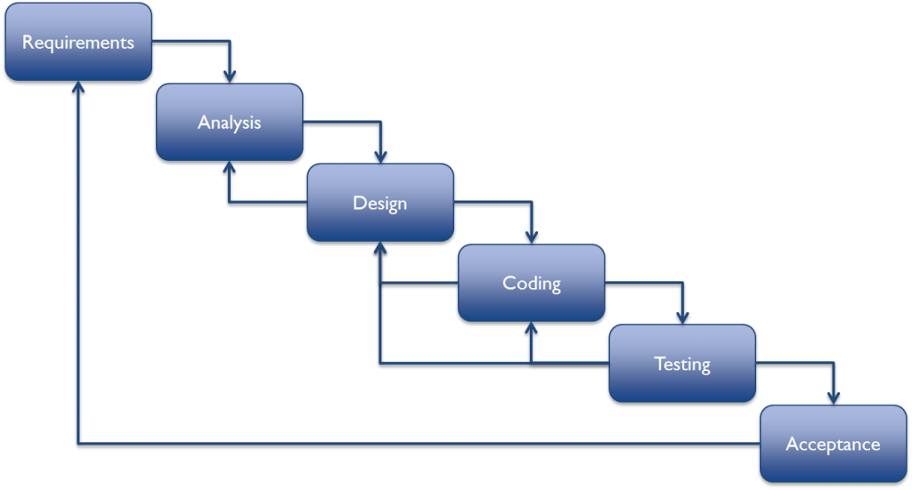
Methodology
Waterfall Model
Pros:
Clear structure.
Define end goal early.
Cons:
Makes chages difficult.
Delays testing until completion.

Slide 7
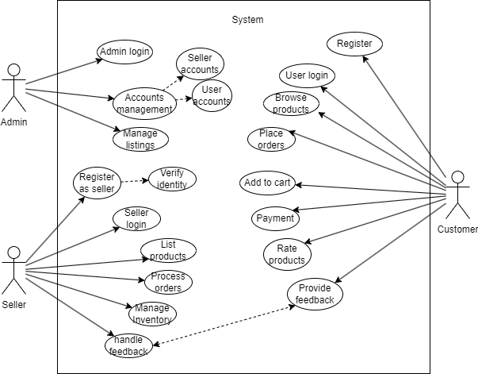
Use Case:

Slide 8
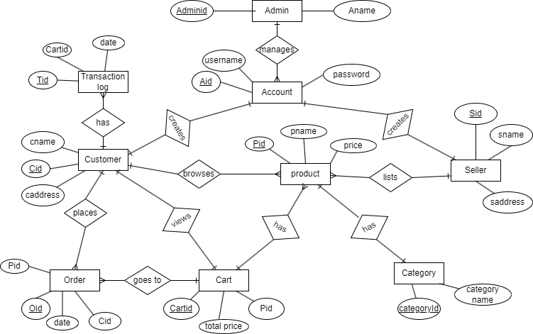
ER diagram

Slide 9
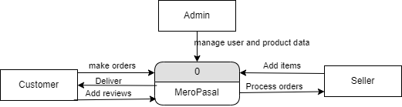
DFD diagram level 0

Slide 10
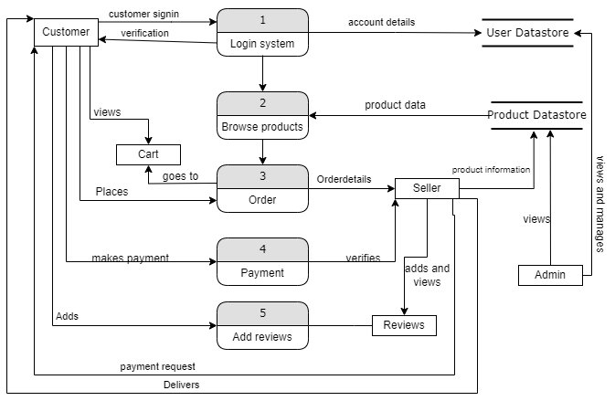
DFD diagram level 1

Slide 11
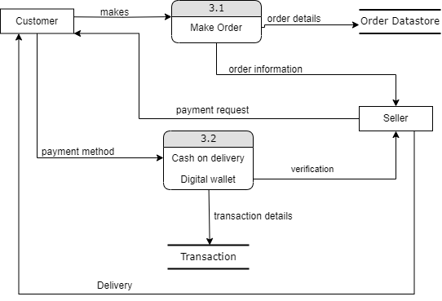
DFD diagram level 2

Slide 12
Description of Algorithm
Binary Search: Efficient algorithm to search for specific items in a sorted list.
Recommendation algorithm: Algorithm that recommends items to users based on similarity to items they have liked before.
Personalization Algorithms: Personalization algorithms are used to customize the user experience by tailoring product recommendations, content, and promotions to individual user preferences.

Slide 13
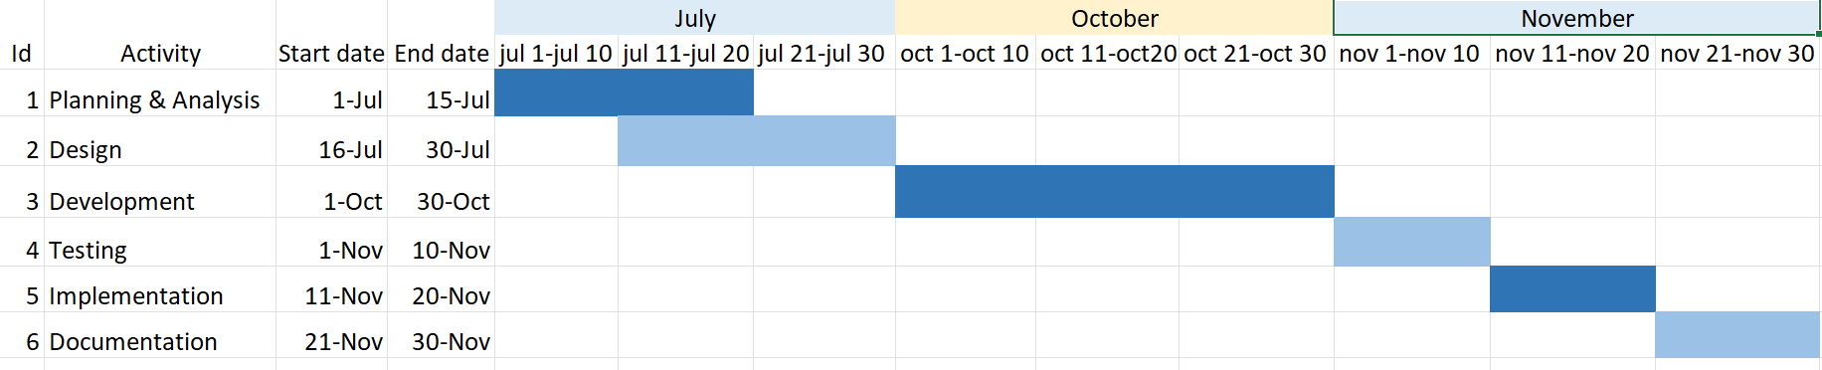
Gantt Chart

