Slide 1
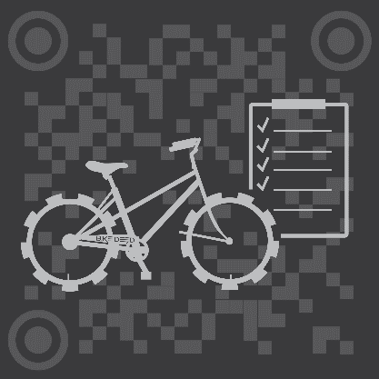
BikeDeed
BLOCKCHAIN PROTECTED.

Slide 2
THE NUMBERS
Two Billion 2,000,000,000
Number of bicycles in use around the world.
One Hundred Million 100,000,000
The number of new bicycles manufactured, shipped, sold and serviced worldwide each year.
Sixty Four Billion 64,000,000,000
PMR Estimate of size of bicycle product market by year 2024.%
One and a Half Million 1,500,000
Estimated number of bicycles stolen each year in the U.S.
Five Percent 5%
Percentage of stolen bicycles returned to owners.

Slide 3
The Problem
There is virtually no authoritative source of information about the individual bikes that are bought, sold, stolen, recovered, or serviced - anywhere in the world.

Slide 4
THE SOLUTION
A Decentralized, Universal, Borderless Repository for Bicycle information.
A Carfax for Bikes. But better.

Slide 5
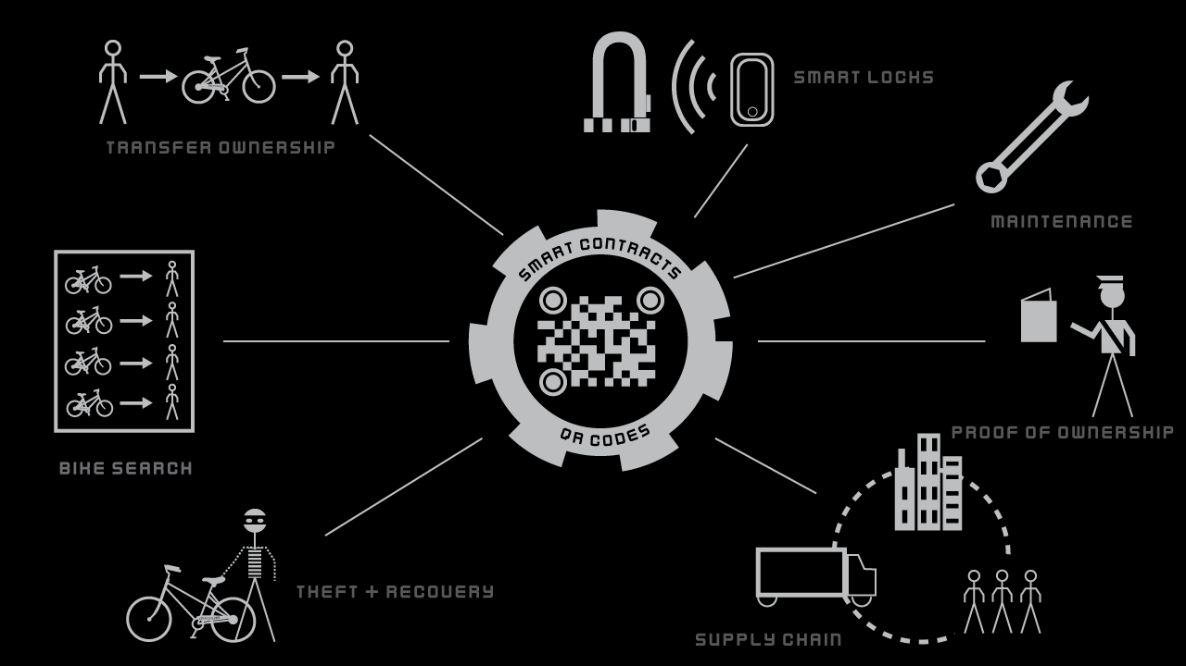
THE BIKEDEED ECOSYTEM

Slide 6
BUSINESS MODEL
A Buck a Bike Flat fee for OE Manufacturers.
Potential revenue of 200 Million Dollars per year.
Sales Channels Cross-sales of Bikes and Components.
Bike Product sales are projected to be a 62 Billion Dollar Industry by 2024.
Insurance Referral Partnerships Renter’s, Home Owner’s, (and Bicycle?) Insurance.
Up to 10 – 15% profit off premium of insurance cross-sales.
Crypto Wallet Referral Partnerships Trust, Cipher.
Token based crypto compensation for steering users to partner wallets.
Big Data Value Added Reseller.
Unique niche in the value chain for maximum sales opportunities.

Slide 7
COMPETITIVE LANDSCAPE
 | Bike Index | Bike Guard | National Bike Registry | BikeDeed
Theft/Recovery | ✔ | ✔ | ✔ | ✔
Proof of Ownership | ✔ | ✔ | ✔ | ✔
Transfer of Ownership | ✖ | ✖ | ✖ | ✔
Service Records | ✖ | ✖ | ✖ | ✔
Supply Chain | ✖ | ✖ | ✖ | ✔
Proof of Value | ✖ | ✖ | ✖ | ✔
Internationally Focused | ✖ | ✖ | ✔ | ✔
Decentralized | ✖ | ✖ | ✖ | ✔

Slide 8

THE TEAM

Slide 9
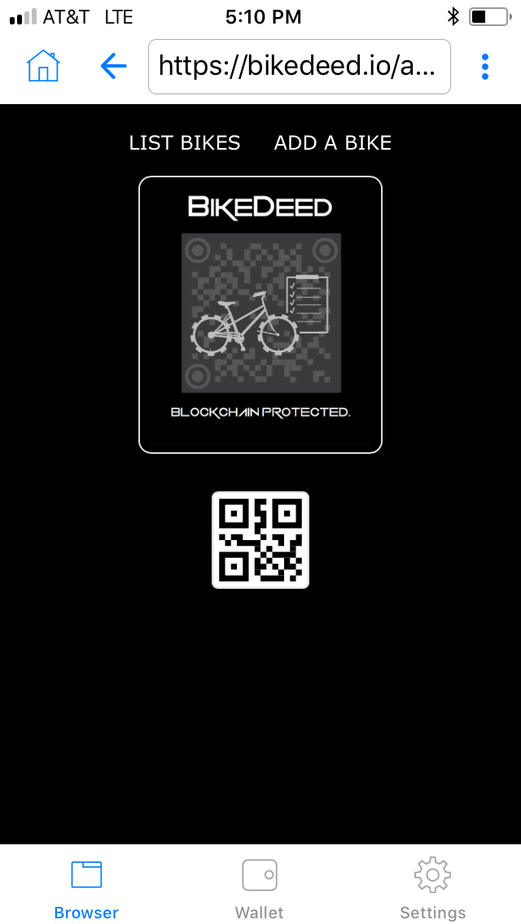
CORE PRODUCT
Proof of Ownership.
Transfer of Ownership.
Bike Searching.
Theft and Recovery.
Bike Valuation/Validation.
Service Tracking.
Supply Chain Tracking.
Smart Locks.
QR Codes/NFC Devices.

Slide 10
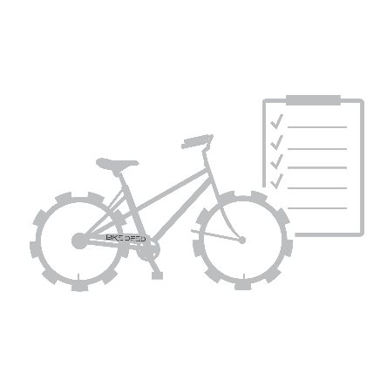
The Geek Stuff
BikeDeed is a Decentralized Registration and Tracking Application running as a Smart Contract on the Ethereum Blockchain. Technologies include:
Inter-Planetary File System
ERC721 non-fungible tokens
Web3
A functional prototype dApp is up and running on the Ethereum Mainnet now. Go to https://bikedeed.io/app

Slide 11
MORE INFO
info@bikedeed.io
https://bikedeed.io

