Slide 1
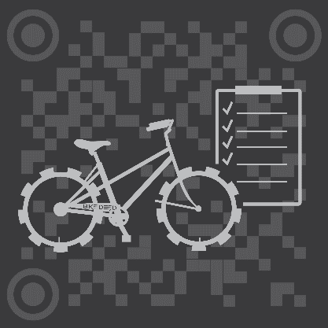
BikeDeed
BLOCKCHAIN PROTECTED.

Slide 2
THE NUMBERS
Two Billion 2,000,000,000
Number of bicycles in use around the world.
One Hundred Million 100,000,000
The number of new bicycles manufactured, shipped, sold and maintained worldwide each year.
One and a Half Million 1,500,000
Estimated number of bicycles stolen each year in the U.S.
Five Percent 5%
Percentage of stolen bicycles returned to owners.

Slide 3
The Problem
There is virtually no authoritative source of information about individual bikes that are bought, sold, stolen, recovered, or maintained, anywhere in the world.

Slide 4
THE SOLUTION
A Universal, Public, Borderless Ecosystem for Bike information.
A CarFax for Bikes, only better.

Slide 5
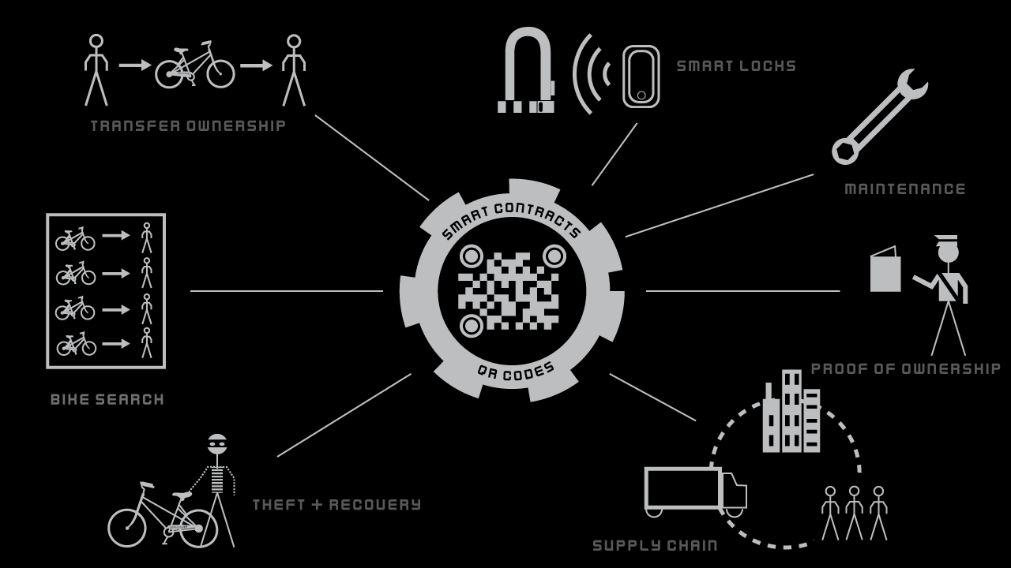
THE BIKEDEED ECOSYTEM

Slide 6
BUSINESS MODEL
A Buck a Bike Flat fee for OE Manufacturers.
Potential revenue of 200 Million Dollars per year.
Sales Channels Cross-sales of Bikes and Components.
Bike Product sales are projected to be a 62 Billion Dollar Industry by 2024.
Big Data Value Added Reseller.
Unique niche in the value chain for maximum sales opportunities.
Insurance Referral Partnerships Renter’s, Home Owner’s, (and Bicycle?) Insurance.
Up to 10 – 15% profit off premium of insurance cross-sales.
Crypto Wallet Referral Partnerships Trust, Cipher, etc.
Token based crypto compensation for steering users to partner wallets.

Slide 7
COMPETITIVE LANDSCAPE
 | Bike Index | Bike Guard | National Bike Registry | BikeDeed
Theft/Recovery | ✔ | ✔ | ✔ | ✔
Proof of Ownership | ✔ | ✔ | ✔ | ✔
Transfer of Ownership | ✖ | ✖ | ✖ | ✔
Maintenance Records | ✖ | ✖ | ✖ | ✔
Supply Chain | ✖ | ✖ | ✖ | ✔
Proof of Value | ✖ | ✖ | ✖ | ✔
Internationally Focused | ✖ | ✖ | ✔ | ✔
Decentralized | ✖ | ✖ | ✖ | ✔

Slide 8

THE TEAM

Slide 9
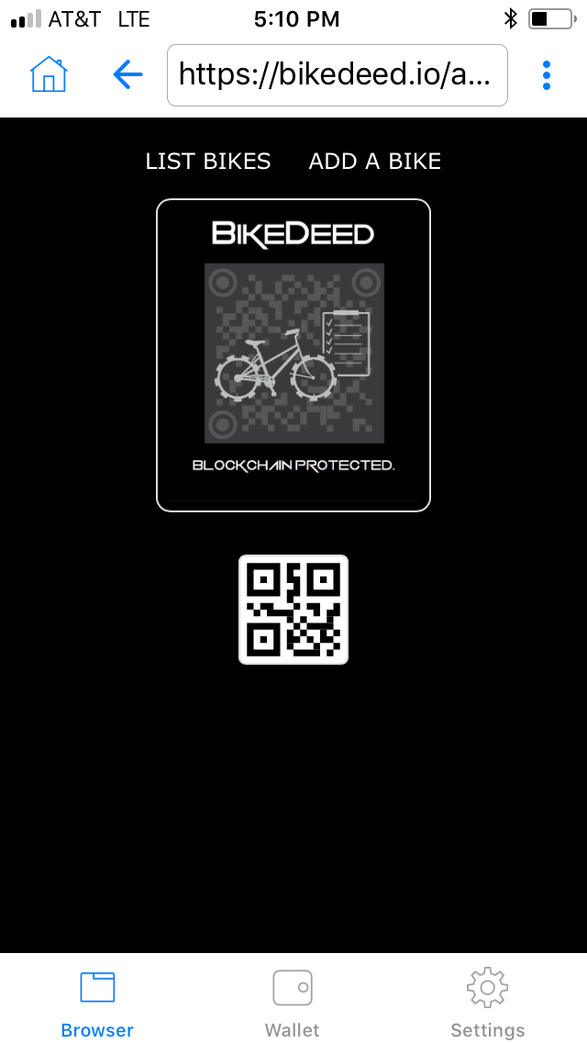
CORE PRODUCT
Theft and Recovery.
Proof of Ownership.
Transfer of Ownership.
Maintenance Tracking.
Supply Chain Tracking.
Bike Record Searching.
Bike Valuation.
Smart Locks.
QR Codes/NFC Devices.

Slide 10
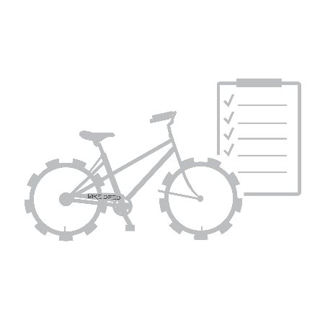
The Geek Stuff
BikeDeed is a Decentralized Registration and Tracking Application running as a Smart Contract on the Ethereum Blockchain. Technologies include:
Inter-Planetary File System
ERC721 non-fungible tokens
Web3
The Minimal Viable Product is up and running on the Ethereum Mainnet now. Go to https://bikedeed.io/app

Slide 11
MORE INFO
info@bikedeed.io
https://bikedeed.io

