Slide 1

Final Presentation on Lung Cancer Prediction
Submitted by:
Bikesh Prajapati C0859472
Padam Regmi C0858265
Rosy Shrestha C0857467
Hemanta Rijal C0835075
Shreebatsa Aryal C0859473

Slide 2
Lung Cancer Prediction using different ML model
In this project, we try to predict high chance to get cancer and its risk factor. Solve the problem by recommending some solution and best model to predict with given data. We did some data visualization to look into correlation and features against target variables.

Slide 3
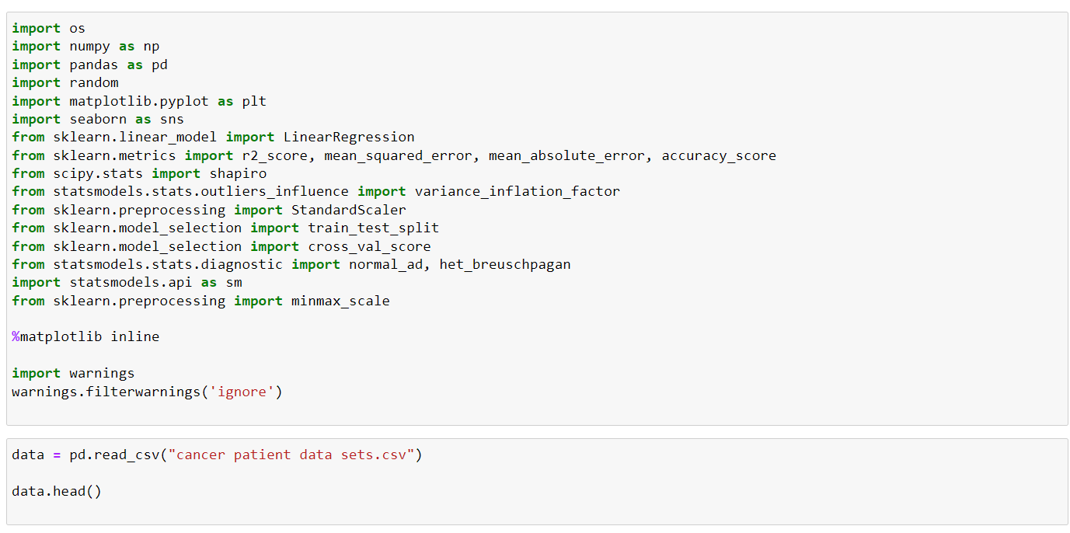
Import the required Libraries

Slide 4
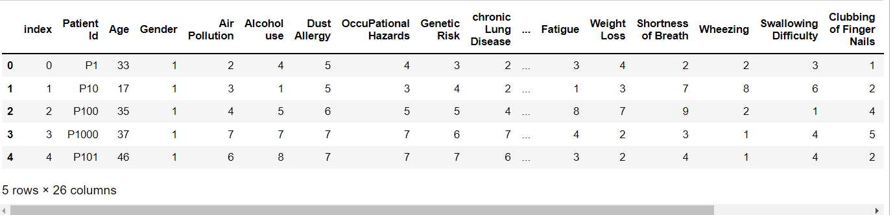
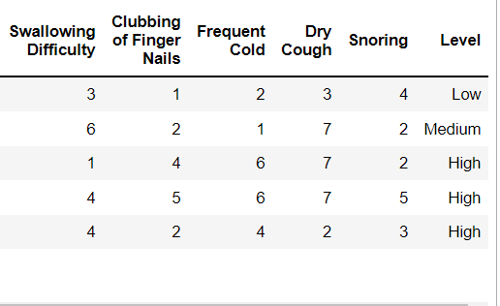
Data Info
Cont …

Slide 5
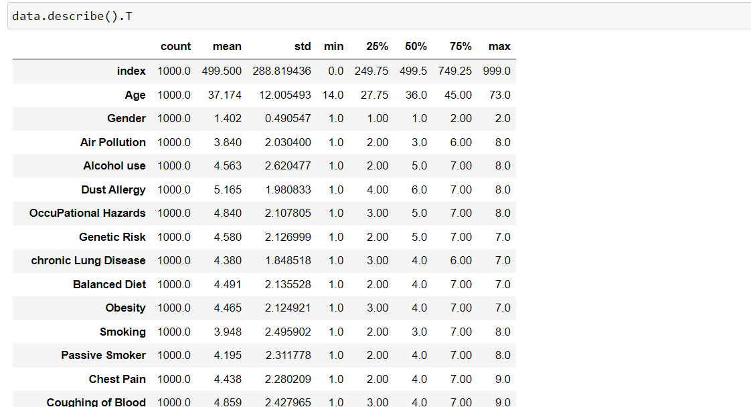
Importing the dataset using pd.read_csv() function
T property is used to transpose index and columns of the data frame.
The main function of this property is to create a reflection of the data frame overs the main diagonal by making rows as columns and vice versa.

Slide 6
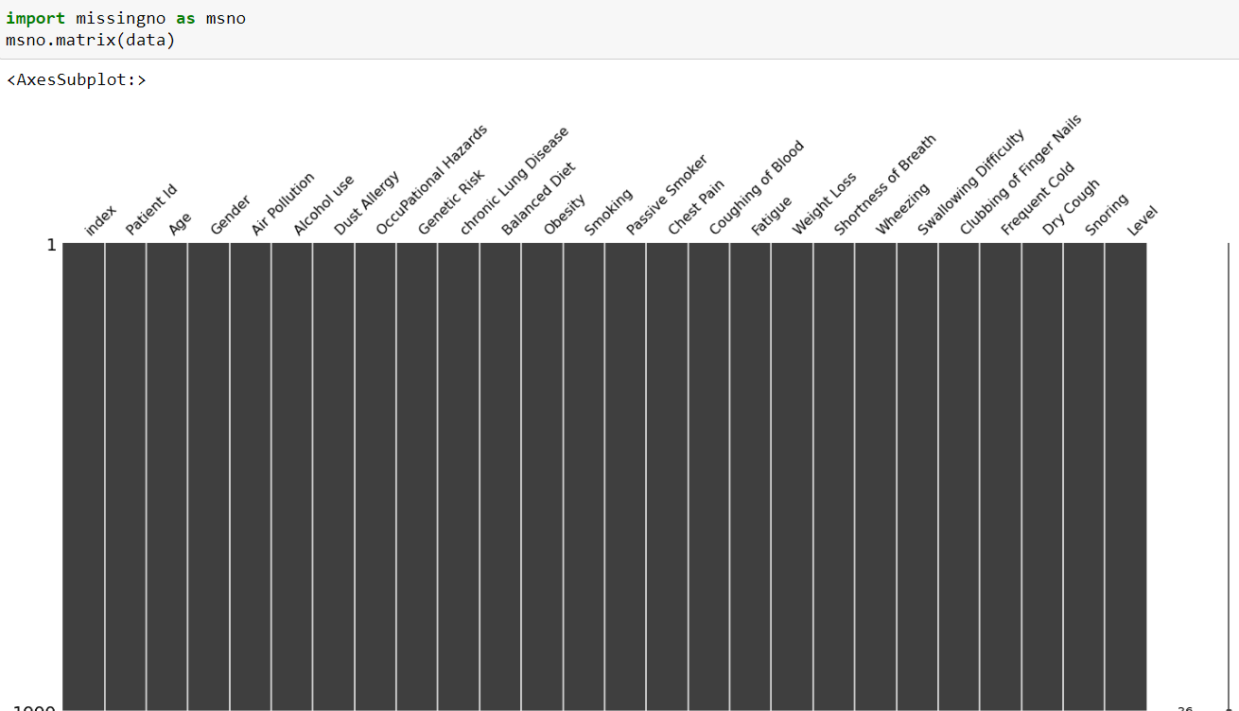
Missingno is a Python library used for the visualization of missing data.
We found out that the dataset has no missing value

Slide 7
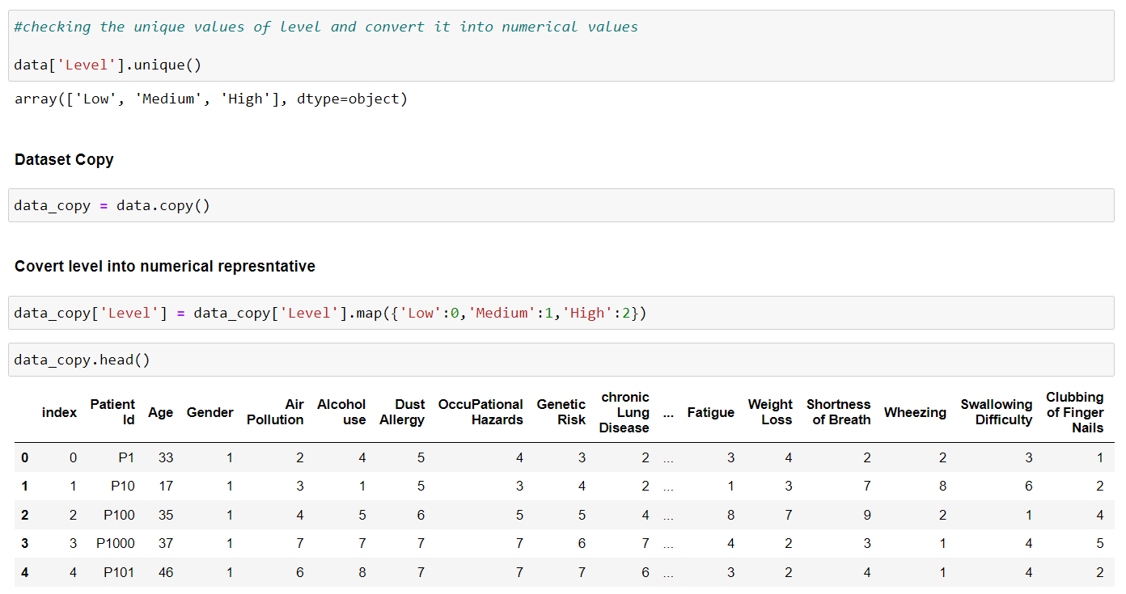
The unique() function is used to get unique values of Series object and Returns the unique values as a NumPy array
And here we got 'Low', 'Medium', 'High‘ as a unique value
map() function is used to substitute each value in a Series with another value.
We can see that the value of level column is 0,1 and 2 form which means low, medium and high

Slide 8
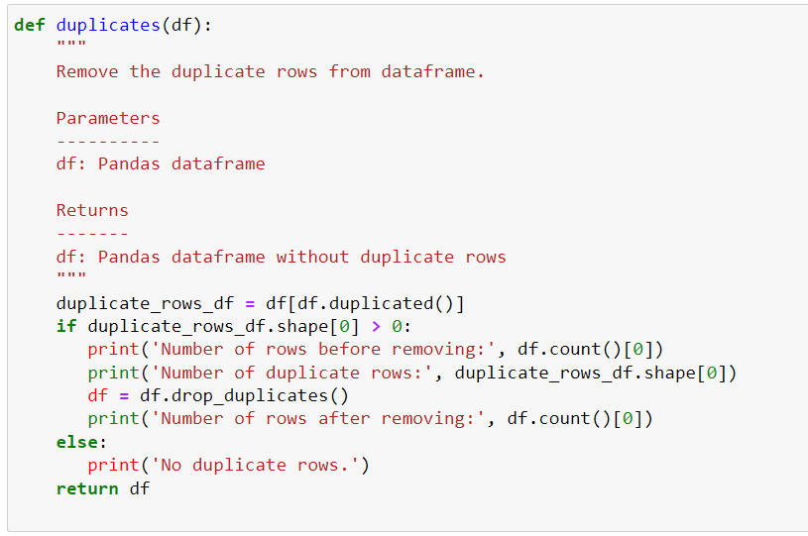
Drop user's column
Index and Patient Id does not affect our prediction of lung cancer so we can drop those columns
Data Cleaning
Data cleansing identifies and fixes errors, duplicates, and irrelevant data from a raw dataset allows for accurate, defensible data that generates reliable visualizations, models, and business decisions.

Slide 9
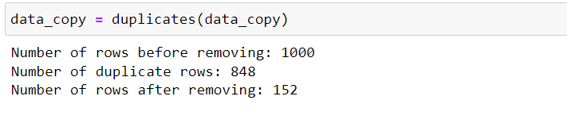
To see the duplicate Series values
We used the duplicated() function

Slide 10
Data Visualization to see correlation
We used the heatmap to see the relationships between two variables one plotted on each axis
According to heat map , the target variable 'Level' is highly correlated to following columns:
Air pollution
Alcohol use
Dust Allergy
Occupational Hazards
Genetic Risk
Chronic Lung Disease
Balance Diet
Obesity
Smoking
Passive Smoker
Chest Pain
Coughing of Blood

Slide 11
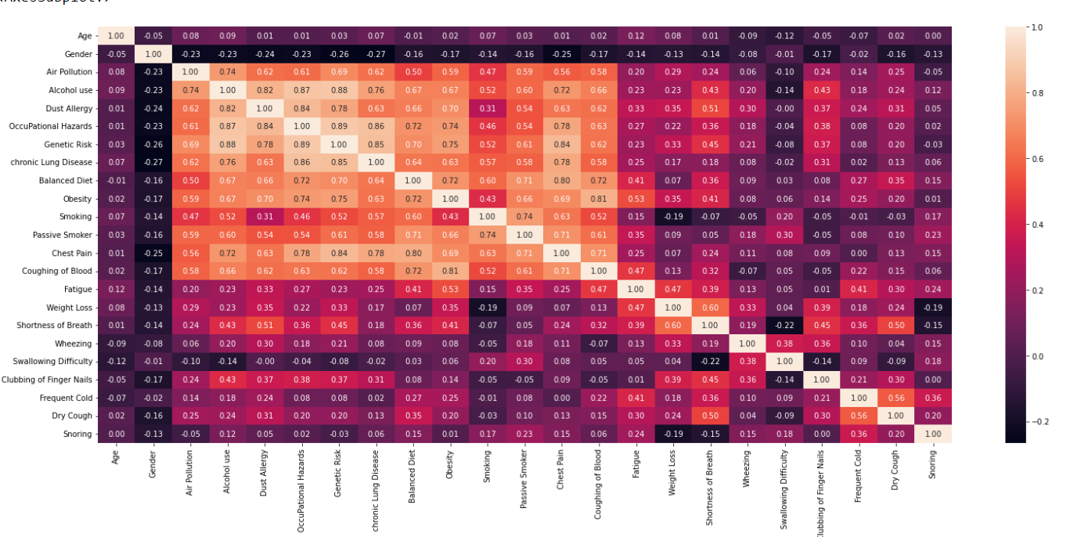

Slide 12
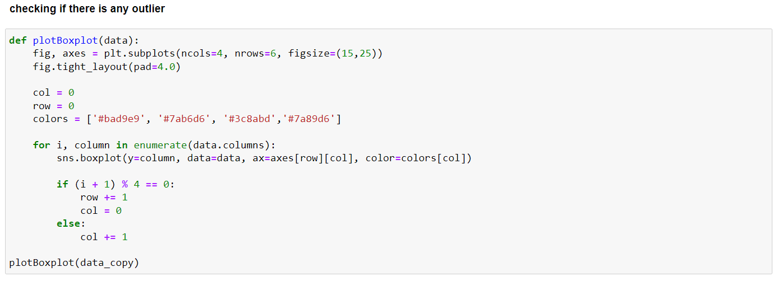
Checking if there is any outlier
We used boxplot to identify the outlier, we can see the data point that is located outside the whiskers of the box plot
we analyzed that only Age has some outlier in the data set.

Slide 13
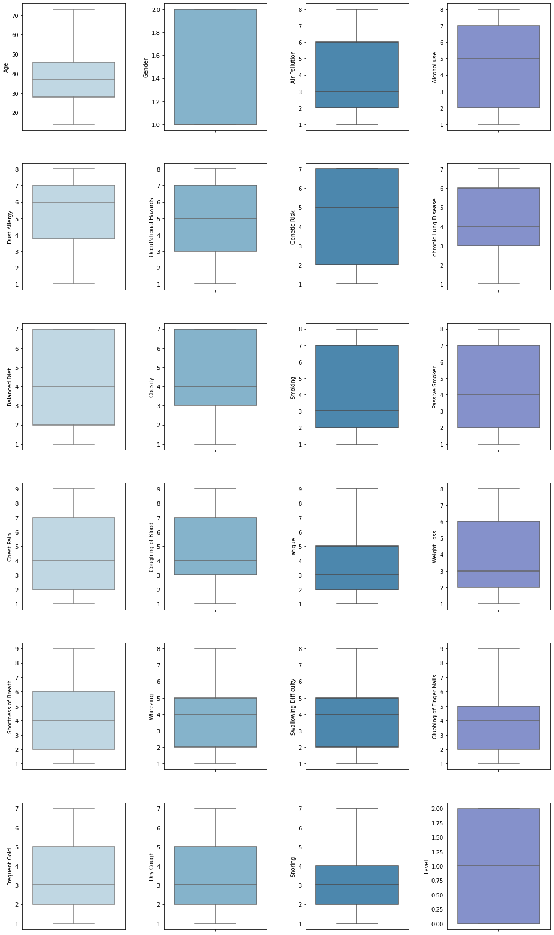

Slide 14
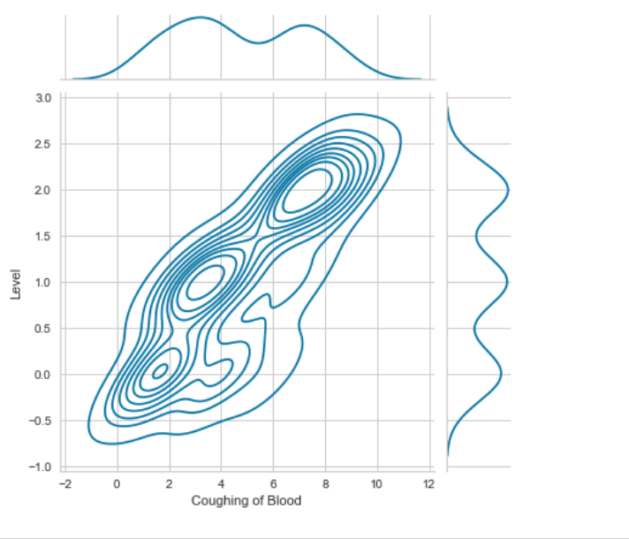
Analyzing Level with coughing blood using kernel density estimation plot.
KDE is a useful technique to create a smooth curve given a set of data.
We have plotted the bar-graph that shows that higher the level of coughing blood higher will be the chance of cancer.

Slide 15
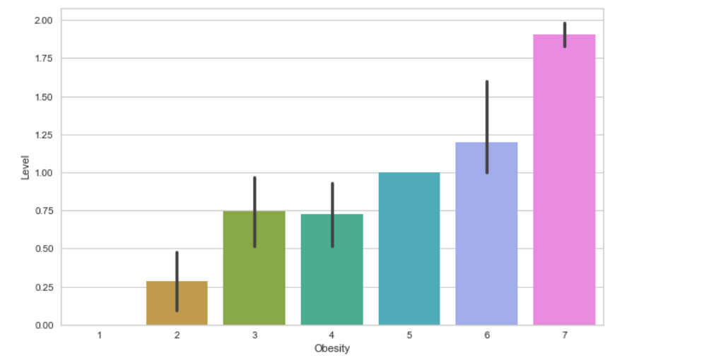
We also plotted the bar plot to see the level over obesity and we can see that it's quite a upward trend in the obesity as we go higher. Higher the obesity higher will be the chance of cancer.

Slide 16
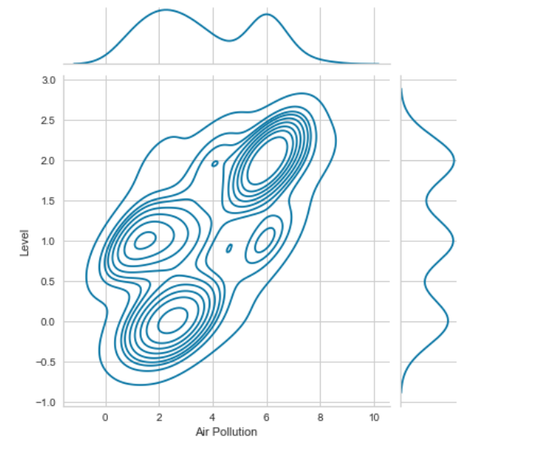
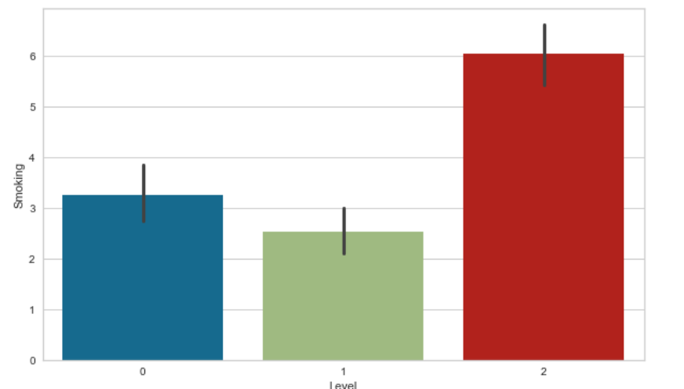
We have plotted the joint plot for level over Air-pollution
Also we have also plotted the bar plot for level over Smoking and we can see that it's quite a upward trend in the smoking as we go higher the smoking level we go higher level chance of cancer

Slide 17
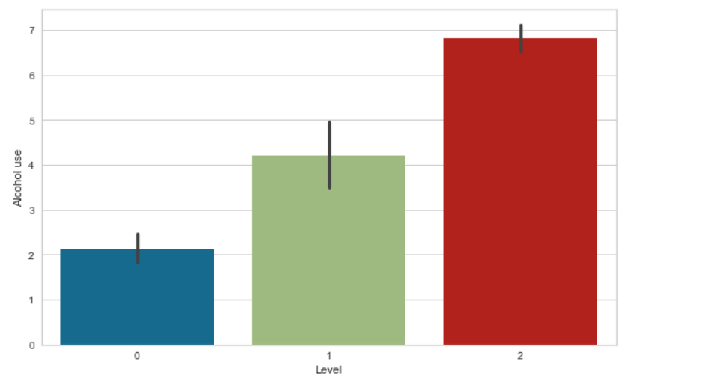
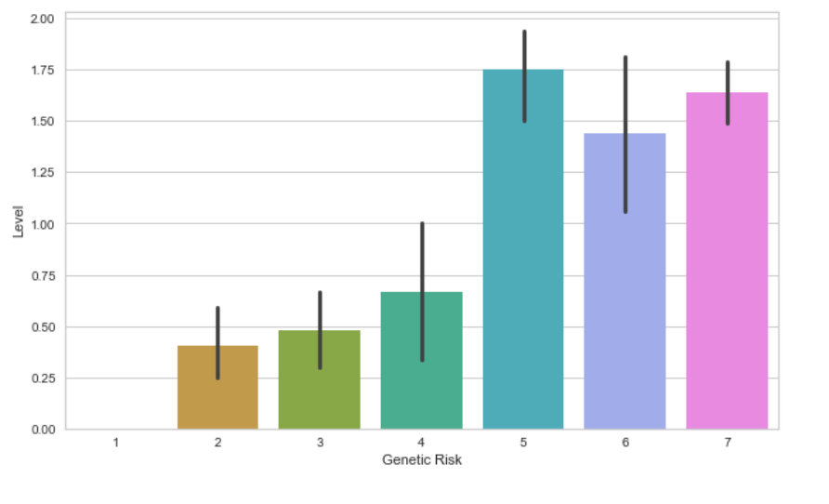
We have also plotted bar graph for Alcohol use over Level and we can see that there is upward trend in the Level as we go higher use of alcohol level we see higher chance of cancer.
Also for the bar-plot for Genetic Risk over level and we can observe that the people having genetic risk has the high chance of getting cancer.

Slide 18
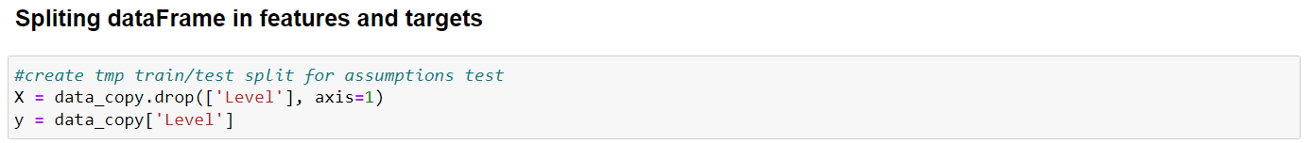
Splitting data-Frame in features and targets
We have splitted the dataset into training and testing sets where for training the model we have taken all the features except level and for testing we have taken the level column as input.
After that we did the visualization using feature correlation library which is used in feature selection to identify features with high correlation or large mutual information with the dependent variable.
Train Test Ratio is 80:20

Slide 19
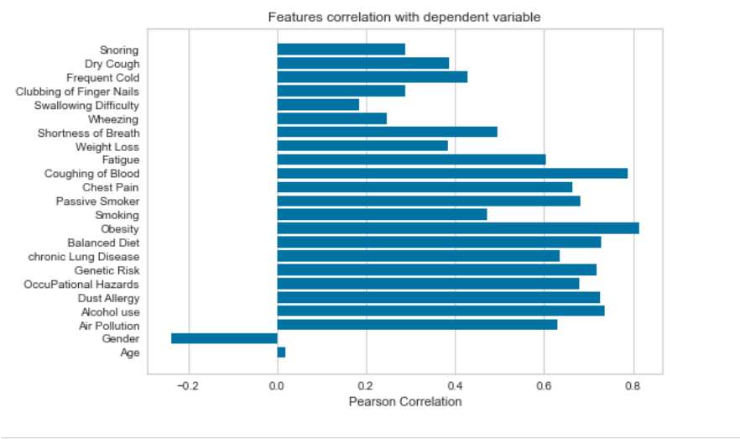

Slide 20
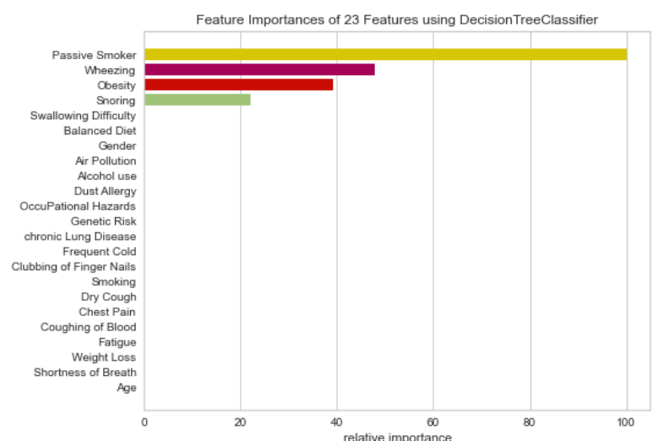
Feature Importance
calculate a score for all the input features.
According to the feature we can conclude that passive smoker, wheezing, obesity and snoring is highly relative importance.

Slide 21
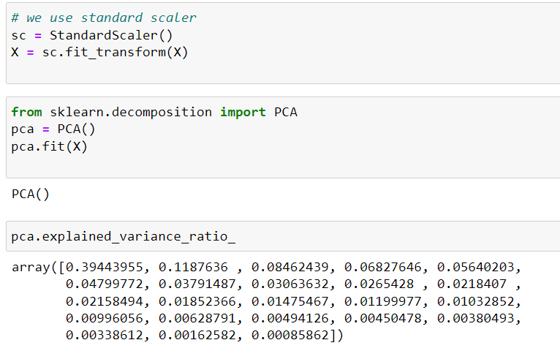
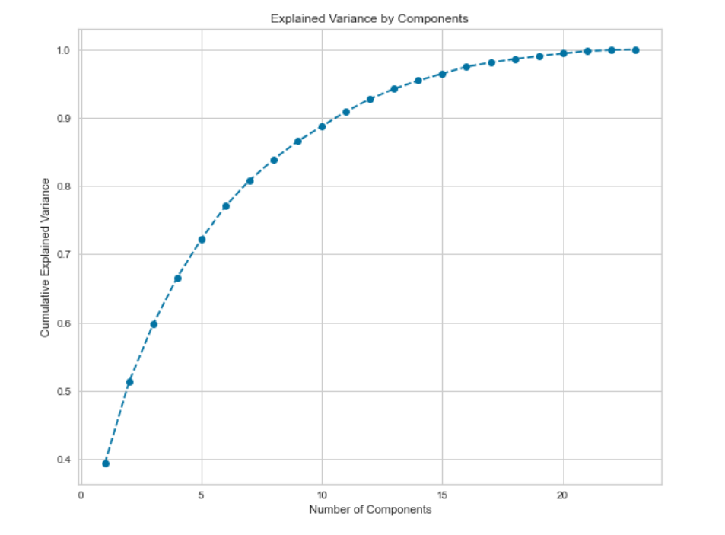
PCA Implementation

Slide 22
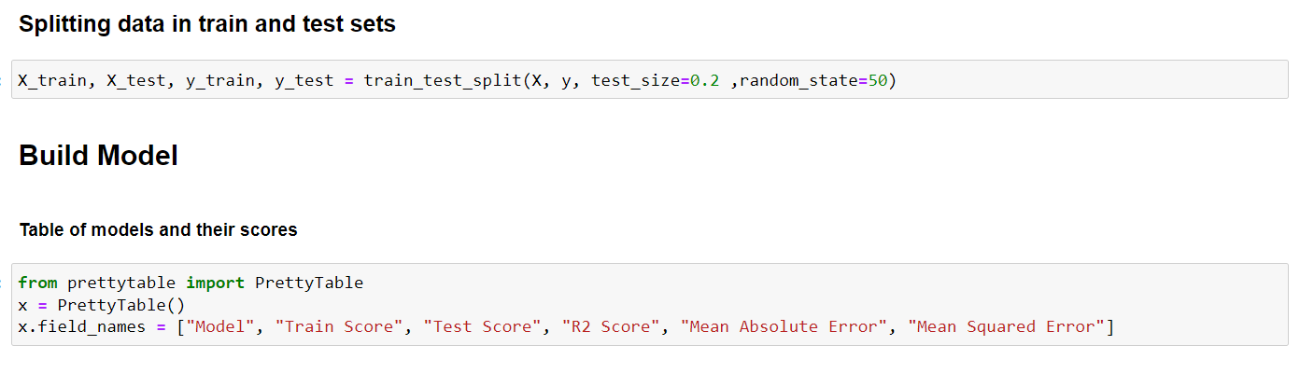
Test Train Split

Slide 23
Model We are Using
Linear Regression
Lasso Regression
Random Forest Regression
Gradient Boosting Regression.

Slide 24
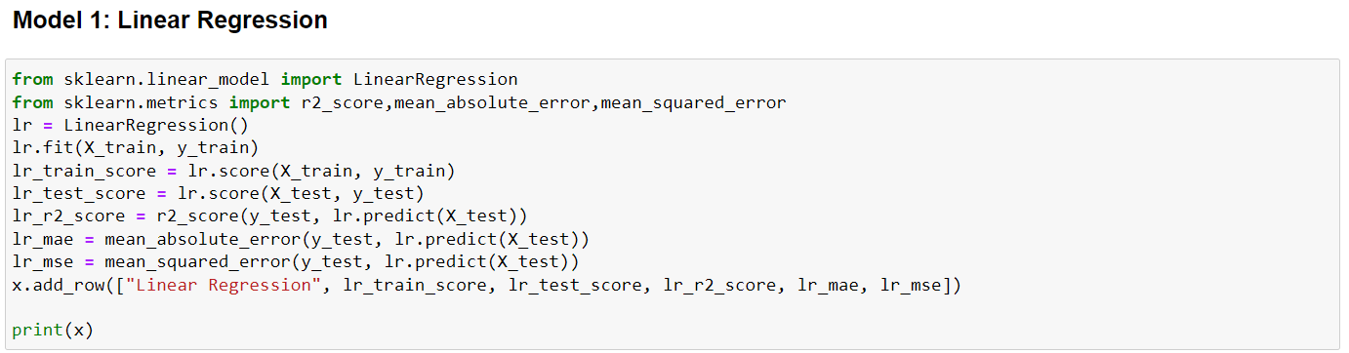
Linear Regression

Slide 25
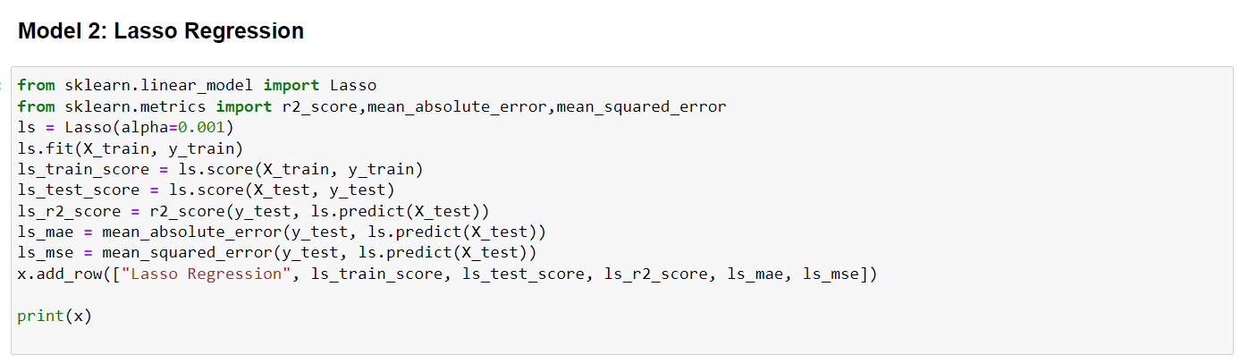
Lasso Regression

Slide 26
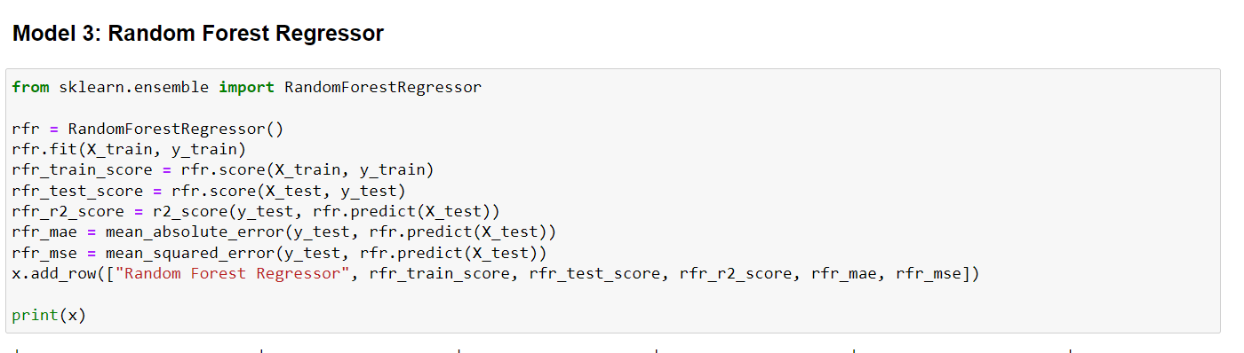
Random Forest Regression

Slide 27
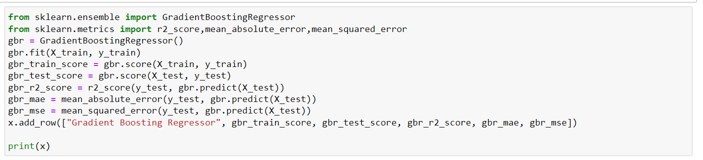
Gradient Boosting Regressor

Slide 28
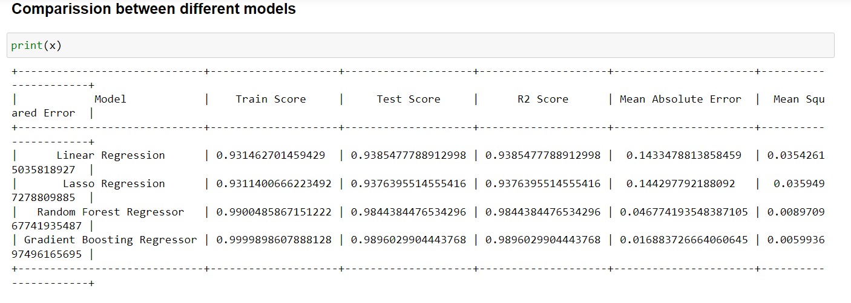

Slide 29
Summery
After visually analyzing the data we built the model using Linear Regression, Lasso Regression, Random Forest Regression Gradient Boosting Regression.
From the table, we can see that the minimum mean square error is obtained by using Gradient Boosting Regression and the value is 0.017192401992716096
Gradient Boosting is good for predicting the lung cancer with 99.99% accuracy, quite amazing.

Slide 30
Summery (Cont..)
It also shows us that obesity, air pollution, balanced diet, cough of blood, passive smoker is strongly correlated with lung cancer, therefore we should be alert when these factors occur to us.
Best treatment for the cancer patient will be early check up if these symptoms are occurs; cough of blood, fatigue, dry cough, obesity, genetic risk and chest pain. And get treatment from doctor as soon as possible.
We can prevent cancer by stop smoking, drinking alcohol, stay away from air polluted area, good balance diet and so on.

