Slide 1
Analyzing the Leading Causes of Deaths in Canada
Presented by Bikin Ghimire

Slide 2
WHY
Public Health Planning
Monitoring Trends
Research and Innovation
Resource allocation
Prevention strategies
Implement policies
Identify emerging threats
Evaluate effectiveness of interventions and treatments
Developing new treatments
Advancing diagnostic methods

Slide 3
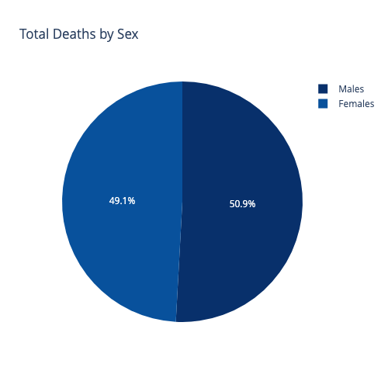
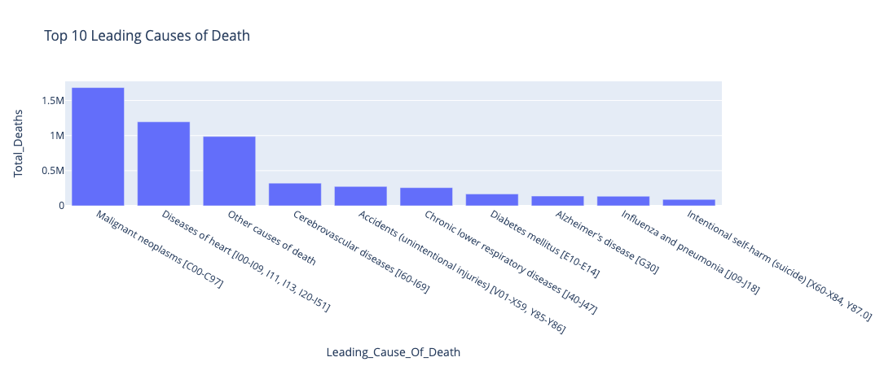
KEY FINDINGS
5,819,828
Malignant neoplasms (Cancer) is the leading cause of death in Canada.
The leading cause of death for people below the age of 40 is Accidents while, the reason for death of people above the age of 40 is most likely to be Cancer or Diseases of the heart.
Total people died in Canada between 2000 and 2022

Slide 4
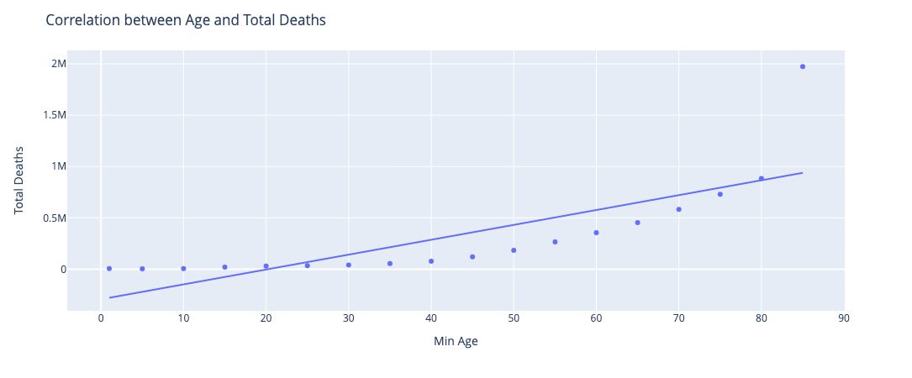
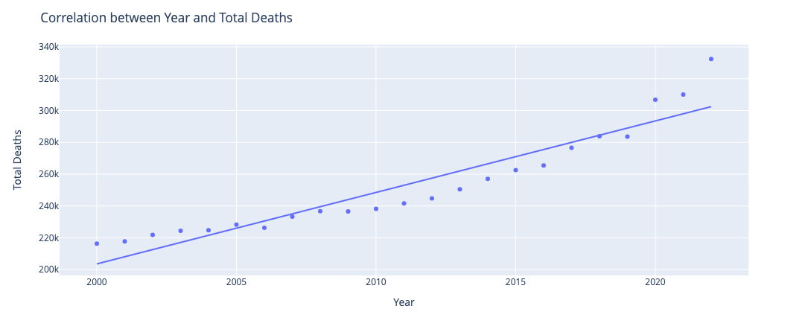
KEY FINDINGS
There is a positive correlation between the age of an individual and their death.
There is also a positive correlation between the years and the total number of deaths of people in Canada.
5,819,828
Total people died in Canada between 2000 and 2022

Slide 5
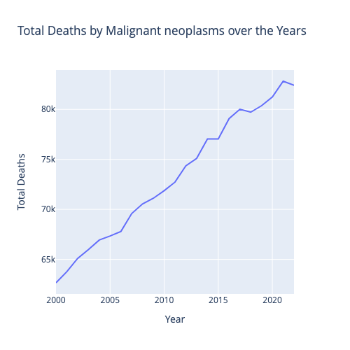
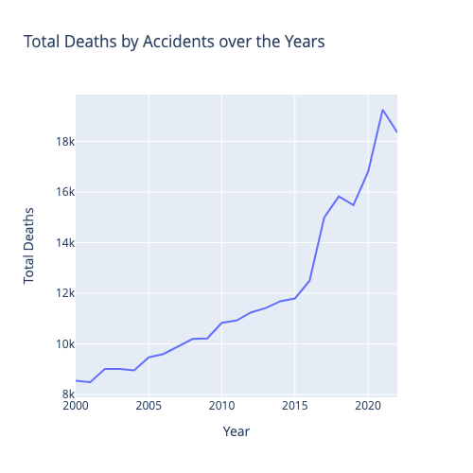
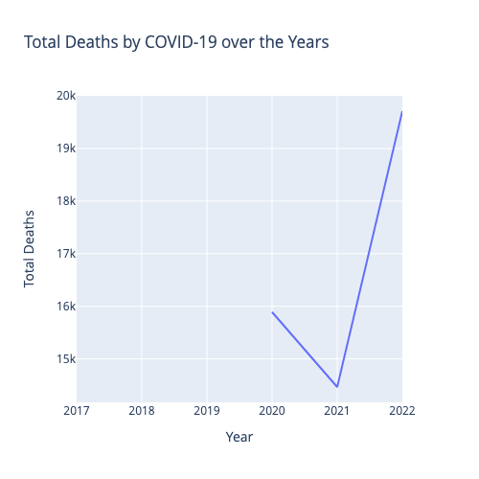
KEY FINDINGS
The 3 causes of deaths that have increased the most over the years are Malignant neoplasms, Accidents, and COVID-19.
5,819,828
Total people died in Canada between 2000 and 2022

Slide 6
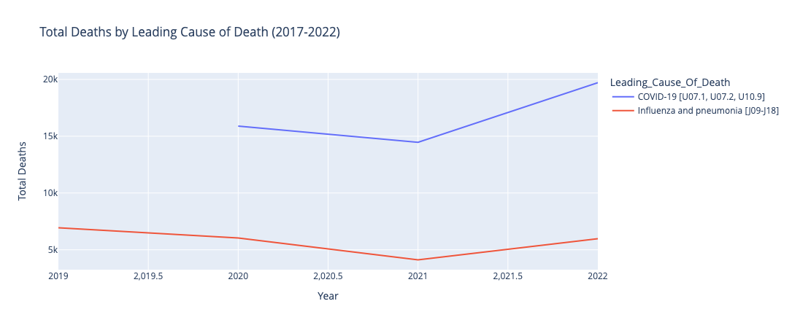
KEY FINDINGS
5,819,828
The death-count due to Influenza and pneumonia has decreased when deaths by COVID started being recorded.
Total people died in Canada between 2000 and 2022

Slide 7
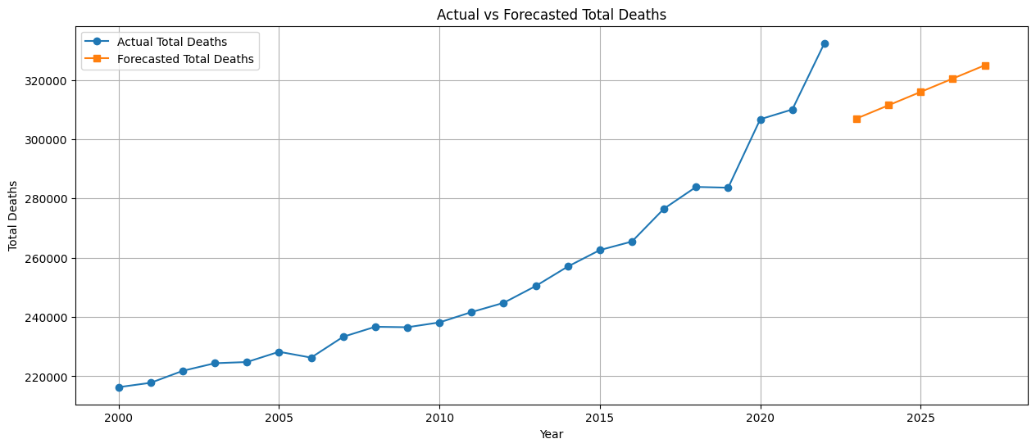
KEY FINDINGS
The total death-count is bound to increase in the upcoming years.

Slide 8
Conclusions
People of a younger age need more awareness and care regarding traffic rules and regulations to reduce deaths by accidents. People of older age require more health services compared to younger people.
The policies and interventions against cancer need to be reviewed and reworked to reduce the high and increasing mortality rate from it.
The death count due to COVID-19, could be false and require further analyses.
The death count is bound to rise even more in the upcoming years, so the public health sector need to:
Prepare better prevention methods
Allocate more resources to make the health system ready for the rise

Slide 9
THANKS!
Do you have any questions?

