Slide 1


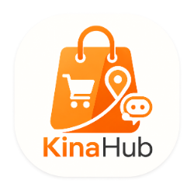
KINAHUB
KinaHub
Local shopping, connected.
Built by Bikram Gole
Computer Engineering Department, Shivapuri
Secondary School
OJT PROJECT

Slide 2


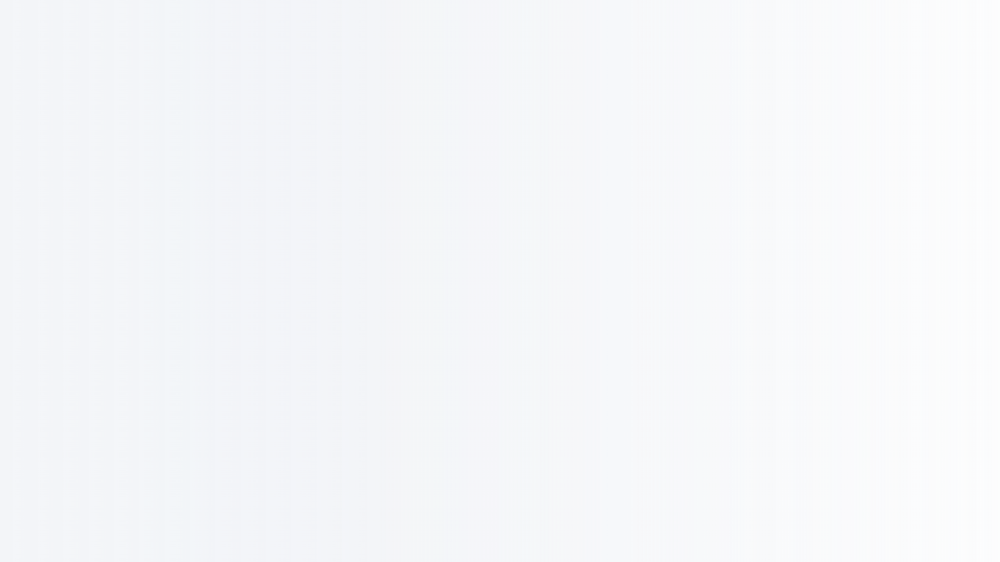




THE CHALLENGE
The local digital gap
Local shops can be hard to find and shop across.
Hard to find
Split deliveries
Generic advice
Small stores may not
have a simple way to sell
online.
Buying nearby can still
mean separate deliveries
and added fees.
Shoppers need guidance
rooted in local products
and value.

Slide 3




THE PROJECT GOAL
A local-first marketplace
One digital marketplace connecting neighborhood shops with local customers.
BROWSE
BUY
CHOOSE
MANAGE
Products,
categories and
brands in a
responsive store.
Secure accounts
and a multi-store
cart.
Kina AI for local
shopping advice.
Seller CRM for
products, orders
and insights.
PROTOTYPE SCOPE
Built for local testing and school demonstrations.

Slide 4


WHERE I BUILT IT
My OJT work context
Design first
I explored and refined the interface in
Google Stitch before coding.
Work in sprints
I focused on cart logic, API endpoints and
AI integration in stages.
Test as I build
Computer Engineering Department, Shivapuri
Secondary School
School workstations and internet access
supported live API testing.

Slide 5
HOW IT IS BUILT
A layered technology stack
The frontend and backend can evolve independently, connected through a REST
API.
Frontend
Backend
Data
AI
React, TypeScript,
Vite, Tailwind CSS
and Framer Motion
Django and
Django REST
Framework
Neon-hosted
PostgreSQL
OpenRouter
powers optional
conversational
shopping help.
SIGN-IN
Google OAuth · Email + OTP
JWT API tokens
DEPLOYMENT · Vercel · Render · Cloudinary

Slide 6




UNDER THE HOOD
The core data models
Four connected records support product discovery, delivery and shopper trust.
Product
Store
Listings and dynamic pricing,
including current_price for
discounts.
Seller identity, store branding
and delivery rules.
Review
Category + brand
Verified-purchase feedback
builds confidence in local
sellers.
A structured catalog that
makes filtering useful.

Slide 7
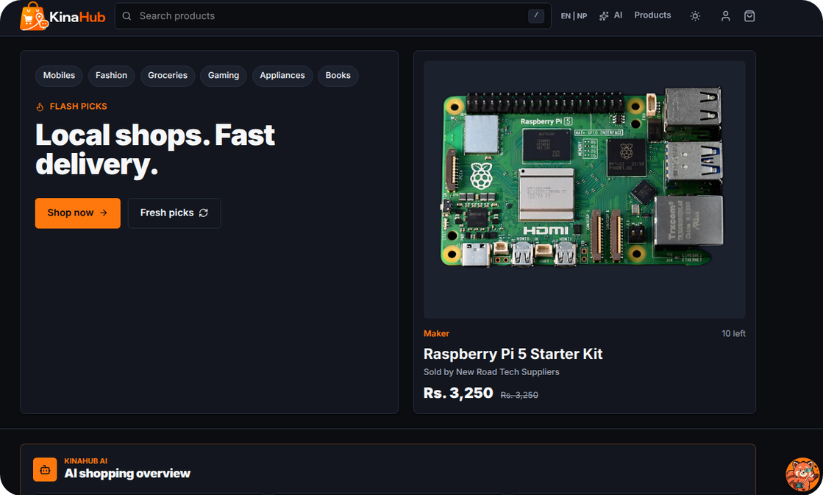
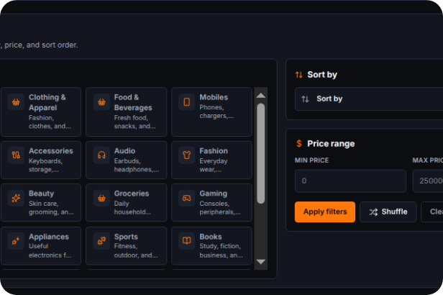
CUSTOMER EXPERIENCE
The customer shopping journey
Local discovery, fewer steps
Browse products from nearby
sellers in one marketplace.
Search by text or narrow results by
category, price, brand and rating.
Check store details, reviews and
current prices before choosing.

Slide 8
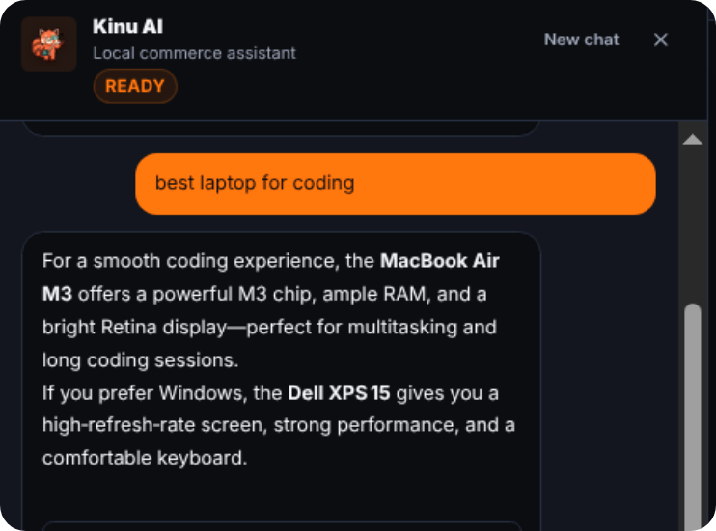
AI SHOPPING ASSISTANT
Kina AI
Shopping advice with local
context
Kina AI summarizes products, suggests
useful picks and surfaces buying signals.
Confidence rankings help shoppers
compare options.
Cart suggestions can group items from
one store to reduce delivery costs.
POWERED BY OPENROUTER

Slide 9
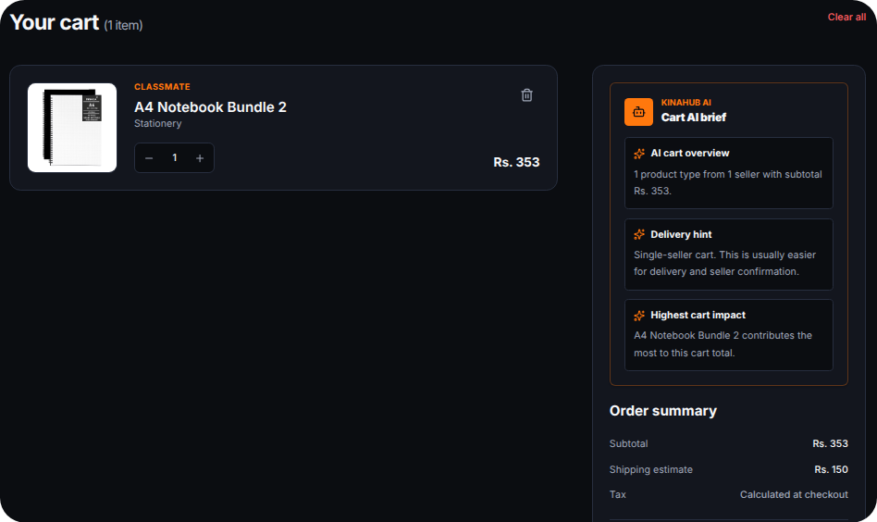
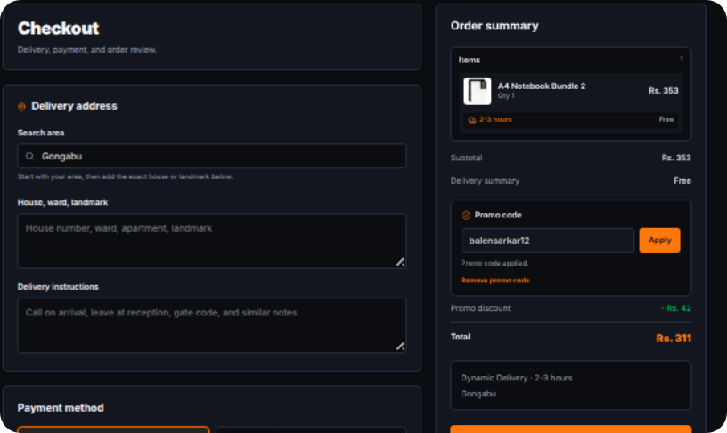
CART TO CHECKOUT
Multi-store checkout
I built cart logic to handle items from different sellers and keep delivery costs
visible.
One cart, multiple stores
A guided checkout
Store-aware delivery fees · secure multi-step checkout

Slide 10





WHAT I LEARNED
Skills I built across the stack
Full-stack
integration
UI and responsive
CSS
Connecting a Django
REST API to a React app
with TypeScript.
Using Tailwind and
Framer Motion to shape
the interface.
AI orchestration
Version control
Designing prompts and
handling streamed AI
responses.
Keeping a clear Git
history while working
through feature
branches.

Slide 11
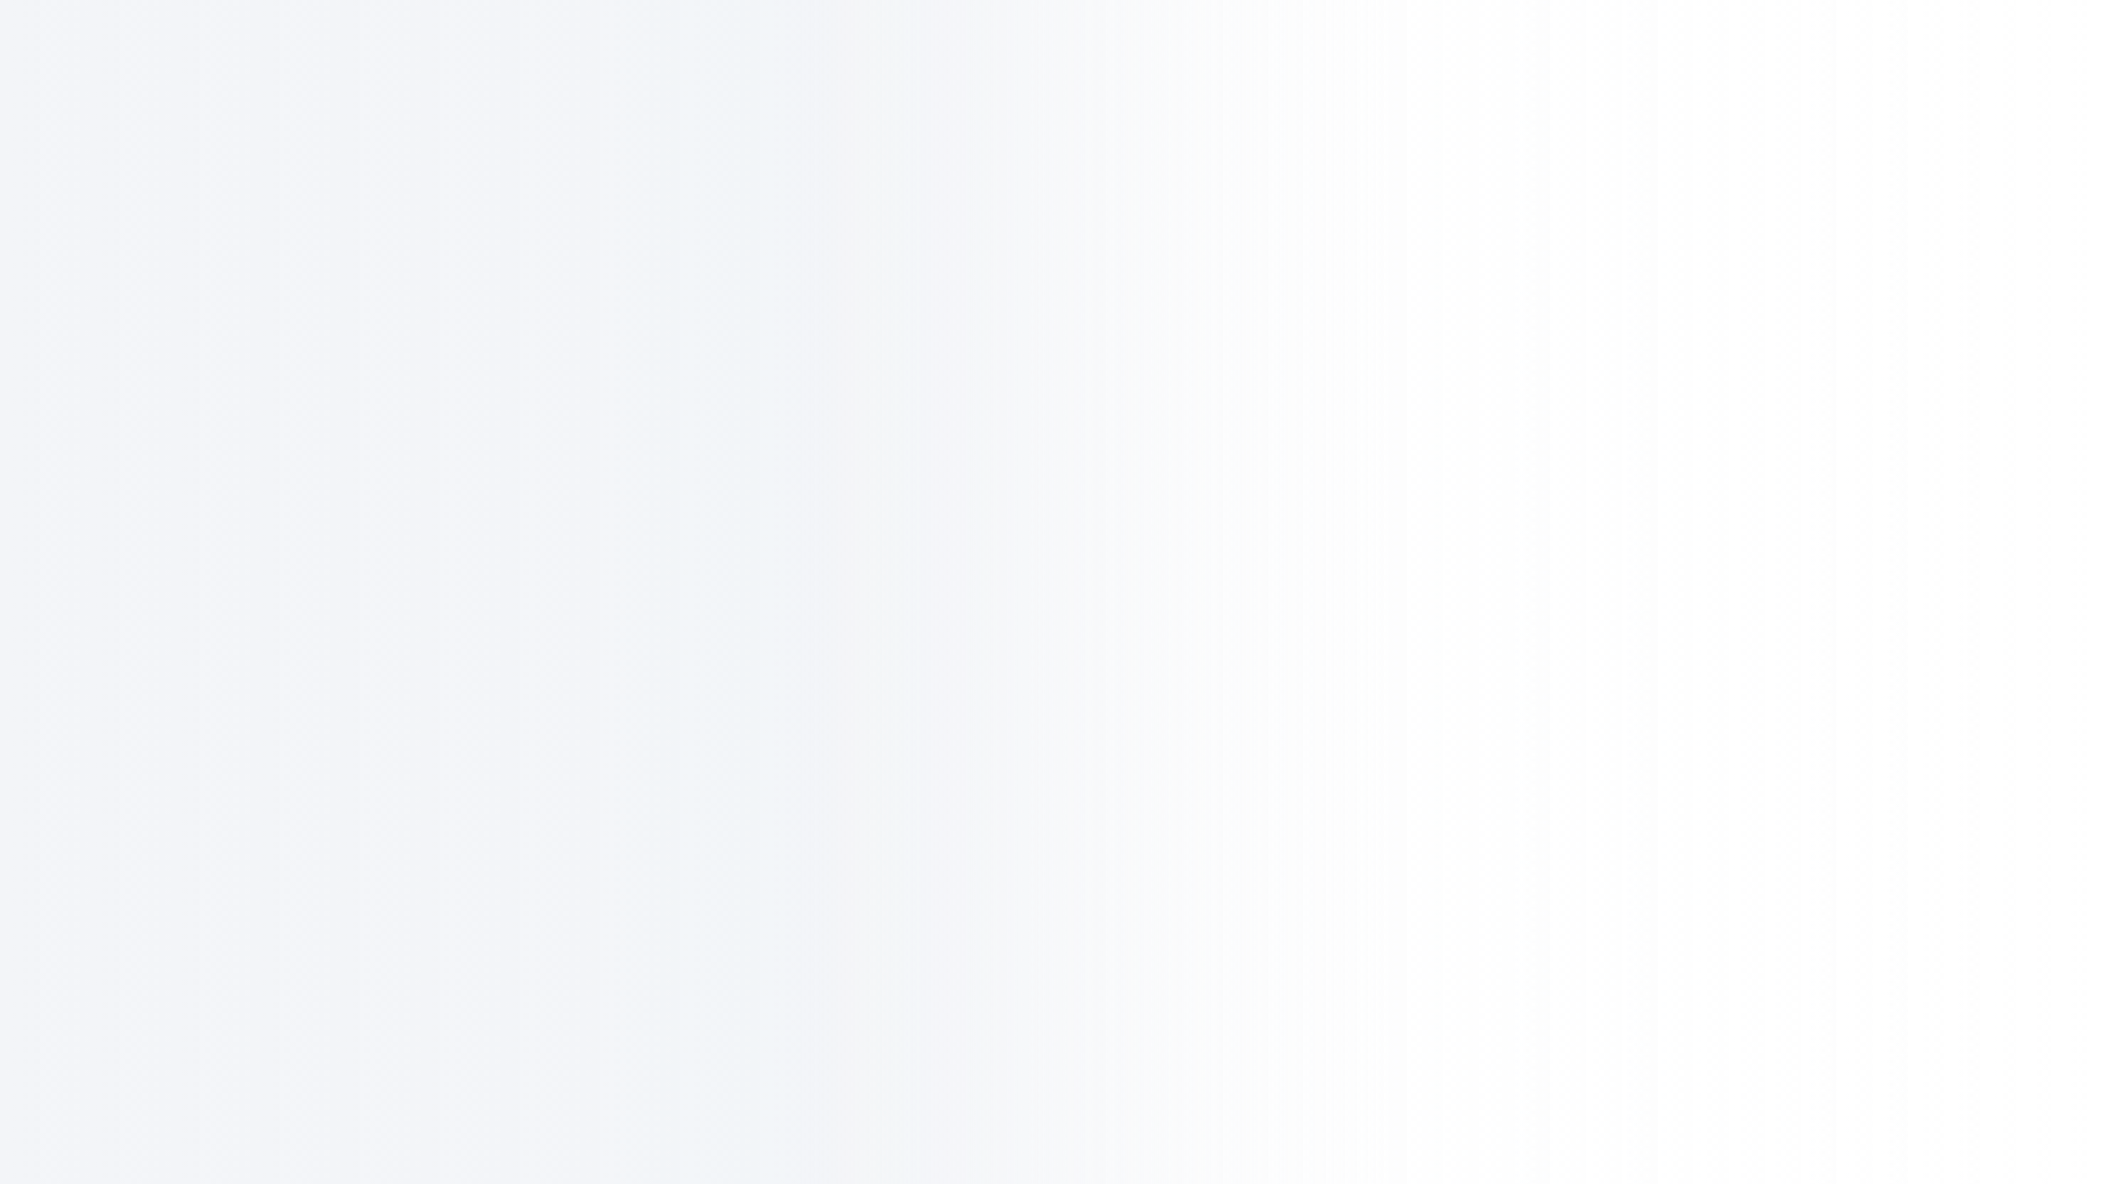


THE JOURNEY CONTINUES
KinaHub is a working start
I turned my Grade 10 OJT into a functional
local-first marketplace—connecting school
ICT learning with full-stack software
development.
“Build what you wish existed. Then keep
leveling up.”
LIVE DEMO ↗
GITHUB SOURCE ↗
kinahub.vercel.app
github.com/BikramGole/KinaHub
KinaHub GitHub organization:github.com/kinahubofficial ↗

