Slide 1

HR Analytics Dashboard

Slide 2
Content:
Project Objective
Data from CSV
Data Transformations
Data Processing and DAX
Dashboard and Insights
Export and Share Project

Slide 3
Project Objective
To gain insights into employee turnover, identify trends and patterns, and develop strategies to improve employee retention, reduce turnover costs, and enhance overall organizational health.
To ensure that the organization remains competitive, retains top talent, and fosters a positive working environment.

Slide 4
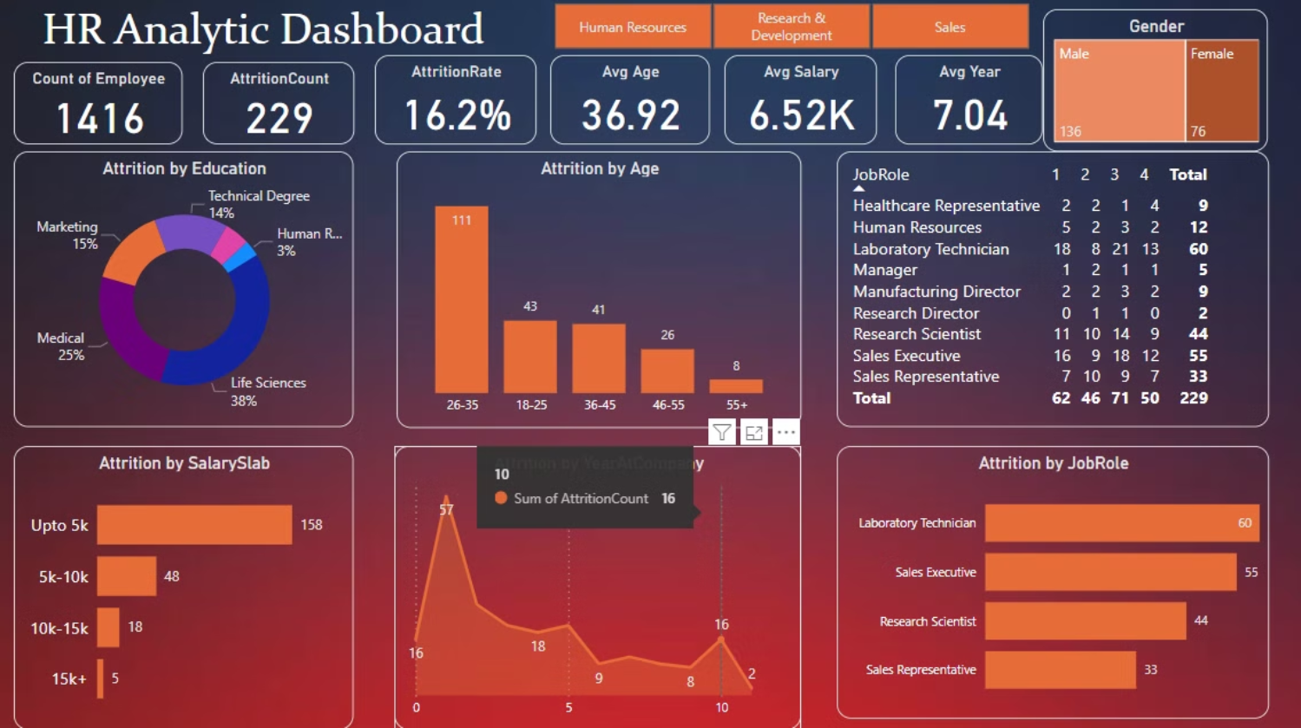

Slide 5
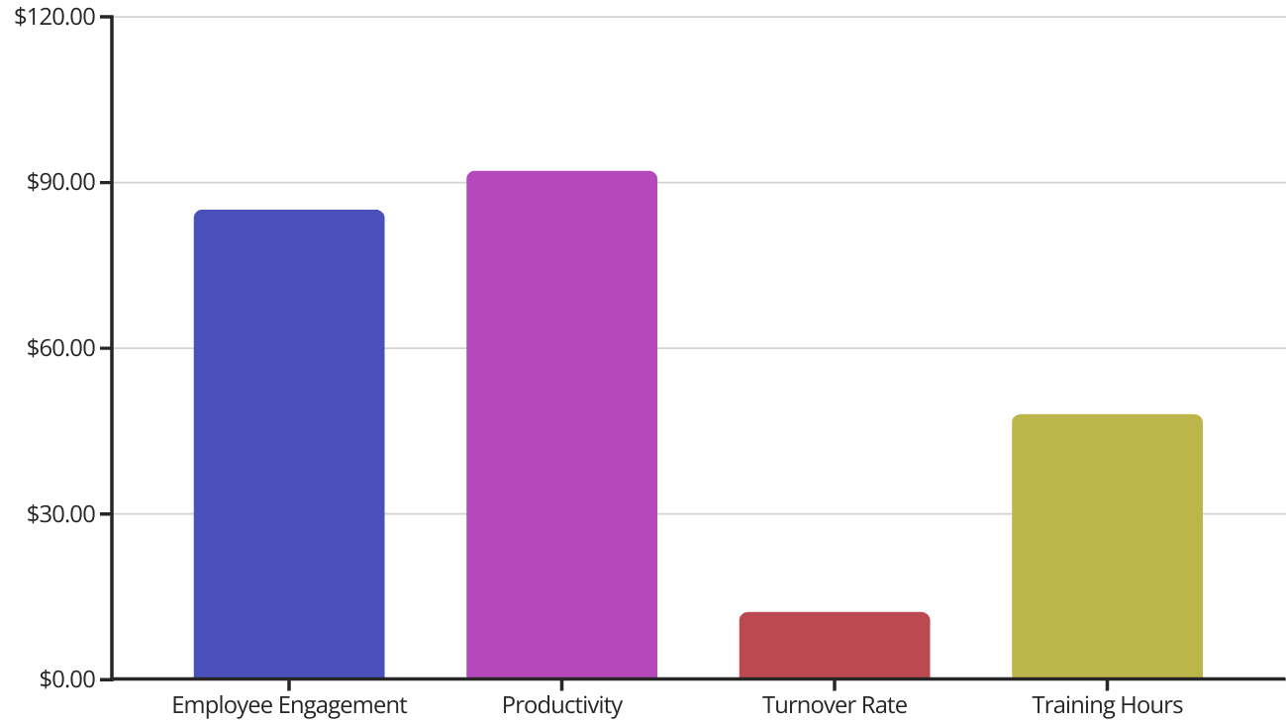
Our HR Analytics Dashboard provides real-time insights to inform strategic decision-making. With robust reporting tools and a focus on employee engagement, we empower our team to maximize productivity and performance.

Slide 6
Download Data:
Github: https://github.com/Bikshibi/Attrition_Analysis/blob/main/AttritionProject.pdf

