Slide 1
Staff Leave
Management System
Developed in Python-Django and SQLite

Slide 2
Introduction
The Staff Leave Management System (SLMS) is an Intranet based application that can be accessed throughout the organization or a specified group/Dept. This system can be used to automate the workflow of leave applications and their approvals.
The project has been planned to be having the view of distributed architecture, with centralized storage of the database. The application for the storage of the data has been planned. All the user interfaces have been designed using the Python technologies and using Django framework. The database connectivity is planned using the “SQLite” methodology. The standards of security and data protective mechanism have been given a big choice for proper usage. The application takes care of different modules and their associated reports, which are produced as per the applicable strategies and standards that are put forwarded by the administrative.

Slide 3
Scope of the Project
This project is aimed at developing a web based Leave Management Tool, which is of importance to any organization. This is an Intranet based application that can be accessed throughout the organization or a specified group/Dept. This system can be used to automate the workflow of leave applications and their approvals. There are features like cancellation of leave, approval of leave, report generators etc. in this Tool.

Slide 4
Problem in Existing System
No use of Web Services and Remoting.
Risk of mismanagement and of data when the project is under development.
Less Security.
No proper coordination between different Applications and Users.

Slide 5
Project Modules
The modules involved are:
Administration
Staff

Slide 6
Admin Module
Admin can add a Staff and also update the Staff info.
Admin can also manage the leave application (approve and not approve).
Every time when a Staff applies for leave admin will get a notification.
Admin can change own password after login.
Admin can also view admin dashboard.

Slide 7
User Module
The Staff can log in with a valid email and password.
Update his/her profile
Applied for leave
View the leave history
Change his/ her password

Slide 8
Requirement Specification
Hardware Configuration:
Client Side
Server Side
RAM | 512 MB
Hard Disk | 10GB
Processor | 1.0 GHz
RAM | 1 GB
Hard Disk | 20GB
Processor | 2.0GHz

Slide 9
Continue.....
Software Requirement:
Client Side
Server Side
Web Browser | Google Chrome or any compatible browser
Operating System | Windows or any equivalent OS
Web Server | APACHE
Server side Language | PHP5.6 or above version
Database Server | MySQL
Web Browser | Google Chrome or any compatible browser
Operating System | Windows or any equivalent OS

Slide 10
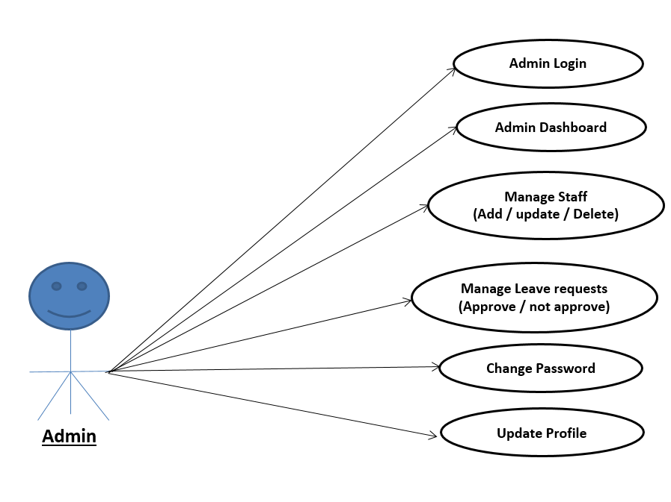
Use Case Diagram
Admin Use Case Diagram
Notes:
USECASE DIAGRAM: A Use case is a description of set of sequence of actions. Graphically it is rendered as an ellipse with solid line including only its name. Use case diagram is a behavioral diagram that shows a set of use cases and actors and their relationship. It is an association between the use cases and actors. An actor represents a real-world object. Primary Actor – Sender, Secondary Actor Receiver.

Slide 11
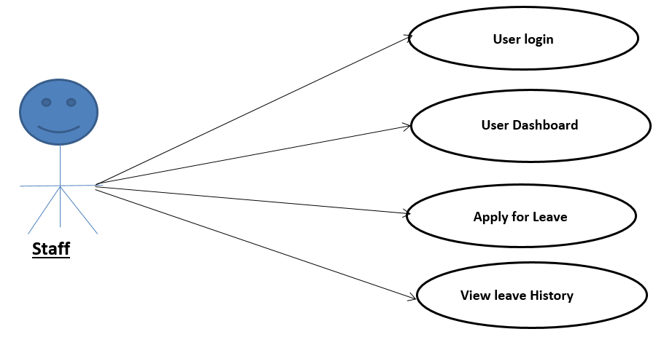
User use case Diagram

Slide 12
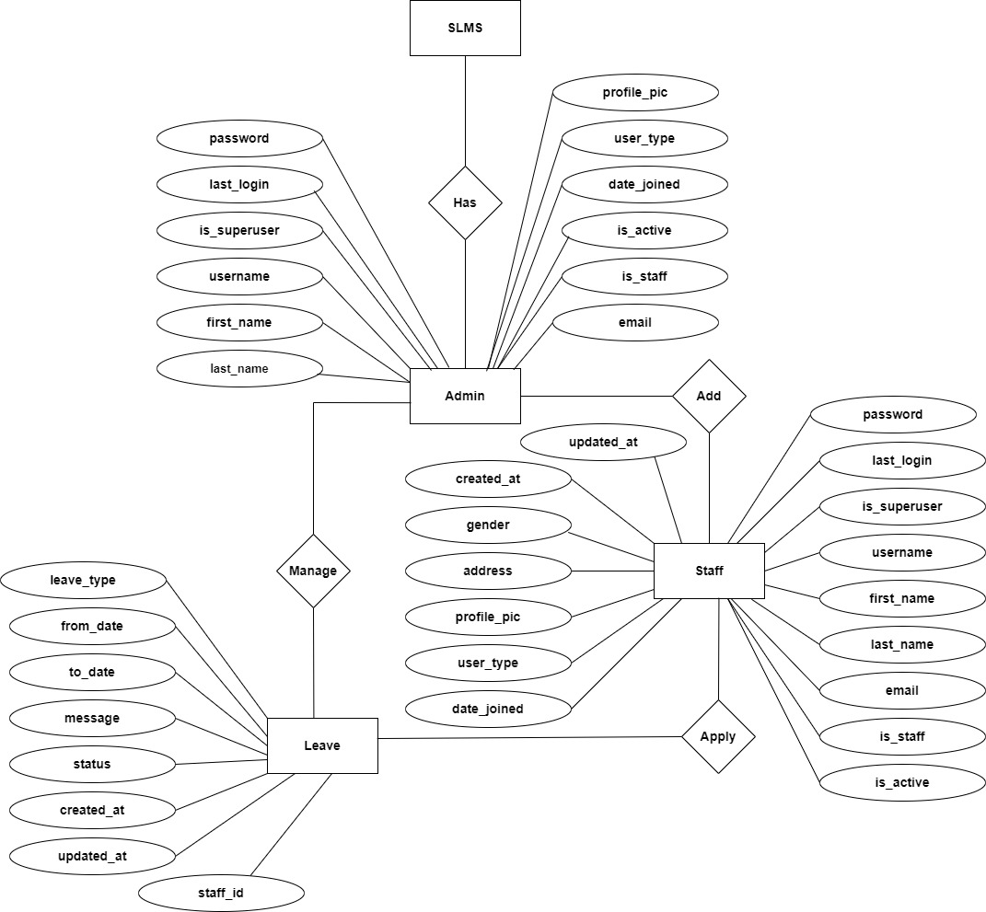
ER Diagram

Slide 13
Dataflow Diagrams (DFDs)
A Data Flow Diagram (DFD) is a traditional visual representation of the information flows within a system. A neat and clear DFD can depict the right amount of the system requirement graphically. It can be manual, automated, or a combination of both.
It shows how data enters and leaves the system, what changes the information, and where data is stored.
The objective of a DFD is to show the scope and boundaries of a system as a whole. It may be used as a communication tool between a system analyst and any person who plays a part in the order that acts as a starting point for redesigning a system. The DFD is also called as a data flow graph or bubble chart.

Slide 14
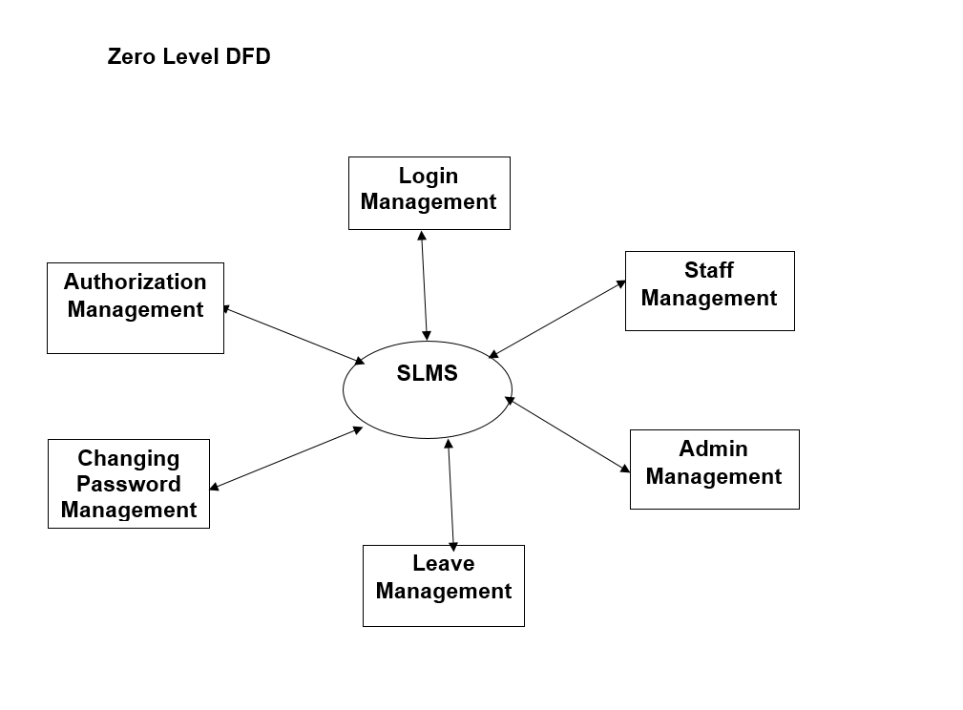

Slide 15
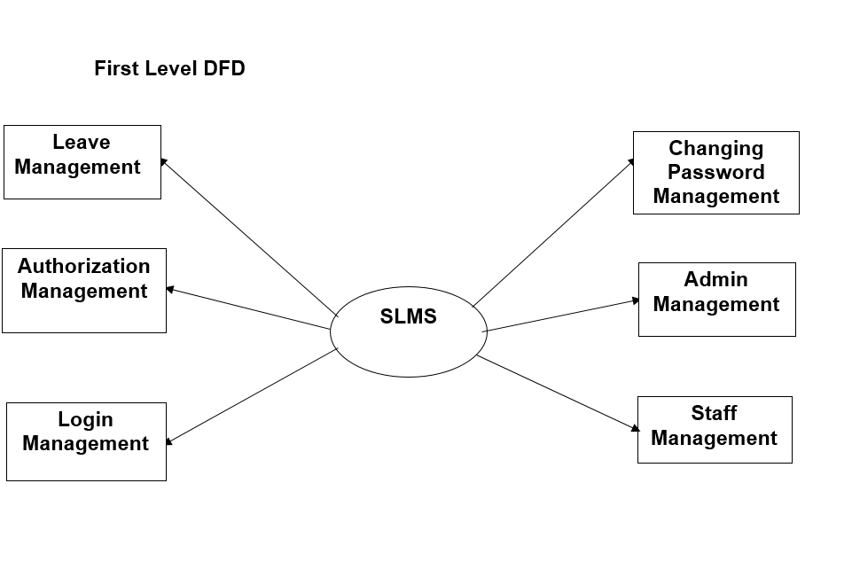

Slide 16
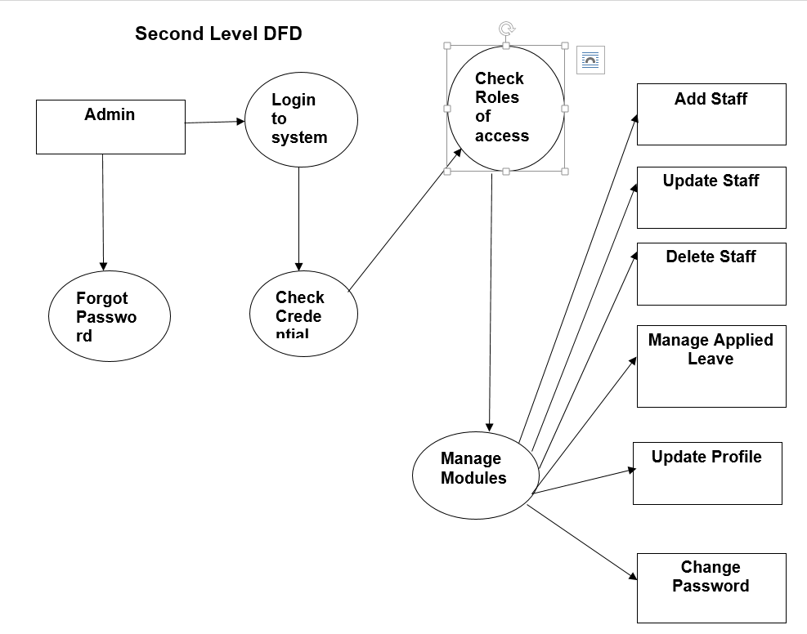

Slide 17
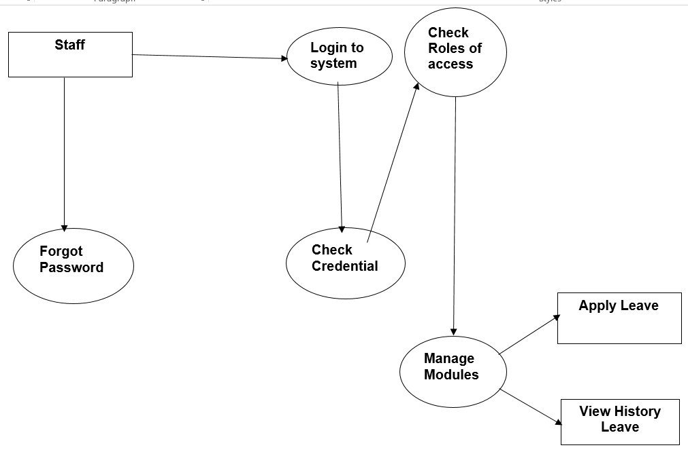

Slide 18
Implementation and
System Testing
After all phase have been perfectly done, the system will be implemented to the server and the system can be used.
System Testing
The goal of the system testing process was to determine all faults in our project .The program was subjected to a set of test inputs and many explanations were made and based on these explanations it will be decided whether the program behaves as expected or not. Our Project went through two levels of testing
Unit testing
Integration testing

Slide 19
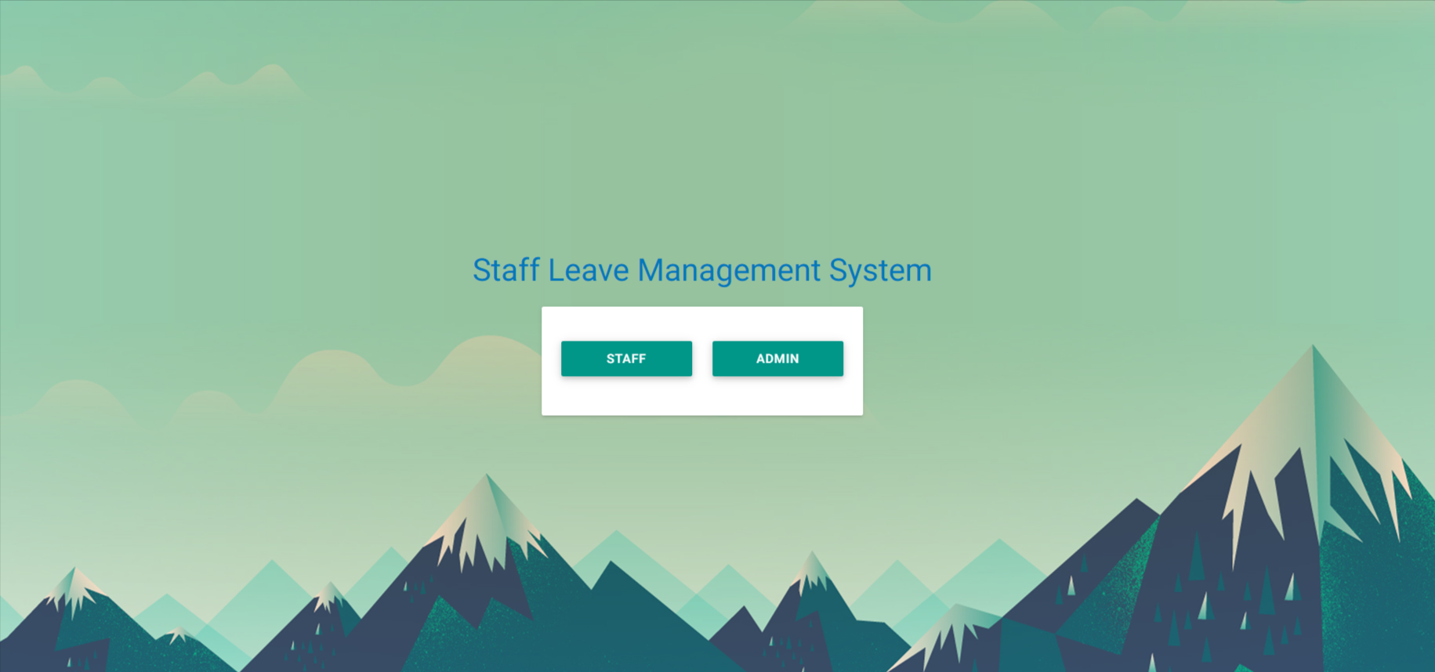
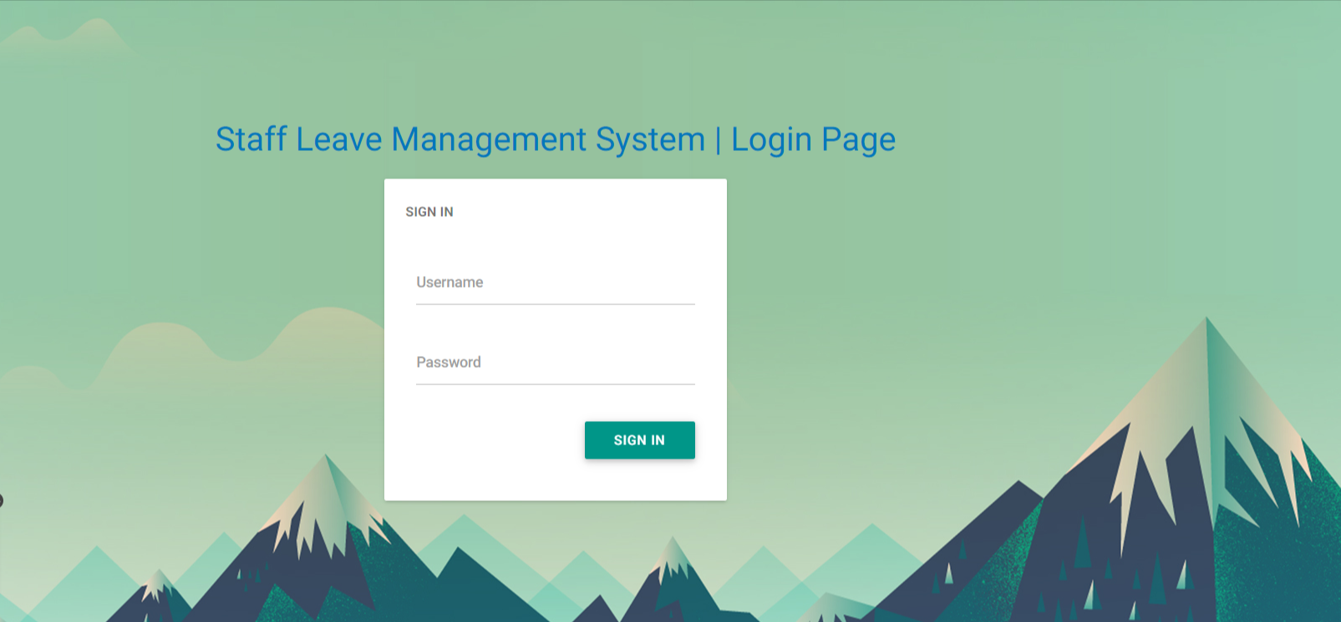
Project Screens

Slide 20
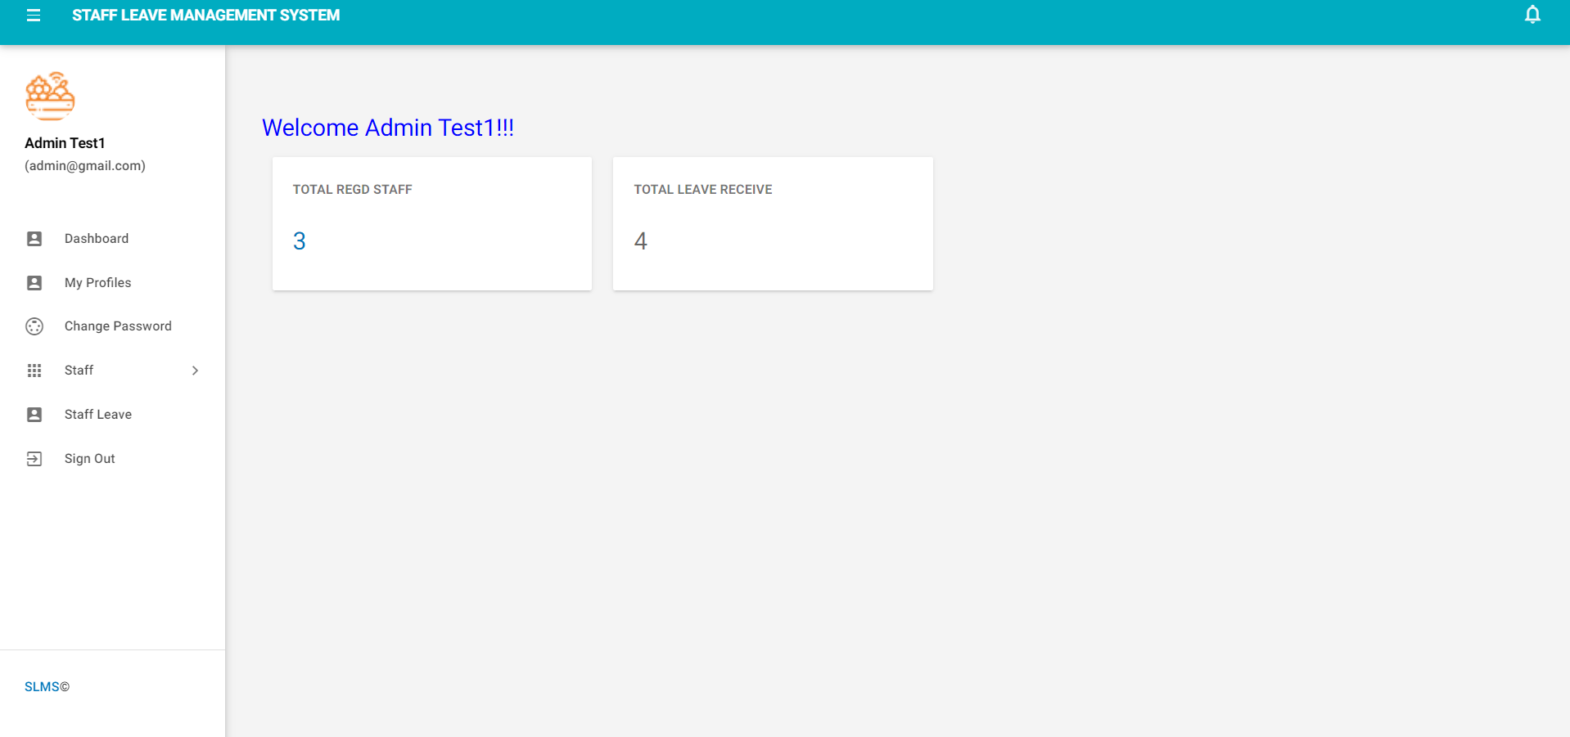
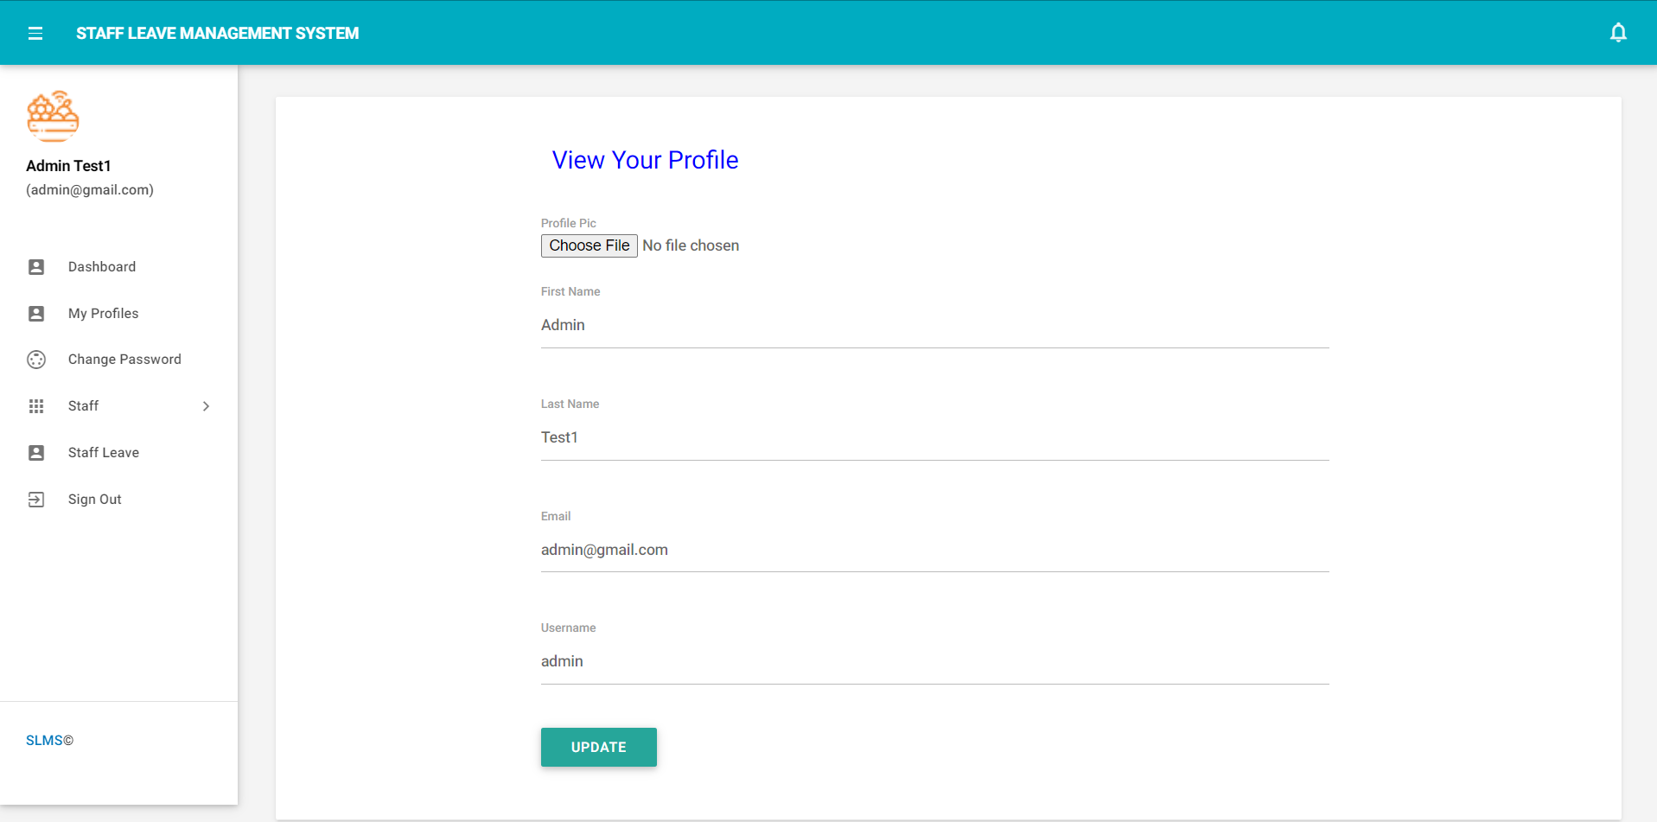

Slide 21
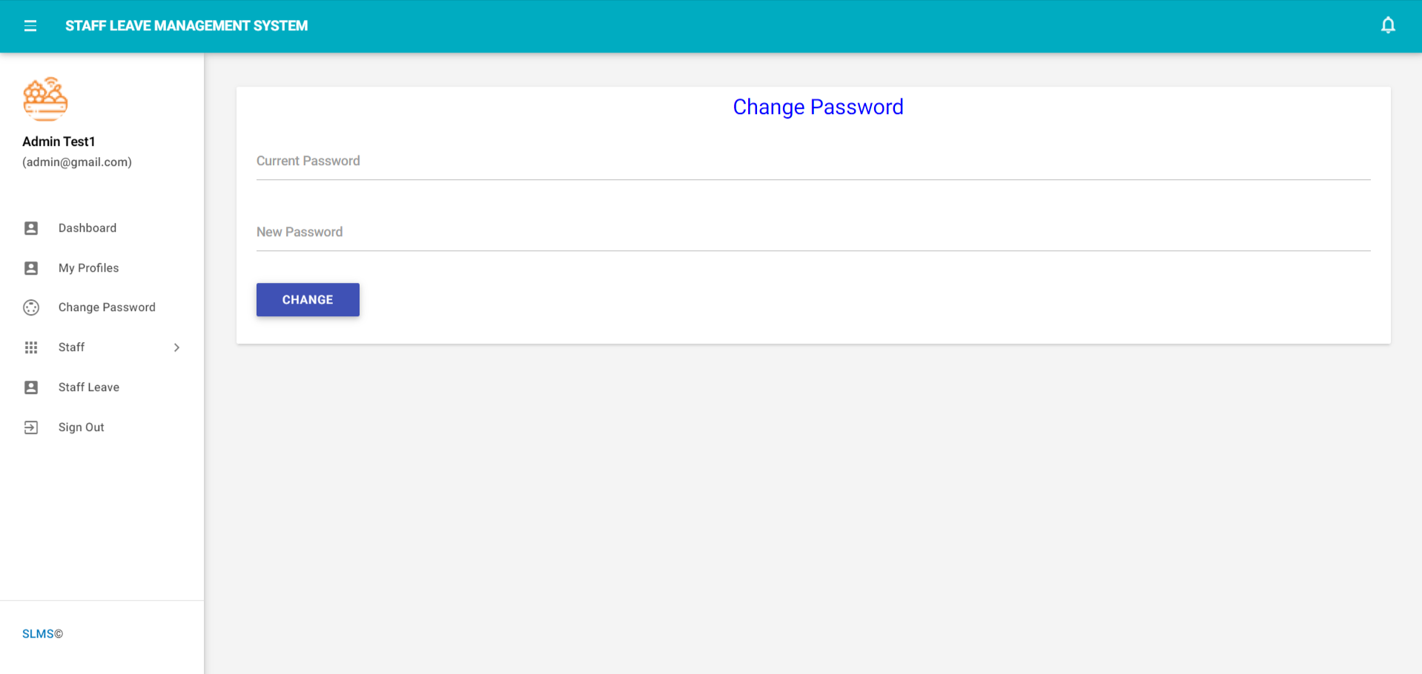
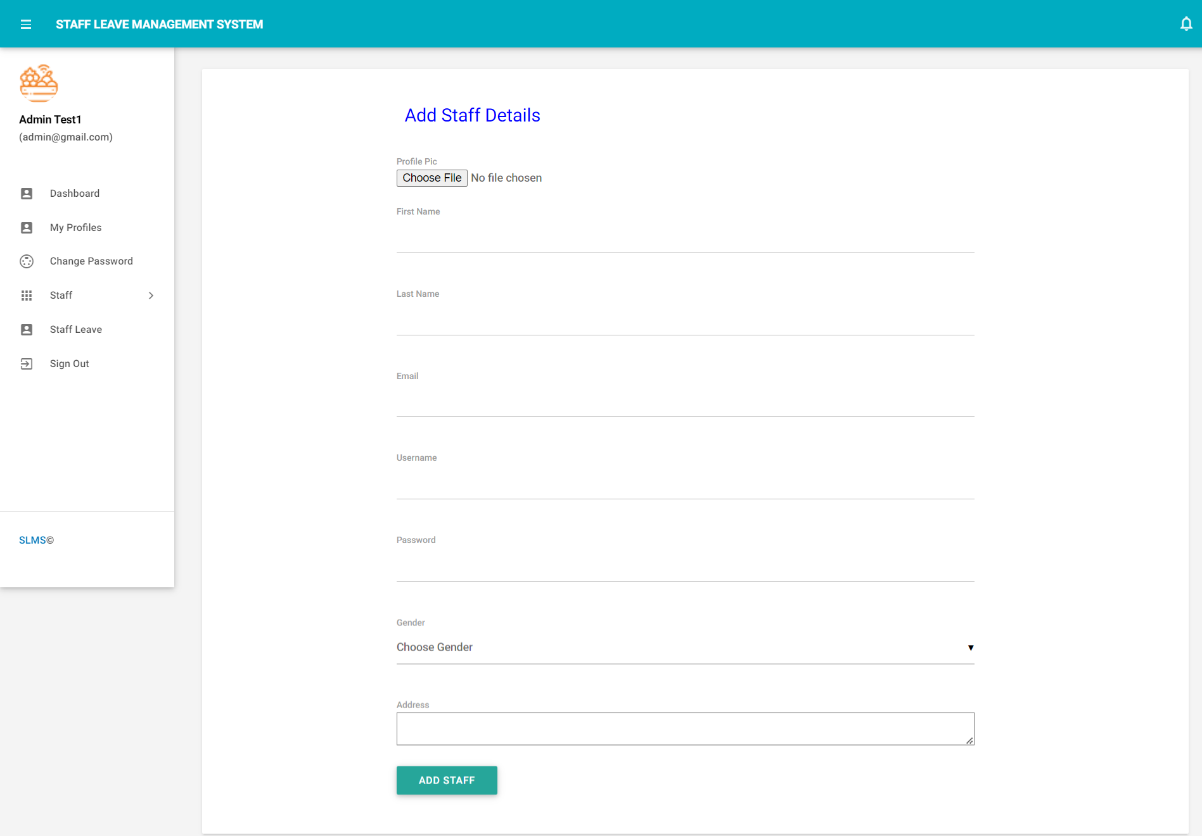

Slide 22
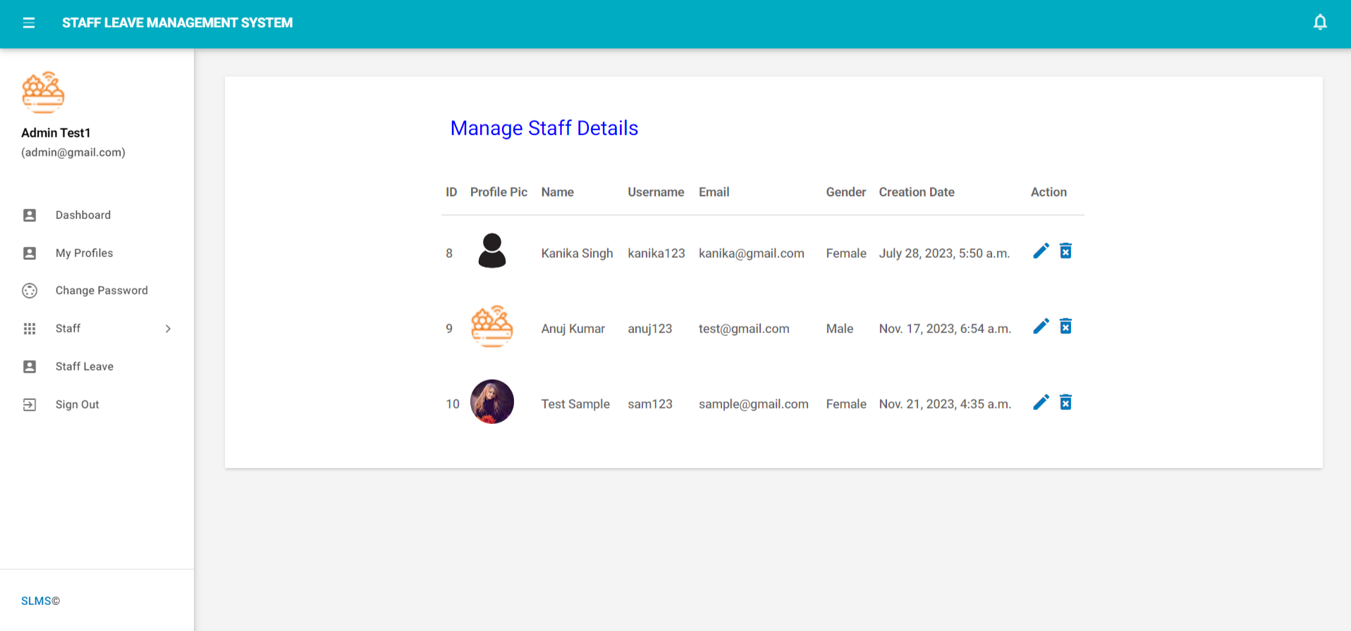
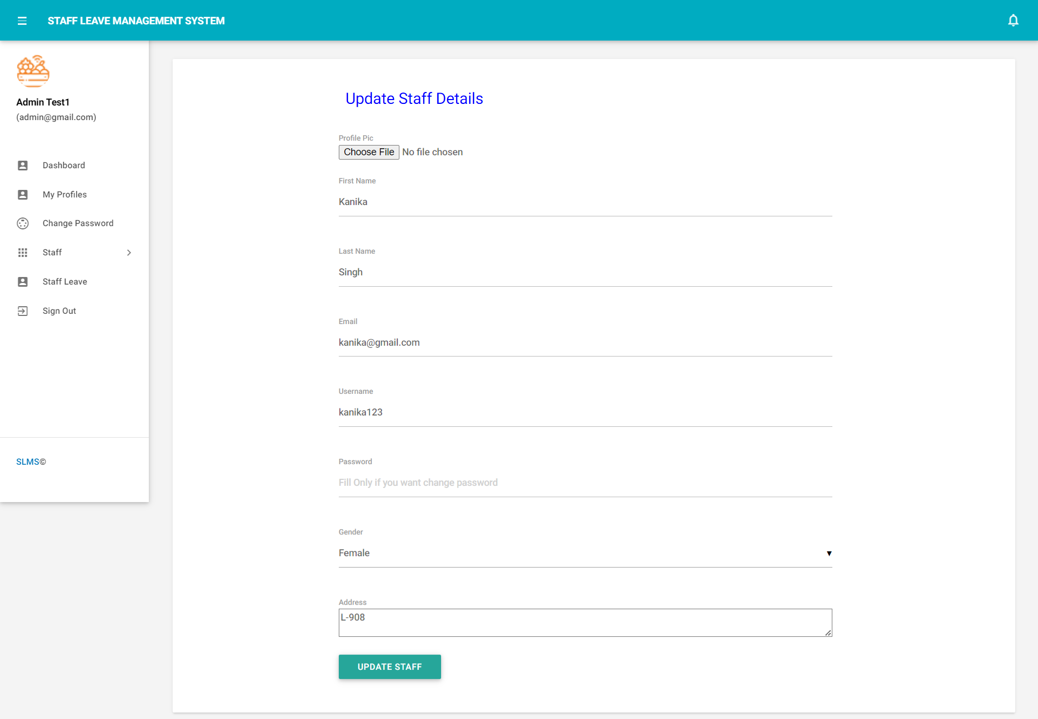

Slide 23
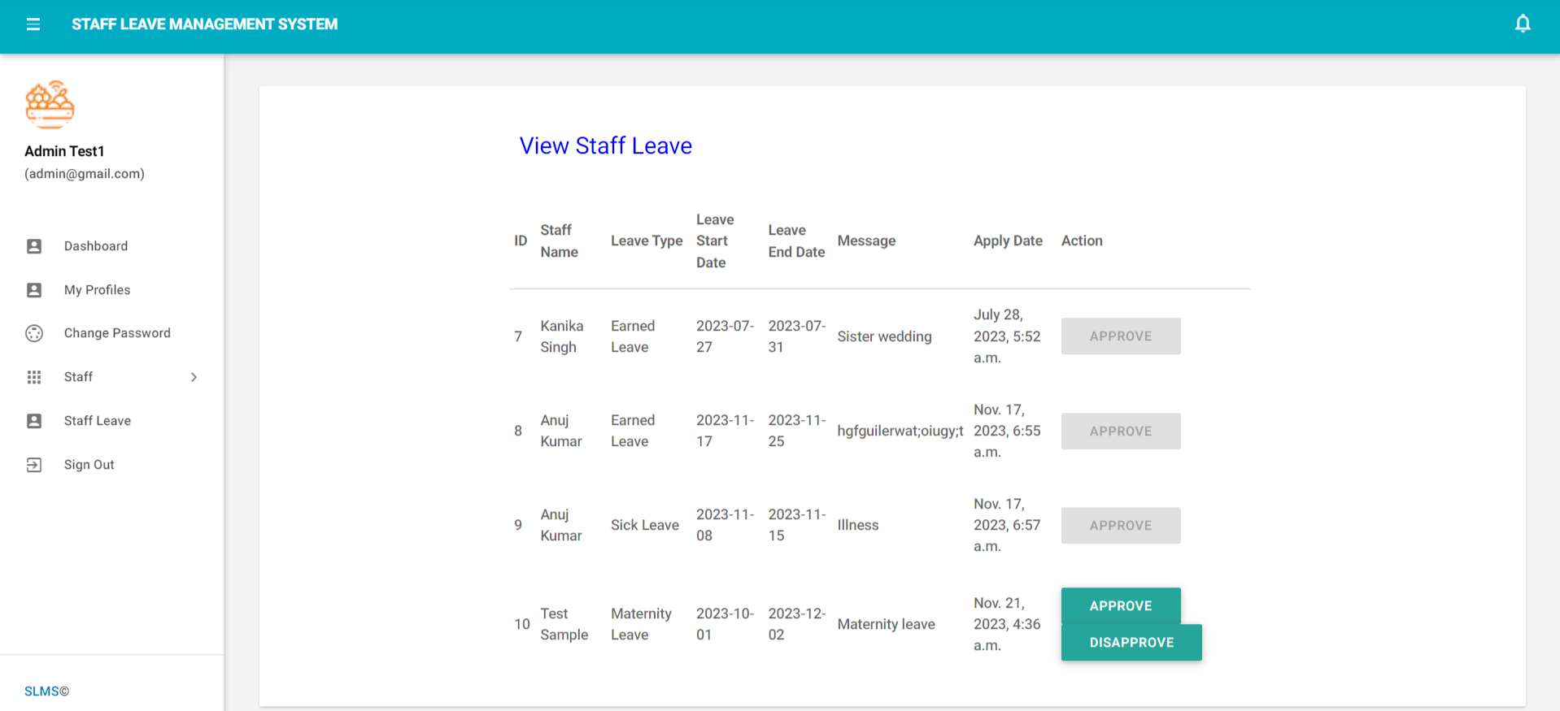
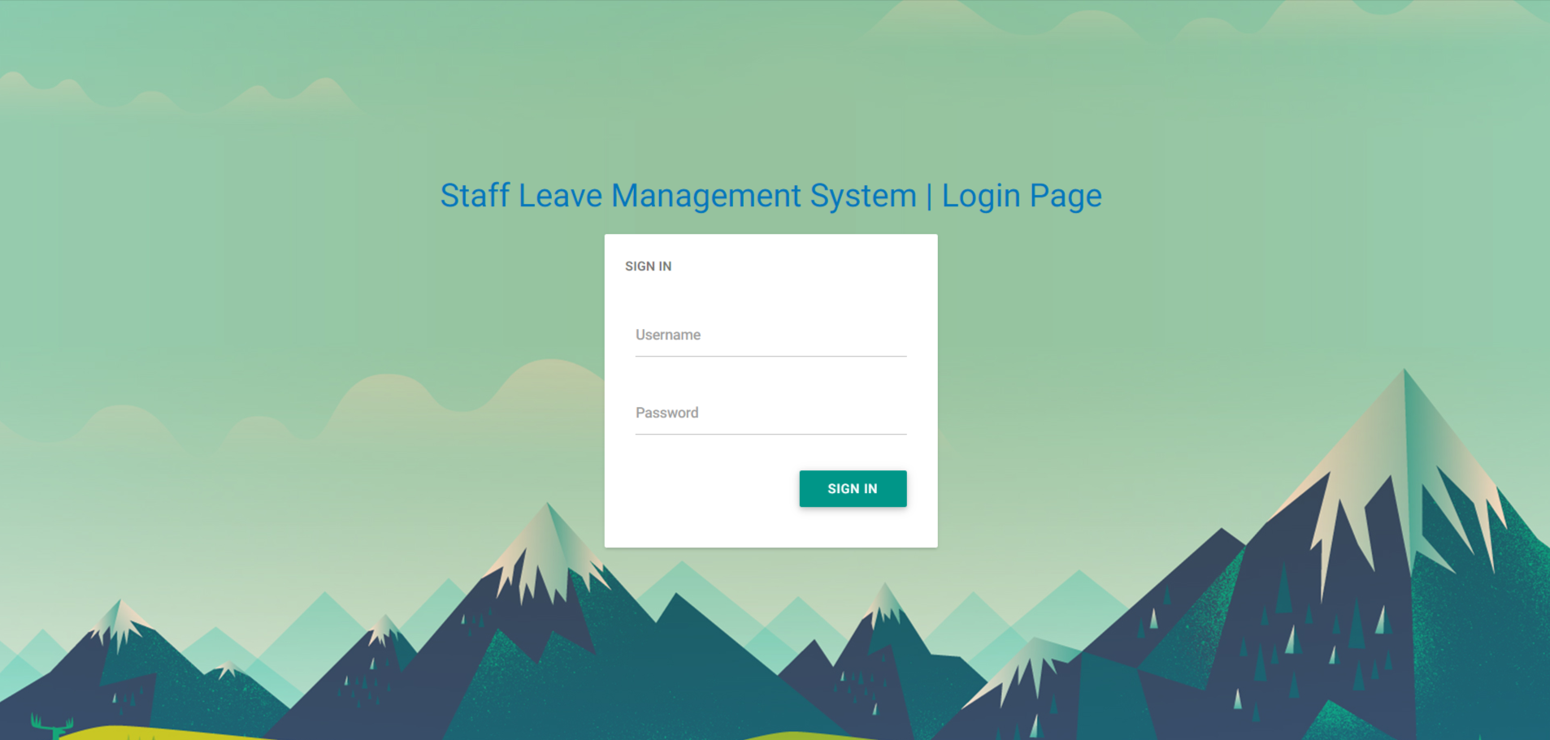

Slide 24
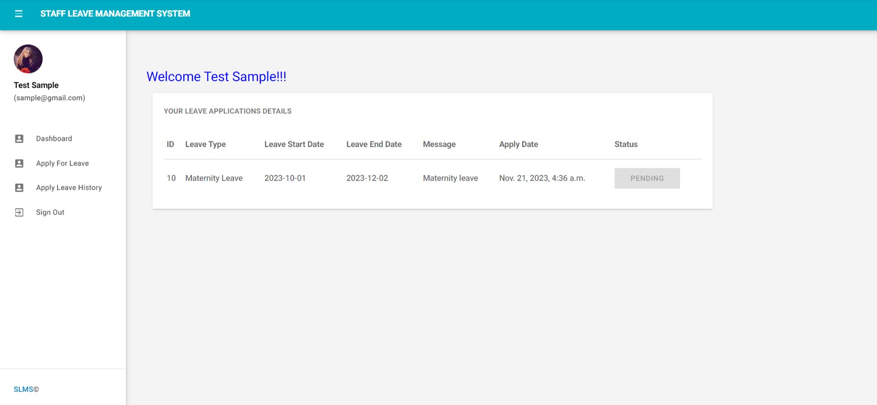
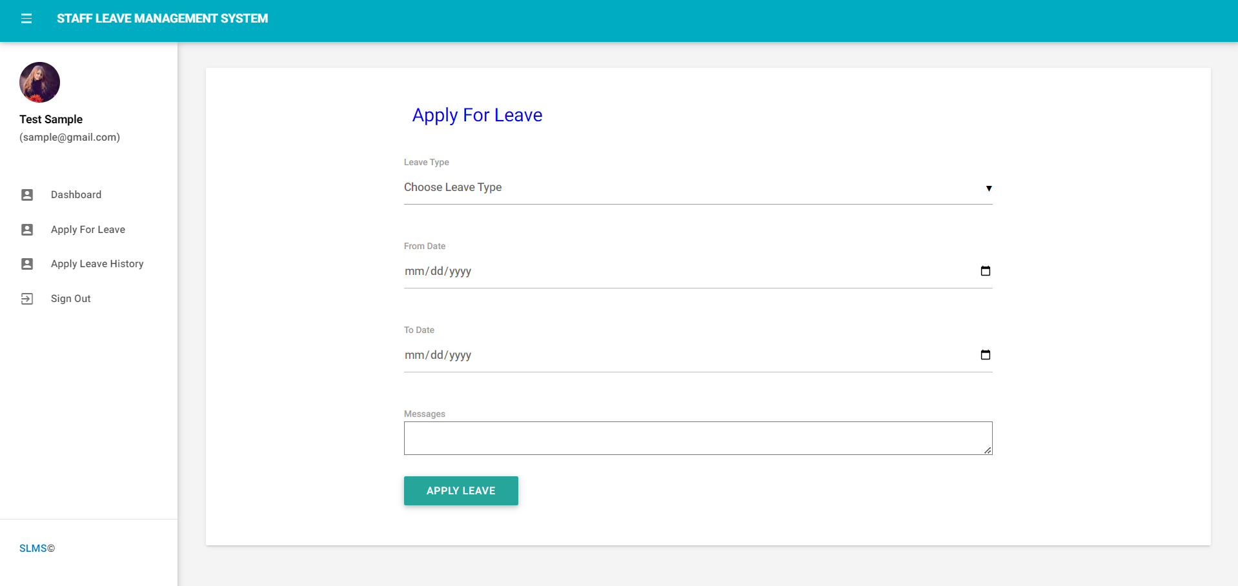

Slide 25
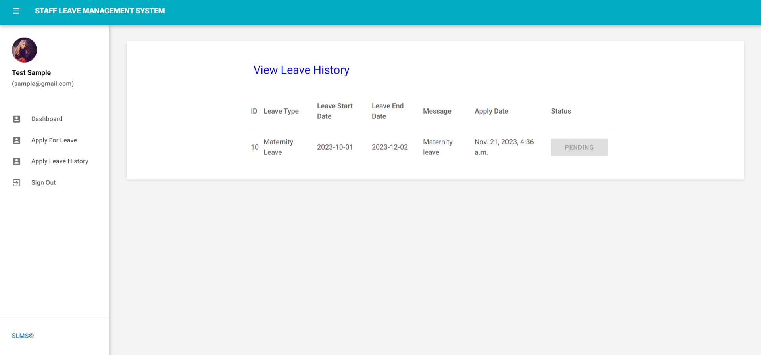

Slide 26
Conclusion
It has been a great pleasure for me to work on this exciting and challenging project. This project proved good for me as it provided practical knowledge of not only programming in Python and SQLITE web based application. It also provides knowledge about the latest technology used in developing web enabled application and client server technology that will be great demand in future. This will provide better opportunities and guidance in future in developing projects independently.
BENEFITS:
The project is identified by the merits of the system offered to the user. The merits of this project are as follows: -
It’s a web-enabled project.
This project offers user to enter the data through simple and interactive forms. This is very helpful for the client to enter the desired information through so much simplicity.
The user is mainly more concerned about the validity of the data, whatever he is entering. There are checks on every stages of any new creation, data entry or updating so that the user cannot enter the invalid data, which can create problems at later date.
Sometimes the user finds in the later stages of using project that he needs to update some of the information that he entered earlier. There are options for him by which he can update the records. Moreover there is restriction for his that he cannot change the primary data field. This keeps the validity of the data to longer extent.
User is provided the option of monitoring the records he entered earlier. He can see the desired records with the variety of options provided by him.
From every part of the project the user is provided with the links through framing so that he can go from one option of the project to other as per
the requirement. This is bound to be simple and very friendly as per the user is concerned. That is, we can say that the project is user friendly which is one of the primary concerns of any good project.

Slide 27
References
Django homepage. http://www.djangoproject.com/.
Python documentation. http://www.python.org/doc.
Django(web framework). http://en.wikipedia.org/wiki/Django.
Django documentation. http://docs.djangoproject.com.
Python(programming language). http://en.wikipedia.org/wiki/Python.
Books: Web Development with Django by Ben Shaw, Saurabh,
Django 4 By Example by Antonio Mele

Slide 28
Thank You

