Slide 1
FASTAG FRAUD DETECTION
DONE BY Mohamed bilal z h

Slide 2
TABLE OF CONTENTS
01
04
02
05
03
06
Dataset Overview
Model Building
Data Preprocessing
Model Evaluation
Exploratory Data Analysis
Conclusion

Slide 3
01
DATASET OVERVIEW

Slide 4
Dataset Name – Fastag Dataset
Source: Provided CSV file ("fastag_fraud_detection.csv")
Shape: (5000,13)
Description of Features:
Categorical: Vehicle Type, Lane Type, Vehicle Dimensions
Numerical: Transaction Amount, Amount Paid, Vehicle Speed
Target Variable: Fraud_indicator(classes: Fraud, Not Fraud)

Slide 5
02
DATASET PREPROCESSING

Slide 6
DATA PREPROCESSING TECHNIQUES
Data Preprocessing:
Label encoding for Categorical Values.
Extracting Data from Timestamp like date, month etc.
Dropping unnecessary Columns.
Handling outliers.
Handling imbalanced classes with SMOTE.
Dimensionality Reduction with PCA
Hyperparameter Tuning
Splitting Data:
Train-Test Split for model evaluation

Slide 7
03
EXPLORATORY DATA ANALYSIS

Slide 8
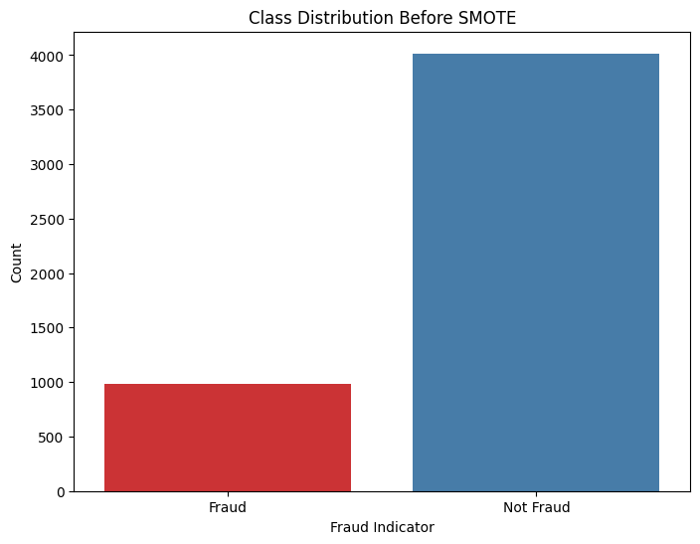
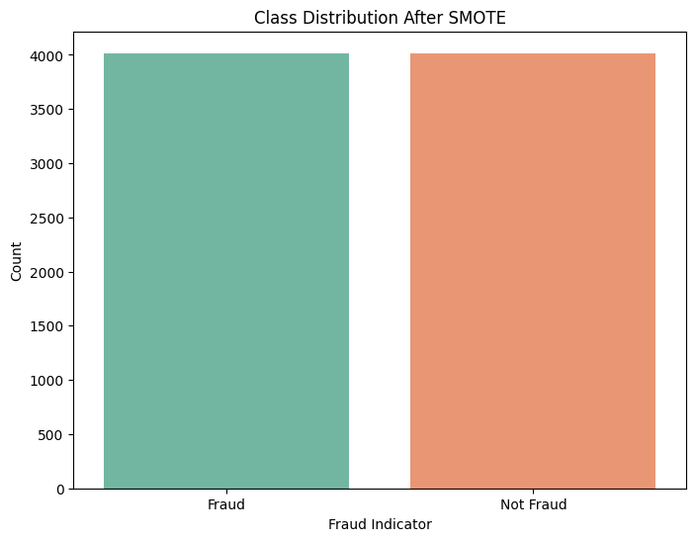
CLASS LABEL DISTRIBUTION

Slide 9
04
MODEL
BUILDING

Slide 10
MODELS USED
Extra-Trees

Slide 11
05
MODEL EVALUATION

Slide 12
EVALUATION METRICS
Accuracy
Confusion Matrix
Classification Report

Slide 13
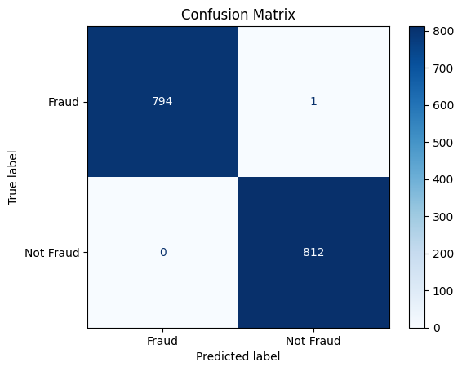
CONFUSION MATRIX

Slide 14
06
CONCLUSION

Slide 15
CONCLUSION
This project aims to develop a ML model where it handle multiple cases of the efficiently.
It had handled a series of flow where data preprocessing, analysis and other techniques and gives a model where it gives result for the real – time data.

Slide 16
THANK YOU

