Slide 1
GOLD PRICE PREDICTION
DONE BY MOHAMED BILAL Z H

Slide 2
TABLE OF CONTENTS
01
04
02
05
03
06
Dataset Overview
Model Building
Data Preprocessing
Model Evaluation
Exploratory Data Analysis
Conclusion

Slide 3
01
DATASET OVERVIEW

Slide 4
Dataset Name – Fastag Dataset
Source: Provided CSV file ("goldstock.csv")
Shape: (2511,7)
Description of Features:
Date : String_type
Numerical: Volume, Open, High, Low
Target Variable: Close ( Closing Price of the particular Day )

Slide 5
02
DATASET PREPROCESSING

Slide 6
DATA PREPROCESSING TECHNIQUES
Pre-Processing:
Identified and dropped instances with missing values and Date is split into day, month, year.
Drop Features:
Unnecessary features are dropped
Splitting Data:
Train-Test Split for model evaluation

Slide 7
03
EXPLORATORY DATA ANALYSIS

Slide 8
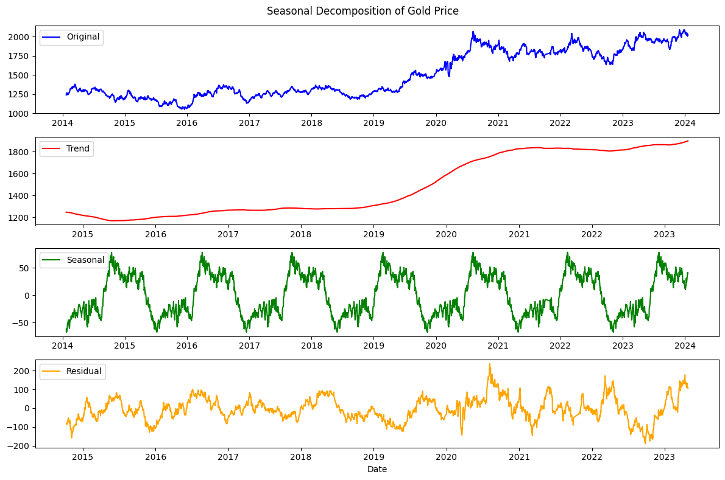
SEASONAL DECOMPOSITION

Slide 9
04
MODEL
BUILDING

Slide 10
MODELS USED
Linear Regression
Decision Tree
Random Forest
Gradient Boosting
Support Vector Machine
K-Nearest Neighbors
MLP Regressor

Slide 11
05
MODEL EVALUATION

Slide 12
EVALUATION METRICS
Mean Squared Error
Mean Absolute Error
R-Squared Error

Slide 13
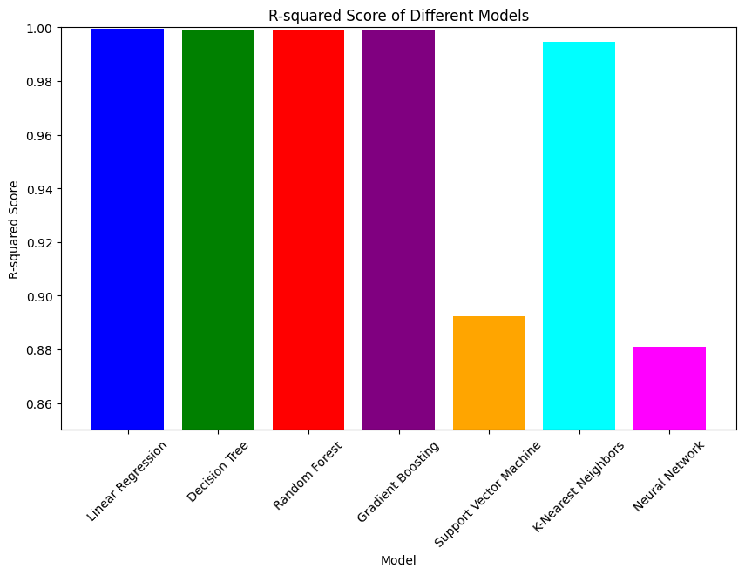
R2_SCORE

Slide 14
06
CONCLUSION

Slide 15
CONCLUSION
This aimed to develop a robust machine learning model for identifying Time-series prediction for Gold Price Prediction.
The project successfully addressed key objectives, including data exploration, data preprocessing, model development, real-time Gold Price Prediction.

Slide 16
THANK YOU

