Slide 1


A comparative study of Regression algorithms on House Sales Price Prediction
PRESENTED BY :
GUIDED BY :
Z.H. Mohamed Bilal
G. Sukesh
S. Yokeswaran
Dr.K.S. Kalaivani
Dr.C.S. Kanimozhi Selvi

Slide 2
Outline
Problem Statement
Objectives
Introduction
Literature Survey
Methodology
Performance Evaluation
Conclusion
References

Slide 3
Problem Statement
Sales of homes have been rising with shifting prices ever since the population has grown. As a result, housing is in high demand worldwide.
Numerous factors, including the house's location, construction year, and amenities nearby, affect the price of the home.
Currently, it is decided by House Price Index (HPI) however researches proven that merely determining the price of the house by HPI in this 21st century is not enough.

Slide 4
Objectives
Machine learning algorithms must be used in order to forecast the sale price of the home.
Since, the target variable is a numerical value i.e. Sale Price we can use regression type algorithms.
In this, we are going to use
1. Linear Regression
2. Random Forest
3. Gradient Boosting
4. Extra-Trees

Slide 5
Introduction
House prices have a big impact on the economy, and clients and real estate agents are quite concerned about their price ranges.
Every year, housing prices rise, which ultimately highlights the necessity for a method or plan that could forecast future home price increases.
Some elements, such as physical conditions, locations, the number of bedrooms, and others, have an impact on home values.
Research has demonstrated that it is ineffective to predict the price of a house using conventional approaches.

Slide 6
Literature Survey
S.NO | TITLE OF THE PAPER | NAME OF THE AUTHORS | ALGORITHM USED
1. | House Price Prediction using Random Forest Machine Learning Technique | Abigail Bola Adetunji, Oluwatobi Noah Akande, Funmilola Alaba Ajala, Ololade Oyewo, Yetunde Faith Akande, Gbenle Oluwadara | Random Forests
2. | Nonlinear Rail Accessibility and Road Spatial Pattern Effects on House Prices | Kaida Chen, Hanliang Lin , Lingyun Liao ,Yichen Lu , Yen-Jong Chen , Zehua Lin , Linxi Teng ,Aifang Weng and Tianqi Fu | Space Syntax Analysis, Linear Regression Model, Spatial Regression Model, OLS Regression
3. | A Comparative Study of Machine Learning and Spatial Interpolation Methods for Predicting House Prices | Jeonghyeon Kim, Youngho Lee, Myeong-Hun Lee and Seong-Yun Hong] | Neural Networks, Random forests, IDW, and kriging
4. | Prediction of House Price Using XGBoost Regression Algorithm | J.Avanijaa, Gurram Sunitha b, K.Reddy Madhavi c , Padmavathi Korad, and R.Hitesh Sai Vittale | XGBoost Regression; Gradient Boost; Ensemble Learning

Slide 7
Methodology
The dataset used for this process has been downloaded from Kaggle. It contains 1460 rows × 81 columns
Dataset Link :
https://www.kaggle.com/competitions/house-prices-advanced-regression-techniques/data
Data Pre-processing
The dataset has been preprocessed using a label encoder because it includes both categories and null values.
For the null values like NaN and none, it has been replaced with a numerical number.
Data Analysis
Selected the top 30 features that have the most effects on the target variable out of the dataset's 81 features and present their relationship. It contributes a total of 0.712754 importance to the dataset.

Slide 8
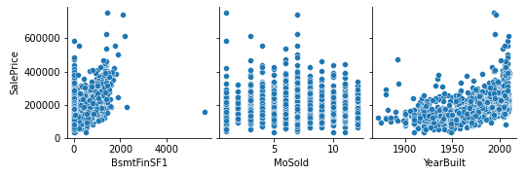
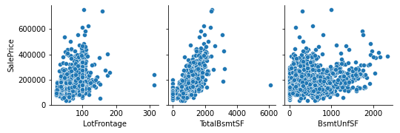
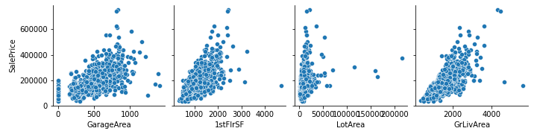
Fig1. Data Analysis
The aforementioned figures can be used to determine the relationship between the features and the target variable.

Slide 9
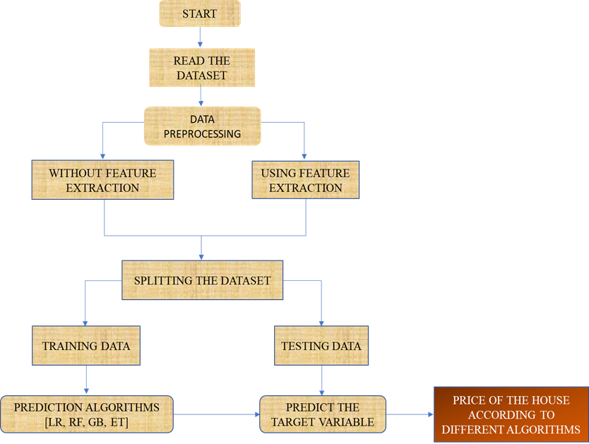
3. Proposed Model
Linear regression, Random Forest, Gradient Boosting, Extra-Trees with and without feature extraction, and model comparison will be evaluated.

Slide 10
Performance Evaluation
To compare our actual and predicted values, R² score, Mean Absolute Error, Root Mean Squared Error, Median Absolute Percentage Error of each model, and choose the one that performs the best using 4 different models, each without feature extraction and each utilizing feature extraction.
Linear Regression
A linear method for simulating the relationship between a scalar response and one or more explanatory variables is linear regression.
Random Forest
An ensemble learning technique for classification, regression, and other problems, random forests or random decision forests build a large number of decision trees during the training phase.

Slide 11
3. Gradient Boosting
A machine learning method called gradient boosting is used, among other things, for classification and regression tasks. It provides a prediction model in the form of an ensemble of decision trees-like weak prediction models.
Extra-Tree
The Extra-Tree approach, short for "extremely randomized trees," aims to further randomize tree construction in the setting of numerical input features, where the selection of the best cut-point determines a significant percentage of the variance of the induced tree.
Now, evaluate the algorithm for both using feature extraction and without feature extraction.

Slide 12
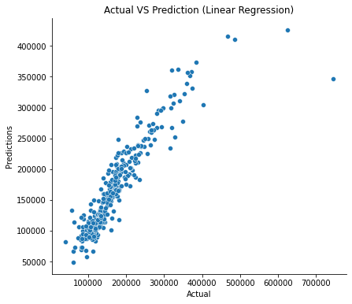
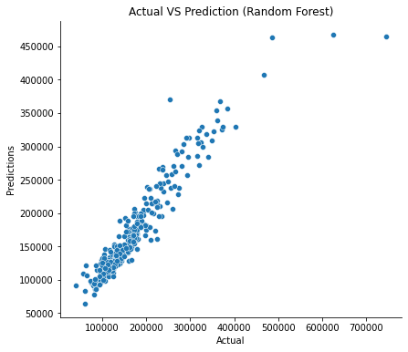
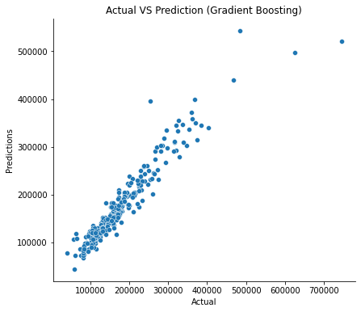
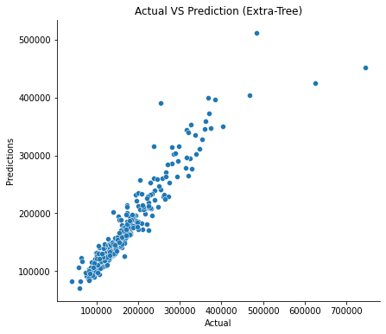
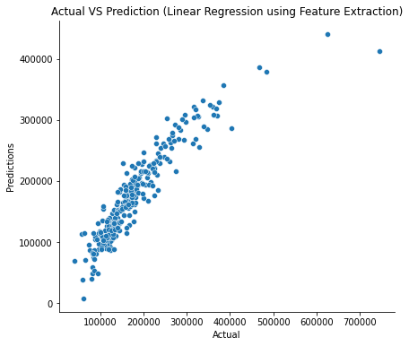
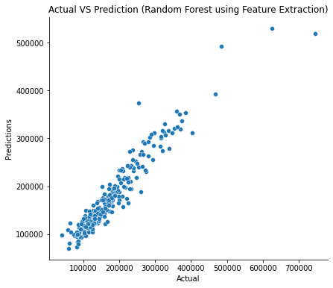
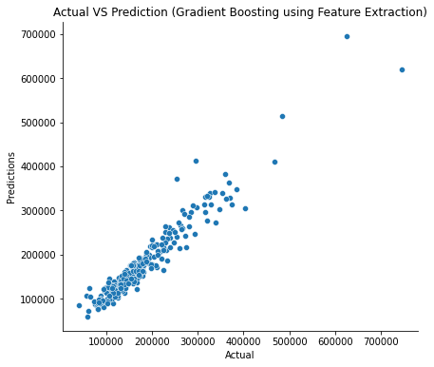
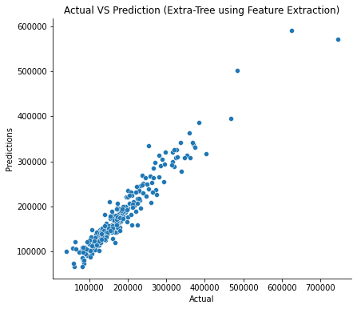
Fig 2. Models without Feature Extraction (ACTUAL Vs PREDICTED)
Fig 3. Models using Feature Extraction (ACTUAL Vs PREDICTED)

Slide 13
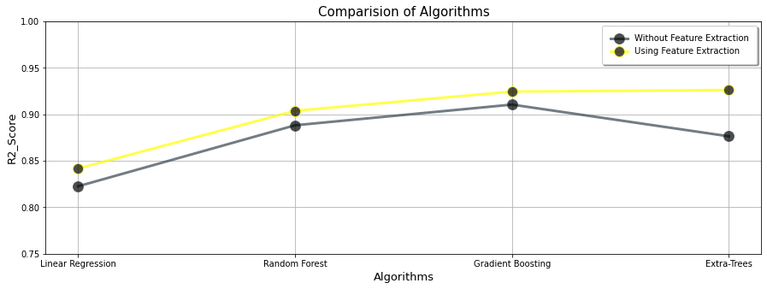
As seen in Fig. 2 and 3, both Random Forest and Extra-Tree produce correct results when employing both Feature Extraction and without it.
Fig 4. Comparison between R² score of the algorithms.

Slide 14
ALGORITHM NAME WHICH IS USED | ERROR METRICS
 | R² SCORE | MAE | RMSE | MDAPE
Linear Regression | 0.8226 | 19707.30 | 35566.38 | 8.11
Random Forest | 0.8882 | 16446.20 | 28232.84 | 6.63
Gradient Boosting | 0.9104 | 15282.86 | 25268.41 | 6.57
Extra-Trees | 0.8763 | 16254.55 | 29695.29 | 6.30
Linear Regression [Using Feature Extraction] | 0.8417 | 19805.50 | 33591.31 | 8.44
Random Forest [Using Feature Extraction] | 0.9038 | 16409.94 | 26190.97 | 6.45
Gradient Boosting [Using Feature Extraction] | 0.9244 | 15289.42 | 23206.63 | 6.77
Extra-Tree [Using Feature Extraction] | 0.9261 | 15107.62 | 22944.64 | 6.11
Table 1. Error Metrics of various Algorithm used

Slide 15
Conclusion
In order to calculate the cost of the house, plot the Actual Vs Predicted values on a graph, and illustrate how they relate to one another, machine learning models has been deployed. Additionally, calculated the R² score , Mean Absolute Error, Root Mean Squared Error, Median Absolute Percentage Error of the models.
From Table 1, we can conclude that Extra-Trees [Using Feature Extraction] is the best model and suitable for the House Price Prediction Problems.
Google Colab Link :
https://colab.research.google.com/drive/1wk5u525BKpB_1EqcAGYPA7YGl8skny6E?usp=sharing

Slide 16
References
1. Adetunji, Abigail Bola, et al. "House Price Prediction using Random Forest Machine Learning Technique." Procedia Computer Science 199 (2022): 806-813.
2. Rico-Juan, Juan Ramón, and Paloma Taltavull de La Paz. "Machine learning with explainability or spatial hedonics tools? An analysis of the asking prices in the housing market in Alicante, Spain." Expert Systems with Applications 171 (2021): 114590.
3. Truong, Quang, et al. "Housing price prediction via improved machine learning techniques." Procedia Computer Science 174 (2020): 433-442.
4. Foryś, Iwona. "Machine learning in house price analysis: regression models versus neural networks." Procedia Computer Science 207 (2022): 435-445.
5. Xu, Xiaojie, and Yun Zhang. "House price forecasting with neural networks." Intelligent Systems with Applications 12 (2021): 200052.
6. Jain, Mansi, et al. "Prediction of house pricing using machine learning with Python." 2020 International Conference on Electronics and Sustainable Communication Systems (ICESC). IEEE, 2020.
7. Ahtesham, Maida, Narmeen Zakaria Bawany, and Kiran Fatima. "House price prediction using machine learning algorithm-the case of Karachi city, Pakistan." 2020 21st International Arab Conference on Information Technology (ACIT). IEEE, 2020.
8. Almaslukh, Bandar. "A Gradient Boosting Method for Effective Prediction of Housing Prices in Complex Real Estate Systems." 2020 International Conference on Technologies and Applications of Artificial Intelligence (TAAI). IEEE, 2020.

Slide 17
9. Wang, Pei-Ying, et al. "Deep learning model for house price prediction using heterogeneous data analysis along with joint self-attention mechanism." IEEE Access 9 (2021): 55244-55259.
10. Durganjali, P., and M. Vani Pujitha. "House resale price prediction using classification algorithms." 2019 International Conference on Smart Structures and Systems (ICSSS). IEEE, 2019.
11. Manasa, J., Radha Gupta, and N. S. Narahari. "Machine learning based predicting house prices using regression techniques." 2020 2nd International conference on innovative mechanisms for industry applications (ICIMIA). IEEE, 2020.
12. Piao, Yong, Ansheng Chen, and Zhendong Shang. "Housing price prediction based on cnn." 2019 9th international conference on information science and technology (ICIST). IEEE, 2019.
13. Wang, J. J., et al. "Predicting house price with a memristor-based artificial neural network." IEEE Access 6 (2018): 16523-16528.
14. Rana, Vivek Singh, et al. "House Price Prediction Using Optimal Regression Techniques." 2020 2nd International Conference on Advances in Computing, Communication Control and Networking (ICACCCN). IEEE, 2020.
15. Varma, Ayush, et al. "House price prediction using machine learning and neural networks." 2018 second international conference on inventive communication and computational technologies (ICICCT). IEEE, 2018.
16. Varma, Ayush, et al. "House price prediction using machine learning and neural networks." 2018 second international conference on inventive communication and computational technologies (ICICCT). IEEE, 2018.

