Slide 1
Earnings and age in urban Sindh
ECO346 Assignment 1 · FA24-BEDS-051 · Section A
Variant 3
Sindh urban
2,644 earners
51 = 6 × 8 + 3
prov 3, area 2
ages 15–64, earnings > 0
Source: PSLM 2019–20. All statistics weighted by hhweight.

Slide 2
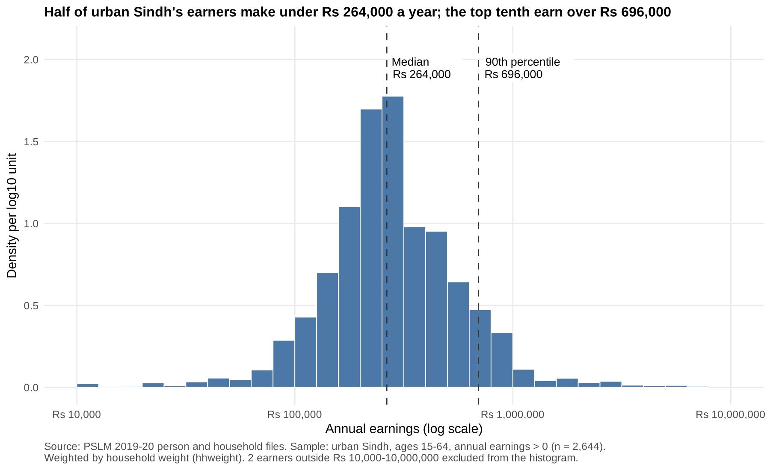
Half earn under Rs 264,000; the top tenth over Rs 696,000
Rs 264,000
weighted median
Rs 252,000
unweighted median
5.80
P90 / P10 ratio

Slide 3
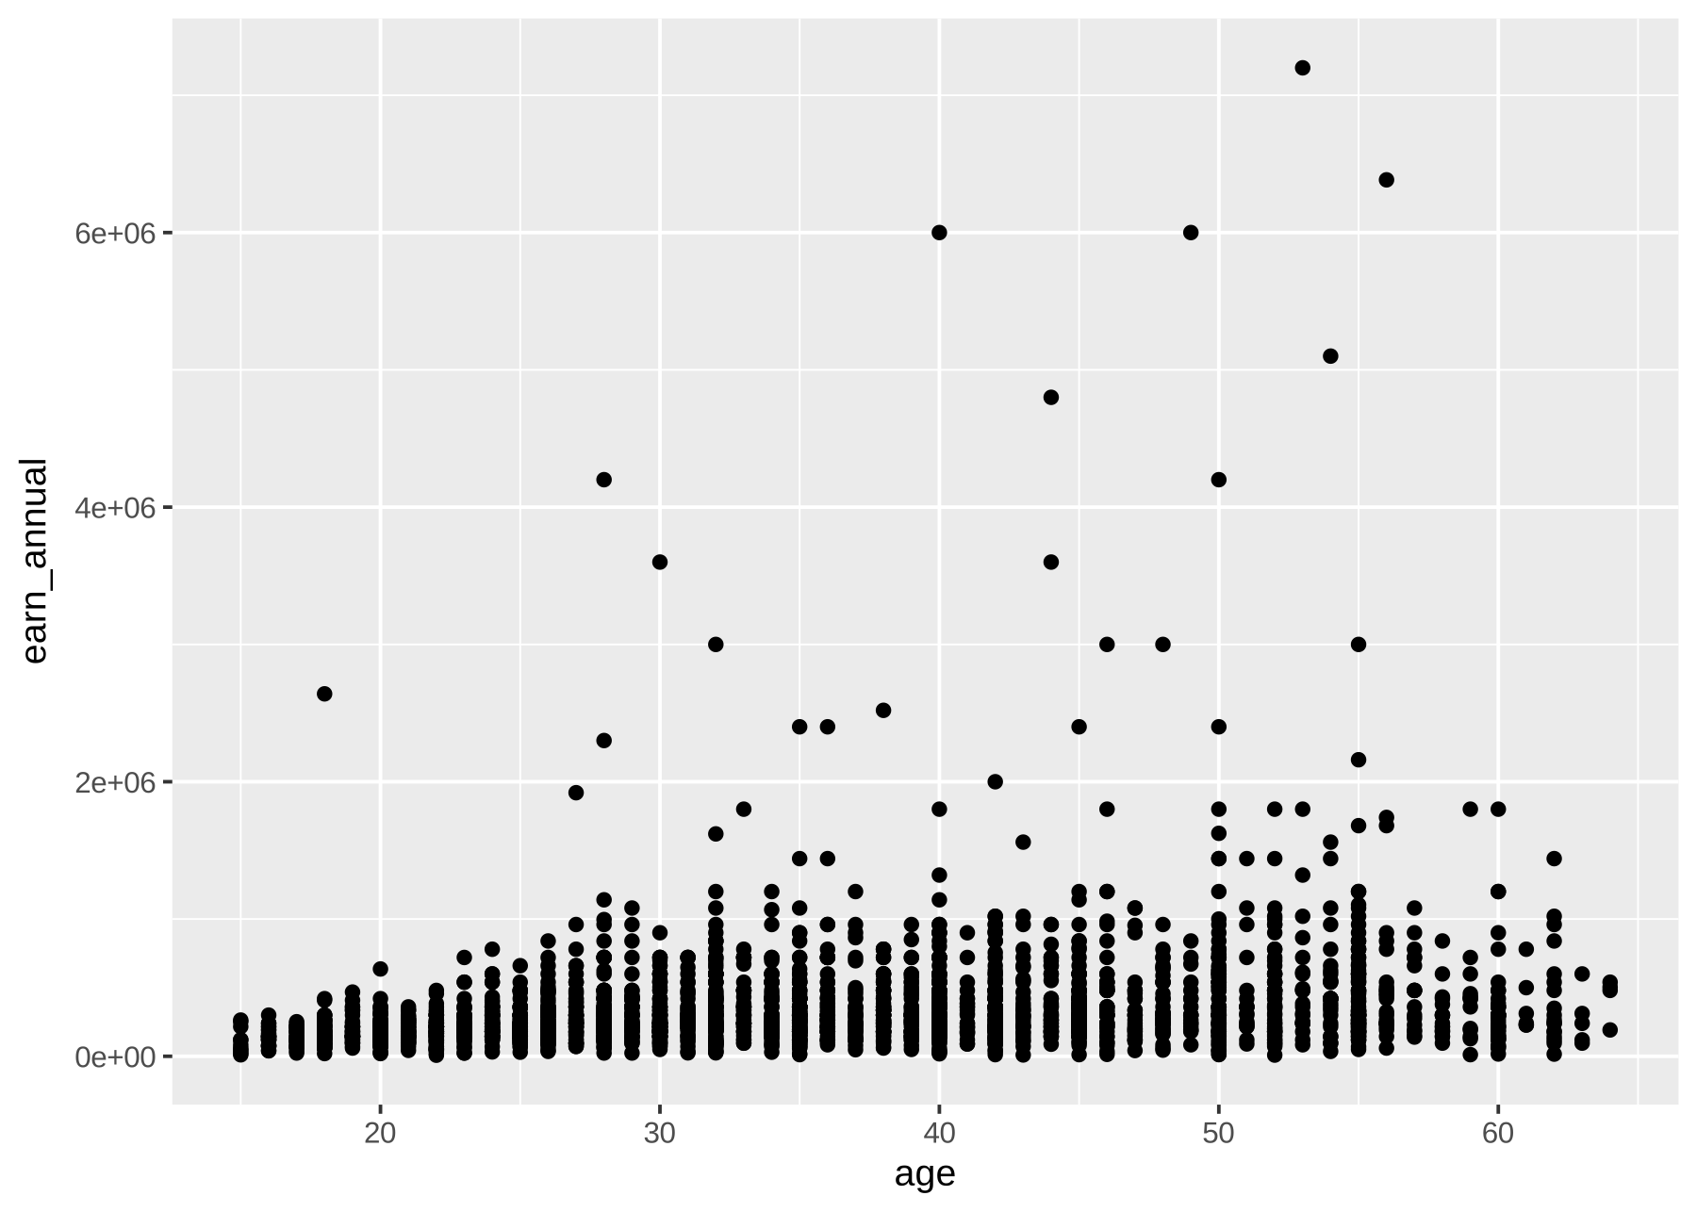
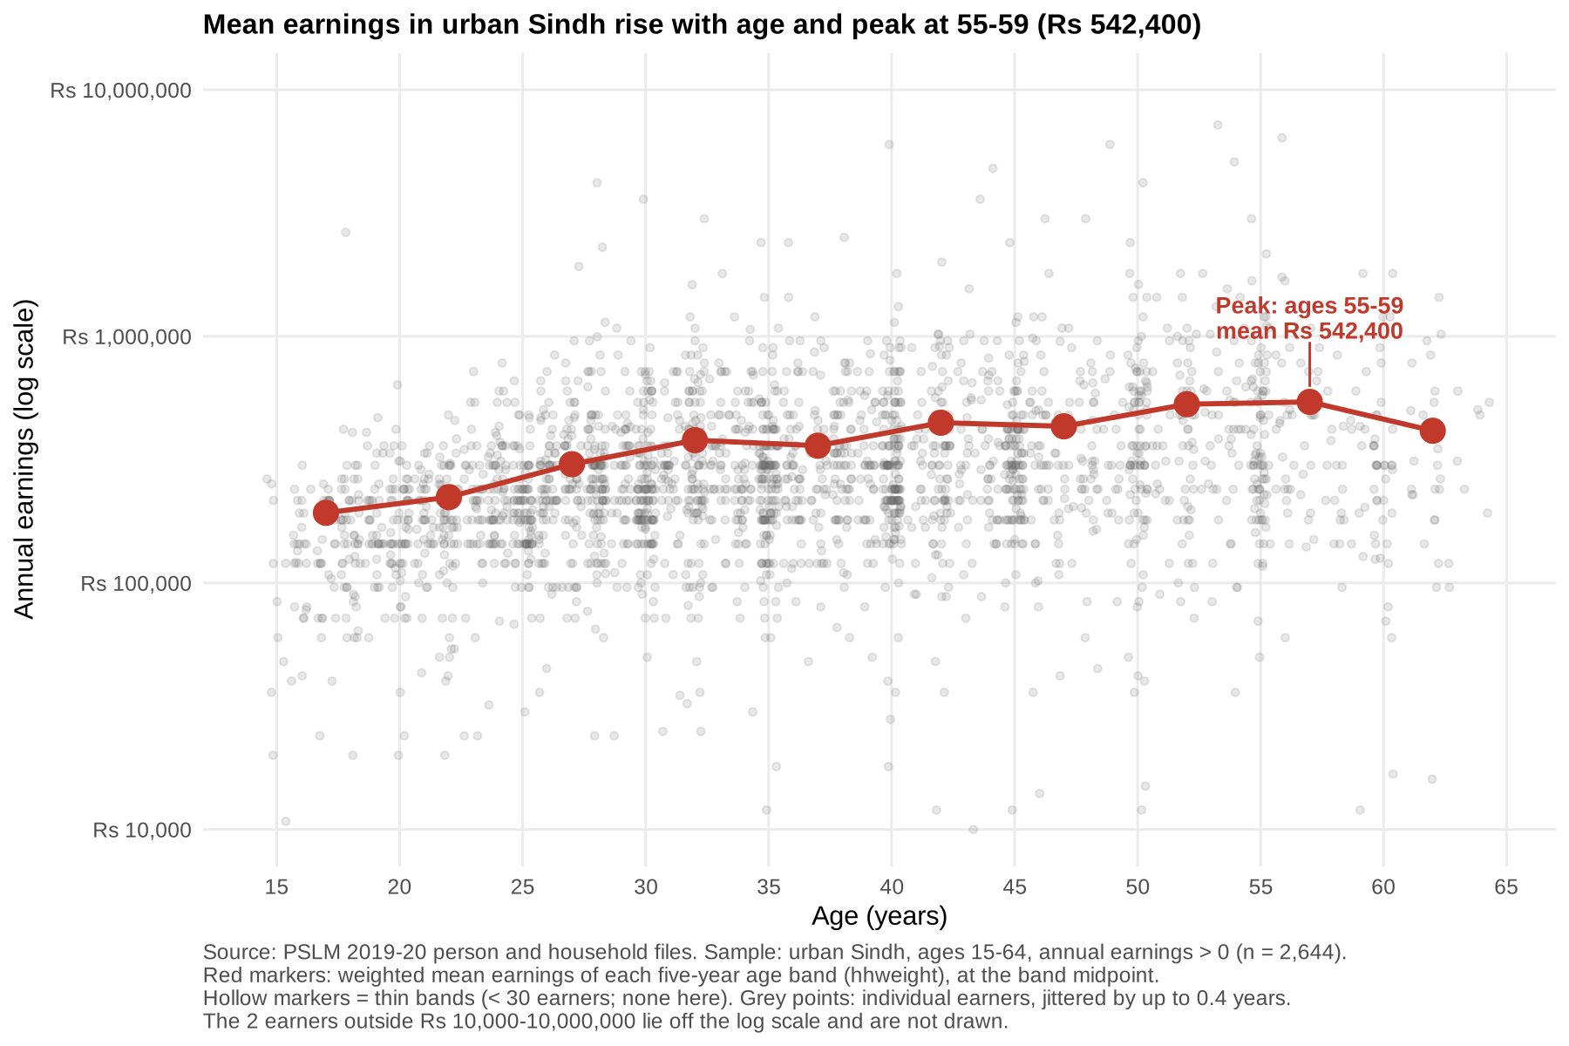
The makeover: from R defaults to a readable age profile
Before: default
After: redesign
Log scale spreads the squashed mass · Jitter + alpha 0.15 fix overplotting · Weighted band means show the profile

Slide 4
Key finding: earnings almost triple from the teens to the late 50s
Rs 192,523
ages 15–19
Rs 303,154
ages 25–29
Rs 542,400
ages 55–59 (peak)
Cross-section only: each band is a different cohort, so this is not one worker’s career path.

