Slide 1
Implementation of simple packet sniffer and os fingerprinting tool
Syed Hamza Alee (CS-306)
Bilal shamim (cs-307)

Slide 2
What is a packet sniffing and os fingerprinting?
Packet sniffing: an act of capturing packets of data flowing across a computer network. The software or device used to do this is called a packet sniffer
OS Fingerprinting: a process of determining the operating system used by a host on a network. There are two techniques for it, active and passive fingerprinting. Active fingerprinting is the process of transmitting packets to a remote host and analyzing corresponding replies. Passive fingerprinting is the process of analyzing packets from a host on a network. In this case, fingerprinting tool acts as a sniffer and doesn't put any traffic on a network.

Slide 3
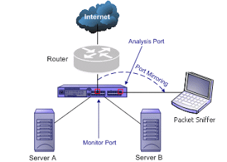
Simple Network Diagram

Slide 4
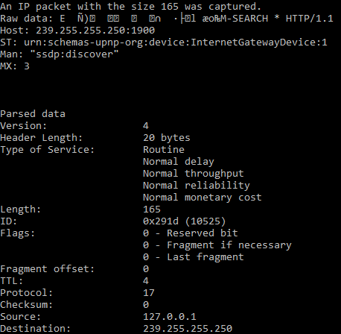
Output
This output is linked with the parsing of captured IP packet. The packet is later unpacked and the main fields of the IP header is displayed into human readable form.
For the Operating system fingerprinting, TTL value and the Window Size is considered which is obtained from TCP packet. However, the technique applied for this purpose is passive fingerprinting which s limited in terms of accuracy.

Slide 5
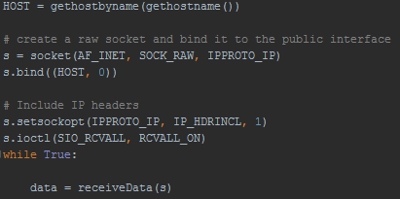
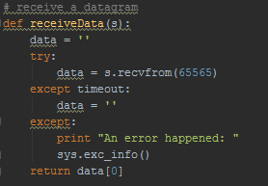
Configuration
The connection is first made by the creation of raw socket which is then bound to the public interface.
After the connection, we receive the datagram with size equals to 65565 (maximum size). This data is later passed to unpacking functions and is parsed to convert it into human readable form

Slide 6
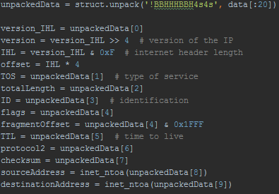
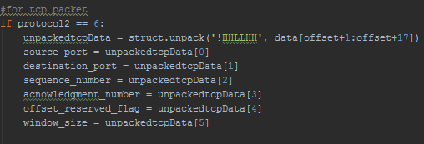
Configuration
The received data is unpacked using struct.unpack function and elements of that unpacked data is stored in the respective variables of fields. The output is later displayed with clear description.
If the protocol present in the IP header is for TCP (value 6), we will unpack the rest of the received data according to TCP header format till our desired field(Window size) is obtained. Both of the TTL and windows size are to be later used for determining Operating system.

Slide 7
Conclusion
Packet sniffers are serious elements under consideration for network security. This is because it can detect clear text passwords or username or any other sensitive information. The good practice is to encrypt data communications since sniffing can take place on both switched and non-switched networks.

