Slide 1
Threads
Course Instructor: Threads

Slide 2
Process Concept
Classically, processes are executed programs that have ...
Resource Ownership
Process includes a virtual address space to hold the process image
Operating system prevents unwanted interference between processes
Scheduling/Execution
Process follows an execution path that may be interleaved with other processes
Process has an execution state (Running, Ready, etc.) and a dispatching priority and is scheduled and dispatched by the operating system
Today, the unit of dispatching is referred to as a thread or lightweight process
The unit of resource ownership remains the process or task
2

Slide 3
Control Blocks
Information associated with each process: Process Control Block
Memory management information
Accounting information
Information associated with each thread: Thread Control Block
Program counter
CPU registers
CPU scheduling information
Pending I/O information
3

Slide 4
Control Blocks
Process ID (PID)
Parent PID
…
Next Process Block
PCB
List of open ﬁles
Handle Table
Image File Name
Thread Control Block (TCB)
List of Thread Control Blocks
…
Next TCB
Program Counter
Registers
…
0

Slide 5
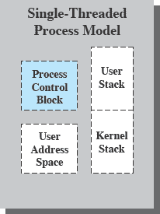
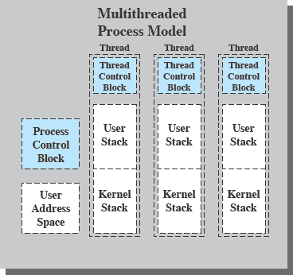
Single & Multithreading Process
Each thread has
An execution state (Running, Ready, etc.)
Saved thread context when not running
An execution stack
Some per-thread static storage for local variables
Access to the memory and resources of its process (all threads of a process share this)
Suspending a process involves suspending all threads of the process
Termination of a process terminates all threads within the process
6
PT / FF 2014

Slide 6
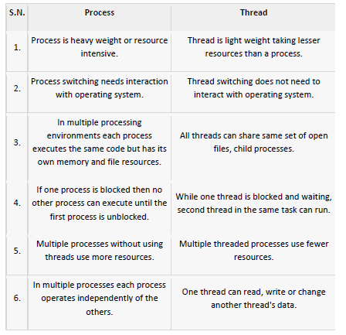
Process Vs. Threads

Slide 7

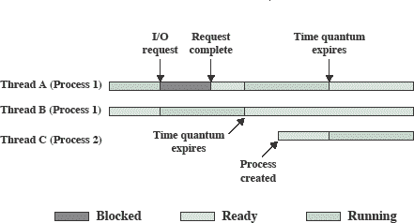
Why Multithreading
Advantages
Better responsiveness - dedicated threads for handling user events
Simpler resource sharing - all threads in a process share same address space
Utilization of multiple cores
for parallel execution
Faster creation and termination of activities
Disadvantages
Coordinated termination
Signal and error handling
Reentrant vs. non-reentrant system calls: reentrant if it can be interrupted in the middle of its execution, and then be safely called again

Slide 8
Thread States
The typical states for a thread are running, ready, blocked
Typical thread operations associated with a change in thread state are:
Spawn: a thread within a process may spawn another thread
Provides instruction pointer and arguments for the new thread
New thread gets its own register context and stack space
Block: a thread needs to wait for an event
Saving its user registers, program counter, and stack pointers
Unblock: When the event for which a thread is blocked occurs
Finish: When a thread completes, its register context and stacks are deallocated.

Slide 9
Thread Dispatching
Thread T₁
Interrupt or system call
Thread T₂
executing
Save state into TCB₁
ready or waiting
Reload state from TCB₂
Interrupt or system call
ready or waiting
executing
Save state into TCB₂
Reload state from TCB₁
ready or waiting
executing

Slide 10
Threads
Threads specific
Attributes….
Threads share….
Global memory
Process ID and parent process ID
Controlling terminal
Process credentials (user )
Open file information
Timers
………
Thread ID
Thread specific data
CPU affinity
Stack (local variables and function call linkage information)
……

Slide 11
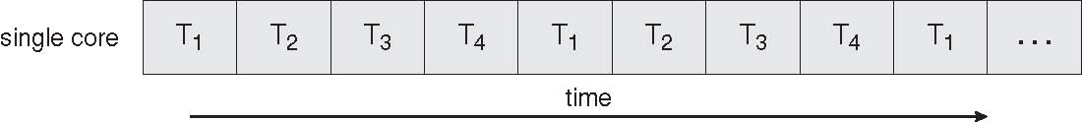
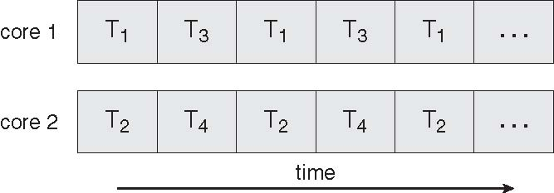
Concurrent Execution on a Single-core System
Multicore Programming
Parallel Execution on a Multicore System

Slide 12
Multicore Programming
Multicore systems putting pressure on programmers, challenges include
Dividing activities
What tasks can be separated to run on different processors
Balance
Balance work on all processors
Data splitting
Separate data to run with the tasks
Data dependency
Watch for dependences between tasks
Testing and debugging
Harder!!!!

Slide 13
Types of Parallelism
Data Parallelism: focus on distributing data across different parallel computing nodes
Task Parallelism: focus on distributing execution processes(threads) across different parallel computing nodes

Slide 14
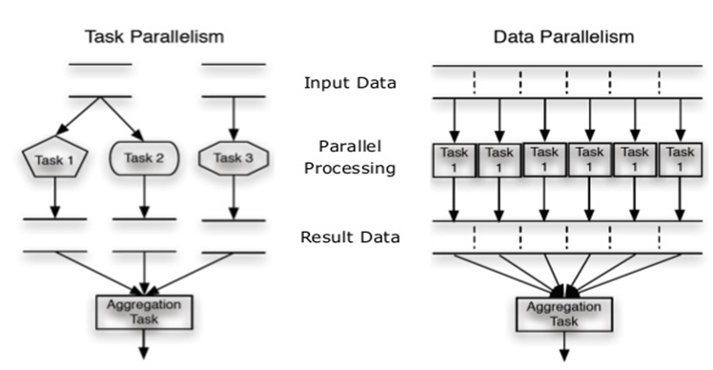
Types of Parallelism

Slide 15
Data vs. Task Parallelism
Data Parallelism | Task Parallelism
Same operations are performed on different subsets of same data. | Different operations are performed on the same or different data.
Synchronous computation | Asynchronous computation
Speedup is more as there is only one execution thread operating on all sets of data. | Speedup is less as each processor will execute a different thread or process on the same or different set of data.
Amount of parallelization is proportional to the input data size. | Amount of parallelization is proportional to the number of independent tasks to be performed
Designed for optimum load balance on multi processor system. | Load balancing depends on the availability of the hardware and scheduling algorithms like static and dynamic scheduling.

Slide 16

Amdahl’s Law
gives the theoretical speedup in latency of the execution of a task at fixed workload that can be expected of a system whose resources are improved
Where S = portion of program executed serially
N = Processing Cores

Slide 17
Amdahl’s Law Example
we have an application that is 75 percent parallel and 25 percent serial. If we run this application on a system with two processing
cores?
S=25%=0.25, N= 2
If we add two additional cores , calculate speedup?

Slide 18
Multithreading Models
Support provided at either
User level -> user threads
Supported above the kernel and managed without kernel support
Kernel level -> kernel threads
Supported and managed directly by the operating system
What is the relationship between user and kernel threads?

Slide 19
User Threads
Thread management done by user-level threads library
Three primary thread libraries:
POSIX Pthreads
Win32 threads
Java threads

Slide 20
Kernel Threads
Supported by the Kernel
Examples
Windows XP/2000
Solaris
Linux
Tru64 UNIX
Mac OS X

Slide 21
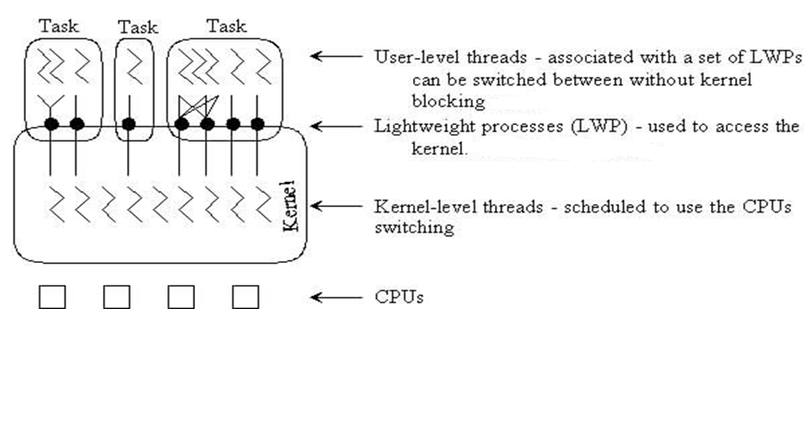
User vs. Kernel Thread

Slide 22
Multithreading Models
User Thread – to - Kernel Thread
Many-to-One
One-to-One
Many-to-Many

Slide 23
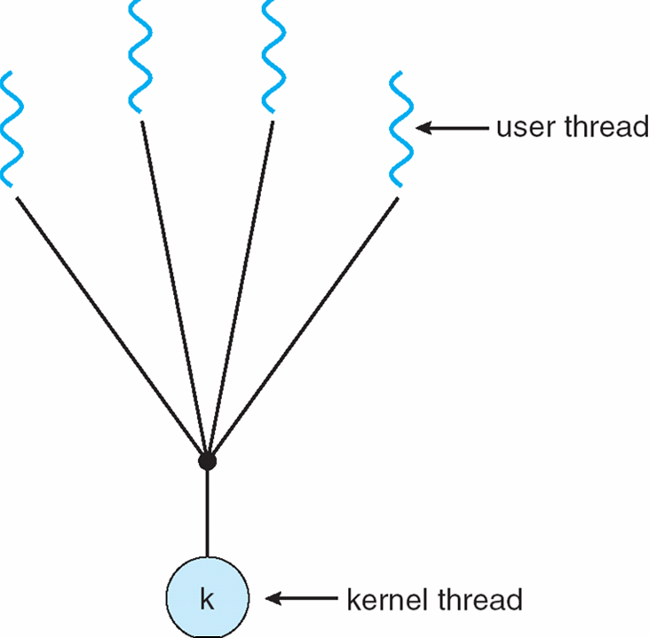
Many-to-One
Many user-level threads mapped to single kernel thread
Only one thread can access the kernel at a time,
multiple threads are unable to run in parallel on multicore systems.
the entire process will block if a thread makes a blocking system call

Slide 24
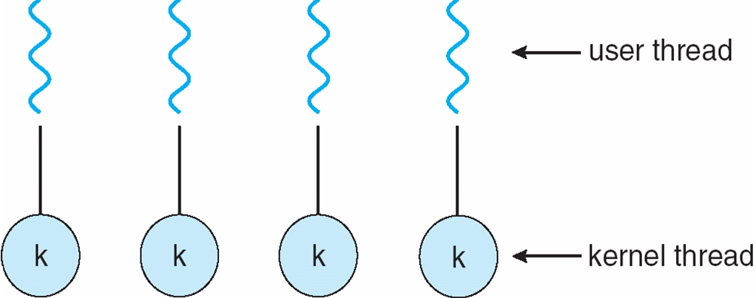
One-to-One
Each user-level thread maps to kernel thread
more concurrency than the many-to-one model by allowing another thread to run when a thread makes a blocking system call.
Allows multiple threads to run in parallel on multiprocessors.
drawback is, creating a user thread requires creating the corresponding kernel thread

Slide 25
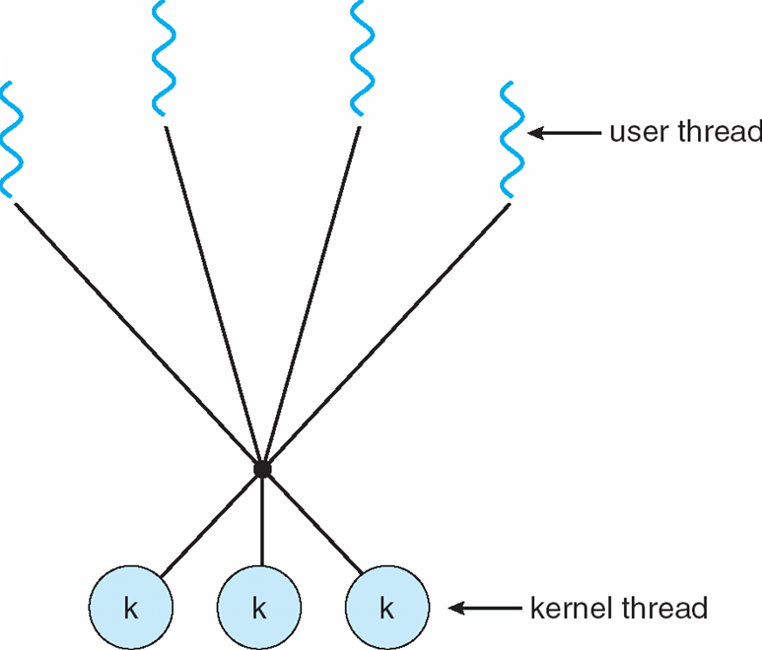
Many-to-Many Model
multiplexes many user-level threads to a smaller or equal number of kernel threads
developers can create as many user threads as necessary, and the corresponding
kernel threads can run in parallel on a multiprocessor.
When thread performs a blocking system call, the kernel can schedule another thread for
execution.

Slide 26
Thread Libraries
Three main thread libraries in use today:
POSIX Pthreads
May be provided either as user-level or kernel-level
A POSIX standard (IEEE 1003.1c) API for thread creation and synchronization
API specifies behavior of the thread library, implementation is up to development of the library
Win32
Kernel-level library on Windows system
Java
Java threads are managed by the JVM
Typically implemented using the threads model provided by underlying OS

Slide 27
POSIX Compilation on Linux
On Linux, programs that use the Pthreads API must be compiled with
–pthread or –lpthread
gcc –o thread –lpthread thread.c

Slide 28
POSIX: Thread Creation
int pthread_create(pthread_t *thread, const pthread_attr_t *attr, void *(*start)(void *), void *arg);
*thread Is the location where the ID of the newly created thread should be stored, or NULL if the thread ID is not required.
attr Is the thread attribute object specifying the attributes for the thread that is being created. If attr is NULL, the thread is created with default attributes.
start Is the main function for the thread; the thread begins executing user code at this address.
arg Is the argument passed to start.

Slide 29
POSIX: Thread ID
#include <pthread.h>
pthread_t pthread_self()
returns : ID of current (this) thread

Slide 30
POSIX: Wait for Thread Completion
#include <pthread.h>
pthread_join (thread, NULL)
returns : 0 on success, some error code on failure.

Slide 31
POSIX: Thread Termination
#include <pthread.h>
Void pthread_exit (return_value)
Threads terminate in one of the following ways:
The thread's start functions performs a return specifying a return value for the thread.
Thread receives a request asking it to terminate using pthread_cancel()
Thread initiates termination pthread_exit()
Main process terminates

Slide 32
int main()
{
pthread_t thread1, thread2; /* thread variables */
thdata data1, data2; /* structs to be passed to threads */
/* initialize data to pass to thread 1 */
data1.thread_no = 1;
strcpy(data1.message, "Hello!");
/* initialize data to pass to thread 2 */
data2.thread_no = 2;
strcpy(data2.message, "Hi!");
/* create threads 1 and 2 */
pthread_create (&thread1, NULL, (void *) &print_message_function, (void *) &data1);
pthread_create (&thread2, NULL, (void *) &print_message_function, (void *) &data2);
/* Main block now waits for both threads to terminate, before it exits
If main block exits, both threads exit, even if the threads have not
finished their work */
pthread_join(thread1, NULL);
pthread_join(thread2, NULL);
exit(0);
}
Example code but not complete

Slide 33
Signal Handling
Signals are used in UNIX systems to notify a process that a particular event has occurred
A signal handler is used to process signals
Signal is generated by particular event
Signal is delivered to a process
Signal is handled
Options:
Deliver the signal to the thread to which the signal applies
Deliver the signal to every thread in the process
Deliver the signal to certain threads in the process
Assign a specific thread to receive all signals for the process

Slide 34
Synchronous vs Asynchronous multithreading
Synchronous: Parent thread waits for child to terminate and after that resumes its operations.
ASynchronous: parent thread resumes after child thread creation

Slide 35
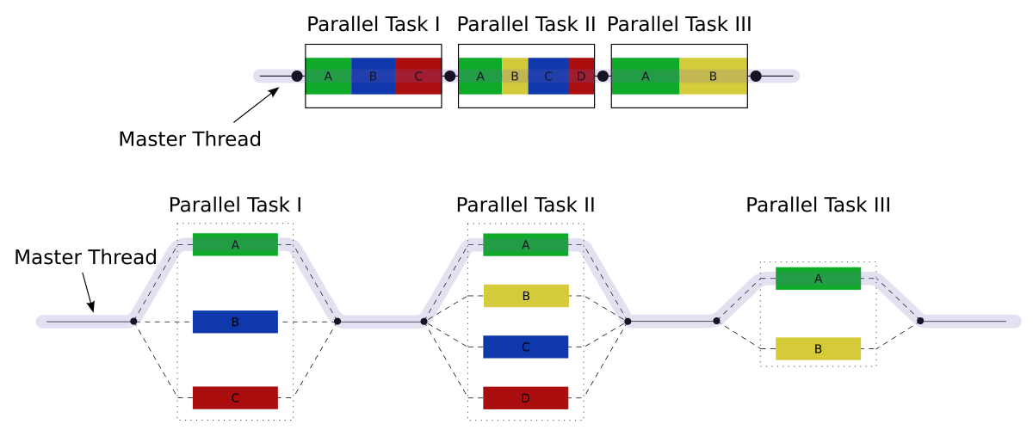
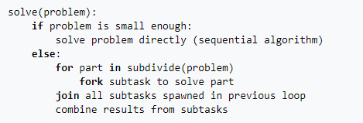
Fork – Join Model (Explicit thread creation)

Slide 36
Implicit threading
Better support the design of concurrent and parallel applications is to transfer the creation and management of threading from application developers to compilers and run-time libraries.
four alternative approaches to designing applications that can take advantage of multicore processors through implicit threading.
Thread pool
Fork Join
OpenMp
Grand Central Dispatch
require application developers to identify tasks—not threads—that can run in parallel.
A task is usually written as a function, which the run-time library then maps to a separate thread, typically using the many-to-many model (Section 4.3.3).
advantage : developers only need to identify parallel tasks, and the libraries determine the specific details of thread creation and management.

Slide 37
Thread Pools
Create a number of threads in a pool where they await work
Advantages:
Usually slightly faster to service a request with an existing thread than create a new thread
Allows the number of threads in the application(s) to be bound to the size of the pool

Slide 38
Thread Scheduling
In systems that support user and kernel-level threads, kernel-level threads are scheduled by the OS
Kernel-level threads instead of processes are scheduled
User-level threads are managed by a thread library
To run on the CPU, the user-level thread must be mapped on an associated kernel- level thread

Slide 39
Thread Scheduling
Contention Scope:
On systems implementing the many-to-one and many-to-many models, the thread library schedules user-level threads to run on an available LWP. This scheme is known as process contention scope (PCS),
(When we say the thread library schedules user threads onto available LWPs, we do not mean that the threads are actually running on a CPU. That would require the operating system to schedule the kernel thread onto a physical CPU.) To decide which kernel-level thread to schedule onto a CPU, the kernel uses system-contention scope (SCS).

Slide 40
Fork-join
synchronous model is often characterized as explicit thread creation, but it is also an excellent candidate for implicit threading.
In the latter situation, threads are not constructed directly during the fork stage; rather, parallel tasks are designated.
A library manages the number of threads that are created and is also responsible for assigning tasks to threads.
In some ways, this fork-join model is a synchronous version of thread pools in which a library determines the actual number of threads to create

Slide 41
OpenMP
An Application Program Interface (API) that may be used to explicitly direct multithreaded, shared memory parallelism
Three main API components
Compiler directives
Runtime library routines
Environment variables
Portable & Standardized
API exist both C/C++ and Fortan 90/77
Multi platform Support (Unix, Linux etc.)
Notes:
41

Slide 42
OpenMP Compilation
GCC
bash: $ gcc -fopenmp hi-omp.c -o hi-omp.x

Slide 43
OpenMP Directives
#pragma omp parallel default(shared) private(beta,pi)
#pragma omp barrier
Each thread waits at the barrier until all threads have reached it.
#pragma omp for
Distributes the iterations of a loop over multiple threads
Notes:
43

Slide 44
OpenMP threads
Thread Creation:
omp_get_num_threads()
Returns number of threads in parallel region Returns 1 if called outside parallel region
Thread Id:
omp_get_thread_num()
Returns id of thread in team Value between [0,n-1] // where n = #threads Master thread always has id 0

Slide 45
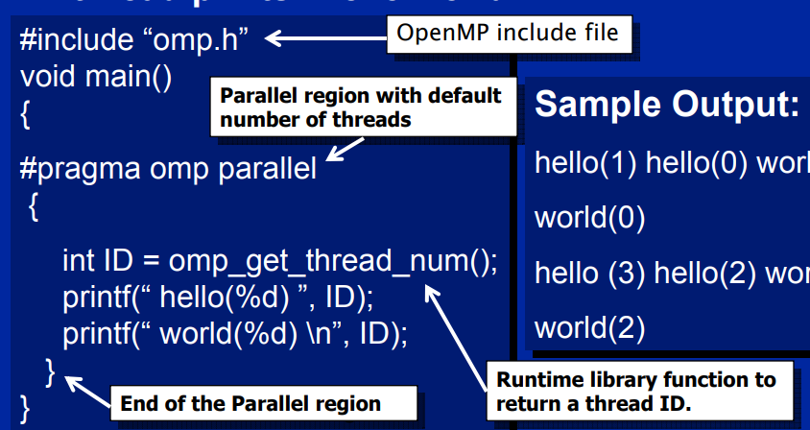
Open MP Example

Slide 46
Grand Central Dispatch(for Apple )
combination of a run-time library, an API, and language extensions to identify sections of code (tasks) to run in parallel.
schedules tasks for run-time execution by placing them on a dispatch queue.When it removes a task from a queue, it assigns the task to an available thread from a pool of threads that it manages.
two types of dispatch queues: serial and concurrent.
Serial queue tasks are removed in FIFO order. Once a task has been removed from the queue, it must complete execution before another task removed. Each process has its own serial queue (known as its main queue), and developers can create additional serial queues that are local to a particular process. (This is why serial queues are also known as private dispatch queues.)
Serial queues are useful for ensuring the sequential execution of several tasks.
Tasks placed on a concurrent queue are also removed in FIFO order, but
several tasks may be removed at a time, thus allowing multiple tasks to execute
in parallel. There are several system-wide concurrent queues (also known as
global dispatch queues)

Slide 47
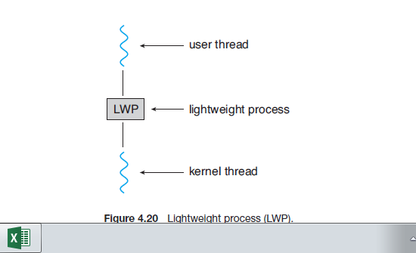
LWP (Light Weight Process

