Slide 1
CS 3006 Parallel and Distributed Computer
Fall 2021
Slides credit to :Dr. Nadeem Kafi Khan

Slide 2
Lecture Topics
Single core vs Multi-core CPUs
Limits of single-core CPUs
Why multi-core CPUs? (Core is the new transistor)
Need for dedicated computer devices like VPUs, GPUs, TPUs, FPGAs
Graphic Processing Units
Graphic processing – Shading, textures, etc.
GPUs are many core devices (~1000s of cores vs single digit cores in CPUs)
Latency vs Throughput
CPU latency vs GPU latency
How GPU increases throughput? How CPU increases latency?
Integrated vs Discrete GPUs

Slide 3
CPU
Single Core CPUs
Flexible
Performant
How to squeeze more functionality?
Power Hungary
Memory CPU speed disparity
Instruction Level Parallelism
Pipelining
Super Scalar
Multi-Cores CPUs
Instead of adding complexity to a single core we scale cores in the same dimensions of the silicon
Current Multi-Cores (Discuss)
Do we need more?
Vector Processing Units (VPUs),
Graphic Processing Units (GPUs),
Associative Processing Units (APUs),
Tensor Processing Units (TPUs)
Field Programmable Gate Arrays (FPGAs),
Quantum Processing Units (QPUs)

Slide 4
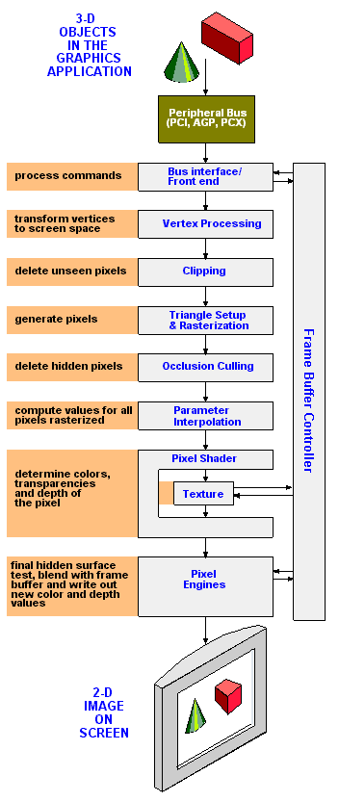
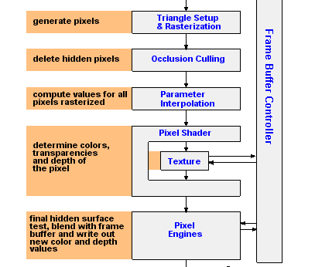
Graphic Processing

Slide 5
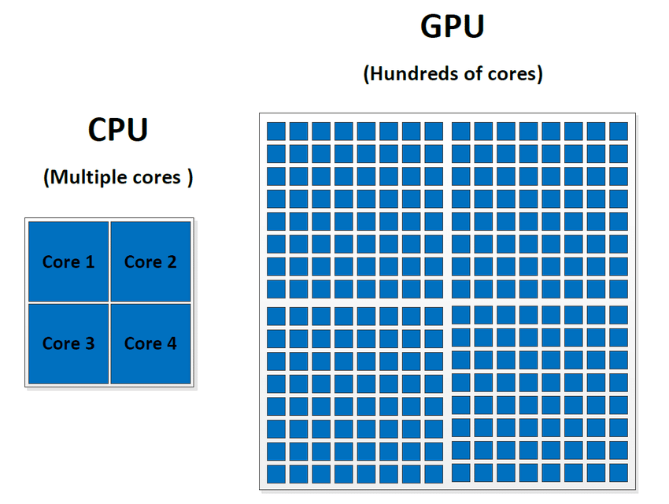
Graphic Processing Units (GPUs)
More HW for Computation
Many Cores
More power efficient
Restricted Programming Model
GPUs were originally designed to accelerate the rendering of 3D graphics. Over time, they became more flexible and programmable, enhancing their capabilities.
This allowed graphics programmers to create more interesting visual effects and realistic scenes with advanced lighting and shadowing techniques.
Other developers also began to tap the power of GPUs to dramatically accelerate additional workloads in high performance computing (HPC), deep learning, and more.

Slide 6
Latency vs Throughput
Latency
Minimize time of one task
Metric: seconds
Focus of CPU
Throughput
Maximize stuff per time
Metric: jobs/hour, pixels/sec
Focus of GPUs

Slide 7
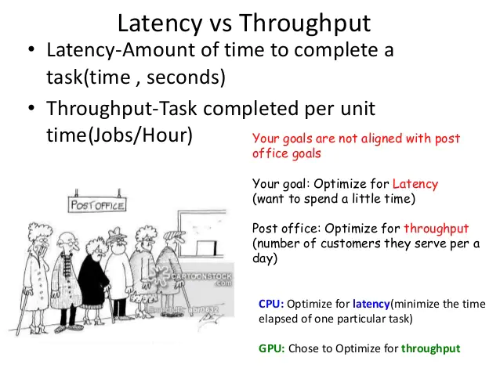

Slide 8
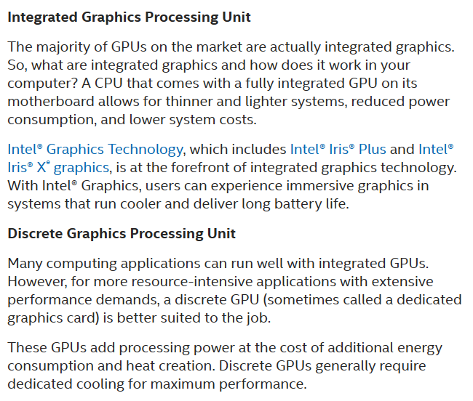
https://www.intel.com/content/www/us/en/products/docs/processors/what-is-a-gpu.html

Slide 9
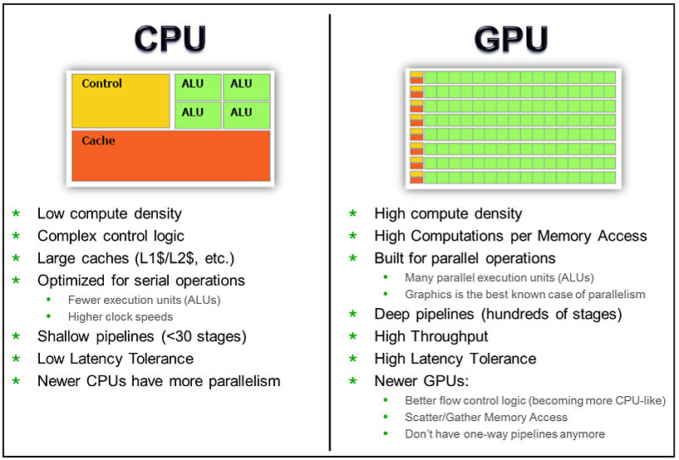

Slide 10
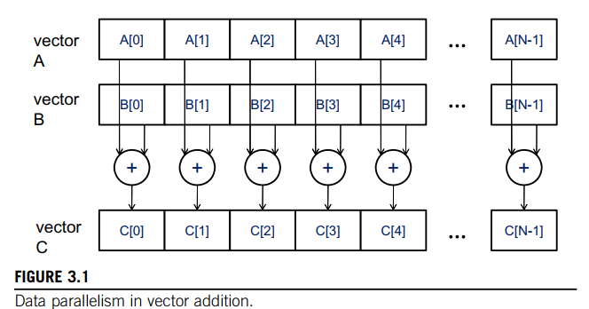
How GPU increases throughput?

Slide 11
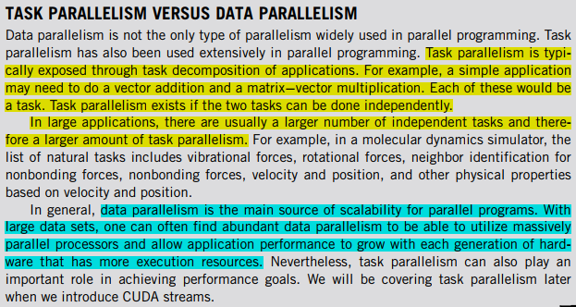

Slide 12
Thank You

