Slide 1
Week 2

Slide 2
Memory architectures
Shared Memory
Distributed Memory
Hybrid Distributed-Shared Memory

Slide 3
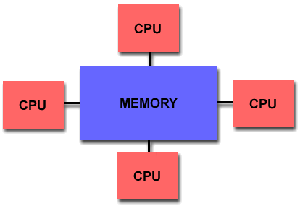
Shared Memory
Shared memory parallel computers vary widely, but generally have in common the ability for all processors to access all memory as global address space.
Multiple processors can operate independently but share the same memory resources.
Changes in a memory location effected by one processor are visible to all other processors.
Shared memory machines can be divided into two main classes based upon memory access times: UMA and NUMA.

Slide 4
Shared Memory : UMA vs. NUMA
Uniform Memory Access (UMA):
  Most commonly represented today by Symmetric Multiprocessor (SMP) machines
  Identical processors
  Equal access and access times to memory
  Sometimes called CC-UMA - Cache Coherent UMA. Cache coherent means if one processor updates a location in shared memory, all the other processors know about the update. Cache coherency is accomplished at the hardware level.
Non-Uniform Memory Access (NUMA):
  Often made by physically linking two or more SMPs
  One SMP can directly access memory of another SMP
  Not all processors have equal access time to all memories
  Memory access across link is slower
  If cache coherency is maintained, then may also be called CC-NUMA - Cache Coherent NUMA

Slide 5
Shared Memory: Pro and Con
Advantages
  Global address space provides a user-friendly programming perspective to memory
  Data sharing between tasks is both fast and uniform due to the proximity of memory to CPUs
Disadvantages:
  Primary disadvantage is the lack of scalability between memory and CPUs. Adding more CPUs can geometrically increases traffic on the shared memory-CPU path, and for cache coherent systems, geometrically increase traffic associated with cache/memory management.
  Programmer responsibility for synchronization constructs that insure "correct" access of global memory.
  Expense: it becomes increasingly difficult and expensive to design and produce shared memory machines with ever increasing numbers of processors.

Slide 6
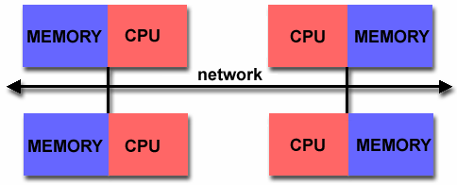
Distributed Memory
Like shared memory systems, distributed memory systems vary widely but share a common characteristic. Distributed memory systems require a communication network to connect inter-processor memory.
Processors have their own local memory. Memory addresses in one processor do not map to another processor, so there is no concept of global address space across all processors.
Because each processor has its own local memory, it operates independently. Changes it makes to its local memory have no effect on the memory of other processors. Hence, the concept of cache coherency does not apply.
When a processor needs access to data in another processor, it is usually the task of the programmer to explicitly define how and when data is communicated. Synchronization between tasks is likewise the programmer's responsibility.
The network "fabric" used for data transfer varies widely, though it can can be as simple as Ethernet.

Slide 7
Distributed Memory: Pro and Con
Advantages
  Memory is scalable with number of processors. Increase the number of processors and the size of memory increases proportionately.
  Each processor can rapidly access its own memory without interference and without the overhead incurred with trying to maintain cache coherency.
  Cost effectiveness: can use commodity, off-the-shelf processors and networking.
Disadvantages
  The programmer is responsible for many of the details associated with data communication between processors.
  It may be difficult to map existing data structures, based on global memory, to this memory organization.
  Non-uniform memory access (NUMA) times

Slide 8
Hybrid Distributed-Shared Memory
Summarizing a few of the key characteristics of shared and distributed memory machines
Comparison of Shared and Distributed Memory Architectures
Architecture | CC-UMA | CC-NUMA | Distributed
Examples | SMPs Sun Vexx DEC/Compaq SGI Challenge IBM POWER3 | Bull NovaScale SGI Origin Sequent HP Exemplar DEC/Compaq IBM POWER4 (MCM) | Cray T3E Maspar IBM SP2 IBM BlueGene
Communications | MPI Threads OpenMP shmem | MPI Threads OpenMP shmem | MPI
Scalability | to 10s of processors | to 100s of processors | to 1000s of processors
Draw Backs | Memory-CPU bandwidth | Memory-CPU bandwidth Non-uniform access times | System administration Programming is hard to develop and maintain
Software Availability | many 1000s ISVs | many 1000s ISVs | 100s ISVs

Slide 9
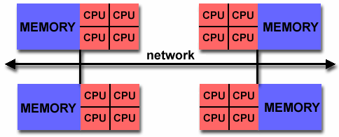
Hybrid Distributed-Shared Memory
The largest and fastest computers in the world today employ both shared and distributed memory architectures.
The shared memory component is usually a cache coherent SMP machine. Processors on a given SMP can address that machine's memory as global.
The distributed memory component is the networking of multiple SMPs. SMPs know only about their own memory - not the memory on another SMP. Therefore, network communications are required to move data from one SMP to another.
Current trends seem to indicate that this type of memory architecture will continue to prevail and increase at the high end of computing for the foreseeable future.
Advantages and Disadvantages: whatever is common to both shared and distributed memory architectures.

Slide 10
Parallel Computing Platforms
Ananth Grama, Anshul Gupta,
George Karypis, and Vipin Kumar
To accompany the text ``Introduction to Parallel Computing'',
Addison Wesley, 2003.

Slide 11
Topic Overview
Implicit Parallelism: Trends in Microprocessor Architectures
Limitations of Memory System Performance
Dichotomy of Parallel Computing Platforms
Communication Model of Parallel Platforms
Physical Organization of Parallel Platforms
Communication Costs in Parallel Machines
Messaging Cost Models and Routing Mechanisms
Mapping Techniques
Case Studies

Slide 12
Scope of Parallelism
Conventional architectures coarsely comprise of a processor, memory system, and the datapath.
Each of these components present significant performance bottlenecks.
Parallelism addresses each of these components in significant ways.
Different applications utilize different aspects of parallelism - e.g., data itensive applications utilize high aggregate throughput, server applications utilize high aggregate network bandwidth, and scientific applications typically utilize high processing and memory system performance.
It is important to understand each of these performance bottlenecks.

Slide 13
Implicit Parallelism: Trends in Microprocessor Architectures
Microprocessor clock speeds have posted impressive gains over the past two decades (two to three orders of magnitude).
Higher levels of device integration have made available a large number of transistors.
The question of how best to utilize these resources is an important one.
Current processors use these resources in multiple functional units and execute multiple instructions in the same cycle.
The precise manner in which these instructions are selected and executed provides impressive diversity in architectures.

Slide 14
Pipelining and Superscalar Execution
Pipelining overlaps various stages of instruction execution to achieve performance.
At a high level of abstraction, an instruction can be executed while the next one is being decoded and the next one is being fetched.
This is akin to an assembly line for manufacture of cars.

Slide 15
Pipelining and Superscalar Execution
Pipelining, however, has several limitations.
The speed of a pipeline is eventually limited by the slowest stage.
For this reason, conventional processors rely on very deep pipelines (20 stage pipelines in state-of-the-art Pentium processors).
However, in typical program traces, every 5-6th instruction is a conditional jump! This requires very accurate branch prediction.
The penalty of a misprediction grows with the depth of the pipeline, since a larger number of instructions will have to be flushed.

Slide 16
Pipelining and Superscalar Execution
One simple way of alleviating these bottlenecks is to use multiple pipelines.
The question then becomes one of selecting these instructions.

Slide 17
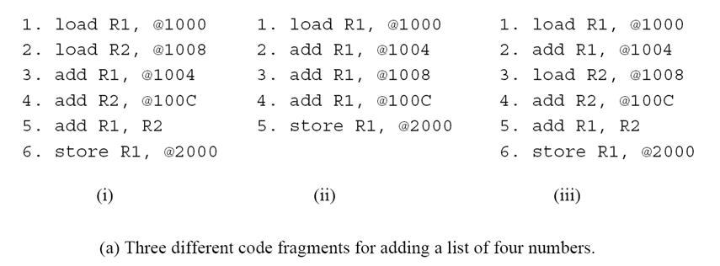
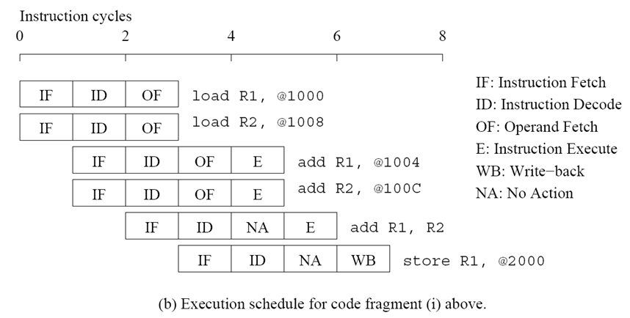
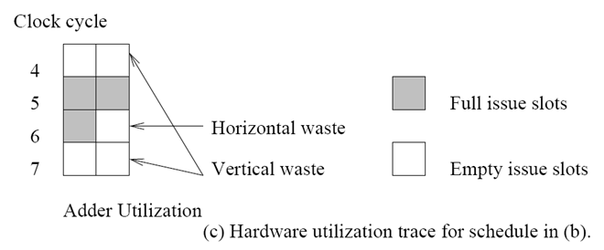
Superscalar Execution: An Example

Slide 18
Superscalar Execution: An Example
In the above example, there is some wastage of resources due to data dependencies.
The example also illustrates that different instruction mixes with identical semantics can take significantly different execution time.

Slide 19
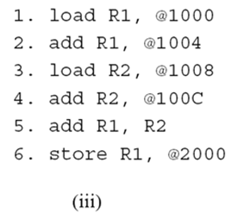

Superscalar Execution
Scheduling of instructions is determined by a number of factors:
  True Data Dependency: The result of one operation is an input to the next.
  Resource Dependency: Two operations require the same resource.
  Branch Dependency: Scheduling instructions across conditional branch statements cannot be done deterministically a-priori.
  The scheduler, a piece of hardware looks at a large number of instructions in an instruction queue and selects appropriate number of instructions to execute concurrently based on these factors. ( example of third code)
  The complexity of this hardware is an important constraint on superscalar processors.
Notes:
As an example, consider the co-scheduling of two floating point operations on
a dual issue machine with a single floating point unit. Although there might be no data
dependencies between the instructions, they cannot be scheduled together since both need the
floating point unit. This form of dependency in which two instructions compete for a single
processor resource is referred to as resource dependency.
The flow of control through a program enforces a third form of dependency between
instructions. Consider the execution of a conditional branch instruction. Since the branch
destination is known only at the point of execution, scheduling instructions a priori across
branches may lead to errors. These dependencies are referred to as branch dependencies or
procedural dependencies and are typically handled by speculatively scheduling across
branches and rolling back in case of errors. Studies of typical traces have shown that on
average, a branch instruction is encountered between every five to six instructions. Therefore,
just as in populating instruction pipelines, accurate branch prediction is critical for efficient
superscalar execution.
The ability of a processor to detect and schedule concurrent instructions is critical to superscalar
performance. For instance, consider the third code fragment in Figure 2.1 which also computes
the sum of four numbers. The reader will note that this is merely a semantically equivalent
reordering of the first code fragment. However, in this case, there is a data dependency
between the first two instructions – load R1, @1000 and add R1, @1004. Therefore, these
instructions cannot be issued simultaneously. However, if the processor had the ability to look
ahead, it would realize that it is possible to schedule the third instruction – load R2, @1008 –
with the first instruction. In the next issue cycle, instructions two and four can be scheduled,
and so on. In this way, the same execution schedule can be derived for the first and third code

Slide 20
Superscalar Execution:
Issue Mechanisms
In the simpler model, instructions can be issued only in the order in which they are encountered. That is, if the second instruction cannot be issued because it has a data dependency with the first, only one instruction is issued in the cycle. This is called in-order issue.
In a more aggressive model, instructions can be issued out of order. In this case, if the second instruction has data dependencies with the first, but the third instruction does not, the first and third instructions can be co-scheduled. This is also called dynamic issue.
Performance of in-order issue is generally limited.

Slide 21
Superscalar Execution:
Efficiency Considerations
Not all functional units can be kept busy at all times.
If during a cycle, no functional units are utilized, this is referred to as vertical waste.
If during a cycle, only some of the functional units are utilized, this is referred to as horizontal waste.
Due to limited parallelism in typical instruction traces, dependencies, or the inability of the scheduler to extract parallelism, the performance of superscalar processors is eventually limited.
Conventional microprocessors typically support four-way superscalar execution.

Slide 22
Very Long Instruction Word (VLIW) Processors
The hardware cost and complexity of the superscalar scheduler is a major consideration in processor design.
To address this issues, VLIW processors rely on compile time analysis to identify and bundle together instructions that can be executed concurrently.
These instructions are packed and dispatched together, and thus the name very long instruction word.
This concept was used with some commercial success in the Multiflow Trace machine (circa 1984).
Variants of this concept are employed in the Intel IA64 processors.

Slide 23
Very Long Instruction Word (VLIW) Processors: Considerations
Issue hardware is simpler.
Compiler has a bigger context from which to select co-scheduled instructions.
Compilers, however, do not have runtime information such as cache misses. Scheduling is, therefore, inherently conservative.
Branch and memory prediction is more difficult.
VLIW performance is highly dependent on the compiler. A number of techniques such as loop unrolling, speculative execution, branch prediction are critical.
Typical VLIW processors are limited to 4-way to 8-way parallelism.

Slide 24
Limitations of
Memory System Performance
Memory system, and not processor speed, is often the bottleneck for many applications.
Memory system performance is largely captured by two parameters, latency and bandwidth.
Latency is the time from the issue of a memory request to the time the data is available at the processor.
Bandwidth is the rate at which data can be pumped to the processor by the memory system.

Slide 25
Memory System Performance: Bandwidth and Latency
It is very important to understand the difference between latency and bandwidth.
Consider the example of a fire-hose. If the water comes out of the hose two seconds after the hydrant is turned on, the latency of the system is two seconds.
Once the water starts flowing, if the hydrant delivers water at the rate of 5 gallons/second, the bandwidth of the system is 5 gallons/second.
If you want immediate response from the hydrant, it is important to reduce latency.
If you want to fight big fires, you want high bandwidth.

Slide 26
Memory Latency: An Example
Consider a processor operating at 1 GHz (1 ns clock) connected to a DRAM with a latency of 100 ns (no caches). Assume that the processor has two multiply-add units and is capable of executing four instructions in each cycle of 1 ns. The following observations follow:
  The peak processor rating is 4 GFLOPS*.
  Since the memory latency is equal to 100 cycles and block size is one word, every time a memory request is made, the processor must wait 100 cycles before it can process the data.
*In computing, floating point operations per second (FLOPS, flops or flop/s) is a measure
of computer performance, useful in fields of scientific computations that require floating-point
calculations. (wikipedia.org)

Slide 27
Memory Latency: An Example
On the above architecture, consider the problem of computing a dot-product of two vectors.
  A dot-product computation performs one multiply-add on a single pair of vector elements, i.e., each floating point operation requires one data fetch.
  It follows that the peak speed of this computation is limited to one floating point operation every 100 ns, or a speed of 10 MFLOPS*, a very small fraction of the peak processor rating!

Slide 28
Improving Effective Memory
Latency Using Caches
Caches are small and fast memory elements between the processor and DRAM.
This memory acts as a low-latency high-bandwidth storage.
If a piece of data is repeatedly used, the effective latency of this memory system can be reduced by the cache.
The fraction of data references satisfied by the cache is called the cache hit ratio of the computation on the system.
Cache hit ratio achieved by a code on a memory system often determines its performance.

Slide 29
Impact of Caches: Example
Consider the architecture from the previous example. In this case, we introduce a cache of size 32 KB with a latency of 1 ns or one cycle. We use this setup to multiply two matrices A and B of dimensions 32 × 32. We have carefully chosen these numbers so that the cache is large enough to store matrices A and B, as well as the result matrix C.

Slide 30
Impact of Caches: Example (continued)
The following observations can be made about the problem:
  Fetching the two matrices into the cache corresponds to fetching 2K words, which takes approximately 200 µs.
  Multiplying two n × n matrices takes 2n³ operations. For our problem, this corresponds to 64K operations, which can be performed in 16K cycles (or 16 µs) at four instructions per cycle.
  The total time for the computation is therefore approximately the sum of time for load/store operations and the time for the computation itself, i.e., 200 + 16 µs.
  This corresponds to a peak computation rate of 64K/216 or 303 MFLOPS.

Slide 31
Impact of Caches
Repeated references to the same data item correspond to temporal locality.
In our example, we had O(n²) data accesses and O(n³) computation. This asymptotic difference makes the above example particularly desirable for caches.
• Data reuse is critical for cache performance.

Slide 32
Impact of Memory Bandwidth
Memory bandwidth is determined by the bandwidth of the memory bus as well as the memory units.
• Memory bandwidth can be improved by increasing the size of memory blocks.
The underlying system takes l time units (where l is the latency of the system) to deliver b units of data (where b is the block size).

Slide 33
Impact of Memory Bandwidth: Example
Consider the same setup as before, except in this case, the block size is 4 words instead of 1 word. We repeat the dot-product computation in this scenario:
  Assuming that the vectors are laid out linearly in memory, eight FLOPs (four multiply-adds) can be performed in 200 cycles.
  This is because a single memory access fetches four consecutive words in the vector.
  Therefore, two accesses can fetch four elements of each of the vectors. This corresponds to a FLOP every 25 ns, for a peak speed of 40 MFLOPS.

Slide 34
Impact of Memory Bandwidth
It is important to note that increasing block size does not change latency of the system.
Physically, the scenario illustrated here can be viewed as a wide data bus (4 words or 128 bits) connected to multiple memory banks.
In practice, such wide buses are expensive to construct.
In a more practical system, consecutive words are sent on the memory bus on subsequent bus cycles after the first word is retrieved.

Slide 35
Impact of Memory Bandwidth
The above examples clearly illustrate how increased bandwidth results in higher peak computation rates.
The data layouts were assumed to be such that consecutive data words in memory were used by successive instructions (spatial locality of reference).
If we take a data-layout centric view, computations must be reordered to enhance spatial locality of reference.

Slide 36
Impact of Memory Bandwidth: Example
Consider the following code fragment:
for (i = 0; i < 1000; i++)
column_sum[i] = 0.0;
for (j = 0; j < 1000; j++)
column_sum[i] += b[j][i];
The code fragment sums columns of the matrix b into a vector column_sum.

Slide 37
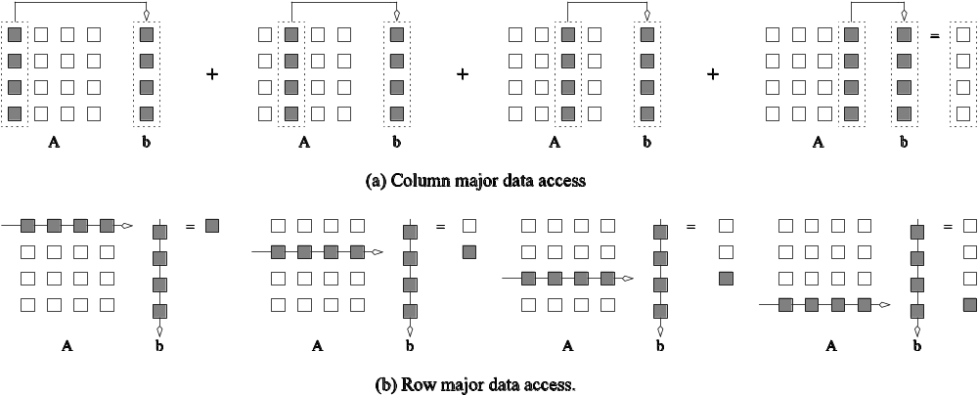
Impact of Memory Bandwidth: Example
The vector column_sum is small and easily fits into the cache
The matrix b is accessed in a column order.
The strided access results in very poor performance.
Multiplying a matrix with a vector: (a) multiplying column-by-column, keeping a running sum; (b) computing each element of the result as a dot product of a row of the matrix with the vector.

Slide 38
Impact of Memory Bandwidth: Example
We can fix the above code as follows:
for (i = 0; i < 1000; i++)
column_sum[i] = 0.0;
for (j = 0; j < 1000; j++)
for (i = 0; i < 1000; i++)
column_sum[i] += b[j][i];
In this case, the matrix is traversed in a row-order and performance can be expected to be significantly better.

Slide 39
Memory System Performance: Summary
The series of examples presented in this section illustrate the following concepts:
  Exploiting spatial and temporal locality in applications is critical for amortizing memory latency and increasing effective memory bandwidth.
  The ratio of the number of operations to number of memory accesses is a good indicator of anticipated tolerance to memory bandwidth.
  Memory layouts and organizing computation appropriately can make a significant impact on the spatial and temporal locality.

Slide 40
Alternate Approaches for
Hiding Memory Latency
Consider the problem of browsing the web on a very slow network connection. We deal with the problem in one of three possible ways:
  we anticipate which pages we are going to browse ahead of time and issue requests for them in advance;
  we open multiple browsers and access different pages in each browser, thus while we are waiting for one page to load, we could be reading others; or
  we access a whole bunch of pages in one go - amortizing the latency across various accesses.
The first approach is called prefetching, the second multithreading, and the third one corresponds to spatial locality in accessing memory words.

Slide 41
Multithreading for Latency Hiding
A thread is a single stream of control in the flow of a program.
We illustrate threads with a simple example:
for (i = 0; i < n; i++)
c[i] = dot_product(get_row(a, i), b);
Each dot-product is independent of the other, and therefore represents a concurrent unit of execution. We can safely rewrite the above code segment as:
for (i = 0; i < n; i++)
c[i] = create_thread(dot_product,get_row(a, i), b);

Slide 42
Multithreading for Latency Hiding: Example
In the code, the first instance of this function accesses a pair of vector elements and waits for them.
In the meantime, the second instance of this function can access two other vector elements in the next cycle, and so on.
After l units of time, where l is the latency of the memory system, the first function instance gets the requested data from memory and can perform the required computation.
In the next cycle, the data items for the next function instance arrive, and so on. In this way, in every clock cycle, we can perform a computation.

Slide 43
Multithreading for Latency Hiding
The execution schedule in the previous example is predicated upon two assumptions: the memory system is capable of servicing multiple outstanding requests, and the processor is capable of switching threads at every cycle.
It also requires the program to have an explicit specification of concurrency in the form of threads.
Machines such as the HEP and Tera rely on multithreaded processors that can switch the context of execution in every cycle. Consequently, they are able to hide latency effectively.

Slide 44
Prefetching for Latency Hiding
Misses on loads cause programs to stall.
Why not advance the loads so that by the time the data is actually needed, it is already there!
The only drawback is that you might need more space to store advanced loads.
However, if the advanced loads are overwritten, we are no worse than before!

Slide 45
Tradeoffs of Multithreading and Prefetching
Multithreading and prefetching are critically impacted by the memory bandwidth. Consider the following example:
  Consider a computation running on a machine with a 1 GHz clock, 4-word cache line, single cycle access to the cache, and 100 ns latency to DRAM. The computation has a cache hit ratio at 1 KB of 25% and at 32 KB of 90%. Consider two cases: first, a single threaded execution in which the entire cache is available to the serial context, and second, a multithreaded execution with 32 threads where each thread has a cache residency of 1 KB.
  If the computation makes one data request in every cycle of 1 ns, you may notice that the first scenario requires 400MB/s of memory bandwidth and the second, 3GB/s.

Slide 46
Tradeoffs of Multithreading and Prefetching
Bandwidth requirements of a multithreaded system may increase very significantly because of the smaller cache residency of each thread.
Multithreaded systems become bandwidth bound instead of latency bound.
Multithreading and prefetching only address the latency problem and may often exacerbate the bandwidth problem.
Multithreading and prefetching also require significantly more hardware resources in the form of storage.

Slide 47
Interconnection Networks for Parallel Computers
Interconnection networks carry data between processors and to memory.
Interconnects are made of switches and links (wires, fiber).
Interconnects are classified as static or dynamic.
Static networks consist of point-to-point communication links among processing nodes and are also referred to as direct networks.
Dynamic networks are built using switches and communication links. Dynamic networks are also referred to as indirect networks.

Slide 48
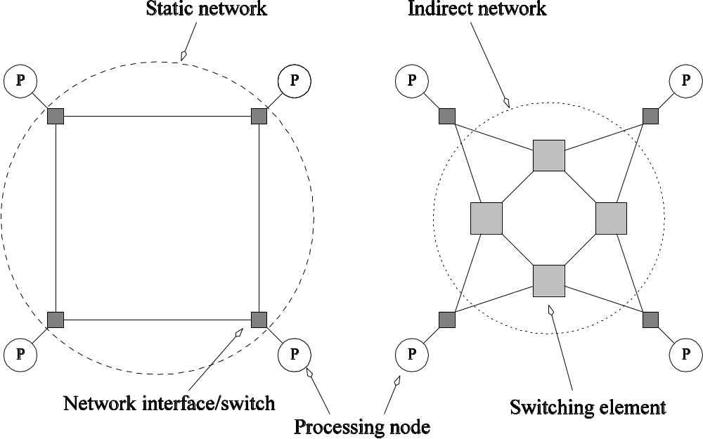
Static and Dynamic
Interconnection Networks
Classification of interconnection networks: (a) a static network; and (b) a dynamic network.

Slide 49
Interconnection Networks
Switches map a fixed number of inputs to outputs.
The total number of ports on a switch is the degree of the switch.
The cost of a switch grows as the square of the degree of the switch, the peripheral hardware linearly as the degree, and the packaging costs linearly as the number of pins.

Slide 50
Interconnection Networks:
Network Interfaces
Processors talk to the network via a network interface.
The network interface may hang off the I/O bus or the memory bus.
In a physical sense, this distinguishes a cluster from a tightly coupled multicomputer.
The relative speeds of the I/O and memory buses impact the performance of the network.

Slide 51
Network Topologies
A variety of network topologies have been proposed and implemented.
These topologies tradeoff performance for cost.
Commercial machines often implement hybrids of multiple topologies for reasons of packaging, cost, and available components.

Slide 52
Network Topologies: Buses
Some of the simplest and earliest parallel machines used buses.
All processors access a common bus for exchanging data.
The distance between any two nodes is O(1) in a bus. The bus also provides a convenient broadcast media.
However, the bandwidth of the shared bus is a major bottleneck.
Typical bus based machines are limited to dozens of nodes. Sun Enterprise servers and Intel Pentium based shared-bus multiprocessors are examples of such architectures.

Slide 53
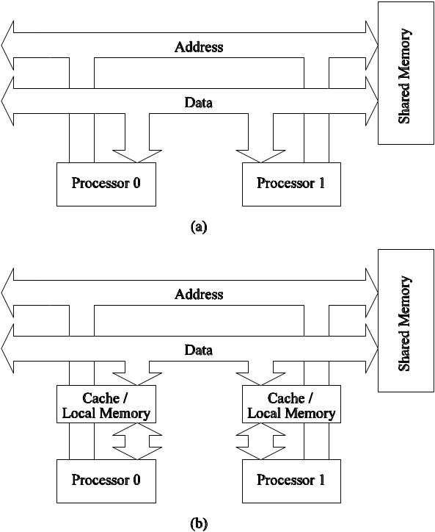
Network Topologies: Buses
Bus-based interconnects (a) with no local caches; (b) with local memory/caches.
Since much of the data accessed by processors is local to the processor, a local memory can improve the performance of bus-based machines.

Slide 54
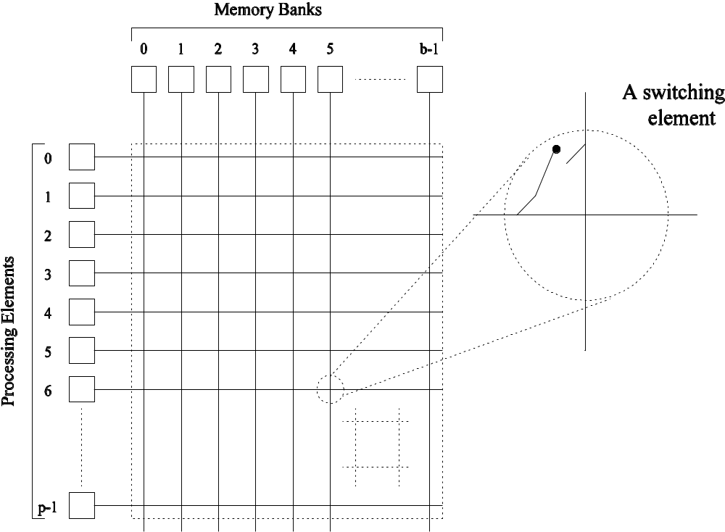
Network Topologies: Crossbars
A crossbar network uses an p×m grid of switches to connect p inputs to m outputs in a non-blocking manner.
A completely non-blocking crossbar network connecting p processors to b memory banks.

Slide 55
Network Topologies: Crossbars
The cost of a crossbar of p processors grows as O(p²).
This is generally difficult to scale for large values of p.
Examples of machines that employ crossbars include the Sun Ultra HPC 10000 and the Fujitsu VPP500.

Slide 56
Message Passing Costs in
Parallel Computers
The total time to transfer a message over a network comprises of the following:
  Startup time (t_{s}): Time spent at sending and receiving nodes (executing the routing algorithm, programming routers, etc.).
  Per-hop time (t_{h}): This time is a function of number of hops and includes factors such as switch latencies, network delays, etc.
  Per-word transfer time (t_{w}): This time includes all overheads that are determined by the length of the message. This includes bandwidth of links, error checking and correction, etc.

