Slide 1

CS302 Design and Analysis of Algorithms
Muhammad sohail afzal

Slide 2
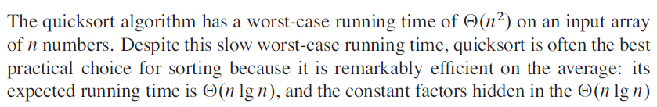
Quick Sort
`
Sorting in place means that algorithm does not take extra memory.
It is a Divide and Conquer algorithm

Slide 3
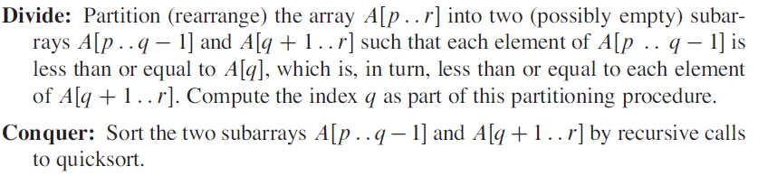
Quick Sort
If “q” is the index of pivot element :

Slide 4
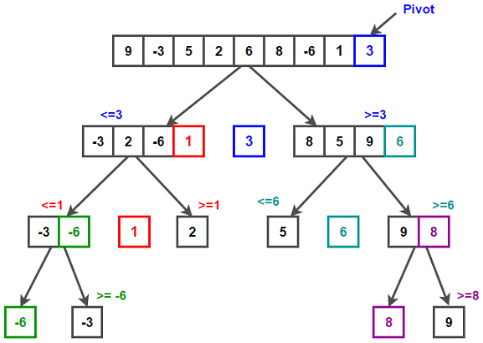
Quick Sort

Slide 5
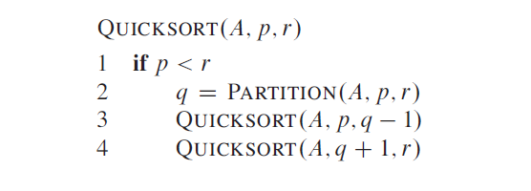
Quick Sort

Slide 6
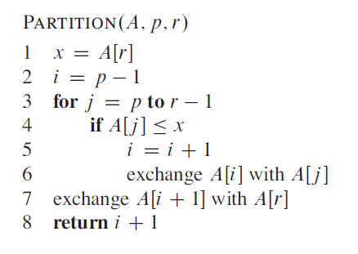
Quick Sort

Slide 7
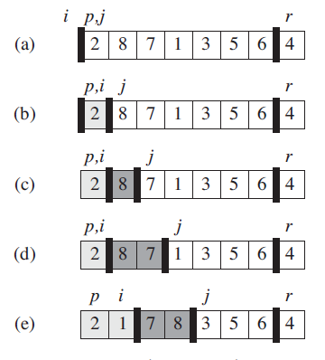
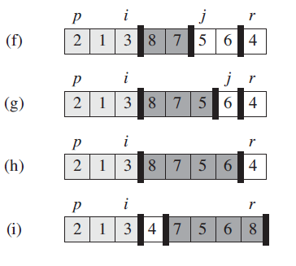
Quick Sort
Figure 7.1

Slide 8
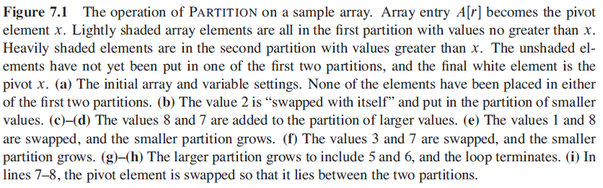
Quick Sort

Slide 9


Quick Sort
Running Time :

Slide 10

Quick Sort
Worst Case partitioning:
The worst-case behaviour for quick sort occurs when partitioning routine produces one sub-problem with “n-1” elements and one with “0” element. Let us assume that this unbalanced partitioning arises in each recursive call. The partitioning costs “theta(n)” time. And the recurrence for running time is :
(can be proved by substitution method)

Slide 11
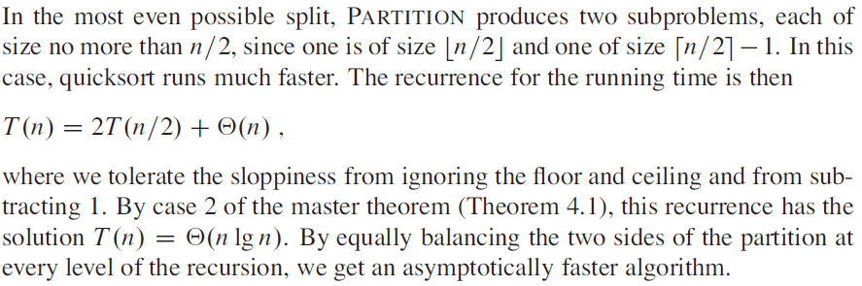
Quick Sort
Best Case Partitioning :

Slide 12
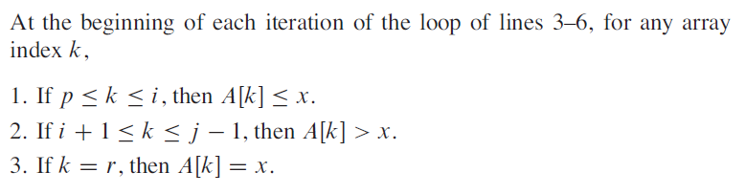
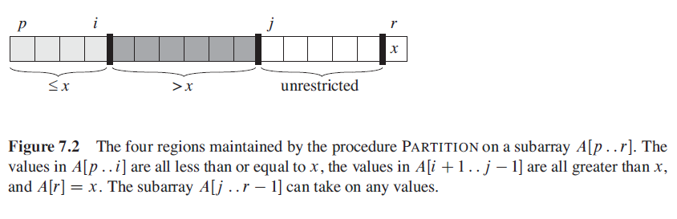
Quick Sort
Loop Invariant:

Slide 13
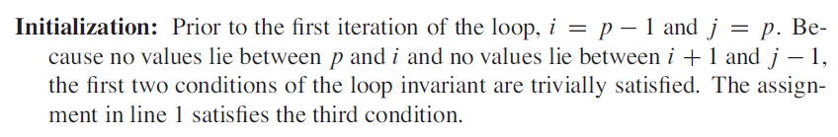
Quick Sort

Slide 14
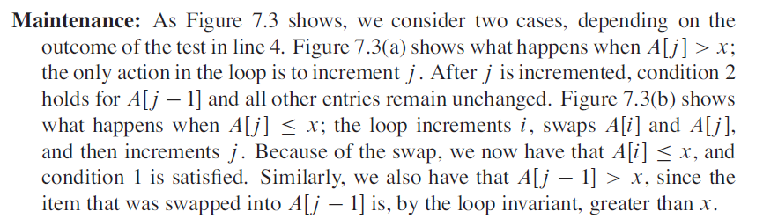
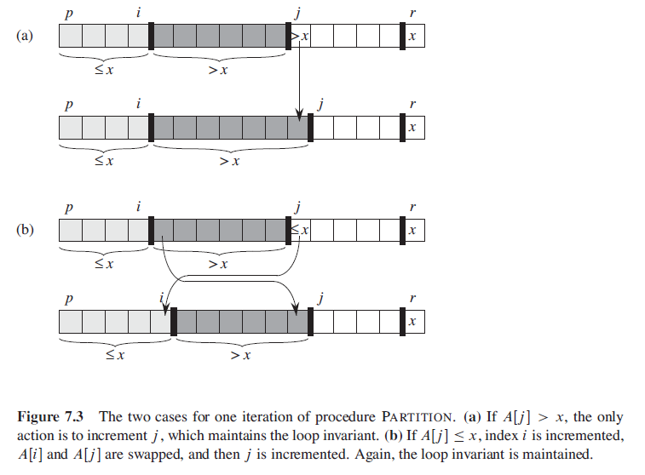
Quick Sort

Slide 15
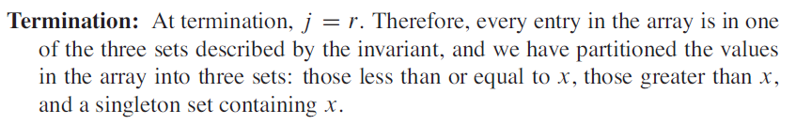
Quick Sort

