Slide 1

CS302 Design and Analysis of Algorithms
Muhammad sohail afzal

Slide 2
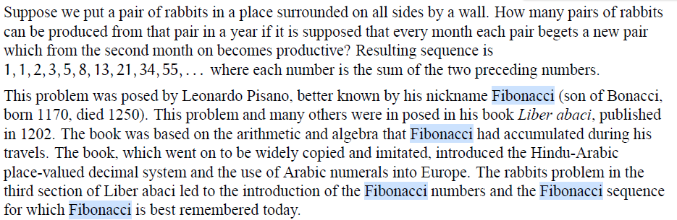
Fibonacci Sequence: Dynamic Programming

Slide 3
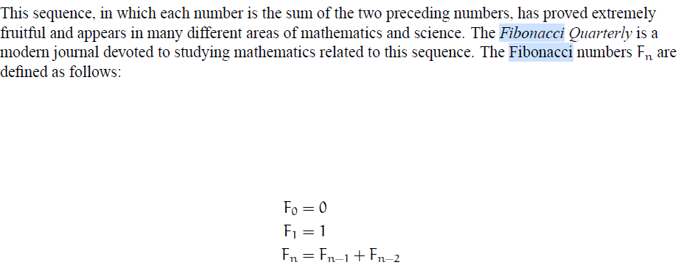
Fibonacci Sequence: Dynamic Programming

Slide 4
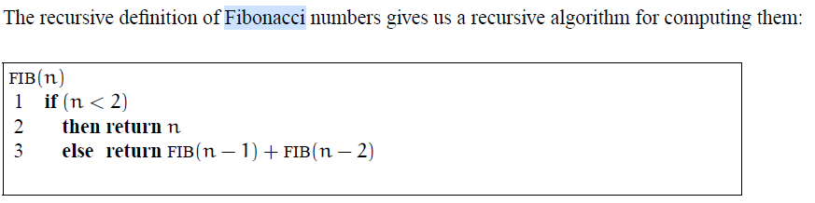
Fibonacci Sequence: Dynamic Programming
This will take time approximately T(n) = 2T(n-1) + 1 which after solving through iterative substitution, we get exponential time. So this recurrence will be taking huge amount of time. Now we will analyze the tree to avoid un-necessary re-computation.

Slide 5
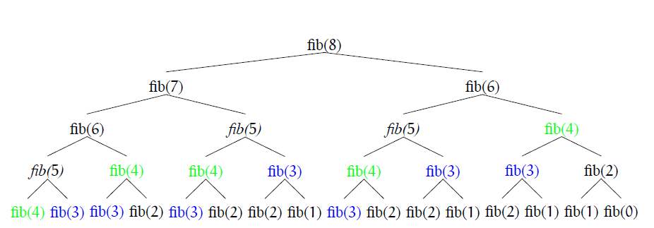
Fibonacci Sequence: Dynamic Programming
Recursive tree of Fib(8) :

Slide 6
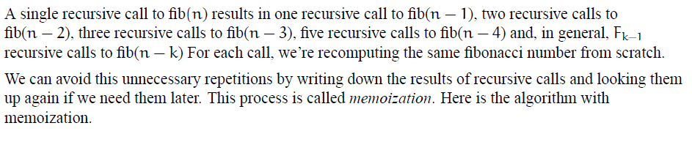
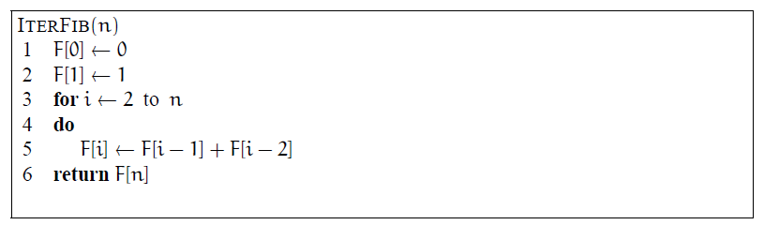
Fibonacci Sequence: Dynamic Programming

Slide 7
Fibonacci Sequence: Dynamic Programming
This algorithm has one loop that will take O(n) time. So we have reduced time complexity of generation of Fibonacci sequence from exponential time to linear time using dynamic programming.

