Slide 1

CS302 Design and Analysis of Algorithms
Muhammad sohail afzal

Slide 2
Computational Geometry - Geometric Algorithms
Online Video Link :
https://drive.google.com/file/d/1qH3Kp-jTcQ7SgTfRVJ0braWHoroIusfd/view?usp=sharing

Slide 3
Computational Geometry - Geometric Algorithms
Computational geometry is the branch of computer science that studies algorithms for solving geometric problems.
In modern engineering and mathematics, computational geometry has applications in such diverse fields as computer graphics, robotics, VLSI design, computer-aided design, molecular modeling, metallurgy, manufacturing, textile layout, forestry, and statistics.

Slide 4
Geometric Algorithms
The input to a computational geometry problem is typically a description of a set of geometric objects, such as a set of points, a set of line segments, or the vertices of a polygon in counterclockwise order.
The output is often a response to a query about the objects, such as whether any of the lines intersect, or perhaps a new geometric object, such as the convex hull (smallest enclosing convex polygon) of the set of points.

Slide 5
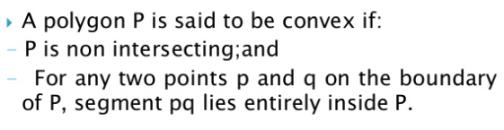
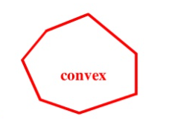
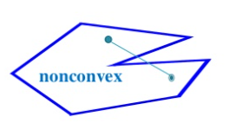
Geometric Algorithms
Convex Hull :

Slide 6
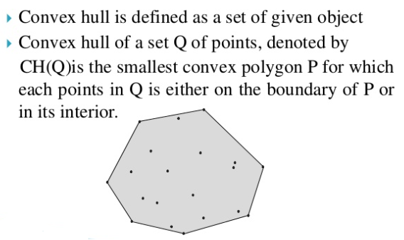
Geometric Algorithms

Slide 7
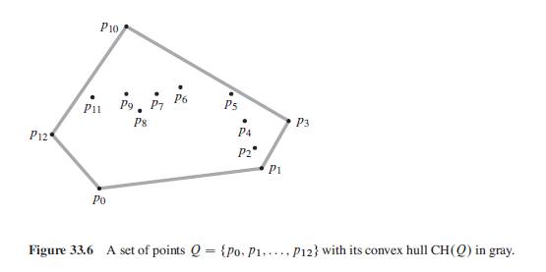
Geometric Algorithms

Slide 8
Geometric Algorithms
There are many approaches to compute convex hull :
Brute force
Graham Scan
Jarvis or Wrapping algorithm
Quick Hull algorithm

Slide 9
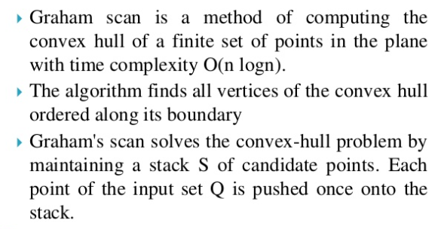
Geometric Algorithms

Slide 10
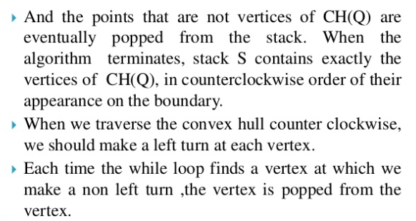
Geometric Algorithms

Slide 11
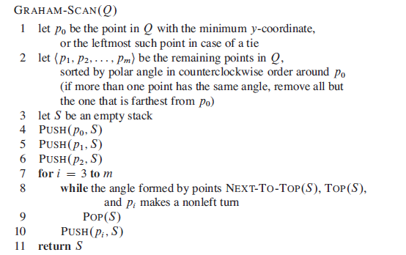
Geometric Algorithms

Slide 12
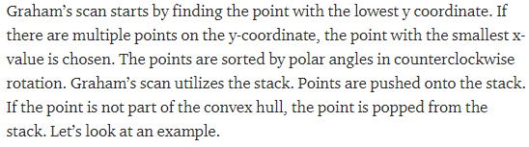
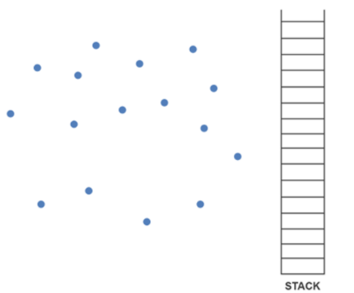
Geometric Algorithms

Slide 13
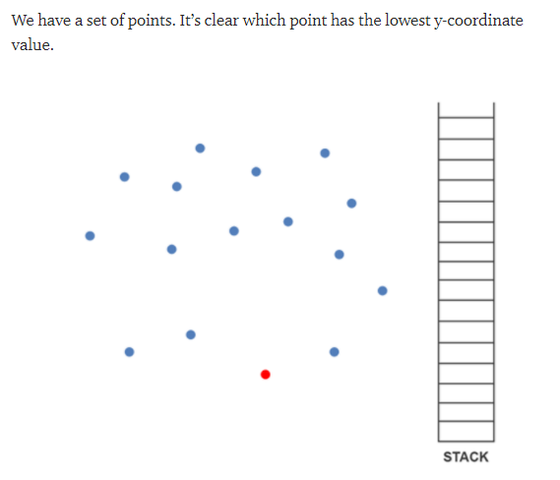
Geometric Algorithms

Slide 14
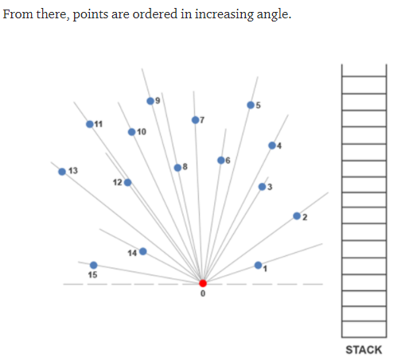
Geometric Algorithms

Slide 15
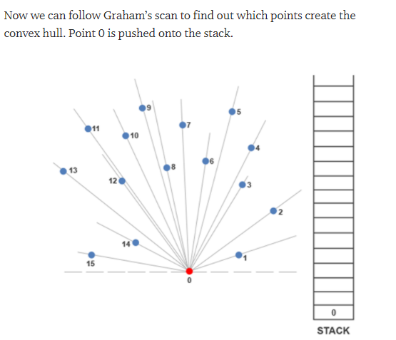
Geometric Algorithms

Slide 16
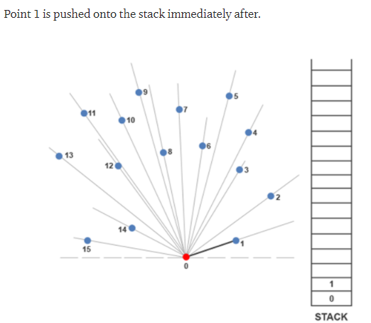
Geometric Algorithms

Slide 17
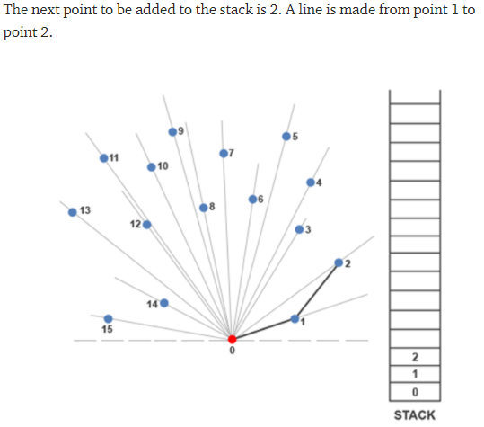
Geometric Algorithms

Slide 18
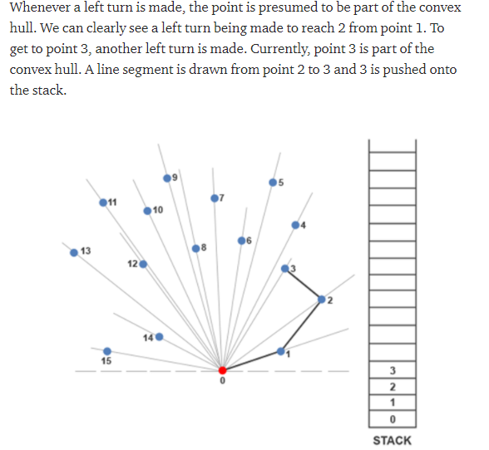
Geometric Algorithms

Slide 19
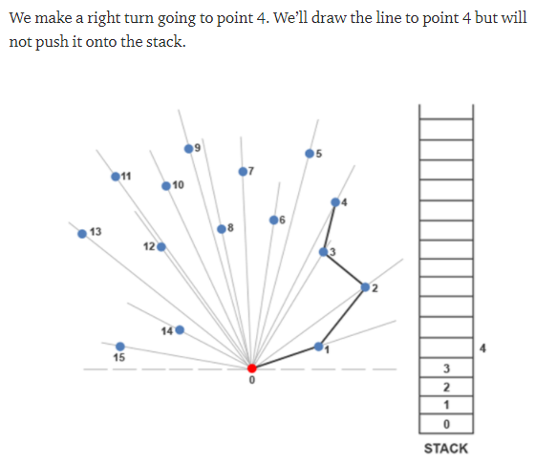
Geometric Algorithms

Slide 20
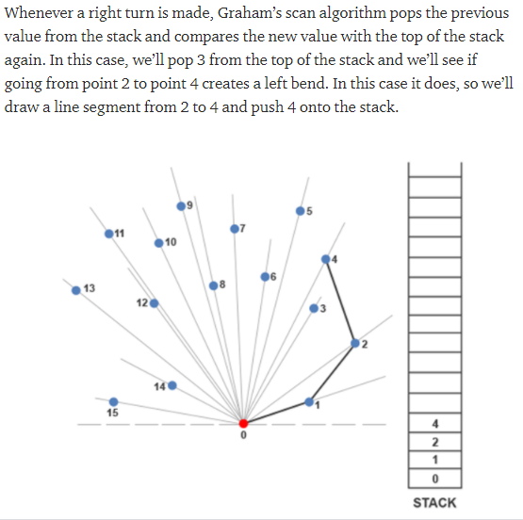
Geometric Algorithms

Slide 21
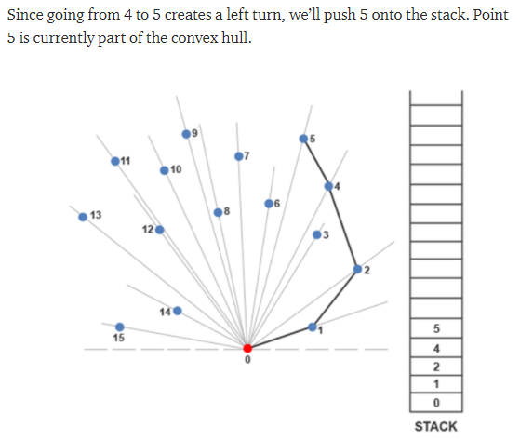
Geometric Algorithms

Slide 22
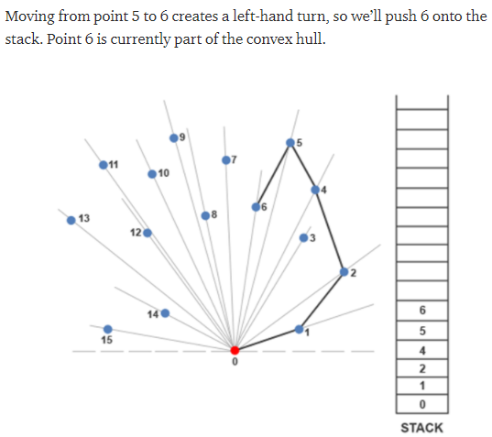
Geometric Algorithms

Slide 23
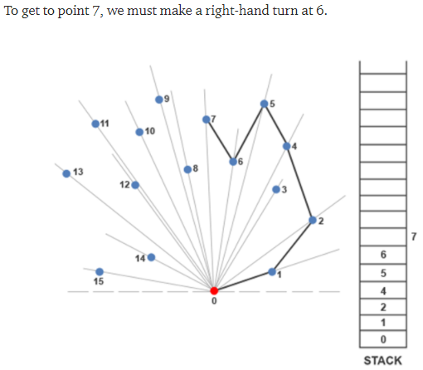
Geometric Algorithms

Slide 24
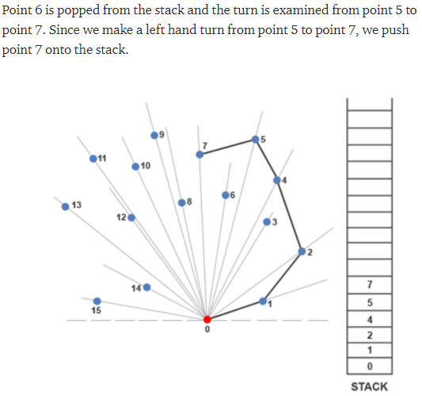
Geometric Algorithms

Slide 25
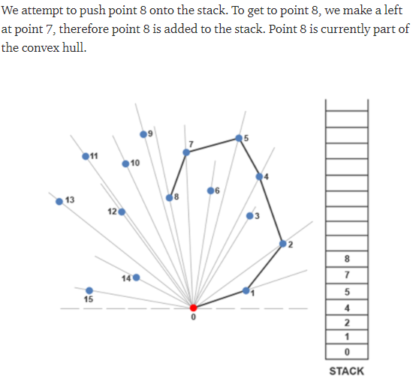
Geometric Algorithms

Slide 26
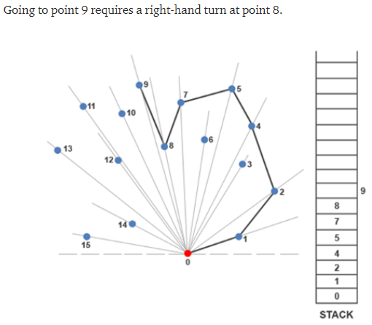
Geometric Algorithms

Slide 27
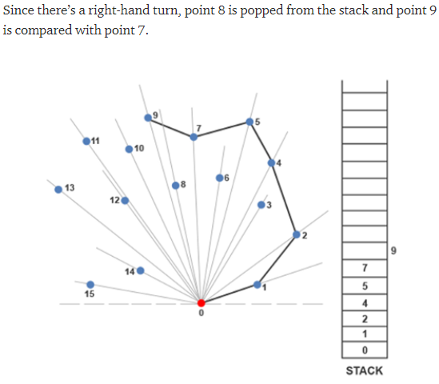
Geometric Algorithms

Slide 28
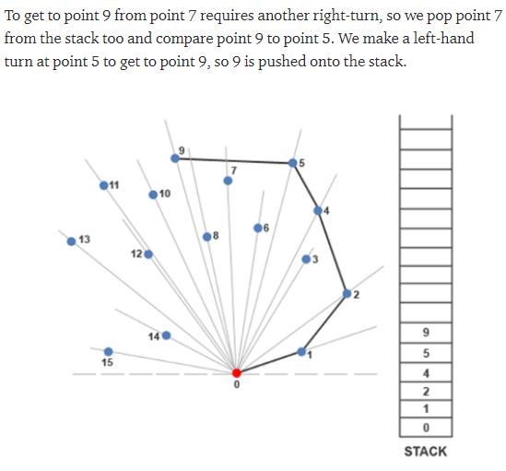
Geometric Algorithms

Slide 29
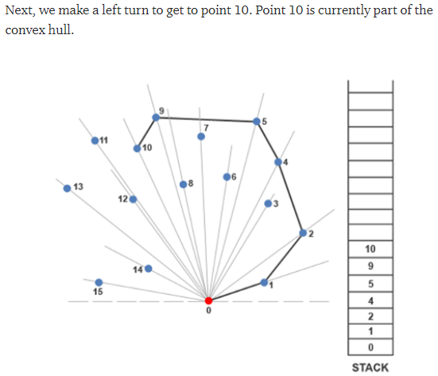
Geometric Algorithms

Slide 30
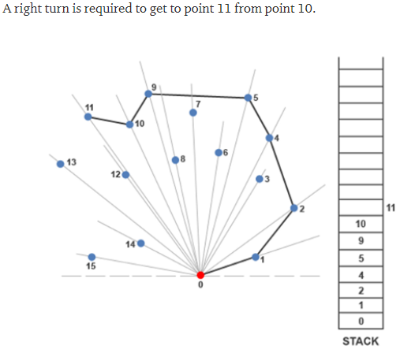
Geometric Algorithms

Slide 31
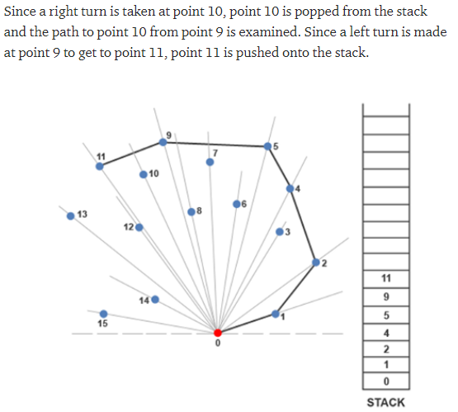
Geometric Algorithms

Slide 32
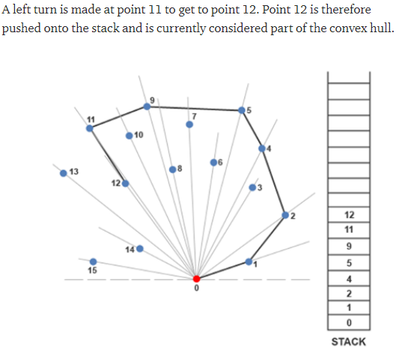
Geometric Algorithms

Slide 33
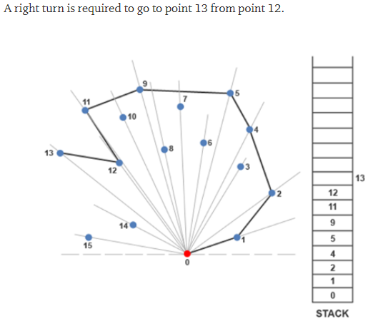
Geometric Algorithms

Slide 34
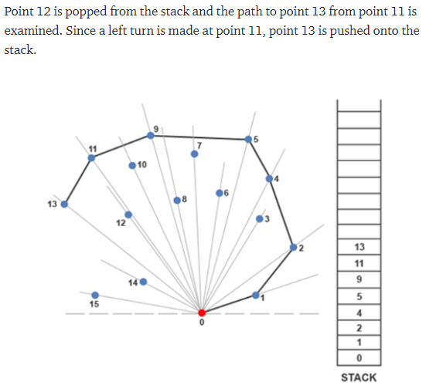
Geometric Algorithms

Slide 35
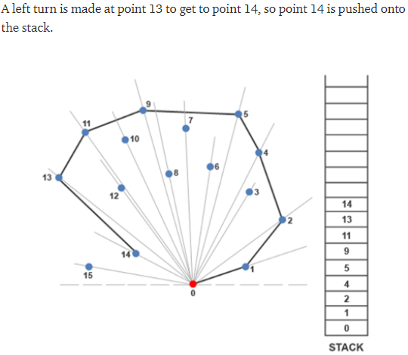
Geometric Algorithms

Slide 36
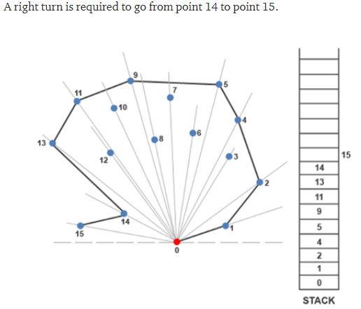
Geometric Algorithms

Slide 37
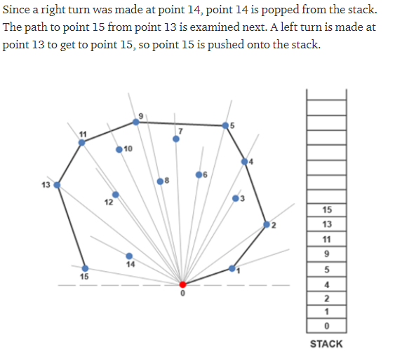
Geometric Algorithms

Slide 38
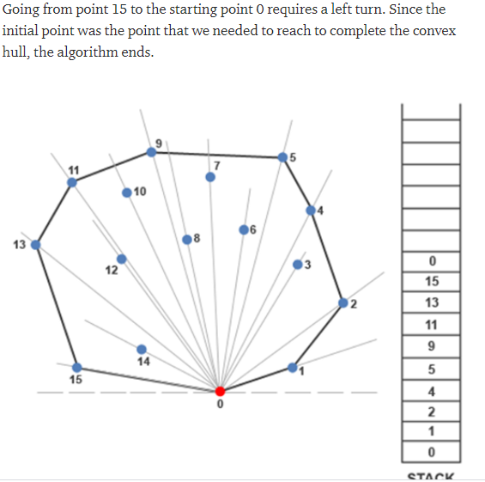
Geometric Algorithms

Slide 39
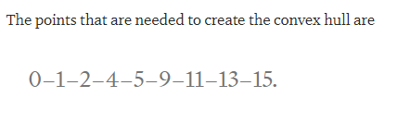
Geometric Algorithms

Slide 40
Geometric Algorithms
Time complexity of graham scan algorithm is O(nlogn) which has been explained in next slide.

Slide 41
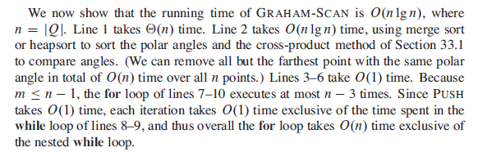
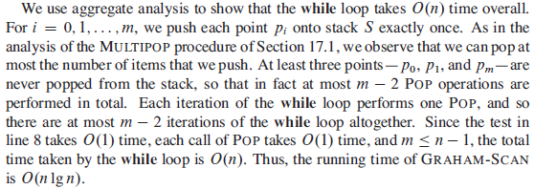
Geometric Algorithms

Slide 42
Geometric Algorithms
Applications :
Collision avoidance: If the convex hull of a car avoids collision with obstacles then so does the car. Since the computation of paths that avoid collision is much easier with a convex car, then it is often used to plan paths. Also in computer animation, replacing objects by their convex hulls speeds up collision detection; the same idea is used in path planning for Mars mission rovers.
Nuclear/Chemical Leak Evacuation. Imagine a modern city with sensors positioned uniformly all over. When a disaster such a chemical leak or nuclear radiation leak, one way to determine the perimeter for immediate evacuation is to construct the convex hull of areas with radiation levels (exceeding a certain threshold).
Tracking Disease Epidemic. Keeping track of the spatial extend of a disease outbreak could be done using the convex hull. A specific example in tracking animal epidemic is available here: https://www.pnas.org/content/110/11/4239.full
and etc

