Slide 1
Communication and Presentation Skills
An Introduction

Slide 2

What is COMMUNICATION?

Slide 3
Is it an ART or a Skill?

Slide 4
Benefits of Developing Communication Skills
It is recognized as a Core Skill for “globally engaged democracy and fueled economy”
It is critical for:
  Intellectual development
  Career Trajectory
  Civic engagement
  Applicable to all types of majors and occupations
  It is seen by employers as a critical employability skill for job seekers

Slide 5
The Fear of Public Speaking- Glossophobia
Palms sweaty, heart racing, stomach in knots?
Throat too tight to breathe?
Trembling legs and hands?
But at some point we've all had to in front of people, so you have to try and overcome it.

Slide 6
What are you afraid of?
Identify the most common and uncommon reasons for fear of speaking and make a list.

Slide 7

Communication-Definition
Communication is the process of conveying information in such a way that the message is received and understood.

Slide 8
The Essence of Communication
Occurs between/among people
Involves change in behavior
Means to influence others
Expression of thoughts and emotions through words & actions.
Tools for controlling and motivating people.
“It is a social and emotional process.”

Slide 9
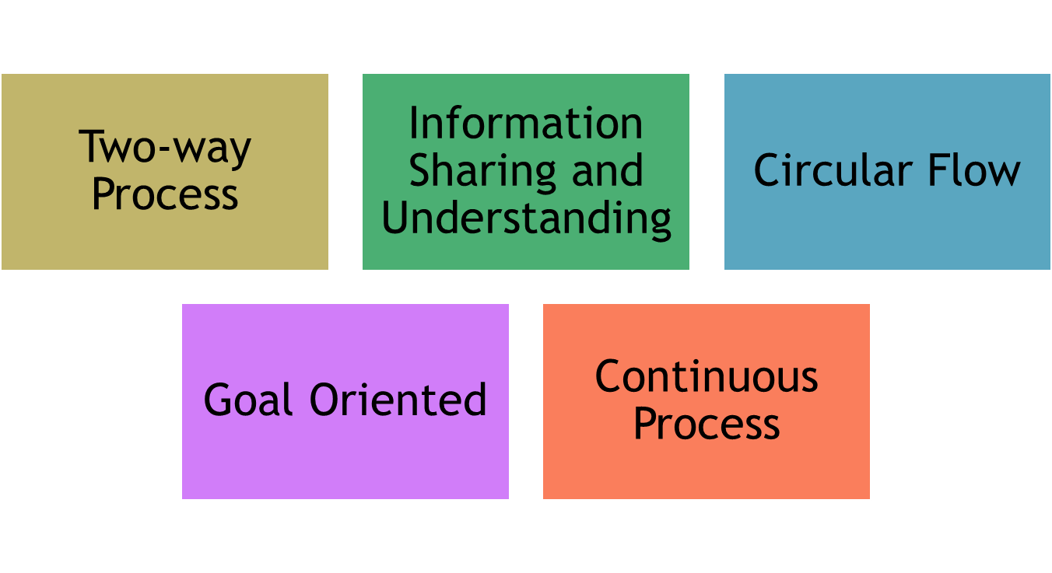
Features of Communication

Slide 10
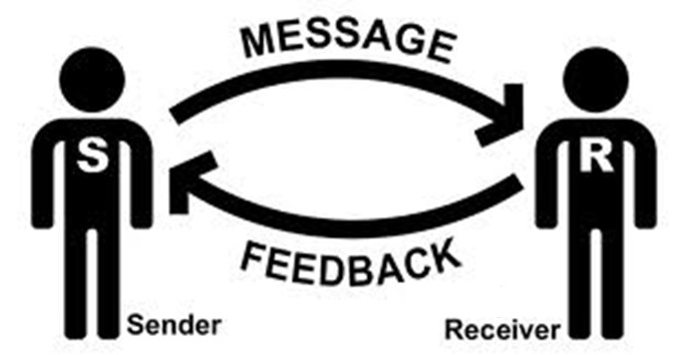
The basic Communication Process

Slide 11
Forms/modes of Communication

Slide 12
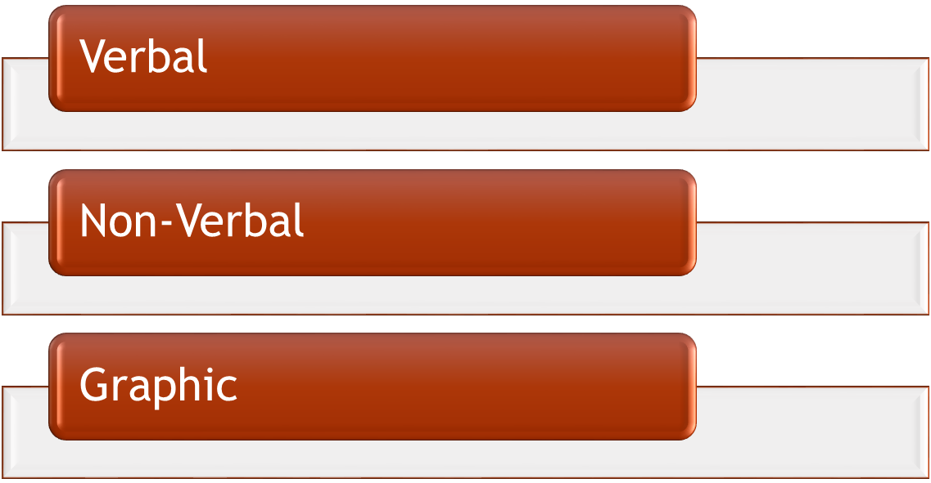
Forms of Communication

Slide 13
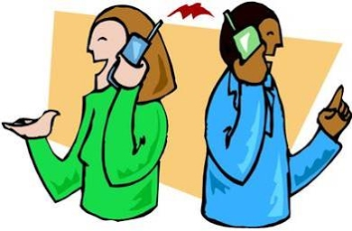
Verbal Communication
Verbal form can either be spoken or written. It involves the use of words.

Slide 14

Non-Verbal Communication
In this form, words or graphics are not employed.
It is present in written, oral, and graphic communication.
It involves the use of body language, paralanguage, dressing in speech.
On the other hand, format, layout, handwriting style, etc are non-verbal elements in writing.

Slide 15

Graphic Communication
It represents ideas, feelings, views, etc visually by the use of shapes, diagrams, lines, symbols, illustrations, color, etc. It can have both verbal and non-verbal elements.

Slide 16
Types of communication

Slide 17
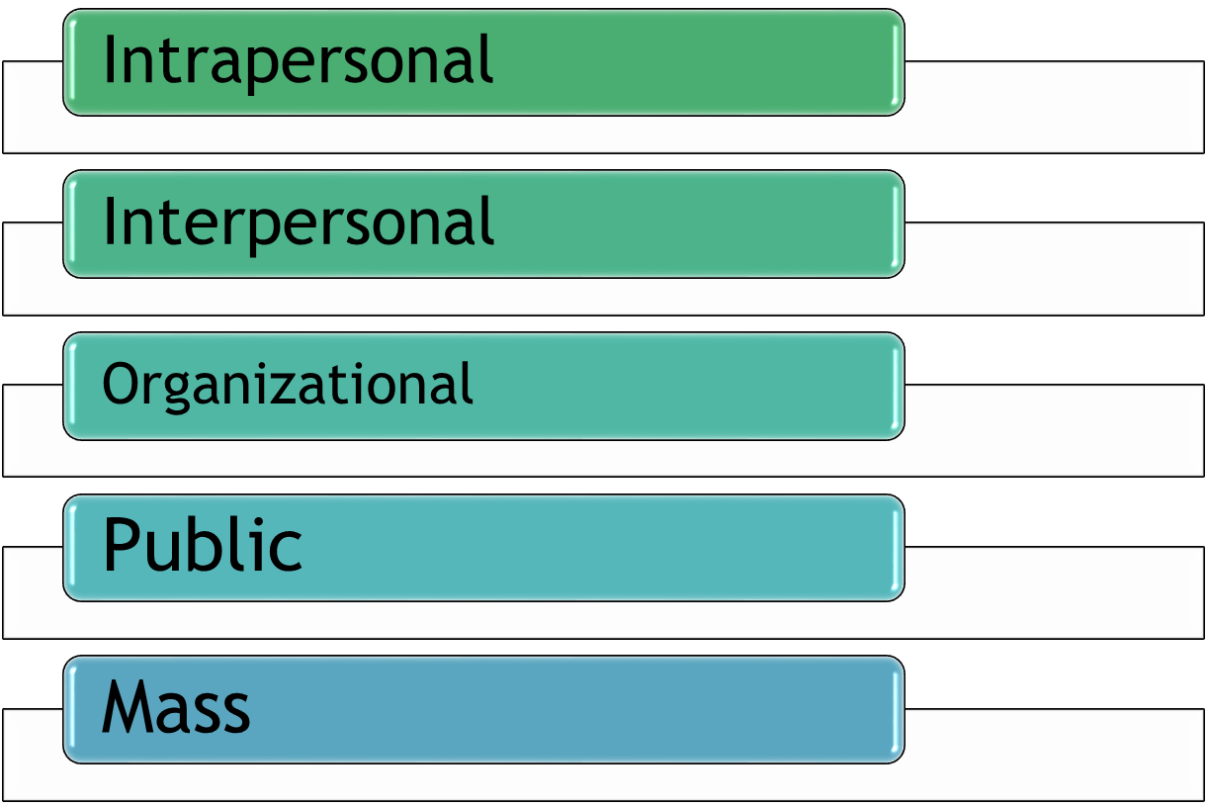

Slide 18
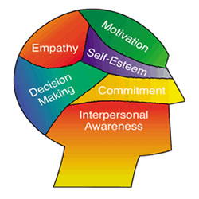
Intrapersonal Communication
Can be defined as a communication with one’s self
Includes imagination and visualization

Slide 19
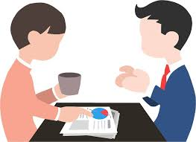
Interpersonal Communication
It is the process of exchange of information, ideas.

Slide 20

Organizational Communication
Refers to the forms and channels of communication among members of organizations such as corporations, nonprofits or small businesses

Slide 21

Public Communication
It involves informing and persuading the members of an audience to hold certain attitudes, values, or beliefs, so that they will think, believe, or act in a particular way

Slide 22

Mass Communication
Can be defined as the process of creating, sending, receiving, and analyzing messages to large audiences via verbal and written media

