Slide 1

PRODUCT ARCHITECTURE BLUEPRINT · v3.1
Multi-Tenant, Plug-and-Play
Digital Banking & Remittance Platform
Engineering architecture review — hexagonal core · regional data planes · NestJS-first, Java calculation islands
Pakistan
UAE
Saudi Arabia
Confidential — Internal Use · 8 July 2026
Notes:
Title. Frame the review: this is the v3.1 build-ready baseline. Three launch markets chosen deliberately to stress the plug-and-play model — three regulators, three currencies, RTL scripts, and KSA's in-Kingdom residency forcing real multi-region isolation from day one.

Slide 2





AGENDA
What this review covers
Problem & approach
01
Hexagonal foundation
02
One platform, many banks — configuration over forks
Ports & adapters; boundaries enforced at build time
Multi-tenancy & residency
03
Technology stack (v3.1)
04
Control plane + three regional data planes
NestJS default; Java islands for money math
Money-movement path
05
Delivery plan & risks
06
The remittance saga with explicit compensation
Phased build order and what we're watching
2
Notes:
Agenda. Six sections. Keep the first three conceptual (why/how), the last three concrete (stack, path, plan).

Slide 3






PROBLEM & APPROACH
One platform sold to many banks — never a fork per customer
THE CHALLENGE
THE APPROACH
Many tenants
Configuration, not code
Banks, EMIs and fintechs on shared infrastructure, each with their own brand and rules
Compliance, currency, language, fees and bank profile are all plug-and-play settings
Conflicting regimes
Swappable adapters
Different regulators, currencies, languages and data-residency law per market
Vendors and rails bind per tenant behind stable ports — no core change to add one
Zero tolerance
Isolation by construction
Cross-tenant data leakage or a rounding error in money are both unacceptable
Tenancy and residency are enforced structurally, then proven by CI, not by convention
3
Notes:
Problem/approach. The core bet: configuration and swappable adapters instead of a code fork per customer. Isolation is enforced structurally then proven by CI, not left to convention.

Slide 4
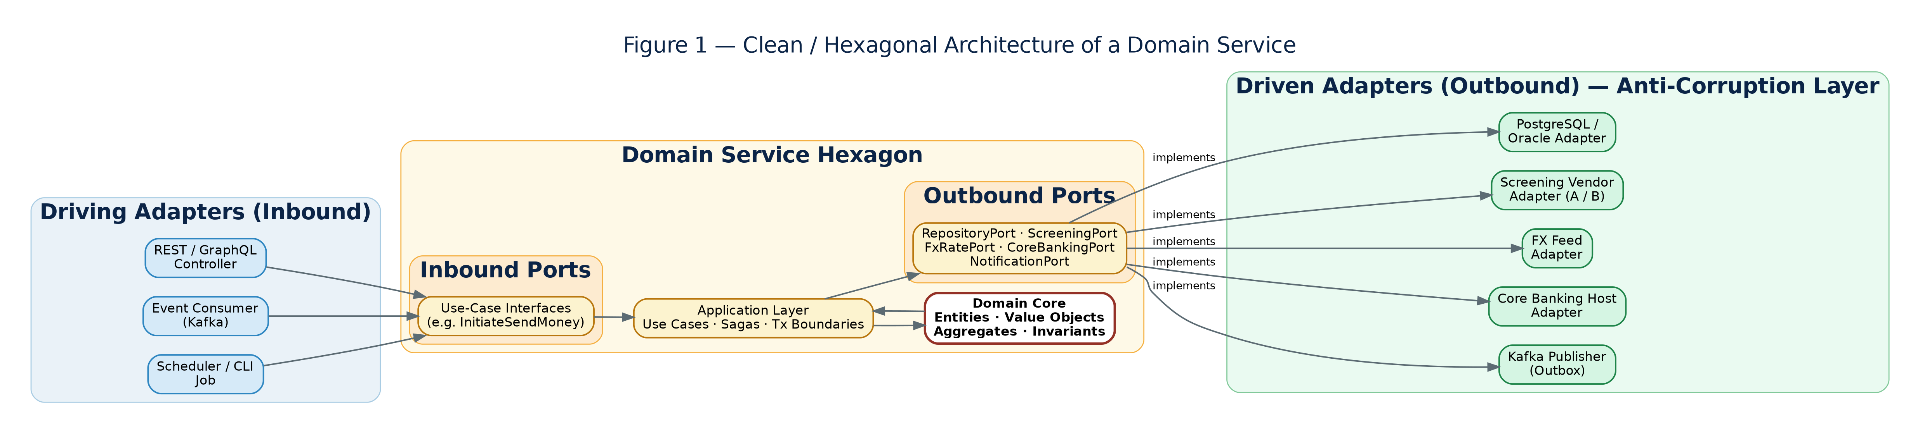

HEXAGONAL FOUNDATION
Ports & adapters — the pattern the whole platform rests on
Domain is pure
Ports define contracts
Enforced at build
No framework or I/O imports — business rules in isolation
Interfaces the domain owns; technology lives only in adapters
dependency-cruiser (TS) / ArchUnit (Java) fail CI on any violation
4
Notes:
Hexagonal. The domain is pure; technology lives only in adapters. The build-time boundary test is what keeps this honest across many squads — dependency-cruiser for TS, ArchUnit for the JVM services.

Slide 5
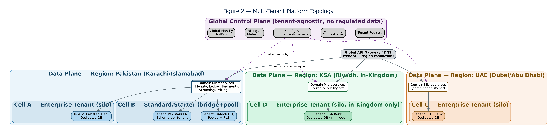
MULTI-TENANCY & RESIDENCY
One global control plane over three regional data planes
Bridge by default
Cells contain blast radius
KSA stays in-Kingdom
Shared compute, isolated data — silo on demand, pool only where safe
Deployment stamps per tenant tier keep one failure from spreading
A dedicated Riyadh plane; regulated data never shares infra across markets
5
Notes:
Topology. One control plane (no regulated data) over three regional data planes. Bridge by default, silo on demand, pool where safe. KSA is a dedicated in-Kingdom plane — never shares infra.

Slide 6

TECHNOLOGY STACK — V3.1
NestJS by default, Java where money math concentrates
NestJS 10 · TypeScript (strict)
Java 21 · Spring Boot 3.3
Default for ~85% of the estate
Calculation islands only
10 domain & platform services, all BFFs, SDKs and both web frontends
DI maps 1:1 onto ports/adapters; per-tenant adapter swap = a provider binding
One language end-to-end — hiring, velocity, team mobility
Ledger (04) and Pricing (10) — exact BigDecimal money math
FX adapter (17) — in-process JVM library, no hop on the quote path
ArchUnit boundaries + JVM throughput on the hot paths
THREE MANDATORY GUARDRAILS WHEN LEAVING THE JVM
Integer minor-unit money
Boundary test in CI
Strict TypeScript
bigint via @platform/money; native number banned by ESLint rule
dependency-cruiser replaces ArchUnit; build fails on violation
strict, noImplicitAny, exactOptionalPropertyTypes — no escape hatch
6
Notes:
Stack decision. The headline: NestJS everywhere except the calculation core. Walk the three guardrails — they are what make leaving the JVM safe. If challenged on 'why two runtimes', point to the risks slide.

Slide 7




TECHNOLOGY STACK — LAYERS
The full stack, layer by layer
Clients & frontend
CROSS-CUTTING
React 18 + Vite + design-token theming · React Native reference apps · generated TypeScript SDKs
OpenTelemetry traces + metrics
Edge & contracts
Kong API gateway · OIDC realm-per-tenant (Keycloak) · OpenAPI 3.1 + Avro schemas · Pact gates in CI
JSON logs with tenant_id + correlation_id
Service runtime
GitHub Actions CI · cosign-signed images
Node 22 + NestJS 10 (TS 5.5 strict) default · Java 21 + Spring Boot 3.3: Ledger, Pricing, FX · OPA policy
Data & eventing
dependency-cruiser / ArchUnit gates
PostgreSQL 16 (silo / bridge / pool) · Redis · OpenSearch · Kafka 3.7 + Debezium outbox · object storage
Vault secrets · per-tenant KMS keys
Infrastructure
Kubernetes 1.30 + Istio 1.22 · Terraform 1.8 · ArgoCD GitOps · three regional clusters: pk · ae · sa
Runtime is the only polyglot layer — everything above and below it is identical for every service.
7
Notes:
Full stack layers. Read bottom-up if asked how a request lands. Key point: runtime is the ONLY polyglot layer — infra, data, edge and frontend are identical for every service, which is what keeps two runtimes cheap to operate.

Slide 8
SERVICE & ADAPTER MAP
12 services, 9 adapters — each with a runtime and an owner
# | Component | Runtime | Owning squad
04 | Ledger | Java / Spring | Ledger & Money Movement
10 | Pricing, Billing & Metering | Java / Spring | Pricing & Billing
17 | FX Rate adapter | Java library | Ledger & Pricing
02 / 03 | Identity/KYC · Screening/AML | NestJS / TS | Identity · Compliance
05 / 06 / 07 | Payments · Wallets · Cards | NestJS / TS | Payments · Accounts & Cards
08 / 09 | Compliance Reporting · Reconciliation | NestJS / TS | Compliance · Ledger
11 / 12 / 13 | Dev Platform · Control Plane · Notification | NestJS / TS | Platform · Dev Platform
14 | Persistence adapter | TS + Java impls | Platform / Enablement
15·16·18–22 | Screening · eKYC · rails · card · msg · OIDC | NestJS / TS | Owning squad per adapter
Java is confined to the three components where a float or rounding defect is catastrophic; everything else is one TypeScript codebase.
8
Notes:
Service map. Java is confined to three components. Everything else is one TypeScript codebase. Note 14 ships dual TS+Java impls, certified to behavioural parity.

Slide 9
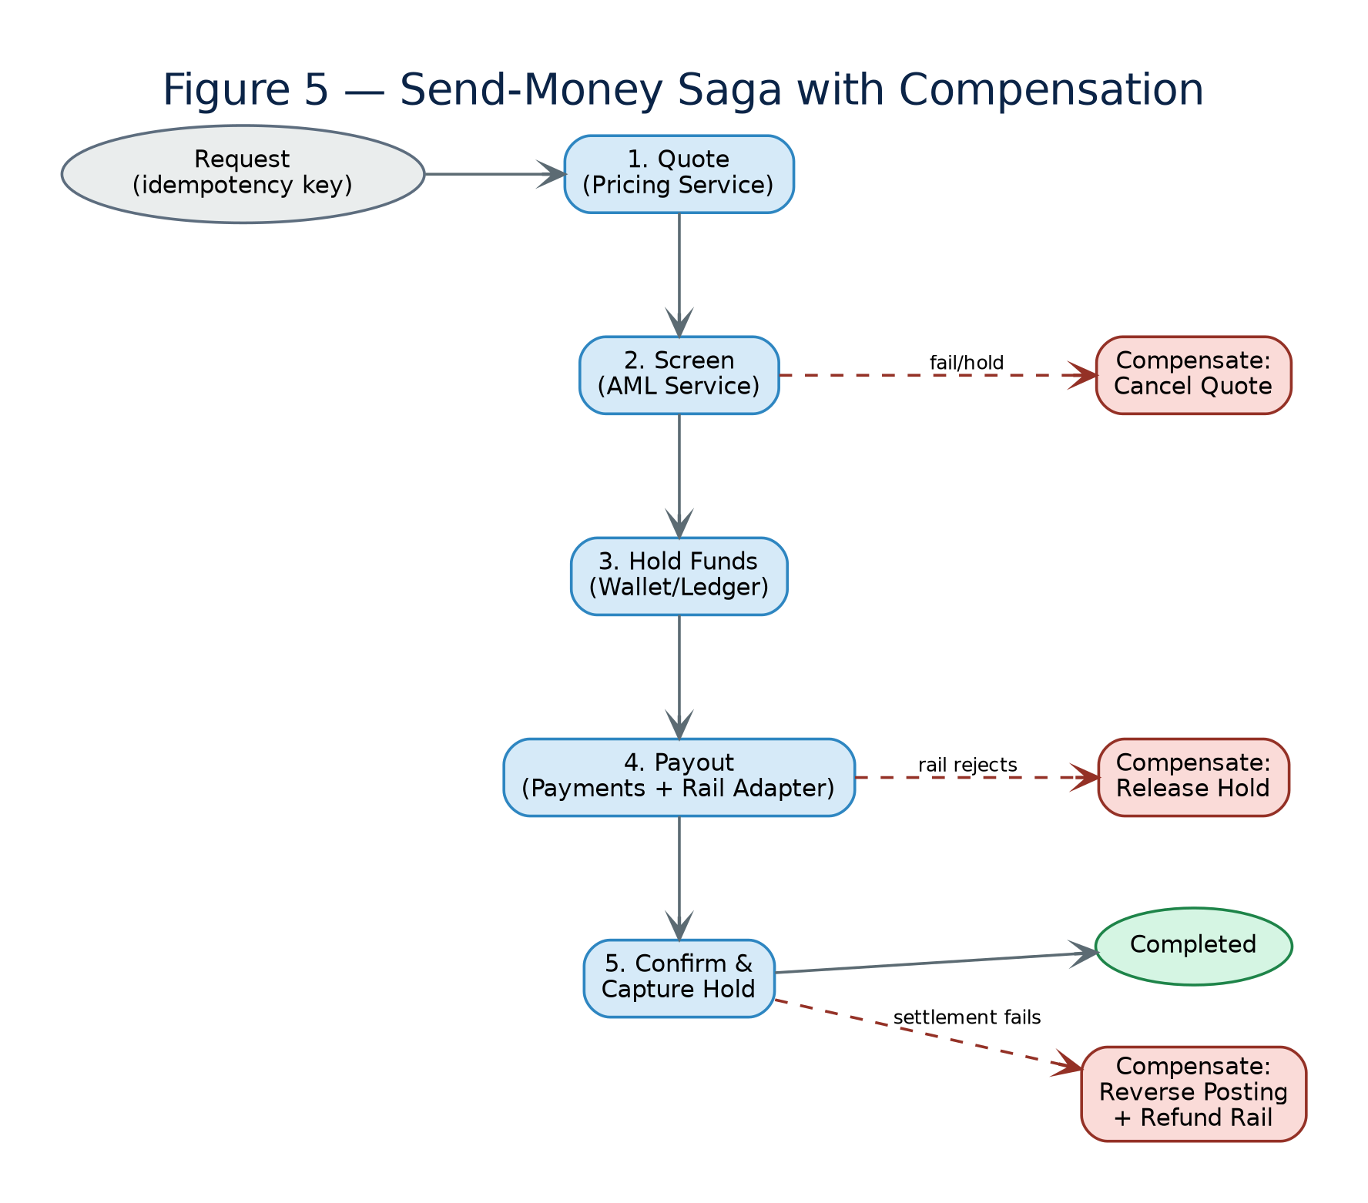

MONEY-MOVEMENT PATH
The remittance saga — quote, screen, hold, pay out, settle
Every step is a persisted, idempotent state transition
Compensations are explicit
Screen-fail cancels the quote; rail-reject releases the hold; settle-fail reverses the journal — each an idempotent saga step
IN_FLIGHT is first-class
A rail timeout is never assumed success or failure; a status-inquiry job resolves it
Amounts never float
@platform/money integer minor units across the whole path; the Ledger hold is the only synchronous money write
Corridors are config
UAE→PK and KSA→PK at launch, bound to Raast / Aani / sarie or a cross-border partner by setting, not code
9
Notes:
Saga. Emphasize explicit compensation and that IN_FLIGHT is first-class — a rail timeout is never guessed. Money never floats; the Ledger hold is the only synchronous money write.

Slide 10

CROSS-CUTTING GUARANTEES
The invariants every service inherits
Transactional outbox
Tenant on everything
Fail-safe closed
State and its events commit in one transaction; Debezium relays to Kafka — no lost or phantom events
tenant_id rides every request, event, row, log line and metric; missing context is rejected before any query
Screening and card-authorization default to HOLD / DECLINE on timeout — never a silent pass
Idempotency everywhere
Contracts block CI
Quantified NFRs
Every mutation takes an Idempotency-Key; retries and duplicate callbacks converge, never double-act
OpenAPI + Avro first; Pact verification is mandatory on both sides of every TS↔JVM seam
Config resolution < 5 ms p99 · outbox lag < 2 s · isolation-test coverage 100%, zero tolerance
10
Notes:
Guarantees. These invariants are inherited by every service via the golden-path template — not re-implemented. Outbox, tenant context, fail-safe-closed, idempotency, contracts, quantified NFRs.

Slide 11

DELIVERY PLAN
Phased build order — Pakistan first, then UAE and KSA
PHASE 1
PHASE 2
PHASE 3
PHASE 4
PHASE 5
PHASE 6
Foundations
Walking skeleton
Compliance gate
Money movement
First tenant (PK)
Scale out
Templates + @platform packages, Control Plane, OIDC, Persistence
Ledger, Identity, eKYC — onboard→verify→post in the PK plane
Screening + provider adapter; SBP/FMU pack certified
Pricing + FX, the Payments saga, Raast + cross-border rail
Full isolation suite green; NADRA + Raast certified live
UAE (CBUAE, Aani) then in-Kingdom KSA (SAMA, sarie)
11
Notes:
Delivery. Pakistan first through phase 5 (first real tenant), then UAE and KSA in phase 6. Each phase has a hard exit criterion — isolation suite and pack certification gate the tenant go-live.

Slide 12
RISKS WE'RE WATCHING
Known trade-offs and how we contain them
Two runtimes to operate
Money safety off the JVM
Risk Polyglot adds a second golden-path template and pipeline
Risk JavaScript has no native decimal type
Mitigation Identical hexagonal layout, shared CI, Pact on every seam; fallback to all-NestJS is a packaging change, not a redesign
Mitigation Integer minor units enforced by lint rule + property tests; the calculation core stays on Java deliberately
Node throughput on hot paths
Regulatory detail may shift
Risk Single-process CPU work trails the JVM
Risk Scheme rulebooks and residency law evolve
Mitigation Ledger/Pricing kept on Java; Cards auth runs on Fastify; scale Node horizontally per cell
Mitigation Compliance packs are versioned config, certified per market with counsel before any tenant goes live
12
Notes:
Risks. Lead with the polyglot cost since it's the most likely pushback. The all-NestJS fallback is a packaging change, not a redesign, precisely because ports are language-agnostic.

Slide 13
Where this leaves us
A build-ready baseline
24 documents plus 24 engineering design specs — interfaces, DDL, sequences and test gates
Architecture that absorbs change
New market, vendor or rail is configuration and one more data plane, not a rewrite
Safety designed in, not bolted on
Isolation, residency, exact money and fail-safe compliance are structural and CI-verified
Next: stand up the foundation repos from the golden-path templates and begin the Pakistan walking skeleton.
Notes:
Close. Build-ready: 24 docs + 24 design specs. Architecture absorbs change. Next concrete step is standing up foundation repos and the PK walking skeleton.

