Slide 1


SHARED ADAPTER PLATFORM · v1.0
One Platform Core,
Two Products — Banking + Takaful
Eight reusable adapters serving the Digital Banking & Remittance app and the new Takaful (Islamic insurance) app — across Pakistan, UAE and Saudi Arabia
Pakistan
UAE
Saudi Arabia
STATUS — DESIGN & BLUEPRINT STAGE · NO CODE BUILT YET
Confidential — Internal Use · 14 July 2026
Notes:
Title. Say it plainly up front: everything here is at DESIGN/BLUEPRINT stage — nothing is built yet (amber status pill). This session is about the strategy and architecture, not a demo. The pitch: design once, build once, launch twice — banking + Takaful over one shared adapter core.

Slide 2




AGENDA
What this session covers
Why one platform, two apps
01
Inside the banking app
02
Design once, build once, launch twice
Architecture, capabilities & tech stack
The shared adapter layer
03
Takaful journeys
04
Eight adapters: five designed, three new
Issuance and claims on shared rails
Engineering & governance
05
Delivery plan & risks
06
Versioning, contracts, ownership
Phases to a Takaful pilot in Pakistan
2
Notes:
Agenda. Six parts. Note we now walk INSIDE the banking app first (architecture + stack) before the shared-adapter strategy, so the audience sees what's been designed.

Slide 3



WHY A SHARED PLATFORM
The regulated plumbing is identical — so build it once
8
5
3
2
3
shared adapters
already designed
new — to design
consumer apps
launch markets
Design once, certify once
Takaful skips re-architecture
One compliance posture
KYC providers, sanctions lists, payment rails and tax rules are certified per country once — both apps inherit the certification
The insurance app reuses adapters already fully specified in the v3.1 blueprint — onboarding, screening, payments, tax, notifications
A single case-management queue, one screening standard and one residency model (pk · ae · sa) across both products
3
Notes:
Why. Stat band: 8 shared adapters — 5 already designed in the v3.1 blueprint, 3 net-new to design. The value is design-once/certify-once: Takaful skips re-architecting the regulated plumbing because it's already specified.

Slide 4
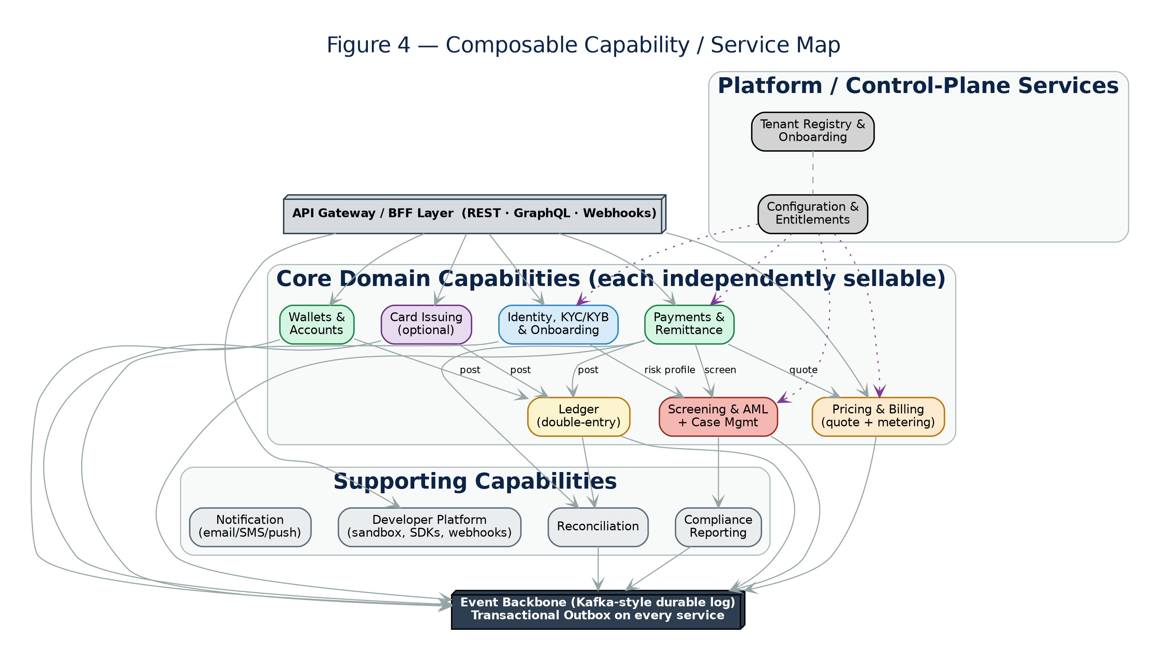

BANKING APP ARCHITECTURE — 1 OF 2
Inside the banking app — composable capabilities
Independently sellable services
Ledger, Payments, Wallets, Cards, Identity, Screening, Pricing — each a bounded service a tenant can license on its own
Control plane stays tenant-agnostic
Tenant Registry and Config & Entitlements hold no regulated customer data; they drive every data-plane service
Event backbone ties it together
A Kafka-style durable log with a transactional outbox on every service — no lost or phantom events
Status: this architecture is fully specified in the v3.1 blueprint (24 design documents) — implementation has not started.
4
Notes:
Banking arch 1 of 2. This is the banking app's capability map — independently sellable domain services, a tenant-agnostic control plane, and an event backbone with a transactional outbox. Footer restates: fully specified, not yet built.

Slide 5
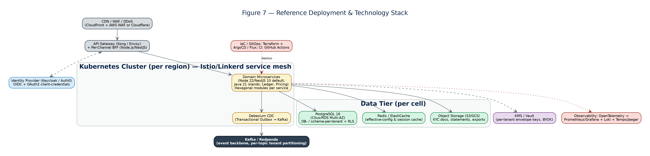

BANKING APP ARCHITECTURE — 2 OF 2
One control plane, three regional data planes
Control plane, deployed once
Data plane per market
One toolchain, per-cell data
Tenant registry, config and entitlements run globally with no regulated data
pk · ae · sa — each its own Kubernetes cluster; KSA fully in-Kingdom; cells contain blast radius
Kong + Istio, Terraform + ArgoCD GitOps, OpenTelemetry; Postgres / Redis / object storage per cell
5
Notes:
Banking arch 2 of 2. Deployment topology: one global control plane, three regional data planes (pk/ae/sa, KSA in-Kingdom), cells for blast-radius, and the toolchain (Kong, Istio, Terraform, ArgoCD, OTel).

Slide 6





TECHNOLOGY STACK
NestJS by default — Java only where money math lives
NestJS 10 · TypeScript (strict)
Java 21 · Spring Boot 3.3
Default for every service AND adapter
The calculation core only
All 8 shared adapters, all domain & platform services, BFFs and SDKs
DI maps 1:1 onto ports/adapters; per-tenant provider swap is configuration
One language, one hiring pool, one mental model
Ledger & Pricing services + the FX-rate adapter — exact money math
New calc-heavy adapters (e.g. Country Tax) judged against the same rule
FX adapter runs in-process — no network hop on the quote path
WHY JAVA ONLY HERE
Exact decimal money
Throughput on hot paths
Strongest boundaries
BigDecimal / integer minor units — a float or rounding error in a ledger or a levy is catastrophic
JVM headroom for journal posting and quote / tax computation under load
ArchUnit enforces hexagonal rules at build time on the most sensitive code
Everything else is TypeScript; every TS↔Java seam is locked by Pact contracts in CI.
6
Notes:
Tech stack. Answers 'why Java + Spring Boot at all': NestJS/TypeScript is the default for every service AND adapter; Java is confined to the calculation core — Ledger, Pricing, and the FX-rate adapter — because a float/rounding error there is catastrophic. New calc-heavy adapters like Country Tax are judged against the same rule. Every TS↔Java seam is Pact-locked.

Slide 7
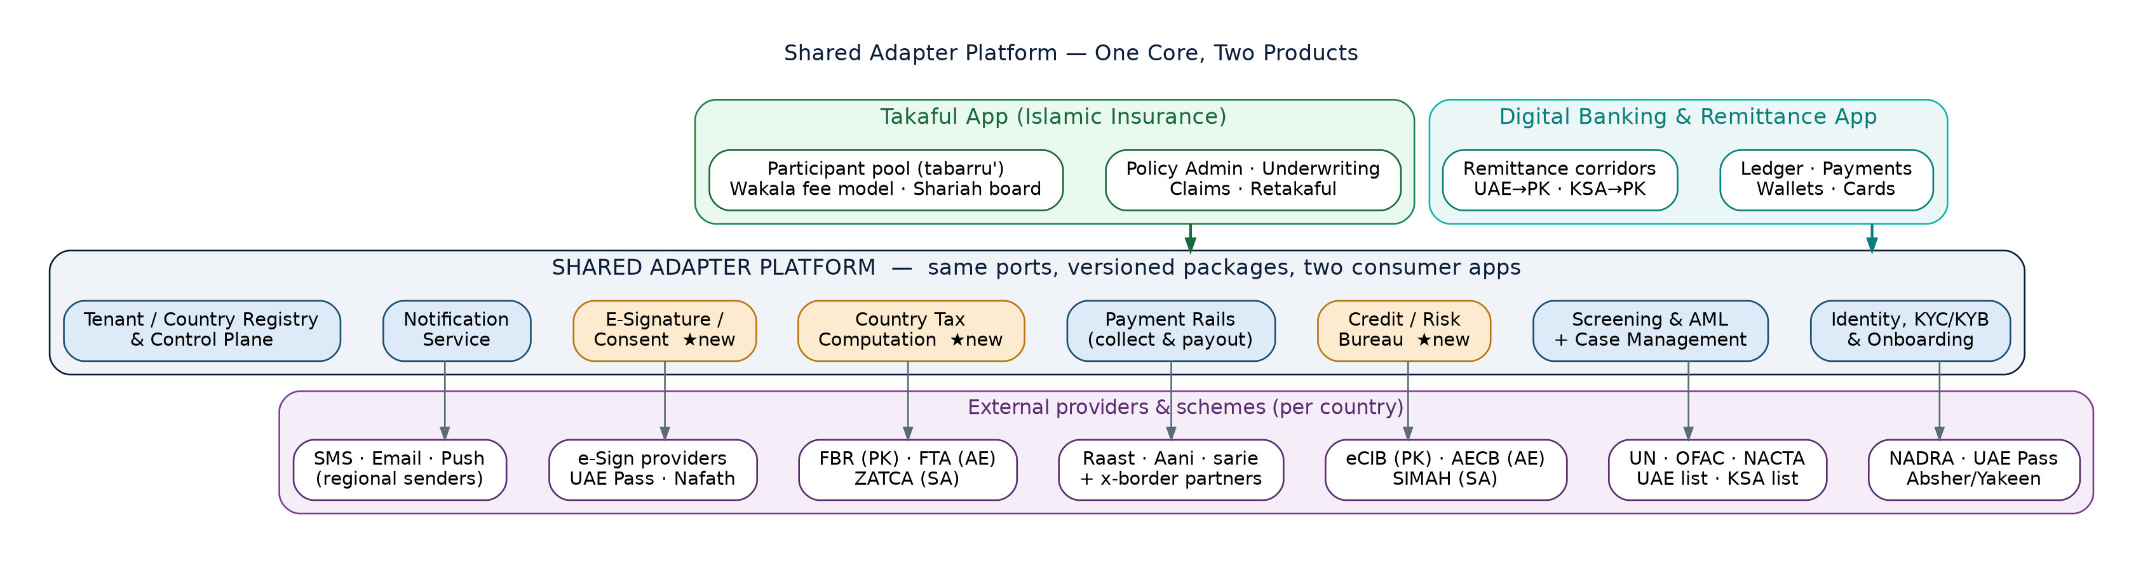
TARGET ARCHITECTURE
Two apps over one shared adapter layer
Apps own their domain
Adapters own the plumbing
Providers bind per country
Ledger and corridors stay in banking; policy, underwriting and claims live only in Takaful
Identity, screening, bureau, rails, tax, e-sign, notifications and the control plane serve both
NADRA/eCIB/FBR/Raast (PK) · UAE Pass/AECB/FTA/Aani (AE) · Yakeen/SIMAH/ZATCA/sarie (SA)
7
Notes:
Target architecture. Now the shared story: apps own their domain, adapters own the plumbing, providers bind per country. Amber boxes are the new builds.

Slide 8






THE EIGHT SHARED ADAPTERS
Five already designed · three new
DESIGNED
DESIGNED
NEW
DESIGNED
Identity, KYC/KYB & Onboarding
Screening & AML + Cases
Credit / Risk Bureau
Payment Rails — collect & payout
NADRA · UAE Pass · Absher/Yakeen; doc + liveness + registry
UN/OFAC + NACTA · UAE list · KSA list; one case queue
eCIB (PK) · AECB (AE) · SIMAH (SA) scores & reports
Raast · Aani · sarie/mada + cross-border partners
NEW
NEW
DESIGNED
DESIGNED
Country Tax Computation
E-Signature / Consent Capture
Notification Service
Tenant / Country Registry & Control Plane
FBR (PK) · FTA VAT 5% (AE) · ZATCA VAT 15% (SA)
UAE Pass sign · Nafath (SA) · ETO-2002 basis (PK)
SMS/email/push · en-PK, ur-PK (RTL), ar-AE, ar-SA
Config hierarchy · entitlements · home_region pk/ae/sa
8
Notes:
The eight. Chips show DESIGNED (5) vs NEW (3). Provider names are per launch market.

Slide 9
REUSE MAP
Same adapter, two products
Shared adapter | Banking app uses it for | Takaful app uses it for
Identity / KYC-KYB | Customer & business onboarding | Participant & policyholder onboarding
Screening & AML + cases | Onboarding + every transfer | Participants, beneficiaries, claim payees
Credit / Risk Bureau ★ | Lending limits, tenant risk checks | Underwriting risk & contribution-default scoring
Payment rails (collect+payout) | Remittance payout, refunds | Contribution collection (recurring) + claim payouts
Country tax computation ★ | WHT on fees, VAT on charges | Levies & VAT on contributions and wakala fees
E-signature / consent ★ | Account & mandate agreements | Policy docs, wakala agreement, claim forms
Notification | OTPs, transfer status | Policy lifecycle, renewal & claim status
Registry & control plane | Tenant config, residency, entitlements | Same — plus takaful product-line config
★ net-new adapter — designed once with both consumers at the table from day one.
9
Notes:
Reuse map. Same port, two products — e.g. rails do remittance payout for banking and recurring contribution collection + claim payouts for Takaful.

Slide 10
WHAT WE BUILD NEXT
Three net-new adapters — same hexagonal recipe
Credit / Risk Bureau
Country Tax Computation
E-Signature / Consent
BureauPort getScore(subject) · getReport(subject) · consent-gated
TaxPort computeLevies(operation, amounts, country) → itemised lines
SignaturePort createEnvelope(docs, signers) · status · evidence bundle
Providers eCIB (PK) · AECB (AE) · SIMAH (SA)
Providers FBR (PK) · FTA — VAT 5% (AE) · ZATCA — VAT 15% (SA)
Providers UAE Pass signature (AE) · Nafath (SA) · ETO-2002 basis (PK)
Design note Consent capture is a legal precondition — wire it through the E-Sign adapter; cache TTL per bureau licence
Design note Pure, versioned rule tables per country pack; integer minor units; every quote line traceable to a rule version
Design note Evidence bundle (who/what/when/how) stored per residency rules — it is the legal artefact for policies and mandates
10
Notes:
New builds. Credit Bureau, Country Tax, E-Sign — each with port signature, per-market providers, and the one design decision that matters. These are to be designed with both apps at the table.

Slide 11
TAKAFUL ON SHARED ADAPTERS
Two journeys, mostly pre-built plumbing
JOURNEY 1 — POLICY ISSUANCE & CONTRIBUTION
Participant applies
KYC / Onboarding
(Identity)
Sanctions / AML
(Screening)
Risk score
(Bureau ★)
Quote + VAT/levies
(Tax ★)
Policy + wakala docs
(E-Sign ★)
Collect contribution
(Rails)
Welcome + schedule
(Notify)
JOURNEY 2 — CLAIM TO PAYOUT
Claim intake
+ evidence
Claim form / consent
(E-Sign ★)
Payee screening
(Screening)
Assessment
(Takaful app)
Claim payout
(Rails)
Status updates
(Notify)
Shared adapter — already designed
Shared adapter — new ★
Takaful app logic
Of 14 journey steps, only the assessment and intake are Takaful-specific logic — everything else is the shared platform.
11
Notes:
Journeys. 14 chevron steps; only intake and assessment are Takaful-specific. Legend: blue = adapter already designed, amber = new adapter, green = app logic.

Slide 12
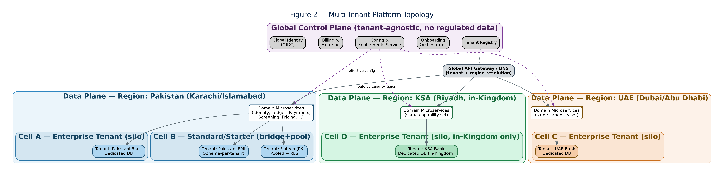

FOUNDATIONS THAT CARRY OVER
Takaful inherits the platform's designed-in guarantees
Hexagonal ports
Both apps consume identical port interfaces; providers swap per tenant/country by configuration
Residency & tenancy
home_region pk/ae/sa routing, silo/bridge/pool isolation and the isolation model apply unchanged
Same three data planes — a Takaful tenant in KSA lands in the in-Kingdom Riyadh plane, exactly like a bank
Money & correctness
@platform/money integer minor units, outbox events, idempotency keys — contributions and claims included
What stays separate
App data is segregated: Takaful gets its own databases/schemas within each country plane — the adapter layer never mixes the two apps' records.
Domain logic stays in the app: policy admin, underwriting rules, claim assessment and the participant pool are Takaful-only services.
Localization
en-PK, ur-PK (Nastaliq RTL), ar-AE, ar-SA templates serve policy documents and notifications too
12
Notes:
Foundations. Same three data planes, isolation model, money guardrails and RTL locales carry over by design. What stays separate: app data (own DBs/schemas per plane) and domain logic.

Slide 13


ENGINEERING & GOVERNANCE
How reuse stays safe with two consumers
Adapters are internal products
Contracts gate every change
One owning squad
Versioned services & packages with semver, a roadmap and release notes — not shared folders
Pact runs for BOTH consumer apps in the adapter's CI; a change that breaks either app cannot merge
A Platform Adapters squad owns the eight; app squads contribute via RFC + inner-source PRs
Deprecation, never surprise
Tenant + app scoping
Shared SLOs
Breaking changes ship as vN+1 alongside vN with a published migration window; both apps move independently
Every adapter call carries tenant_id and app_id; quotas and rate limits per app stop noisy-neighbour effects
Adapter availability and latency SLOs are set with both apps; dashboards split per consumer
13
Notes:
Governance. Where shared platforms live or die: adapters as versioned internal products, Pact for BOTH consumers gating merges, one owning squad, deprecation windows, app_id scoping and per-app quotas.

Slide 14

DELIVERY PLAN
Four phases to a Takaful pilot — Pakistan first, again
Phase A — Build the shared core
Phase B — Design & build 3 new
Phase C — Takaful pilot (PK)
Phase D — Scale out
Build the five already-designed adapters as versioned internal products — app_id scoping, per-app quotas and dual-consumer Pact contracts baked in from day one
Credit Bureau (eCIB/AECB/SIMAH), Tax (FBR/FTA/ZATCA rule packs), E-Sign (UAE Pass/Nafath) — designed with both apps at the table
Policy issuance + contribution collection via Raast with SECP-aligned compliance pack; claims path in sandbox
UAE (CBUAE insurance regime) then in-Kingdom KSA (SAMA cooperative-insurance rules); claims live in all three
Exit gates carry over: isolation suite green, pack certified with the insurance regulator, providers certified per market.
14
Notes:
Delivery. Phase A builds the five designed adapters as dual-consumer internal products; B designs & builds the three new; C is the Pakistan Takaful pilot (issuance + Raast collection); D scales to UAE and in-Kingdom KSA.

Slide 15
RISKS WE'RE WATCHING
Shared platforms fail on governance, not code
Two masters, one roadmap
Breaking-change blast radius
Risk Banking and Takaful will want conflicting priorities from the same adapters
Risk One bad adapter release now hits two products
Mitigation A single owning squad with a published roadmap; RFC process; capacity split agreed quarterly at the platform council
Mitigation Pact for both consumers blocks merge; vN/vN+1 side-by-side with deprecation windows; canary per app
Insurance-specific compliance
New provider dependencies
Risk SECP Takaful Rules (PK), CBUAE insurance regime, SAMA cooperative rules + Shariah board sign-off differ from banking packs
Risk Bureaus (eCIB/AECB/SIMAH), tax authorities and e-sign schemes add certification timelines
Mitigation Compliance packs get an insurance variant per market, certified with counsel and the Shariah board before pilot
Mitigation Start provider onboarding in Phase A in parallel; mock adapters keep app teams unblocked; per-provider circuit breakers
15
Notes:
Risks. Lead with governance (two masters, one roadmap). Insurance regimes differ (SECP/CBUAE/SAMA + Shariah board) — packs get an insurance variant per market.

Slide 16
The ask & next steps
Endorse the shared-adapter model
Eight adapters, one owning squad, contract-gated releases serving both apps
Fund the three new builds
Credit Bureau, Country Tax and E-Signature — banking benefits from all three as well
Green-light the Pakistan Takaful pilot
Phase A/B start now; issuance + contribution collection on Raast as the first live journey
One platform core. Two regulated products. Three markets — certified once.
Notes:
Close. Three asks: endorse the model, fund the three builds, green-light the PK pilot. Closing line: one platform core, two regulated products, three markets — certified once.

