Slide 1
From the given data:
Number of Training Samples: Monk 2 has maximum number of samples for training, hence it should give lowest amount of error.
Noise: Monk 3 training set is contaminated by noise, hence it should give highest amount of error.
Condition for True state: Monk 2 has a very generalized condition statement for Class “True” and turns out to be most difficult decision tree formation.
Data in MONK2 is not equally distributed as frequency of ones is less than 0.5, hence it should be biased and produce worst error rate.

Slide 2
Entropy (Up to 4 decimal Places)
Data Set | Entropy | Frequency of True
MONK1 | 1.0000 | 62/124
MONK2 | 0.9571 | 64/169
MONK3 | 0.9998 | 60/122
Entropy Relation to Distribution:
Uniform distribution sets the upper limit on the entropy value.
Entropy (Uniform Distribution) = N * (1/N) *(-log₂(1/N)) = log₂(N)
Any non-uniform distribution gives entropy always less than the entropy for uniform distribution.
Example:
For a fair dice (with p(i) = 1/6 for i = 1, 2, … , 6)
Entropy = 2.58
For a biased dice (with p(i)= 0.1 for i = 1, 2, … , 5 and p(6) = 0.5)
Entropy = 2.16 (High Entropy, Low Bias)
For a biased dice (with p(i)= 0.01 for i = 1, 2, … , 5 and p(6) = 0.95)
Entropy = 0.4025 (Low Entropy, High Bias)

Slide 3
Information Gain
Data Set | a₁ | a₂ | a₃ | a₄ | a₅ | a₆ | Root Node
MONK1 | 0.0753 | 0.0058 | 0.0047 | 0.0263 | 0.2870 | 0.0008 | a₅
MONK2 | 0.0038 | 0.0025 | 0.0011 | 0.0157 | 0.0173 | 0.0062 | a₅
MONK3 | 0.0071 | 0.2937 | 0.0008 | 0.0029 | 0.2559 | 0.0071 | a₂
Info. Gain Heuristics:
Information Gain Minimizes the overall entropy of the system by using the attribute with lowest uncertainty (i.e. we have more knowledge about the occurrence of outcome for that particular attribute).

Slide 4
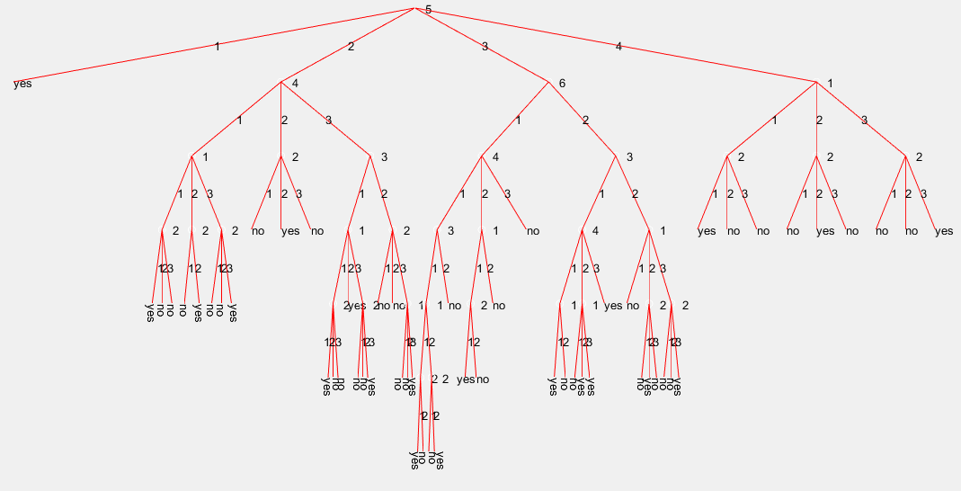
55 for T1 (Majority Decisions can be made till Level 5)

Slide 5
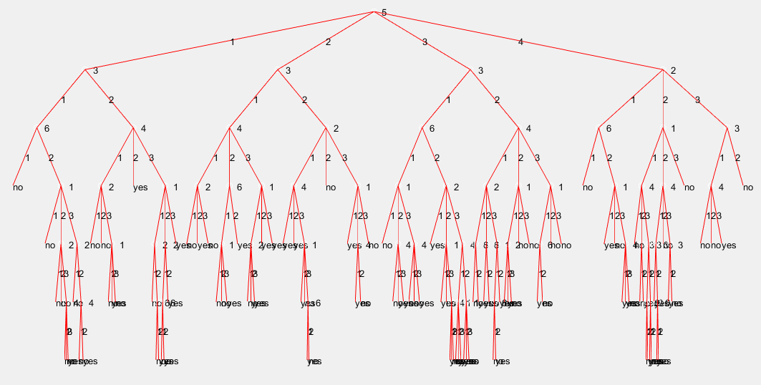
105 for T2 (6 Levels)
(Have to traverse through all levels to reach a final decision)

Slide 6
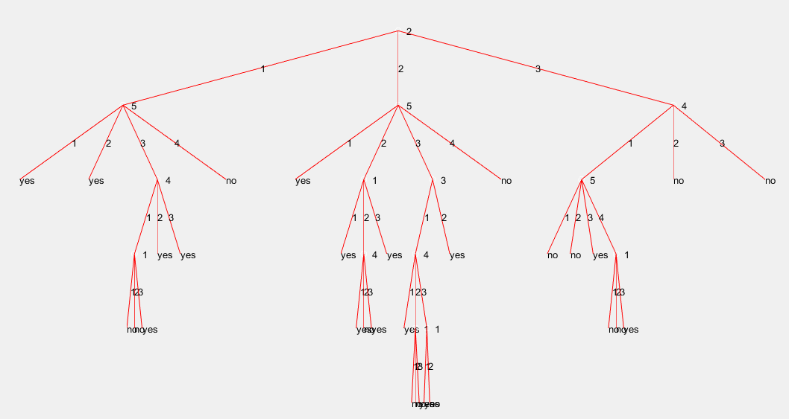
30 Leaf Nodes (Simplest of all the trees, Majority of the decisions are made till Level 4)

