Slide 1
Kalman Filter

Slide 2
Kalman Filter Fair Price Estimation
The observed mid-price is an important reference for fair price, but they tend to be noisy, dynamic and unstable, especially for a low liquidity market.
The Kalman filter is an algorithm used for estimating the state of a dynamic system from a series of incomplete and noisy measurements.

Slide 3
State Transition Equation
x(t) = F(t)x(t-1) + w(t)
x(): true state
F(): state-transition matrix
w(t) ~iid N(0, Q(t)) process noise
Let x() represents the fair price, F() = 1:
x(t) = x(t-1) + w(t)
fair price follows random walk

Slide 4
Measurement (Observation) Equation
z(t) = H(t)x(t) + v(t)
x(): true state
z(): observation of the true state (noisy)
H(): observation matrix, (true state space -> observed space)
v ~iid N(0, R(t)) observation noise
Let z(t) is the observed price, H() = 1:
z(t) = x(t) + v(t)
The observed price is the true price plus some observation noise

Slide 5
State Update Equation
x(t|t) = x(t|t-1) + K(t) (z(t) - x(t|t-1))
= (1-K(t)) x(t|t-1) + K(t) z(t)
x(t|t): posterior state estimate
x(t|t-1) : prior state estimate = x(t-1|t-1)
z(): observation of the true state
z(t) - x(t|t-1)): innovation
K(): Kalman gain
This is a recursive estimator, no history of observations or estimates is required.
This is a weighted average between the prior estimate and the new observation, with more weight being given to estimates with greater certainty. The weight is controlled by Kalman Gain.

Slide 6
Optimal Kalman Gain K(t)
K(t) = P(t|t-1) / [P(t|t-1) + R(t)]
P(t|t-1) = P(t-1|t-1) + Q(t)
P(t|t) = [1-K(t)] P(t|t-1)
P(t|t-1) : prior covariance (estimated accuracy of the state estimate)
P(t|t): updated posterior estimate covariance
[P(t|t-1) + R(t)]: innovation covariance
Kalman Gain determines how much we trust the new observation
With a high gain, the filter places more weight on the most recent measurements. With a low gain, the filter conforms to the model predictions more closely
Kalman Gain may need to be tuned to achieve a particular performance

Slide 7
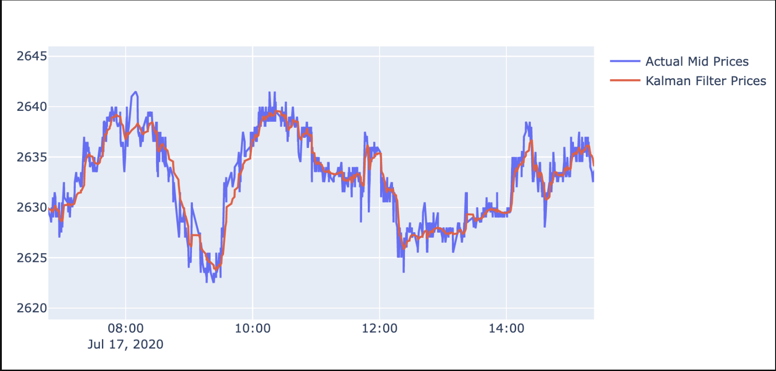
Actual Mid Prices VS Kalman Filter Prices

Slide 8
Avellaneda and Stoikov’s Market Making Strategy

Slide 9
Avellaneda and Stoikov’s Strategy
"High-frequency trading in a limit order book"
Avellaneda & Stoikov focus on market maker's two challenges:
inventory risk
optimal bid and ask spreads
Algorithm:
Calculate a reservation price based on inventory, volatility, time etc.
Calculate the optimal bid and ask spread based on utility framework and the microstructure of actual limit order books
Create market orders using the reservation price as reference:
Bid offer price = reservation price - optimal spread / 2
Ask offer price = reservation price + optimal spread / 2
Notes:
https://blog.hummingbot.org/2021-04-avellaneda-stoikov-market-making-strategy/

Slide 10
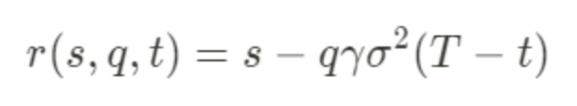
Reservation price
s = current market mid price
q = quantity of assets in inventory of base asset (could be positive/negative for long/short positions)
σ = market volatility
T = closing time
t = current time
γ = inventory risk aversion parameter
Creating symmetrical bid/ask orders around the market mid-price may lead to inventory skewing in one direction
Instead of using market mid-price, we can calculate a new reference price that takes inventory, market volatility, and time until trading session ends into consideration
Notes:
q: is the distant of the trader’s current inventory position from the target position
Gamma: how much inventory risk does the trader wants to take? Your risk appetite
(T-t): Time until the trading session ends

Slide 11
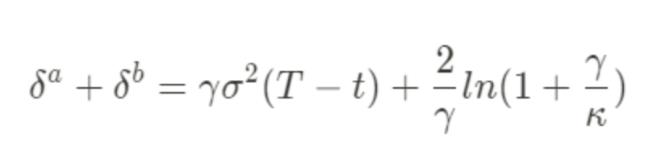
Optimal Spread
δa, δb = bid/ask spread, symmetrical → δa=δb
γ = inventory risk aversion parameter
σ = market volatility
κ = order book liquidity parameter
Denser order book -> significant κ value -> smaller optimal spread (more competition)
Notes:
q: is the distant of the trader’s current inventory position from the target position
Gamma: how much inventory risk does the trader wants to take? Your risk appetite
(T-t): Time until the trading session ends

