Slide 1

Cutting-Edge AI Innovations: A Deep Dive
This presentation explores groundbreaking AI advancements. We will examine DeepMind, Tesla, NVIDIA, and Yandex. Discover how AI is revolutionizing gaming, transportation, healthcare, graphics, and robotics.

Slide 2
DeepMind's MuZero: Mastering Complex Games
MuZero learns the rules as it goes. It achieves superhuman performance without prior knowledge. It excels in games like chess, Go, and Atari. MuZero represents a major step in general-purpose AI.
Model-Based RL
It uses a model to predict future states.
Tabula Rasa
It learns from scratch, without rules.

Slide 3
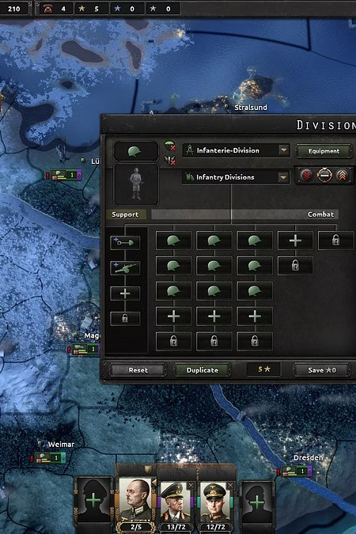
Hoi4 AI: Revolutionizing Real-Time Strategy
Hearts of Iron IV (Hoi4) features sophisticated AI opponents. These opponents adapt to player strategies and world events. The AI manages complex economies and military campaigns. This pushes the boundaries of game AI.
Adaptive
The AI reacts to the game's evolution.
Strategic
It plans operations across many nations.
Challenging
The AI provides difficult and engaging gameplay.

Slide 4
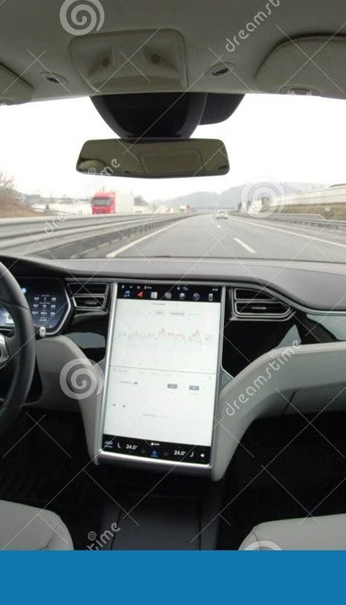
Tesla Autopilot: Autonomous Driving Advancements
Tesla Autopilot enhances driving safety and convenience. It uses advanced neural networks and sensor fusion. It enables features like lane keeping and adaptive cruise control. Tesla is paving the way for full autonomy.
1
Data Collection
Real-world driving data improves models.
Neural Nets
Advanced deep learning algorithms used.
2
3
Sensor Fusion
Multiple sensors create a safety envelope.

Slide 5


DeepMind Health: Transforming Healthcare
DeepMind Health applies AI to solve healthcare challenges. It helps with disease detection and personalized treatments. AI can analyze medical images with greater accuracy and speed. This improves patient outcomes.
Helps with disease detection.
Offers personalized treatments.
Improves patient outcomes.

Slide 6


NVIDIA RTX AI and DLSS: Graphics Breakthroughs
NVIDIA RTX AI revolutionizes real-time graphics. Deep Learning Super Sampling (DLSS) enhances image quality. It increases frame rates in games. It is making gaming more immersive.
120
80
40
0
Cyberpunk
Control
DLSS Off
Metro
DLSS On

Slide 7
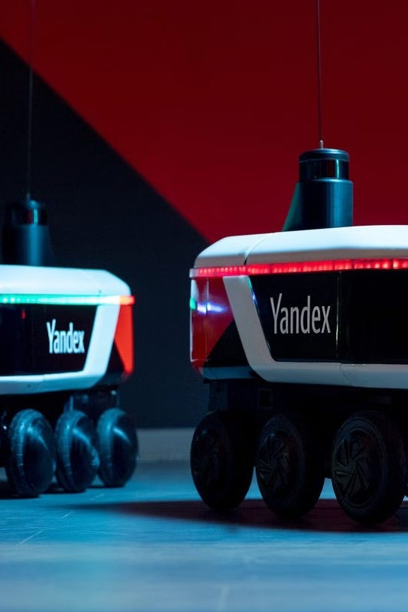
Yandex Rover: Autonomous Navigation and Exploration
Yandex Rover delivers goods autonomously. It navigates city streets and complex environments. It utilizes computer vision and sensor technology. It represents the future of delivery services.
1
Delivery
It delivers goods autonomously.
2
Navigation
It can navigate urban environments.
3
Computer Vision
Uses sensors and computer vision.

Slide 8

Conclusion: Unlocking the Future with AI
AI innovations are transforming industries globally. DeepMind, Tesla, NVIDIA, and Yandex lead the way. Continued advancements promise a future with AI. Expect breakthroughs in the next decade.
1
Gaming
2
Transport
3
Health
4
Robotics

