Slide 1
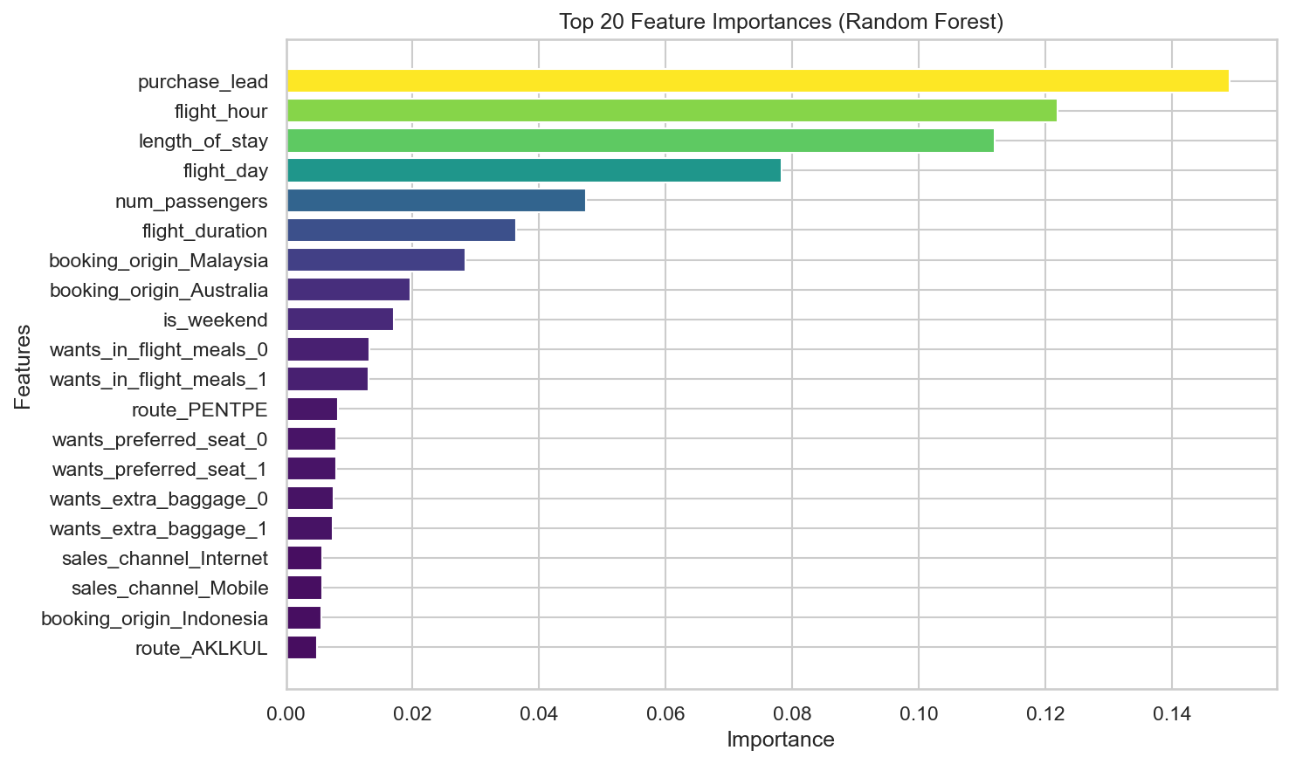
Customer Booking Prediction Model - Summary
Random Forest Classifier Performance Analysis
📊 Cross-Validation Results (5-Fold)
ROC AUC: 0.781 ± 0.002
Accuracy: 0.851 ± 0.002
Precision: 0.504 ± 0.019
Recall: 0.142 ± 0.012
F1 Score: 0.221 ± 0.016
🎯 Test Set Performance
ROC AUC: 0.790
⚙️ Model Configuration
Algorithm: Random Forest
Trees: 300
Features: 914
Training Samples: 40,000
Test Samples: 10,000
Generated on October 18, 2025 | British Airways Customer Booking Analysis

