Slide 1
Project Title House Price Prediction By Regression Model
Name: Muhammad Bilal Ghafoor
Reg No# 2021-BS-AI-009

Slide 2
What is Regression Model?
Definition: A statistical model used to predict a continuous outcome based on one or more input variables.
Establish a relationship between independent variables (features) and a dependent variable (target) for prediction.
Key Components:
Dependent Variable (Y): The value to predict (e.g., house price).
Independent Variables (X): Features used for prediction (e.g., area, bedrooms).
How It Works:
Training: Learning the relationship between inputs and output from data.
Prediction: Predicting the outcome for new inputs using the learned model.

Slide 3
Introduction
In this project, we aim to predict house prices based on various features using machine learning techniques. The goal is to build a regression model that can accurately estimate the price of a house given its characteristics, such as area, number of bedrooms, bathrooms, floors, and other relevant features.
To achieve this, we will:
Use a dataset that includes features like the house's area, bedrooms, bathrooms, floors, year built, location, condition, and garage to predict the price.
Preprocess the data to handle missing values, remove irrelevant features, and scale the data to ensure the model works effectively.
Train a linear regression model to establish a relationship between the input features and the target variable (house price).
Develop a Flask-based web application that allows users to input house details and predict the house price in real-time.

Slide 4
About Dataset
If you should predict the price of the House? With this dataset you can predict the House price by training the regression model according to its Features
Dataset Source:
The Dataset download from Kaggle.
Dataset Structure:
No. of Rows: 1000
No. of Columns: 8
Target Feature:
The Dataset include only one Target Feature “House Price”.

Slide 5
Implementation
Steps Taken:
Step 1: Import Libraries
Step 2: Load the Dataset
Step 3: Data Exploration
Step 4: Data Preprocessing
Step 5: Split the Dataset
Step 6: Implement Linear Regression Model
Step 7: Evaluate the Model
Step 8: Save the Model
Step 9: Implement on Flask App and Design User Interface.
Step 8: Make Predictions

Slide 6
Import Libraries
Pandas : A library for data manipulation and analysis, providing data structures like DataFrame for handling tabular data.
Numpy : A library for numerical computing, providing support for large, multi-dimensional arrays and matrices, along with mathematical functions.
Matplotlib: A plotting library for creating static, animated, and interactive visualizations in Python.
Scikit-Learn: A machine learning library that provides simple and efficient tools for data mining and data analysis, including algorithms for classification, regression, clustering, and preprocessing.

Slide 7

Load The Dataset
Firstly I download the dataset in system by the following link:
https://www.kaggle.com/datasets/prokshitha/home-value-insights
Then I just load into my python file.

Slide 8
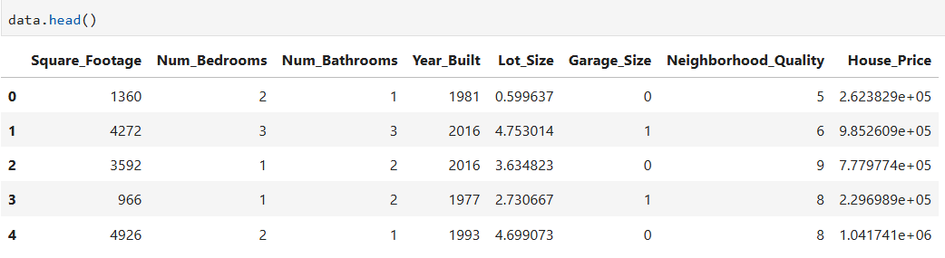
Data Exploration
Show the First Five Rows:
Displays the first 5 rows of the dataset by head() function.
Useful for getting a quick overview of the dataset's structure, column names, and sample data.

Slide 9
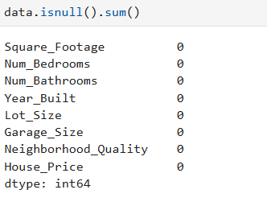
Data Preprocessing
Checking For Missing Values
Identifies the total number of missing (null/NaN) values in each column

Slide 10
Data Preprocessing
Removing Unrelated and Less important Features:
Key Steps:
Feature Importance Analysis:
Use techniques like correlation analysis, feature importance scores from models (e.g., Decision Trees, Random Forest), or statistical tests to evaluate each feature's impact.
Manual Selection:
Drop features that are irrelevant or redundant (e.g., IDs, unrelated categorical columns).
Dimensionality Reduction:
Techniques like PCA (Principal Component Analysis) can help reduce feature dimensionality by transforming features into a smaller set of components.
Domain Knowledge:
Use insights about the dataset to remove features that don't logically affect the target variable.

Slide 11
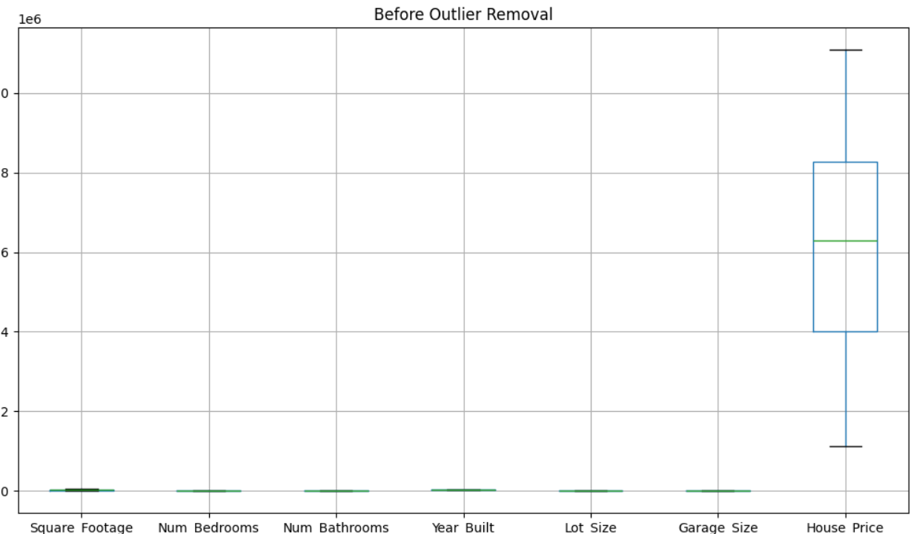
Data Preprocessing
Detecting Outliers
Outliers are extreme values that deviate significantly from the rest of the data.

Slide 12
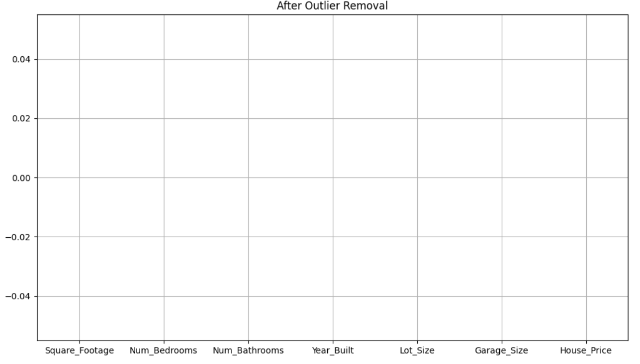
Data Preprocessing
Remove outliers: Filter out rows containing outliers.
Normalize the data: Scale the remaining data using MinMaxScaler to ensure uniform contribution of features.

Slide 13
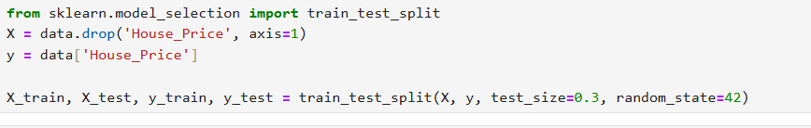
Split the Dataset
Training the Model: The training set is used to teach the model. The model learns patterns, relationships, and weights based on this data.
Testing the Model: The testing set is a separate portion of the dataset that the model has never seen during training. This set evaluates how well the model generalizes to new, unseen data.

Slide 14
Split the Dataset
X : Contains the independent variables (features like Area, Bedrooms, etc.).
Y : Contains the dependent variable (target, like Price).
test_size=0.3 : Allocates 30% of the dataset to the test set and 70% to the training set.
Output
X_train and y_train: Training set (used to train the model).
X_test and y_test : Testing set (used to evaluate the model).

Slide 15
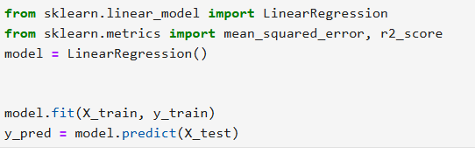
Implementation of Linear Regression
Linear Regression is a supervised learning algorithm used to model the relationship between independent variables (features) and a dependent variable (target) by fitting a straight line.
Implementation:

Slide 16
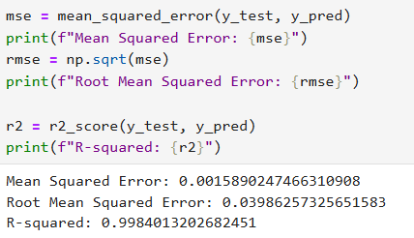
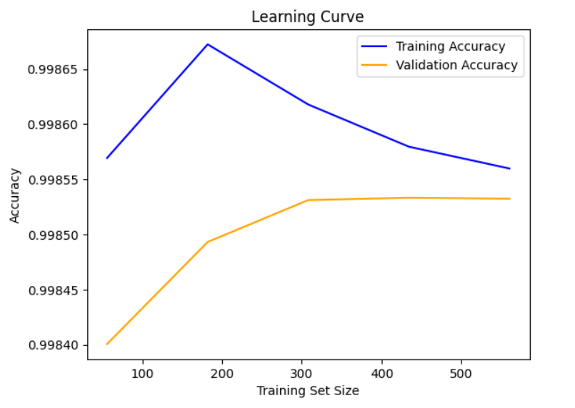
Evaluate the Model
To evaluate a Linear Regression model, key metrics include Mean Squared Error (MSE), which measures the average squared difference between actual and predicted values, and R-squared (R²), which indicates the proportion of variance in the target variable explained by the model. A lower MSE and higher R² suggest better model performance.

Slide 17
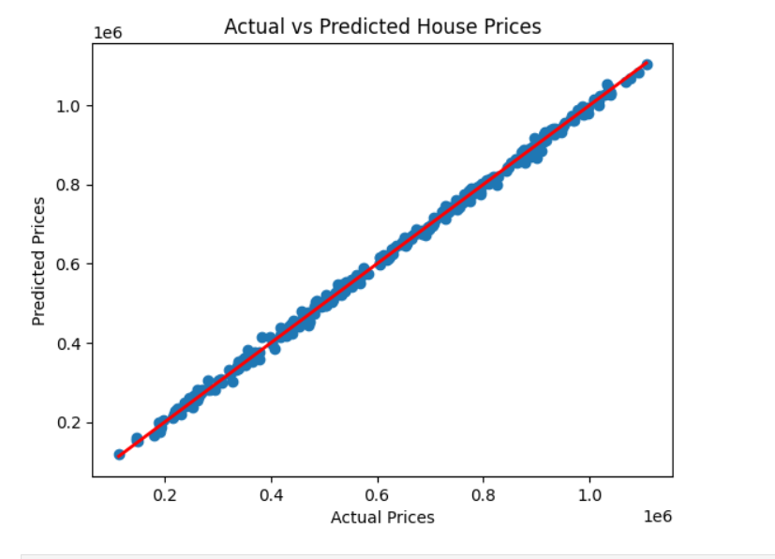
Evaluate the Model
By Visualization

Slide 18
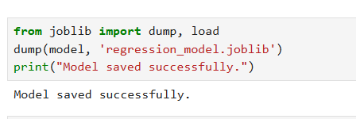
Save the Model
We save the trained machine learning model to avoid retraining it every time we want to make predictions, which saves computational resources and time. This allows the model to be reused for predictions, deployed in applications, or shared with others.

Slide 19
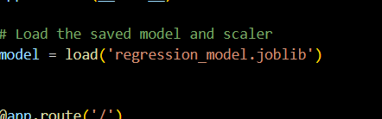
Flask Application Setup
Flask Setup:
Flask install with (pip install flask)
Create a new python file (app.py)
Loading the Save
Load the save model in flask app

Slide 20
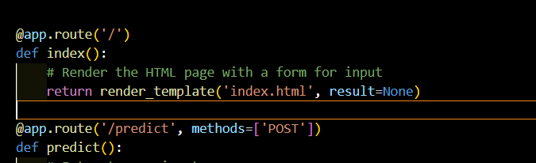
Creating Flask Routes
Home Route (index.html): A simple HTML page to take user input.
Prediction Route:
Handle POST request from the user to get inputs (Area, Bedrooms, etc.)
Predict the house price based on input using the trained model.

Slide 21
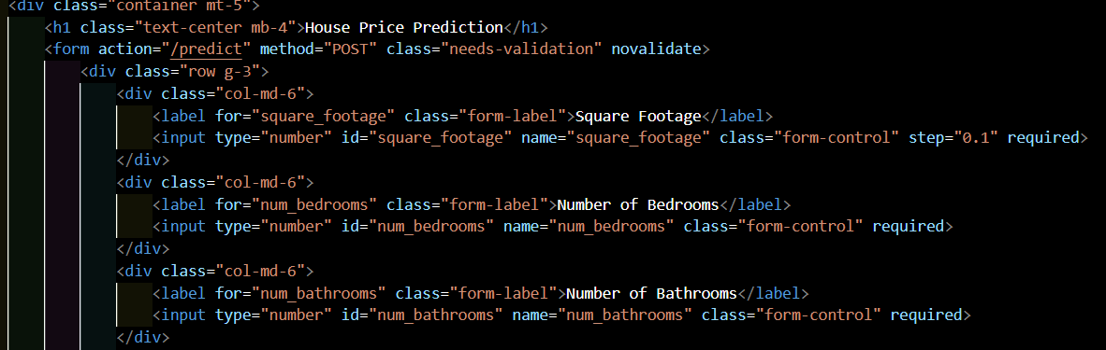
HTML Form (index.html)
User Inputs: Form to accept Area, Bedrooms, and other relevant features.

Slide 22
Running the Flask App
Starting the Flask server:
Run the application with: python app.py
Open the browser at http://127.0.0.1:5000/ to interact with the model.

Slide 23
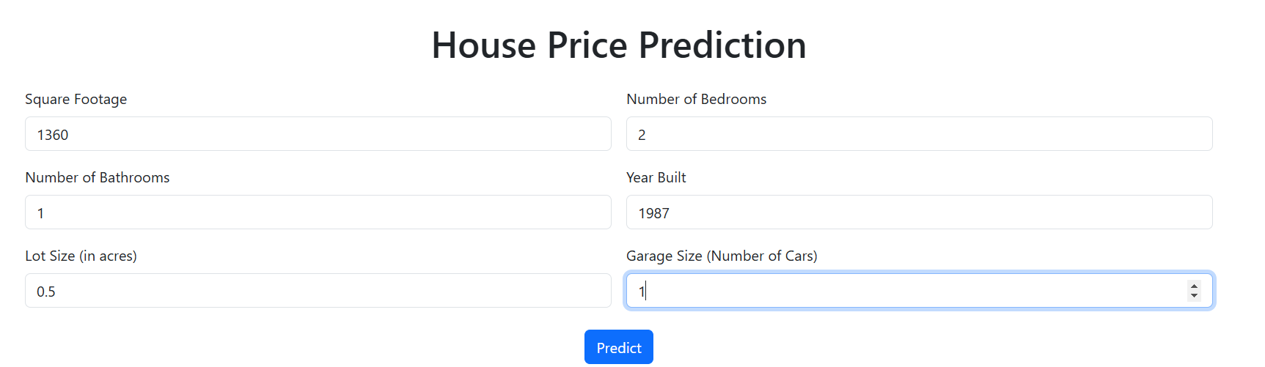
Model Prediction and Result

Slide 24
Any Question?

