Slide 1


Line Following Car
Group Members:
Bilal Naeem (F23CSC008)
Sadia Tehreem (F23CSC043)
Saba Ramzan (F23CSC025)
Faculty Name:
Miss. Saadia Karim
Miss. Seema Hashwani
Computer Organizer and Assembly Language
Department of Computer Science
Faculty of Information and Technology

Slide 2


Overview
Introduction /Background
Motivation
Problem Statement
Scope of the Project
Project Objectives
Literature Review/Research Gap
Methodology/Framework
Tools and Languages
Gantt Chart
Conclusion
References
Division of role

Slide 3
Introduction/Background:
Autonomous vehicles are becoming increasingly vital in today's automated world.
This project involves developing a Line Following Car that tracks and follows a predefined path using IR sensors and an STM32 microcontroller.
It focuses on sensor integration and motor control, providing foundational knowledge in real-world autonomous navigation.
The project aims to contribute to understanding automation and robotics by addressing challenges in hardware-software integration and real-time data processing.

Slide 4
Motivation:
To explore the foundational principles of autonomous navigation and sensor-based systems.
To contribute to the growing field of automation by addressing challenges in designing efficient and reliable navigation systems.
To gain practical experience in hardware-software integration, enhancing problem-solving skills in robotics and automation.
To develop low-level programming skills and understand real-world applications of microcontroller-based projects.

Slide 5
Problem Statement:
Traditional vehicles rely on human intervention, which can lead to errors and inefficiencies. There is a need for automated navigation systems to enhance safety, reliability, and efficiency in transportation.
Solution:
Develop a Line Following Car using IR sensors and an STM32 microcontroller to autonomously follow a predefined path, demonstrating the principles of sensor integration and motor control for foundational autonomous navigation.

Slide 6
Scope of Project:
Differentiation:
Introduces a practical application of autonomous navigation by integrating sensor-based path detection and motor control, emphasizing hands-on learning with real-world relevance.
Efficiency:
Utilizes IR sensors and an STM32 microcontroller for precise, real-time line following, ensuring a reliable and optimized performance in automation tasks. This project bridges the gap in understanding foundational autonomous systems, offering insights into self-driving car technology while fostering skill development in hardware-software integration.

Slide 7
Project Objectives:
IDEA:
Design and implement a Line Following Car to demonstrate the principles of autonomous navigation, emphasizing sensor-based control and real-time path detection.
DELIVERABLES:
A fully operational car capable of autonomously following a black line on a white surface.
Integration of IR sensors with an STM32 microcontroller for precise path tracking.
Motor control algorithms developed using Assembly language for accurate movement.
KEY FEATURES:
Reliable line detection using IR sensors.
Smooth and efficient path-following behavior.
Modular design enabling easy debugging and enhancements.
Real-time sensor data processing for accurate navigation.

Slide 8
Literature Review:
Study | What It Did | How It Helps Us
Research on Line Following Robots | Used IR sensors to make robots follow a line. | Shows how IR sensors can track paths.
Advances in Autonomous Vehicles | Studied how sensors guide self-driving cars. | Gives ideas for building sensor-based systems.
STM32 Microcontroller Use | Showed how STM32 runs control systems. | Proves STM32 is good for controlling motors.
Motor Control Techniques | Explained how to move robots accurately. | Helps in writing better motor control code.

Slide 9
Methodology/Framework:
Development Tools:
Programming Language: Assembly language for motor control and path-following logic.
Microcontroller: STM32 for sensor integration and motor control.
Sensors: IR sensors for path detection and tracking.
Hardware: Motors, chassis, and power supply for the physical Line Following Car.
IDE: STM32CUBEIDE for coding and debugging Assembly language programs.
Development Approach:
Incremental Model: The project will follow an iterative approach, starting with basic path detection and gradually adding motor control and navigation refinements.
Hardware-Software Integration: Seamless coordination between sensors, the microcontroller, and motors will be achieved through a modular design.
Algorithm Development: Precise motor control and path-tracking algorithms will be designed and tested in real-world scenarios.
Testing and Optimization: Continuous testing of sensor responsiveness and motor efficiency will be conducted to ensure reliability and performance.

Slide 10
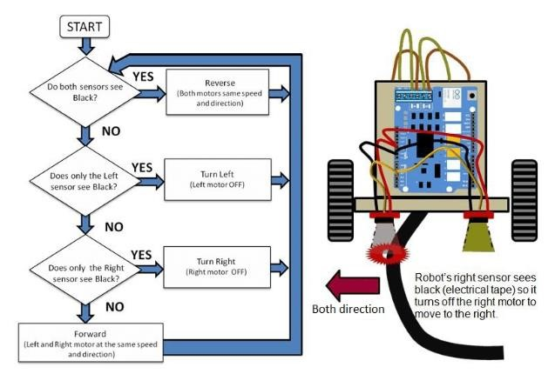
Methodology/Framework
Framework is a diagram that describes in outline the logic flow goes to a study

Slide 11
Circuit Diagram:

Slide 12
Tools and Languages
Programming Language: Assembly (Motor control algorithms)
Microcontroller: STM32 (Hardware control and sensor integration)
Sensors: IR Sensors (Path detection)
Development Environment: STM32CubeIDE
Hardware Tools: IR Sensors, Motor Driver, Chassis, STM32 Board
Version Control: Git/GitHub

Slide 13
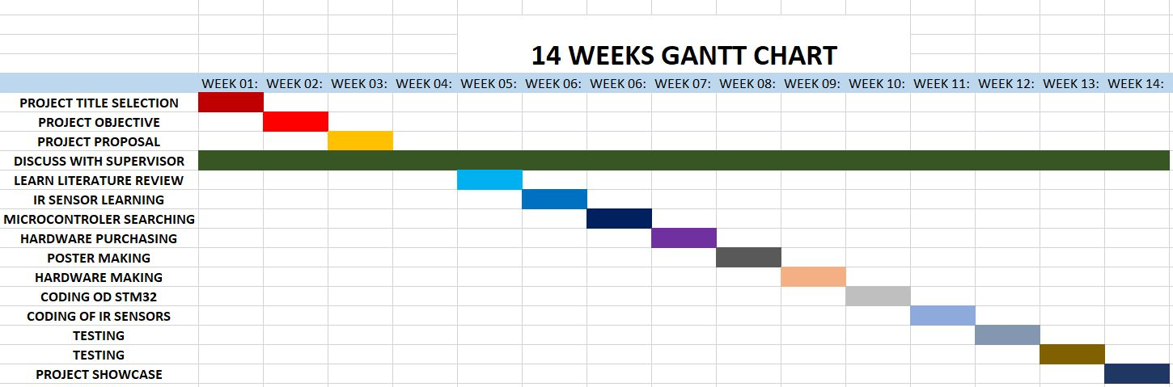
Gantt Chart

Slide 14
Conclusion
The Line Following Car project provided hands-on experience in integrating hardware with low-level programming.
We successfully implemented a system that can autonomously follow a black line using IR sensors and the STM32 microcontroller.
The project deepened our understanding of real-time sensor data processing and precise motor control using Assembly language.
This foundational work prepares us for more advanced research in robotics and autonomous vehicle technologies.

Slide 15

References
Books and Manuals:
B. Kumar and R. Joshi, Introduction to Robotics and Automation. Springer, 2021.
S. F. Barrett and D. J. Pack, Embedded Systems: Design and Applications with the STM32 Microcontroller. CRC Press, 2016.
· Research Articles:
R. Gupta and S. Patel, "Autonomous Line Following Robots: Challenges and Applications," International Journal of Robotics Research, vol. 15, no. 2, pp. 145-159, 2020.
C. Y. Lee and K. T. Wong, "IR Sensor Calibration Techniques for Line Following Robots," IEEE Sensors Journal, vol. 18, no. 8, pp. 2307-2314, 2019.
Online Resources:
Arduino Project Hub, "Building a Line Following Robot Using IR Sensors," 2022. [Online]. Available: https://create.arduino.cc.
STM32 Documentation, "Programming and Development with STM32 Microcontrollers," 2023. [Online]. Available: https://www.st.com.

Slide 16
Q/A Session

Slide 17
Thank You

