Slide 1


Brain Tumor Detection & Classification
By
Minhaj & Talha

Slide 2
Objective
Detect Brain Tumor
Classify into three classes
Use less resources

Slide 3
Flow
Detection by pre-trained YOLOv3 model
DWT feature of detected Region
SVM Classifier

Slide 4
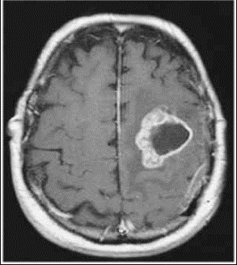
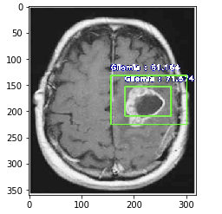
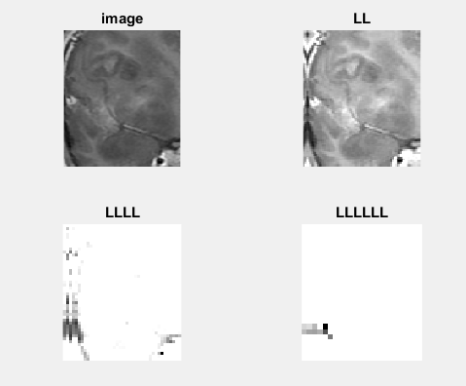

Yolo-V3
SVM

Slide 5
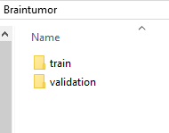


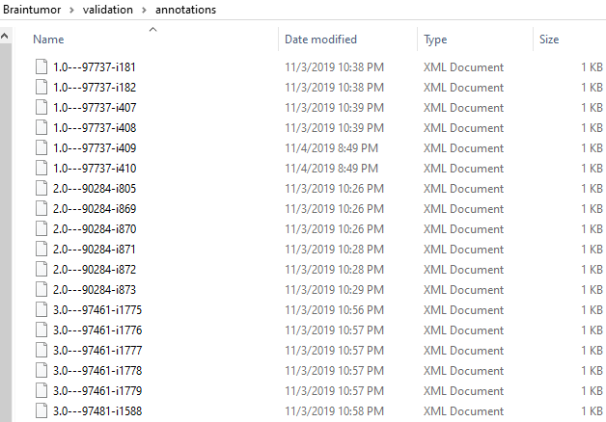
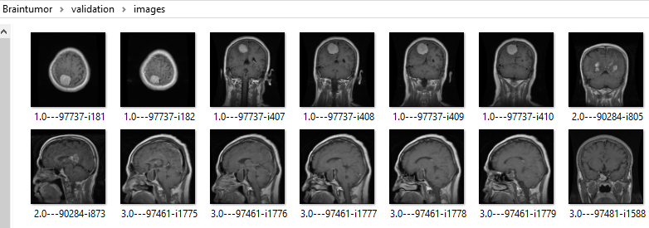

Slide 6

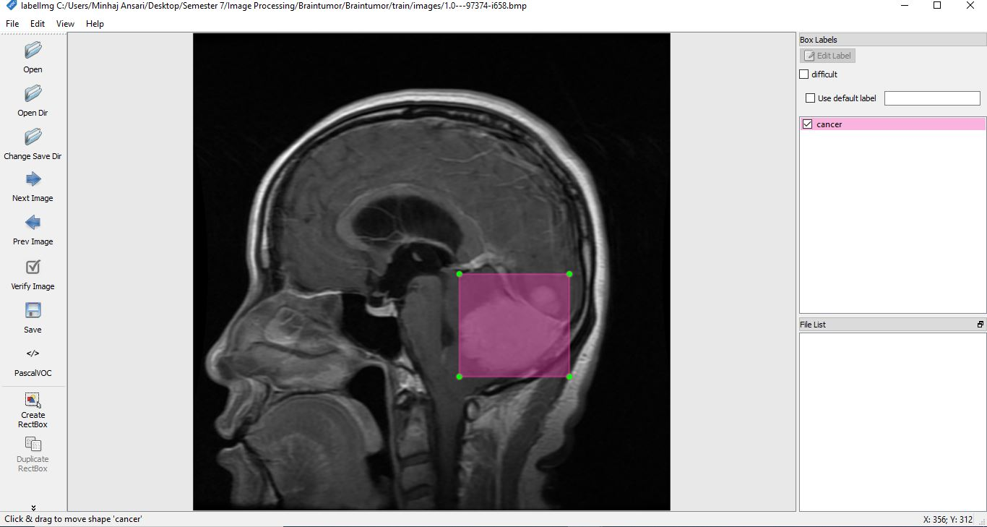
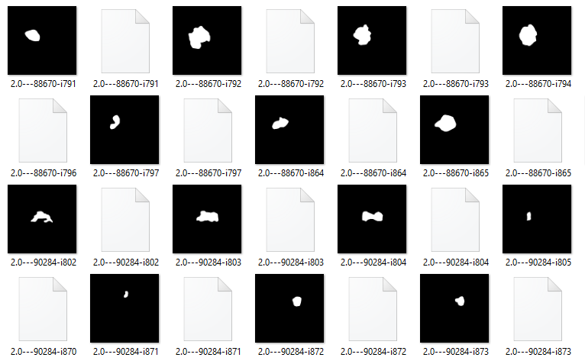
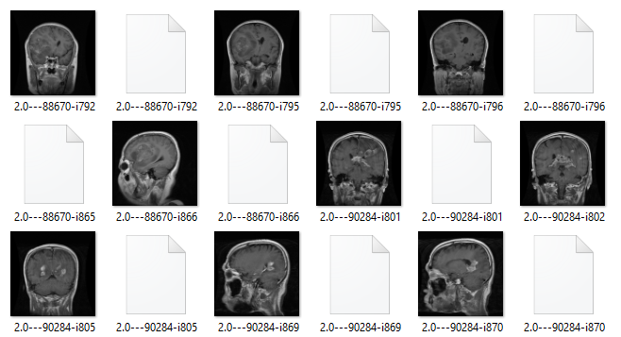

Slide 7
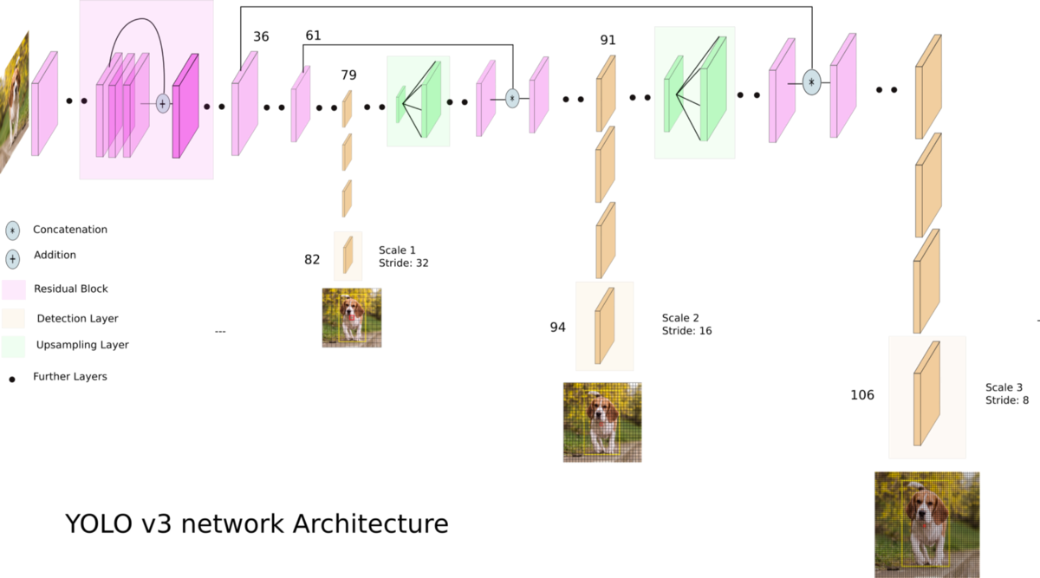

Slide 8
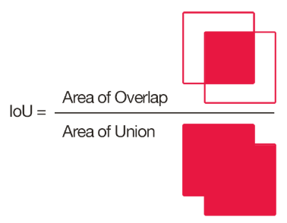
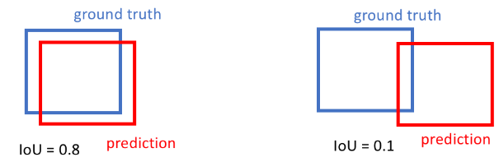
Evaluation Metric (IOU)

Slide 9
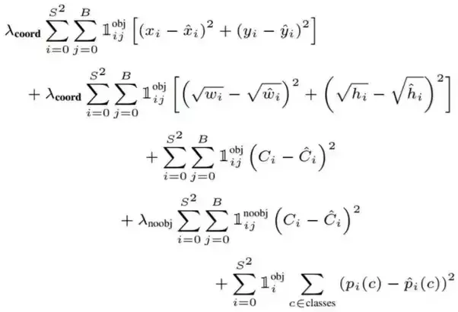
Loss Function

Slide 10
Framework, Optimizer & Batch Size
Tensorflow
Adam (lr=0.001)
Batch Size=4
Train/Test=80/20

Slide 11
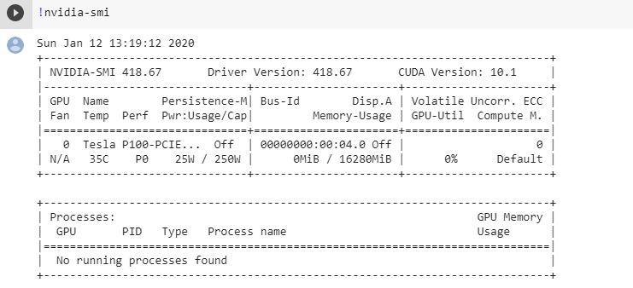
System

Slide 12
Epochs
Epoch 1/5
88/88 [==============================] - 107s 1s/step - loss: 75.2515 - val_loss: 35.9936
Epoch 2/5
88/88 [==============================] - 76s 864ms/step - loss: 26.9066 - val_loss: 19.8674
Epoch 3/5
88/88 [==============================] - 78s 881ms/step - loss: 19.7862 - val_loss: 13.9313
Epoch 4/5
88/88 [==============================] - 78s 887ms/step - loss: 17.0861 - val_loss: 12.5050
Epoch 5/5
88/88 [==============================] - 77s 876ms/step - loss: 14.9311 - val_loss: 15.0932

Slide 13
Epochs
Epoch 1/10
88/88 [==============================] - 100s 1s/step - loss: 93.1397 - val_loss: 39.2504
Epoch 2/10
88/88 [==============================] - 71s 810ms/step - loss: 32.8103 - val_loss: 18.1742
Epoch 3/10
88/88 [==============================] - 72s 813ms/step - loss: 22.1800 - val_loss: 13.6545
Epoch 4/10
88/88 [==============================] - 71s 808ms/step - loss: 17.3966 - val_loss: 10.0252
Epoch 5/10
88/88 [==============================] - 72s 815ms/step - loss: 16.6996 - val_loss: 11.4400
Epoch 6/10
88/88 [==============================] - 72s 815ms/step - loss: 15.8101 - val_loss: 9.1912
Epoch 7/10
88/88 [==============================] - 72s 821ms/step - loss: 13.2116 - val_loss: 9.8833
Epoch 8/10
88/88 [==============================] - 72s 815ms/step - loss: 9.9498 - val_loss: 8.5687
Epoch 9/10
88/88 [==============================] - 71s 807ms/step - loss: 8.9794 - val_loss: 10.6297
Epoch 10/10
88/88 [==============================] - 72s 818ms/step - loss: 8.7132 - val_loss: 8.7181

Slide 14
Epochs

Slide 15
Result

Slide 16
DWT (Different Levels)

Slide 17
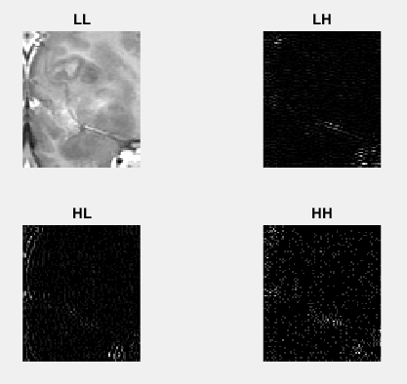
DWT (LL+HH)

Slide 18

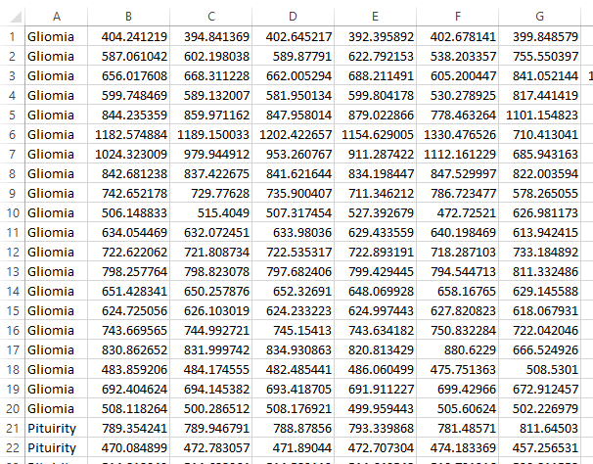
DWT Features

Slide 19
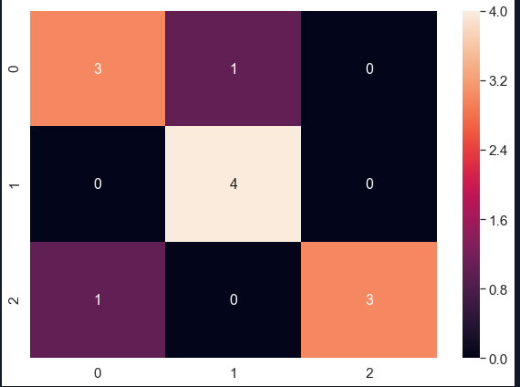
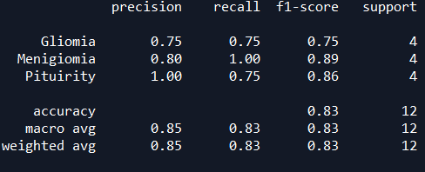
Result with LL

Slide 20
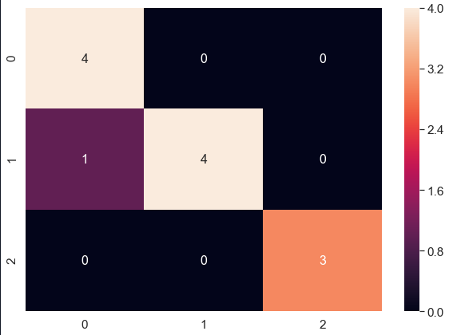
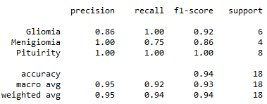
Result with LL+HH

Slide 21
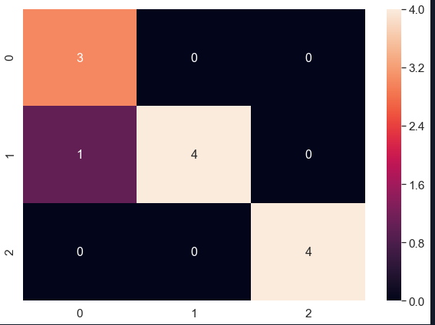
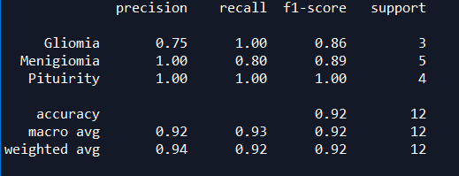
Result from Complete Image

Slide 22
Conclusion
 | Detection | Classification (Cropped)(LL) | Classification (Cropped)(LL+HH) | Classification (Original Image)
Accuracy | 91.29 | 83.33 | 94 | 92
Precision | - | 85 | 93.33 | 91.66
Recall | - | 83.33 | 96 | 93.33
F1-Score | - | 83.33 | 94 | 91.66
Training Time | 745s | 0.00027917849s | 0.000995874404s | 0.00299811363s

Slide 23
Conclusion

Slide 24

Thanks

