Slide 1
EMAIL / SMS SPAM CLASSIFIER
Project Report 2026
Section: E | Department of Computer Science | UET Peshawar
Instructor: Rida Zarkash

Slide 2
👥 GROUP MEMBERS
01
Hazrat Bilal
24PWBCS1345
02
Haroon Ur Rashid
24PWBCS1357
03
Khalida Afghan
24PWBCS1416
04
Ilham Raza
24PWBCS1259

Slide 3
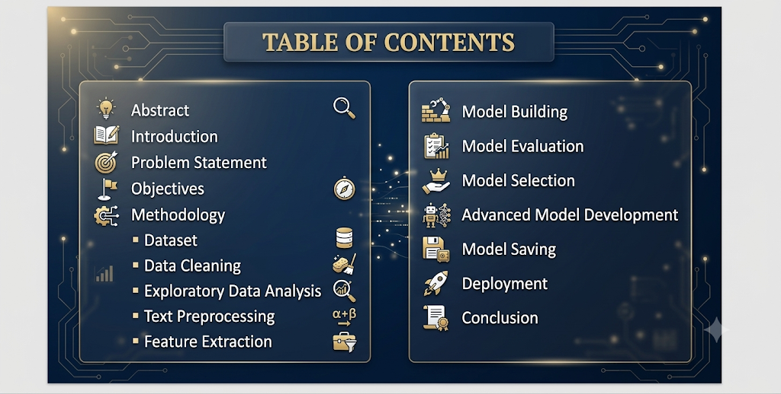
TABLE OF CONTENTS
🔹 Abstract
🔹 Introduction
🔹 Problem Statement
🔹 Objectives
🔹 Methodology
▪ Dataset
▪ Data Cleaning
▪ Exploratory Data Analysis
▪ Text Preprocessing
▪ Feature Extraction
🔹 Model Building
🔹 Model Evaluation
🔹 Model Selection
🔹 Advanced Model Development
🔹 Model Saving
🔹 Deployment
🔹 Conclusion

Slide 4
📄 ABSTRACT
An SMS Spam Detection system using Machine Learning and Natural Language Processing (NLP).
Objective: Automatically classify SMS messages as Spam or Ham
Approach:
• Data Cleaning & Text Preprocessing
• TF-IDF Vectorization
• Naive Bayes Classification
Best Model: Multinomial Naive Bayes (100% Precision)
Deployment: Streamlit Web Application

Slide 5
🔍 INTRODUCTION
What are Spam Messages?
Spam = Unsolicited messages containing:
• Advertisements
• Scams & Fraudulent offers
• Phishing attempts
Solution: Machine Learning + NLP
Clean & Preprocess Text
Convert to Numerical Features (TF-IDF)
Train Naive Bayes Models
Deploy as Web Application

Slide 6
PROBLEM STATEMENT
Increasing Number of Spam SMS
Class Distribution:
• Ham (Non-Spam): 87.37%
• Spam: 12.63%
Challenges:
• Users exposed to fraud & phishing
• Manual filtering is time-consuming
• Need for automated, accurate classification

Slide 7
🎯 OBJECTIVES
1️⃣ Build an SMS Spam Detection Model
2️⃣ Clean and Preprocess Text Data
3️⃣ Perform Exploratory Data Analysis
4️⃣ Convert Text into TF-IDF Features
5️⃣ Train and Compare Naive Bayes Classifiers
6️⃣ Evaluate Model Performance
7️⃣ Deploy the Model using Streamlit

Slide 8
📊 DATASET
📁 SMS Spam Collection Dataset
Dataset Statistics:
• Total Records: 5,572
• Ham Messages: 4,827 (87.37%)
• Spam Messages: 745 (12.63%)
Sample Data:
┌────────┬──────────────────────────────────────────┐
│ Label │ Message │
├────────┼──────────────────────────────────────────┤
│ ham │ Go until jurong point, crazy.. │
│ spam │ Free entry in 2 a wkly comp... │
│ ham │ U dun say so early hor... │
└────────┴──────────────────────────────────────────┘

Slide 9
🧹 DATA CLEANING
🔧 Cleaning Steps:
✓ Remove unnecessary columns (Unnamed: 2,3,4)
✓ Rename columns: v1→target, v2→text
✓ Label Encoding: Ham=0, Spam=1
✓ Remove duplicate records
✓ No missing values found
Before:
┌────────┬─────────────┬────────────┬───────────┬──────────┐
│ v1 │ v2 │ Unnamed: 2 │ Unnamed:3 │ Unnamed:4│
├────────┼─────────────┼────────────┼───────────┼──────────┤
│ ham │ message... │ NaN │ NaN │ NaN │
└────────┴─────────────┴────────────┴───────────┴──────────┘
After:
┌────────┬──────────────┐
│ target │ text │
├────────┼──────────────┤
│ 0 │ message... │
└────────┴──────────────┘

Slide 10
📊 EDA - CLASS DISTRIBUTION
Class Distribution of SMS Messages
📊 87.37% 📊 12.63%
Ham (Non-Spam) Spam
⚠️ Dataset is Imbalanced!
• Precision is more important than accuracy

Slide 11
📊 EDA - TEXT LENGTH
Three New Numerical Features Created:
📏 Characters 📝 Words 📝 Sentences
Example: "You've won a free prize!"
Characters: 22 Words: 5 Sentences: 1
💡 Spam messages are generally:
• Longer (more characters)
• More words
• More sentences

Slide 12
📊 EDA - CHARACTER DISTRIBUTION
Comparison of Character Count
[Insert Histogram Image: media/image14.png]
📌 Key Insight:
• Ham: Most contain < 100 characters
• Spam: Concentrated between 100-170 characters
🔵 Ham 🟠 Spam

Slide 13
📊 EDA - WORD DISTRIBUTION
Comparison of Word Count
[Insert Histogram Image: media/image15.png]
📌 Key Insight:
• Ham: Mostly 5-20 words
• Spam: Concentrated between 20-35 words
🔵 Ham 🟠 Spam

Slide 14
📊 EDA - PAIR PLOT
[Insert Pair Plot Image: media/image16.png]
📌 Key Insights:
• Positive correlation: more characters = more words
• Spam messages show higher values across all features
• Features are useful for classification
🔵 Ham Messages 🟠 Spam Messages

Slide 15
📊 EDA - CORRELATION HEATMAP
[Insert Correlation Heatmap Image: media/image17.png]
📌 Key Insights:
• Strong correlation: chars ↔ words (0.97)
• Moderate: sentences ↔ chars (0.62) & words (0.68)
• Weak positive correlation with target

Slide 16
🔧 TEXT PREPROCESSING
Natural Language Processing (NLP) Pipeline
Raw Text: "Free entry in 2 a wkly comp!"
↓ 1️⃣ Convert to Lowercase
"free entry in 2 a wkly comp!"
↓ 2️⃣ Tokenization
['free', 'entry', 'in', '2', 'a', 'wkly', 'comp!']
↓ 3️⃣ Remove Special Characters
['free', 'entry', 'in', '2', 'a', 'wkly', 'comp']
↓ 4️⃣ Remove Stop Words & Punctuation
['free', 'entry', 'wkly', 'comp']
↓ 5️⃣ Porter Stemming
['free', 'entri', 'wkli', 'comp']

Slide 17
☁️ WORD CLOUDS
🟠 Spam Message Word Cloud 🔵 Ham Message Word Cloud
[Insert Word Cloud Images: media/image19.png & media/image20.png]
📌 Key Differences:
• Spam: Promotional words (free, call, text, claim)
• Ham: Conversational words (love, know, go, good)

Slide 18
📊 TOP FREQUENT WORDS
🟠 Top 30 Words in Spam Messages
[Insert Bar Chart: media/image21.png]
🔵 Top 30 Words in Ham Messages
[Insert Bar Chart: media/image22.png]

Slide 19
🤖 MODEL BUILDING
Workflow:
TF-IDF Features → Train/Test Split (80/20) → Naive Bayes Classifiers
🔹 Gaussian Naive Bayes (GNB)
🔹 Multinomial Naive Bayes (MNB)
🔹 Bernoulli Naive Bayes (BNB)
Evaluation Metrics:
• Accuracy
• Precision (most important for imbalanced data)
• Confusion Matrix

Slide 20
📊 MODEL EVALUATION - NAIVE BAYES
📊 Results Comparison
┌────────────────┬──────────────┬──────────────┐
│ Model │ Accuracy │ Precision │
├────────────────┼──────────────┼──────────────┤
│ Gaussian NB │ 87.33% │ 51.60% │
│ Multinomial NB │ 97.10% │ 🏆100.00% │
│ Bernoulli NB │ 98.36% │ 99.19% │
└────────────────┴──────────────┴──────────────┘
🏆 Best Model: Multinomial Naive Bayes
✅ Why? 100% Precision - No ham misclassified as spam
⚠️ Note: Precision > Accuracy for imbalanced datasets

Slide 21
🚀 ADVANCED MODELS
🔬 Additional Models Tested:
🧠 Support Vector Machine (SVM)
🌲 Random Forest (RF)
📊 Advanced Model Results
┌────────────────┬──────────────┬──────────────┐
│ Model │ Accuracy │ Precision │
├────────────────┼──────────────┼──────────────┤
│ SVM │ 97.58% │ 97.48% │
│ Random Forest │ 97.68% │ 97.50% │
└────────────────┴──────────────┴──────────────┘
💡 Decision: MNB remains the final model
📌 Reason: 100% Precision > Small accuracy improvement

Slide 22
💾 MODEL SAVING
Saved Models using Pickle Library
📁 Saved Files:
🗂️ model.pkl (Multinomial NB)
🗂️ vectorizer.pkl (TF-IDF Vectorizer)
🔄 These files are used for deployment

Slide 23
🌐 DEPLOYMENT - STREAMLIT
[Insert Streamlit App Screenshot: media/image23.png]
┌─────────────────────────────────────────────┐
│ 📱 SMS / Email Spam Classifier │
│ │
│ ┌─────────────────────────────────────┐ │
│ │ Enter your message here... │ │
│ └─────────────────────────────────────┘ │
│ │
│ [ 🔍 Predict Button ] │
│ │
│ ┌─────────────────────────────────────┐ │
│ │ ✅ Prediction: Not Spam (Ham) │ │
│ └─────────────────────────────────────┘ │
└─────────────────────────────────────────────┘
🔹 Real-time classification
🔹 User-friendly interface
🔹 Instant results

Slide 24
🔄 DEPLOYMENT WORKFLOW
1️⃣ User enters message in text box
↓
2️⃣ Click "Predict" button
↓
3️⃣ Text is preprocessed (lowercase, tokenize, etc.)
↓
4️⃣ Converted to TF-IDF features
↓
5️⃣ Trained model predicts class
↓
6️⃣ Result displayed: "Spam" or "Not Spam (Ham)"
📱 Quick & Easy!

Slide 25
📊 RESULTS SUMMARY
🏆 Best Model: Multinomial Naive Bayes
✅ Accuracy: 97.10%
✅ Precision: 100.00%
📈 Key Achievements:
✓ No ham messages misclassified as spam
✓ High accuracy on imbalanced dataset
✓ Real-time prediction capability
✓ User-friendly web interface

Slide 26
✅ CONCLUSION
🎯 Project Successfully Achieved:
1️⃣ Complete end-to-end data science pipeline
2️⃣ 100% Precision → No false positives
3️⃣ Deployed as Streamlit web application
4️⃣ Effective solution for spam message detection
🔄 Complete Data Science Pipeline:
Data → Clean → Analyze → Model → Evaluate → Deploy

Slide 27
🙏 THANK YOU
Email/SMS Spam Classifier
Team: Hazrat Bilal • Haroon Ur Rashid • Khalida Afghan • Ilham Raza
UET Peshawar | Department of Computer Science

