Slide 1
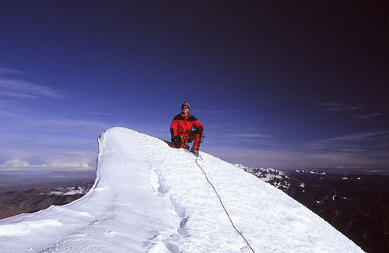
Image Captioning
The caption generation problem involves training the machine to generate a textual description given an image as input
A person in red snow gear is kneeling on a snowy ridge under a blue sky .
Bilal Majeed

Slide 2
Given an image as an input, generate a textual description or caption for the image
This involves an image-based model, which extracts the features out of the image, and the other is a language-based model, which translates the features given by the image-based model to a natural sentence
The generated caption is expected to describe in a sentence what is shown in the image, i.e., the objects present, their interactions, their properties, and the actions being performed
Applications
Visually impaired persons
Social media
Visual video content (frame by frame)
Problem Description
Bilal Majeed

Slide 3
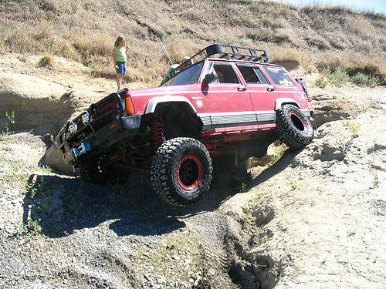
Flickr8k dataset with 5 captions per image
8091 images, each 224 x 224 x 3 channels, with a unique image_id as the file name
Descriptions are in a text file, with 5 captions for each image_id
https://www.kaggle.com/adityajn105/flickr8k
Dataset Description
A four wheel drive car is navigating along a rocky off road trail .
A jeep sideways on some rocks .
A red jeep hangs from the edge of a rocky cliff as a girl looks on .
A red truck is driving over a rocky surface .
A woman stands next to a red SUV that has run off into a ditch .
Bilal Majeed

Slide 4
Why is deep learning required?
Image Feature Extraction
Dimensionality reduction from 224 x 224 x 3 (150,058) to a 4096 x 1 vector (PCA or LDA)
Descriptor like BREIF (Binary Robust Independent Elementary Features)
These are available options, but not like VGG19 trained on imagenet dataset
Description Generation
This became popular with Seq2Seq models (encoder/decoder networks), but even basic Seq2Seq models are not effective as sequence length gets longer due to the sequential nature
Attention and Transformers provide state-of-the-art performance for sequence generation
Bilal Majeed

Slide 5
Extract features of all images (load_img → image_to_array → preprocess_input → VGG19)
Generate dictionary of captions by removing punctuation and special characters, and adding <START> and <END> tags to each caption
Tokenize each caption and find maximum length to pad each caption to same length
Generate vocabulary to transform captions to sequence of indices
Generate 2 input arrays and 1 output array
Data Preprocessing
X1 | X2 (sequences) | Y
Image features | [A] | jeep
Image features | [A, jeep] | sideways
Image features | [A, jeep, sideways] | on
Image features | [A, jeep, sideways, on] | some
Bilal Majeed

Slide 6
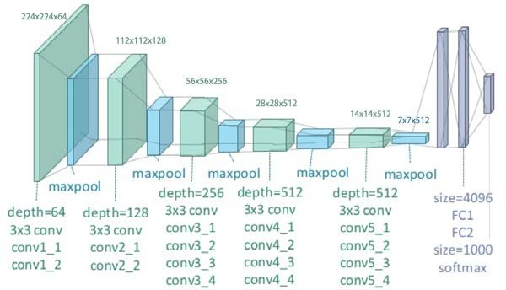
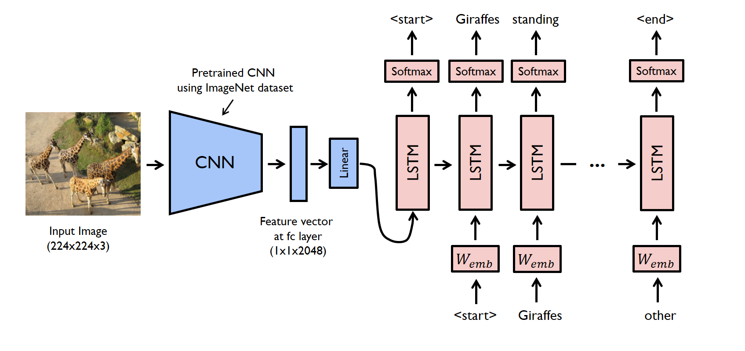
Model Architecture
Bilal Majeed

Slide 7
Model Training
Captioning network (2 inputs, 1 output):
Input – 4096 (image features)
Dense – 256 units, relu activation
Caption encoder input – vocab size
Embedding – 256 length
Dropout regularization
LSTM – 256 units
Caption decoder
Combine dense 256 and LSTM 256 output
Dense – 256 units, relu activation
Output – vocab size, softmax activation
3 epochs with training (75%) and validation sets (10%), with the adam optimizer and categorical crossentropy (1hr30mins of training)
Bilal Majeed

Slide 8
Model Prediction
Load image, transform image to array, preprocess array, and predict image features from VGG19 (fc2 layer)
Initialize the caption with <START>
Loop predictions until given maximum caption length
Tokenize current caption
Pad current caption to maximum length
Predict using image features and padded current caption → output of vocabulary length
Maximum in output is the index in vocabulary of predicted word
If word is <END>, add it and break loop
Otherwise, add word to current caption and continue
Bilal Majeed

Slide 9
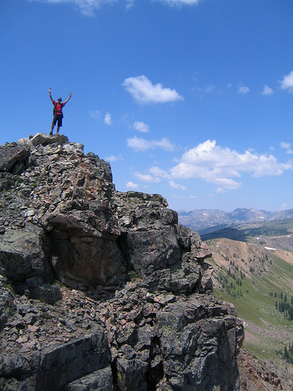
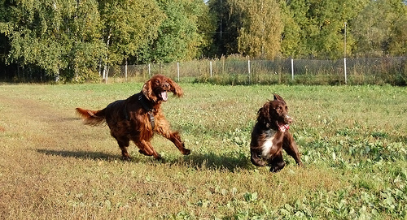
Comparing the expected output and the generated caption (15% of data) using the BLEU (metric for evaluating a generated sentence to a reference sentence score):
BLEU-1: 0.538577 (1-gram score, high quality)
Expected: 0.401 to 0.578
BLEU-2: 0.287183 (cumulative 2-gram score, gist clear but grammar issues)
Expected: 0.176 to 0.390
BLEU-3: 0.194631 (cumulative 3-gram score, hard to understand)
Expected: 0.099 to 0.260
BLEU-4: 0.089581 (cumulative 4-gram score, not useful)
Expected: 0.059 to 0.170
Results
BLEU scores compared to paper with suggested scores for skillful model: Where to put the Image in an Image Caption Generator
['<START>', 'dog', 'is', 'running', 'through', 'the', 'grass', '<END>']
['<START>', 'man', 'is', 'climbing', 'rock', 'wall', '<END>']
Bilal Majeed

Slide 10
Use the larger Flickr30k or MSCOCO
The vocabulary size in the Flick8k descriptions is small for useful caption generation
BERT embeddings for encoder instead of generating an embedding
Image feature attention
“Human perception does not tend to process a whole scene in its entirety at once but applies some mechanisms to selectively focus on the information needed.”
Combine image feature extraction models: Pre-trained CNN Model and Pre-trained Object Detector
Possible Improvements
Bilal Majeed

