Slide 1
Sequence to Sequence Chatbot with Attention
Members: Bilal Majeed and Sandhya Prakash
Use an encoder-decoder model with an attention mechanism to help reduce the bottleneck by allowing the decoder to look at the input sequence while predicting.

Slide 2
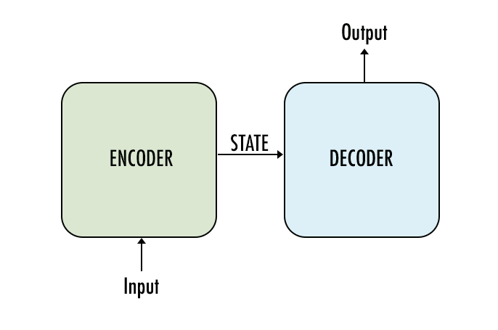
Problem Description and Proposed Solution
Previously, chatbots have been developed using hand-written rules, making models static. Recently, Sequence to Sequence (seq2seq) models with recurrent neural networks are being used to solve complex language problems.
But there exists a bottle neck as it is difficult to encode a large input sequence into a single fixed-length vector.
To improve the seq2seq model and make it more robust, during training, an attention mechanism is included to gather context for each input word, allowing the decoder to have more information about each part of the input sentence.

Slide 3
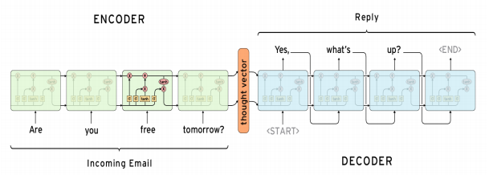
Data Source and Preparation
Cornell movie dialog corpus dataset (lines and conversations)
304714 lines in the dataset
20000 could only be used due to hardware constraints
Prepare input and output sequence
Clean both inputs and outputs using regex
Input: padded sequence of fixed length
Output: <BOS> + padded sequence of fixed length + <EOS>
Prepare model training sequence
Remove <BOS> so first word is the predicted word
Matrix of sentence length * vocabulary length

Slide 4
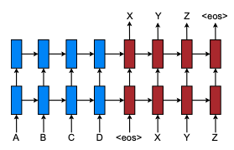
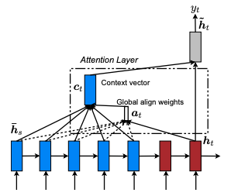
Model Architecture
Encoder:
Embedding and LSTM layers with 256 units outputting overall sequence output and encoder states (thought vector in figure above)
Decoder:
Embedding and LSTM layers with 256 units outputting overall sequence output and decoder states
Encoder states from the encoder are used as initial states of the decoder
Attention:
The dot product of the encoder overall sequence output and the decoder outputs with the softmax generates the “global align weights”
The dot product of the “global align weights” and the encoder outputs generates the “context vector”
The context vector and the decoder output are then concatenated, and used as an input to a dense layer for the final output vector of vocabulary size

Slide 5
Inference and Predictions
Run encoder on cleaned and processed user input
Loop until <EOS> is seen or maximum length is reached
Run decoder on current word using current state and apply attention to produce next word
Add next word to predicted output, update current word and current state to decoder hidden states
Initialize current word as <BOS> and current state for decoder as encoder hidden states
Requires the generation of models based on the trained models:
Encoder uses the encoder inputs and outputs the encoder states defined in the model building
Decoder uses the current states (starts with encoder states) with the current word (starts with 'BOS') and outputs the decoder states
Predictions use the outputs from the inference encoder and decoder model

Slide 6
Conclusions and Future Direction
During this project, we learnt that a seq2seq model with attention required lots of data and processing power to train. Despite the attention mechanism implemented, the lack of training and the subset of data selected did not allow the model to perform well.
It is nearly impossible to obtain a human-human like conversation with a chatbot due to the use of a movie lines dataset.
Direction:
Better hardware to use all available data and train for more epochs, or learn to progressively train the model
BERT embeddings weights used instead of generated own embeddings
Test Transformer architecture chatbot and compare results

