Slide 1

RFM Analysis
Customer Analytics
Bilal Shafique

Slide 2

Agenda
Introduction on RFM
Calculation of RFM
Visualizations
Recommendations
Conclusion
Stack Holders
Marketing Manager
Sales Team
Interns

Slide 3

RFM?
RFM analysis is a customer segmentation technique that stands for Recency, Frequency, and Monetary value.

Slide 4
Introduction
Recency measures how recently a customer made a purchase
Frequency measures how often a customer buys from you
Monetary value measures how much a customer spends with you

Slide 5
Benefits of RFM
The primary benefits of RFM analysis are:
Targeted Marketing
Customer Retention
Personalization
Resource Allocation

Slide 6

Calculation of RFM
Let’s dive in

Slide 7
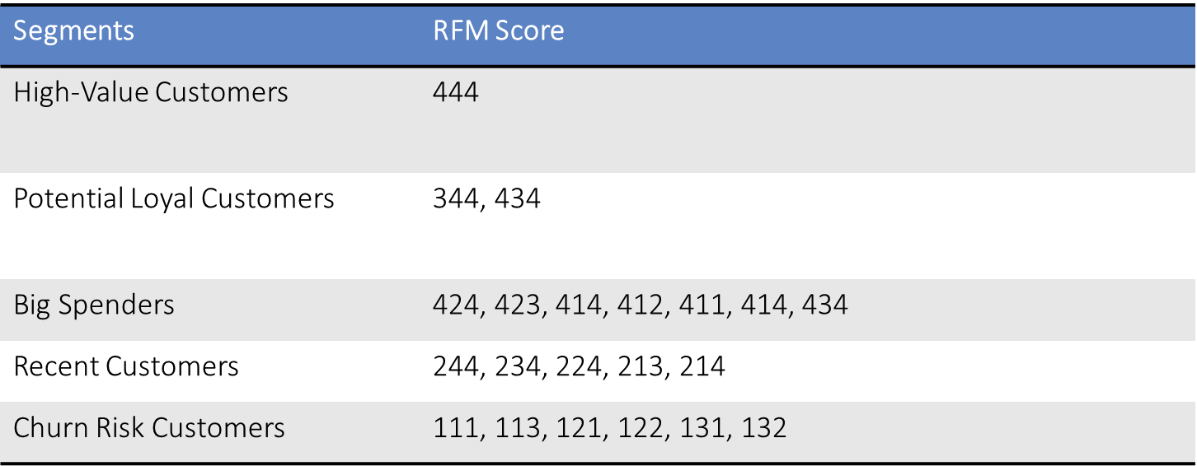
Customer’s Segmentation
High-Value Customers: Top-tier customers contributing significantly to revenue.
Potential Loyal Customers: Promising customers with moderate spending and engagement.
Big Spenders: High-value customers with significant purchases.
Recent Customers: customers with frequent purchases in the recent past.
Churn Risk Customers: Potential churn.

Slide 8




RFM Score
R
F
M
RFM
2
4
4
244

Slide 9
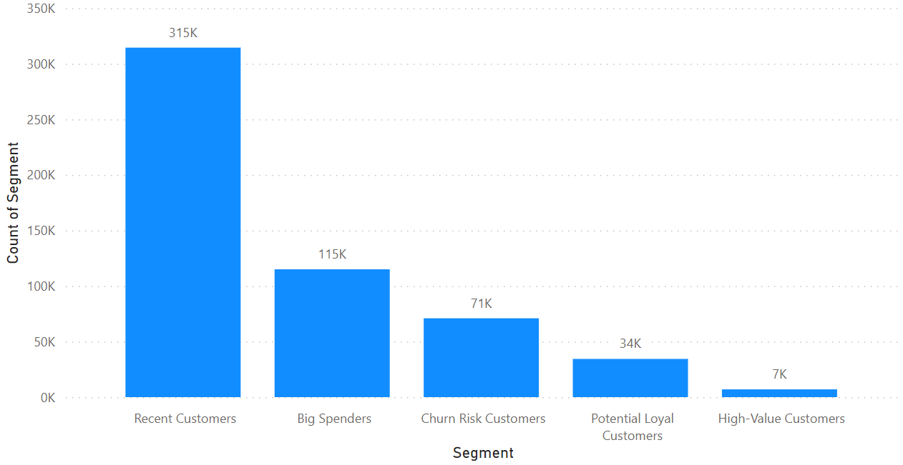
Segment’s Count

Slide 10
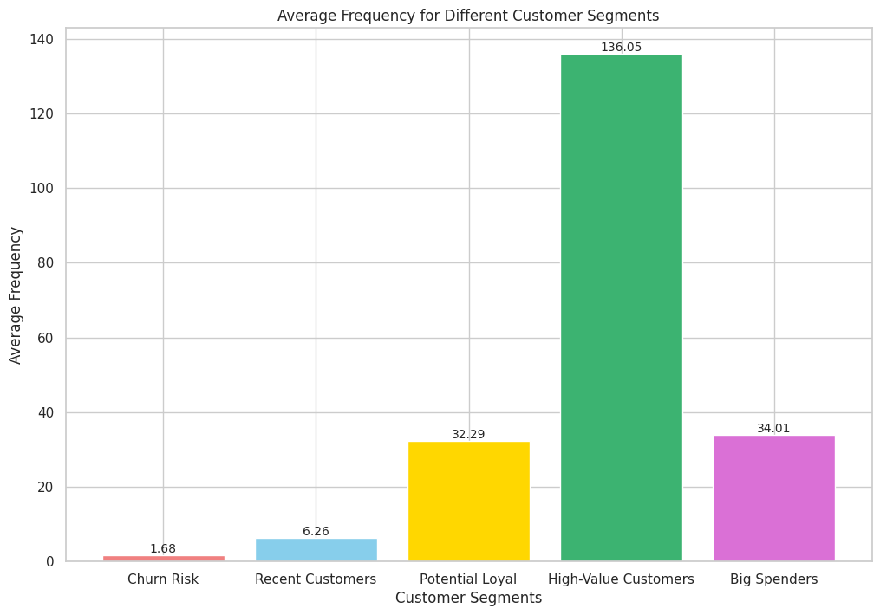
Frequency
High-Value customers Should be incentivized to increase their frequency

Slide 11

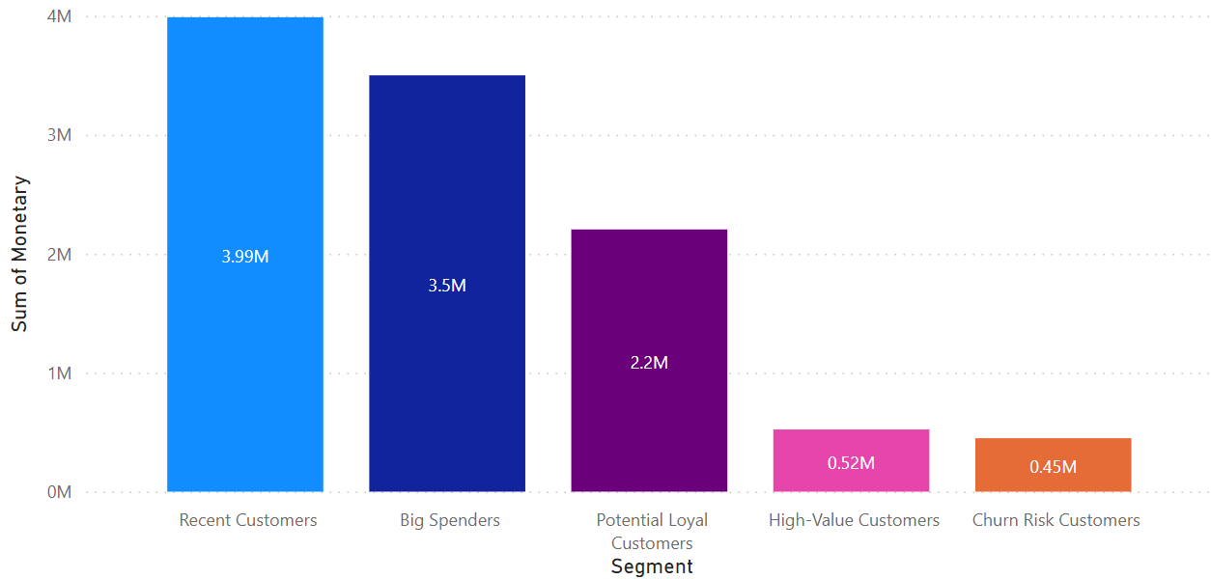
Monetary:
Targeted marketing strategies:
Potential Loyal customers Should focus on retaining their loyalty
Big Spenders could be targeted with exclusive offers to maintain their high spending levels.

Slide 12

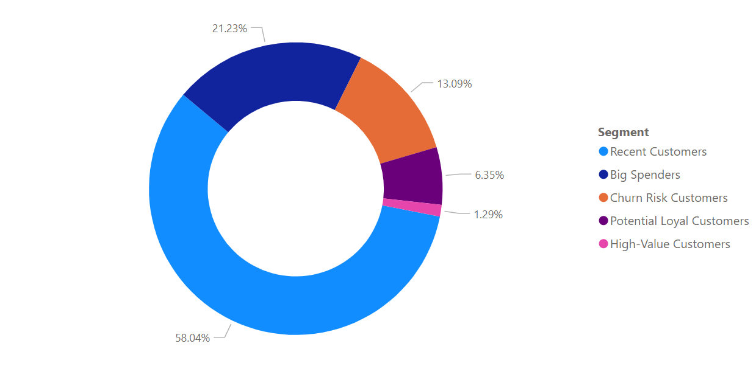
Monetary:
Targeted marketing strategies:
Potential Loyal customers Should focus on retaining their loyalty
Big Spenders could be targeted with exclusive offers to maintain their high spending levels.

Slide 13
Country Based Results
Let’s dive in

Slide 14
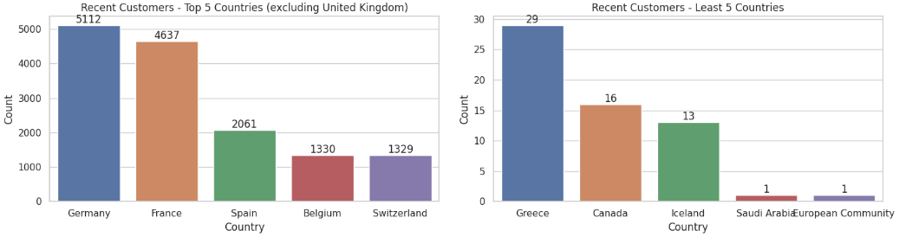
Recent Customers
United Kingdom(293707) appears prominently
Germany and France consistently appear in the top countries across different segments, suggesting their importance in recent customers.

Slide 15
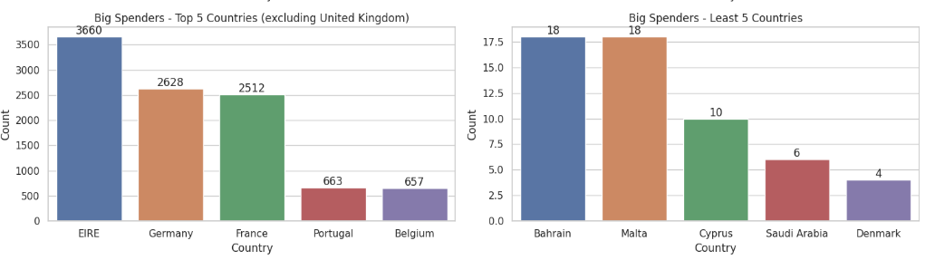
Big Spenders
United Kingdom(100900) appears prominently in Big Spenders
Ireland, Germany and France consistently appear in the top countries across different segments

Slide 16
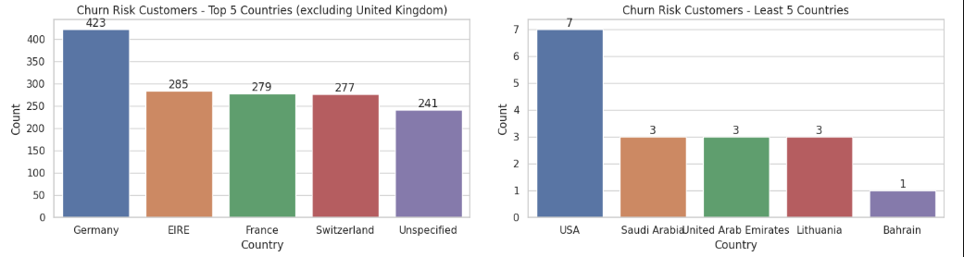
Churn Customers
United Kingdom(68458) appears prominently in Churn Segment
Germany, Ireland and France consistently appear in the top countries

Slide 17
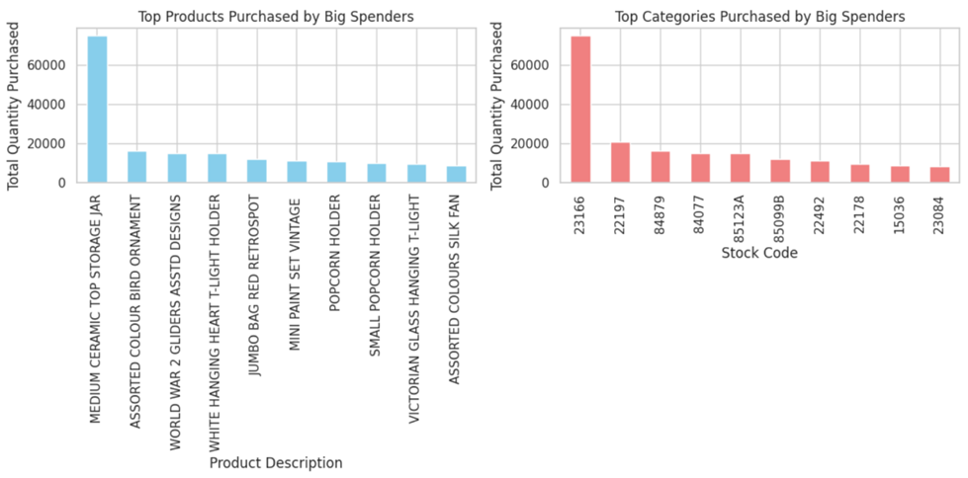
Recommendations:
Focus on introducing and promoting premium and unique products in similar categories.
Special promotions, exclusive offers, or loyalty programs for these specific items may further enhance customer engagement and loyalty within this high-value segment.

Slide 18
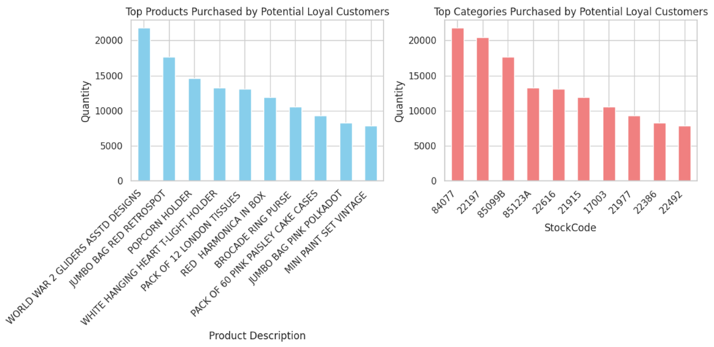
Recommendations:
Promotions and Bundles:
Consider creating promotions or bundles that include the popular products like "WORLD WAR 2 GLIDERS" and "JUMBO BAG RED RETROSPOT" to attract more purchases.
Targeted Marketing:
Use targeted marketing campaigns for products in the top categories to engage Potential Loyal Customers and encourage repeat purchases.
Diversification:
Explore adding related products to the popular ones, creating a diversified product offering to meet the varied preferences of Potential Loyal Customers.

Slide 19
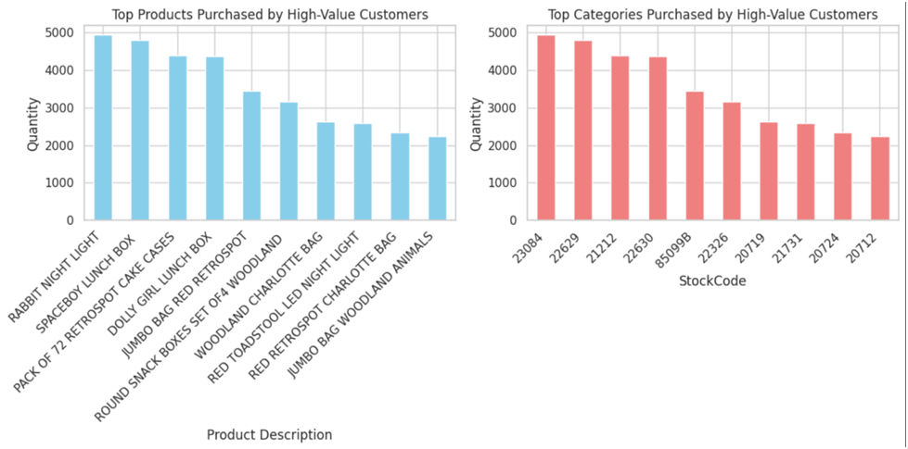
Recommendations:
Exclusive Offers:
- Create exclusive offers or discounts for High-Value Customers on their favorite products like "RABBIT NIGHT LIGHT" to strengthen their loyalty.
Bundle Deals:
- Consider creating bundle deals that include the top products to encourage customers to purchase complementary items together.

Slide 20
Recommendations:
Limited Editions:
- Introduce limited edition or exclusive versions of popular products to entice High-Value Customers with unique offerings.
Product Relations:
- Products like "SPACEBOY LUNCH BOX" and "ROUND SNACK BOXES SET OF 4 WOODLAND" might be related. Consider cross-promoting these items to increase sales.

Slide 21
Recommendations

Slide 22


High-Value Customers:
Recommendations:
Develop strategies to increase frequency and maximize revenue.
Provide premium services or early access to new products.
Acknowledge and appreciate their high-value status with exclusive perks

Slide 23
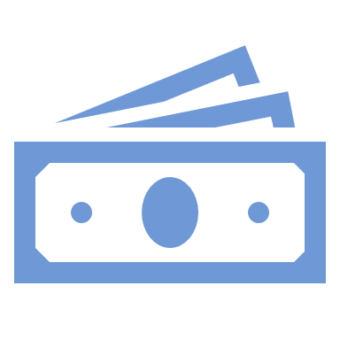
Big Spenders:
Recommendations:
Exclusive rewards for high-value transactions.
Create limited-time offers to drive urgency
Personalize communication to make them feel valued.

Slide 24
Potential Loyal Customers:
Recommendations:
Provide exclusive benefits for repeat business to foster loyalty.
Implement personalized communication to strengthen the relationship.

Slide 25

Recent Customers:
Recommendations:
Develop targeted promotions to encourage repeat purchases.
Use personalized marketing to enhance the overall customer experience such as:
Faster Delivery
CSR

Slide 26



Churn Risk Customers:
Recommendations:
Launch targeted re-engagement campaigns with special offers.
Gather feedback to identify and address potential pain points.
.

Slide 27



Q???
Muhammad Bilal
Bilalshafiq139@gmail.com

