Slide 1

Foundational Concepts
and Working Setup
AI & Machine Learning Track
Bile Initiative
DAY 01
Day focus
•
Understand the core AI terms
•
Prepare the tools & Environment

Slide 2

TABLE OF CONTENTS
01
AI, ML and Deep Learning, Generative AI
Foundational Concepts
02
Machine learning concepts
03
LLMs Concepts
04
Project 01: Student Performance Prediction
05
Setup & Resources
06
Conclusion
BILE Initiative · AI & Machine Learning Track

Slide 3
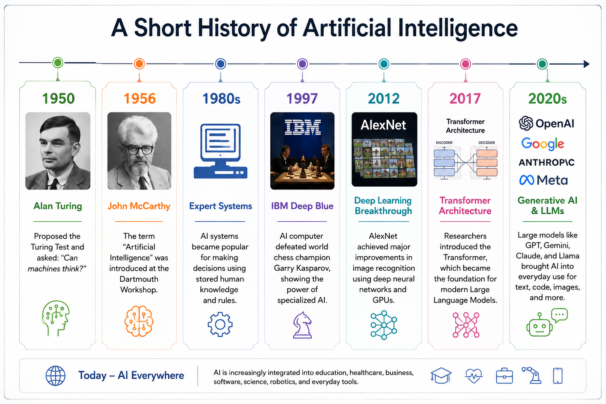
BILE Initiative · AI & Machine Learning Track
Notes:
https://courses.cs.umbc.edu/471/papers/turing.pdf BY alan turning

Slide 4
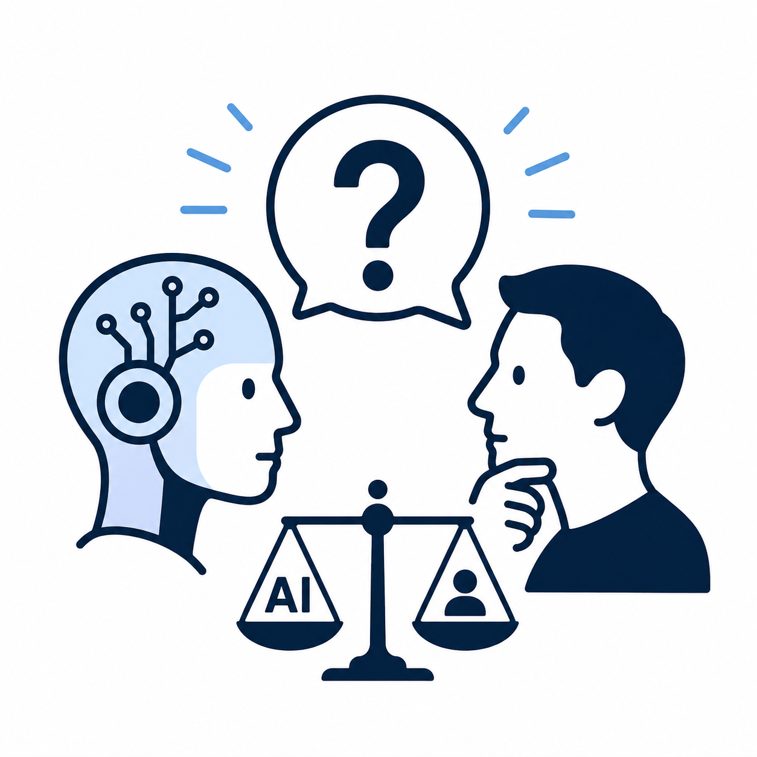
If AI learns from human-created data, can AI become better than humans at making decisions? Why or why not?
BILE Initiative · AI & Machine Learning Track

Slide 5
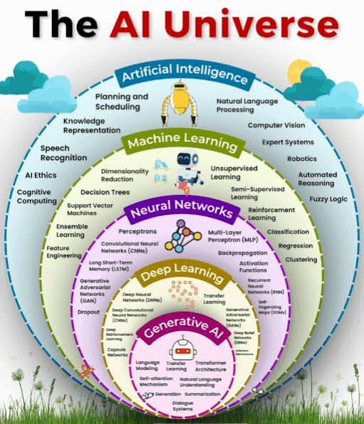
AI Intersect
The AI landscape
Artificial Intelligence: AI is the overall goal of making computers perform tasks that normally require human intelligence.
Machine Learning: Machine Learning is one way of building AI systems. Instead of writing every rule manually, we give the computer data and let it learn patterns from examples.
Neural Networks: They learn relationships by passing information through connected layers of artificial neurons.
Deep Learning: Deep Learning is a branch of neural networks that uses many layers.
Generative AI: Generative AI uses learned patterns to create new content, rather than only classify or predict something. It can generate text, images, audio, video, and code.
Not every AI system uses Machine Learning because some
AI systems simply follow predefined rules.
BILE Initiative · AI & Machine Learning Track

Slide 6
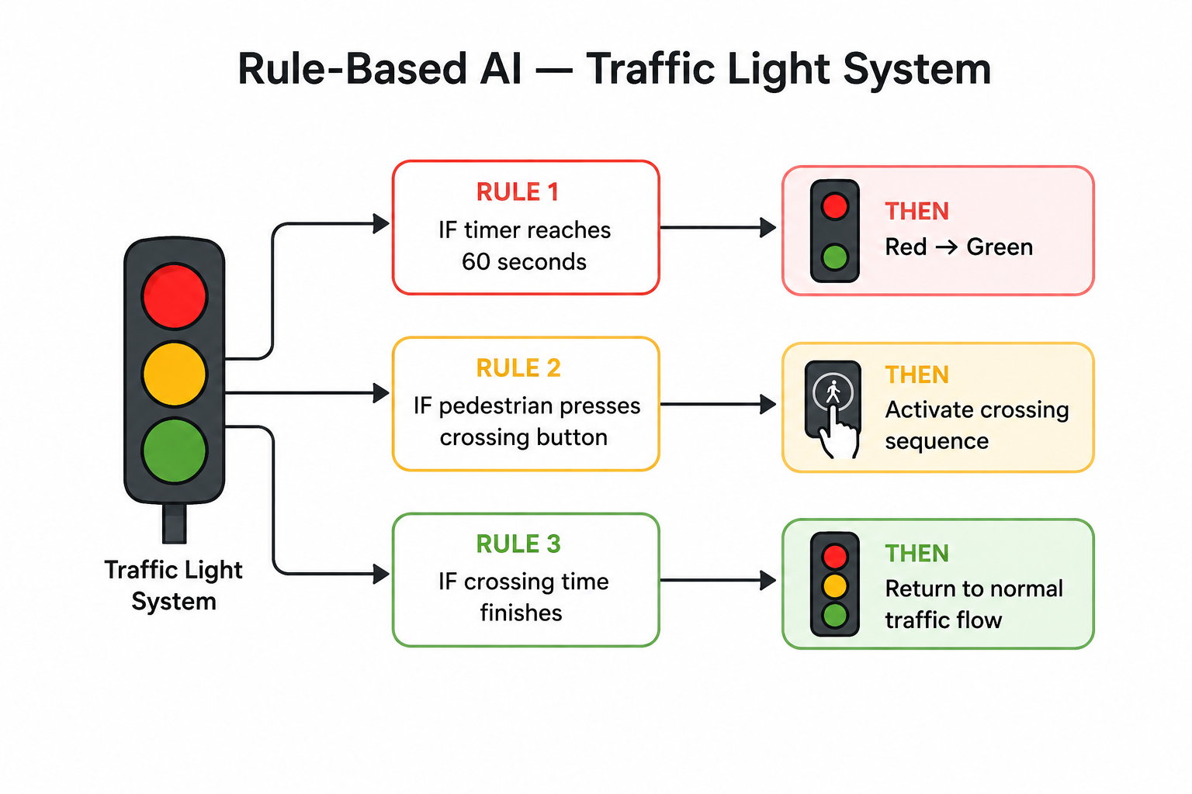
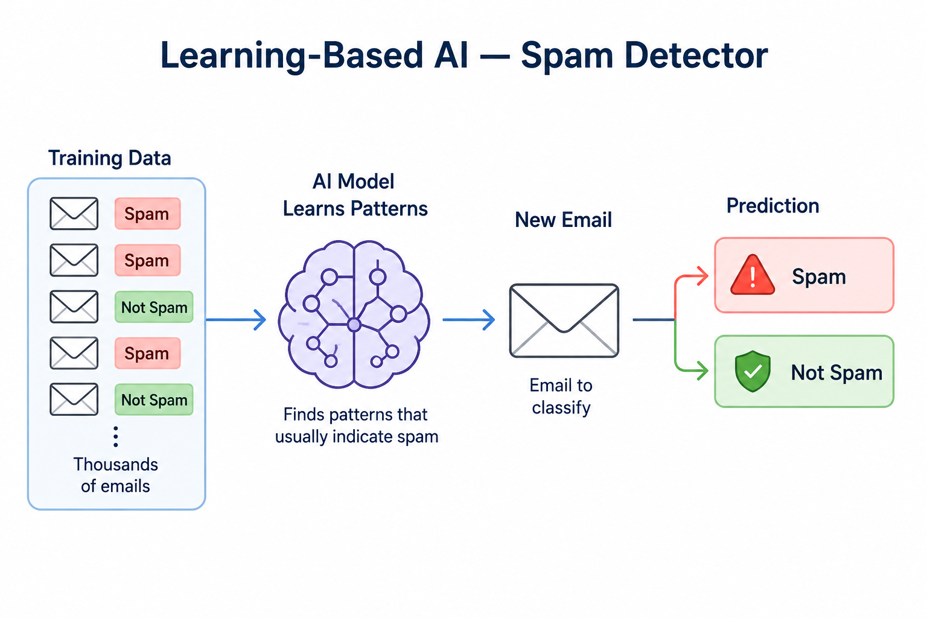
AI Intersect
Two simple types of AI systems
Rule-Based AI
Learning-Based AI
The system follows rules written by humans.
The system learns patterns from data using Machine Learning or Deep Learning.
BILE Initiative · AI & Machine Learning Track

Slide 7
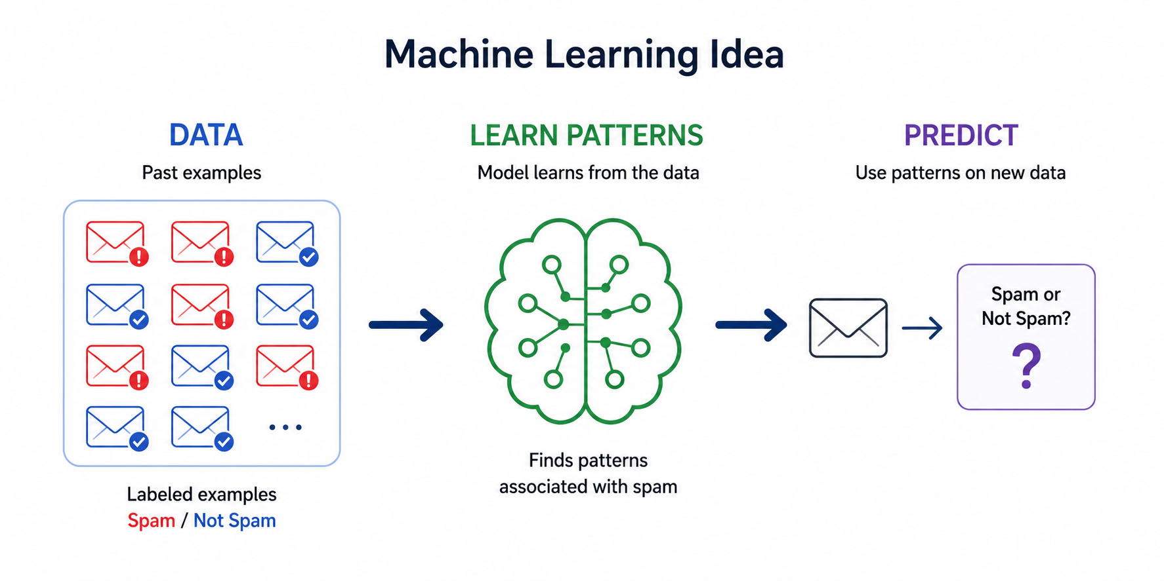
ML
Machine Learning (ML)
Machine Learning is a branch of AI where computers learn patterns from data
to make predictions or decisions, instead of being given every rule manually.
BILE Initiative · AI & Machine Learning Track

Slide 8
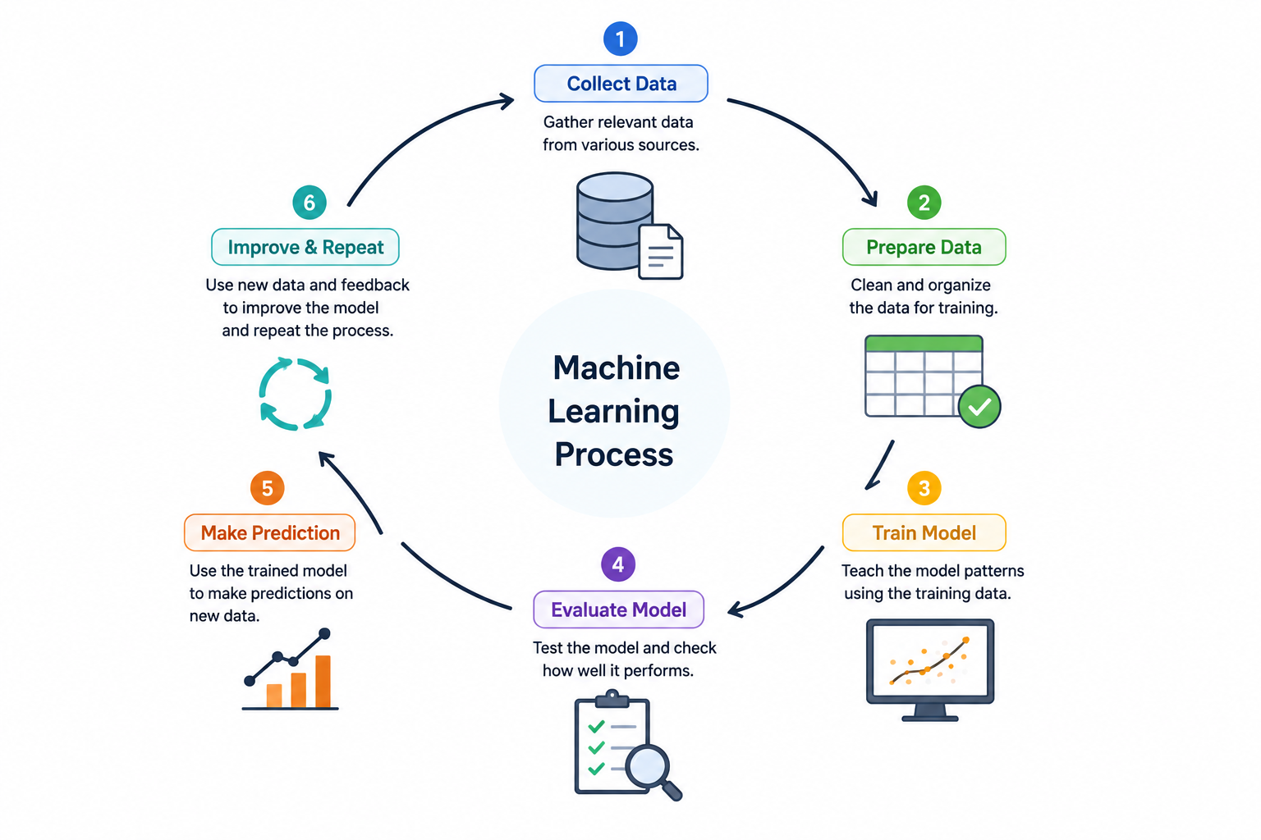
ML
How Machine Learning Works
Machine Learning follows a simple process: it learns from existing data, creates a model,
and uses that model to make predictions on new data.
BILE Initiative · AI & Machine Learning Track

Slide 9
ML
Main Types of Machine Learning
Type | Definition | Data Used | How It Learns | Example
Supervised Learning | Learns from examples where the correct answers are already provided. | Labeled data | Compares its predictions with known answers and learns the patterns. | Spam Detection
Unsupervised Learning | Learns from data without correct answers and discovers hidden patterns or groups. | Unlabeled data | Looks for similarities, differences, and natural structures in the data. | Customer Grouping
Reinforcement Learning | Learns which actions work best by interacting with an environment and receiving feedback. | Experience & feedback | Takes an action → sees the result → receives feedback → improves future actions. | Robot Navigation
BILE Initiative · AI & Machine Learning Track

Slide 10
ML
Essential Machine Learning Terminology
Term | Definition
Feature | Information used by the model to learn or make a prediction.
Label / Target | The answer or value the model is trying to predict.
Training | The process where the model learns patterns from data.
Inference | Using a trained model to produce an answer for new data.
Classification | Predicting a category, such as Spam / Not Spam.
Regression | Predicting a number, such as a house price.
Accuracy | How often the model makes the correct prediction.
Epoch | One complete pass through the training dataset.
Overfitting | The model learns the training data too closely and performs poorly on new data.
Underfitting | The model has not learned enough to capture important patterns.
Generalization | How well the model works on new, unseen data.
BILE Initiative · AI & Machine Learning Track

Slide 11
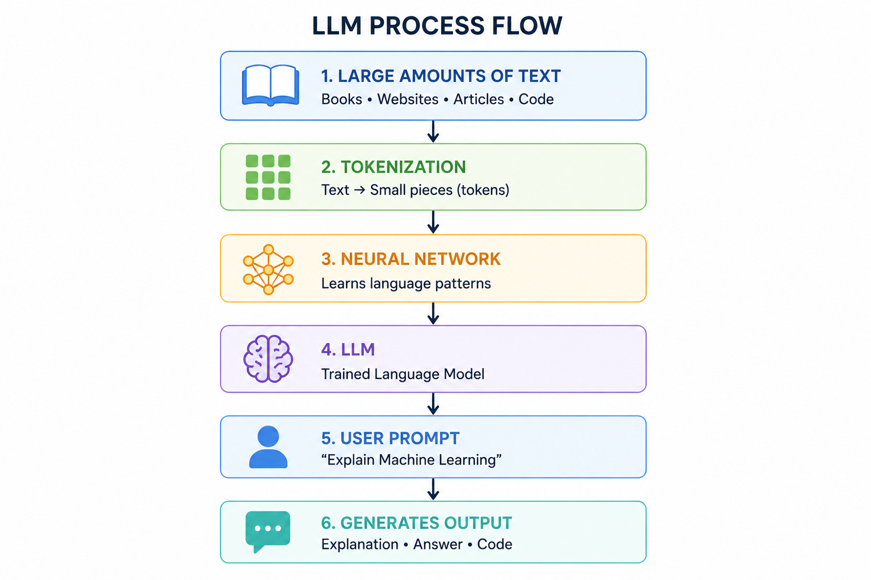
LLMs
Large Language Models (LLMs)
A Large Language Model (LLM) is a deep learning model trained on large amounts of text to understand
and generate human-like language.
Language Patterns: Learns how words and ideas relate.
Context: Uses surrounding text to understand what is being discussed.
Next-Token Prediction: Generates text by predicting the next likely token repeatedly.
For example:
“Machine learning is a type of ___”
→ the model may predict “AI”
Then it predicts the next token, then the next, gradually creating a complete response.
Examples of LLMs
GPT • Gemini • Claude • Llama
BILE Initiative · AI & Machine Learning Track

Slide 12
Setup & resources
Setup & Resources
Tool | Purpose
Google Colab | Main environment for ML practice and model training
VS Code | Local coding and project development
Python 3 | Main programming language
Jupyter Extension | Run notebooks directly inside VS Code
Ollama | Run LLMs locally for project inference
Project Resources — GitHub
All workshop and project materials will be available in GitHub repository:
Link: https://github.com/Bile-Initiative-AIML-Track/aiml-track-resources
BILE Initiative · AI & Machine Learning Track

Slide 13
Setup & resources
Specs & Links
Components | Minimum*
RAM | 8GB
CPU | Core i5
Storage | 15-20 GB Free
Link | Access
Collab | https://colab.research.google.com/
VS Code | https://code.visualstudio.com/download
Python 3 | https://www.python.org/downloads/
Ollama | https://ollama.com/download
Git | https://git-scm.com/downloads/
NOTE: If your laptop has 8 GB RAM, use small quantized models (1B–3B) for smoother performance.
Avoid larger models, as they may exceed your system’s available memory.
BILE Initiative · AI & Machine Learning Track

Slide 14
Project 01
Student Performance Prediction
This project turns a dataset into a small web app that predicts a student outcome from selected inputs.
Build a Machine Learning model that uses historical student data to identify whether a student is:
Likely to PASS
At Risk of FAILING
Learning Paradigm: Supervised Learning
Task: Binary Classification
Target: PASS / FAIL
Main Algorithm: Logistic Regression
Dataset
Clean data
Train model
Evaluate
web app
BILE Initiative · AI & Machine Learning Track
Notes:
After completing the Logistic Regression model: Train a different classification algorithm using the same prepared dataset and compare its performance with Logistic Regression. For example (Decision Tree) You will understand that the same Machine Learning problem can be solved using different algorithms, and model evaluation helps us determine which approach performs better.

Slide 15
DATASET START
We will use the Student Performance Dataset from the UCI Machine Learning Repository,
a public platform widely used for Machine Learning education and research.
Our dataset contains: 649 Students • 33 Attributes
Input Features (X):
Selected student information such as study time, absences, past failures, support, activities, and other relevant attributes.
Target (y):
We use the historical final grade G3 to create:
G3 ≥ 10 → PASS (1)
G3 < 10 → FAIL (0)
G3 itself will not be used as an input feature.
As early-risk, we'll also exclude G1 and G2 from the model inputs.
BILE Initiative · AI & Machine Learning Track
Notes:
Historical student data provides the examples our model needs to learn patterns associated with PASS and FAIL.

Slide 16
DATASET PREVIEW
First notebook: open, load, inspect
What head() shows
import pandas as pd
df = pd.read_csv('student_data.csv')
df.head()
df.shape
df.info()
•
The first few rows, useful for seeing the real columns and values.
What shape shows
•
The number of rows and columns, useful for understanding dataset size.
What info() shows
•
Column types and missing values, useful before any cleaning begins.
BILE Initiative · AI & Machine Learning Track

Slide 17
conclusion
Key Takeaways
Today, we built the foundation for understanding Artificial Intelligence and Machine Learning.
Understood how AI, ML, Deep Learning, Generative AI, and LLMs are connected.
Learned how machines use data to discover patterns and make predictions.
Explored Supervised, Unsupervised, and Reinforcement Learning
Understood how LLMs learn language patterns and use context and token prediction to generate responses.
Next, we move from understanding AI to working with real data and building practical solutions.
BILE Initiative · AI & Machine Learning Track

