Slide 1
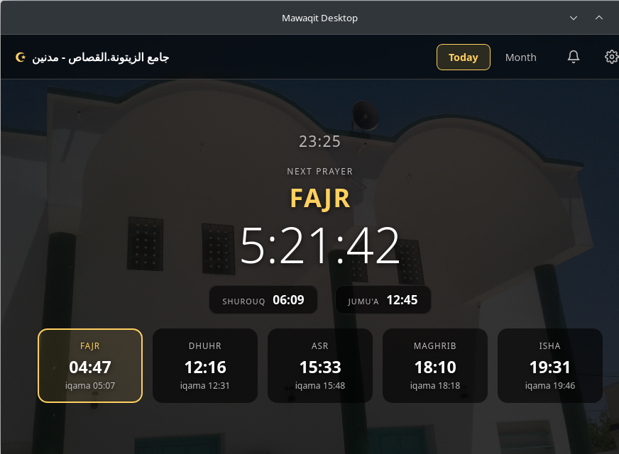
mawaqit-desktop
PRAYER TIMES FOR PEOPLE WHO WORK
Deep work.
Zero missed prayers.
Prayer times live in your desktop tray —
so your phone can stay face-down.
Today's times for your mosque — next prayer on countdown.
Free & open source · Windows · macOS · Linux
Notes:
Hook: the phone is where focus goes to die. mawaqit-desktop moves the prayer clock to the machine you actually work on.

Slide 2
01 · THE REAL COST
Your prayer reminder lives in the noisiest place you own.
9:41
One glance becomes twenty minutes.
WhatsApp · 3 unread
Checking the next prayer time means picking up the phone — and the phone has other plans.
X · 12 new posts
Silence it, and the adhan is gone.
YouTube · autoplay
A phone on Do Not Disturb swallows the one call that actually matters.
Instagram · stories
Focus pays the bill.
Mawaqit — Fajr in 5 min
Every unlock is a context switch your deep work didn't ask for.
The one alert you need, drowned by the rest.
Notes:
The problem is structural: prayer info and distraction live behind the same lock screen.

Slide 3
02 · THE FIX
Prayer times belong
where the work happens.
mawaqit-desktop sits in your system tray and calls the adhan at prayer time —
no dock, no tab, no phone screen ever turned on.
Live tray countdown — orange under 10 min, red under 5.
05:12
23:25
your tray
Notes:
Positioning: the desktop is the only screen without an infinite scroll attached to it.

Slide 4
03 · HOW IT WORKS
From mosque search to adhan — in three steps.
1
2
3
Find your mosque
Your tray learns the times
Get called to prayer
One search across the mawaqit.net mosque directory. No account, no API key, no setup wizard.
Today's schedule lands in the tray with a live countdown to the next prayer — iqama included if you want it.
At prayer time you get a desktop notification and the adhan — or a quiet heads-up, your choice per prayer.
Times refresh automatically every day — DST, calendar layouts and iqama offsets handled.
Notes:
Zero-friction onboarding is the point: keyless by design, works in under a minute.

Slide 5
04 · PER-PRAYER CONTROL · V0.2.0
Each prayer, its own rules.
Prayer Notifications
A mode per prayer
Fajr
Dhuhr
Asr
Maghrib
Isha
Silent for a quiet popup, Default for a standard one, Adhan for the full call — independently per prayer.
Silent
Default
Adhan
Your sound, your volume
Use the built-in athan or any mp3/wav on your disk, with per-prayer volume from 0 to 100.
Sound built-in athan · volume 40%
Notify before
5 Minutes
−
+
One heads-up, on time
Notify before 1–30 minutes — exactly one reminder, never a countdown spam.
Set this for every prayer
Shurouq & bulk edit
Optional pre-sunrise reminder, and one click to apply a prayer's settings to all five.
The notifications panel
Notes:
v0.2.0 headline: each prayer is configured independently — modes, sound file, volume, and a single on-time reminder.

Slide 6
05 · EVERYDAY DETAILS
Small things that make it stick.
Countdown tray icon
Month calendar
The badge shifts green, orange, red as the next prayer approaches.
The full adhan & iqama table for the month, today highlighted.
Iqama alerts
Starts at login
An optional heads-up when each iqama starts.
Boots minimized to the tray — it never opens itself in your way.
Shurouq reminder
Stop the athan
One notification before sunrise, for those who fast.
Click the notification or the tray item to silence it instantly.
Notes:
These are the retention details — the app respects attention instead of demanding it.

Slide 7
06 · PRIVACY
Nothing to sign up for. Nothing tracking you.
0
0
0
accounts
API keys
ads & trackers
Keyless access to public mosque data. Your settings live in a local file —
nothing leaves your machine, and there is no server of ours to leak.
Notes:
Trust slide: the absence of infrastructure is the privacy policy.

Slide 8
07 · EVERYWHERE YOU WORK
Light on your machine.
~25 MB
Windows
MSI & NSIS installers
macOS
installed footprint. Built with Tauri 2 and Rust —
not Electron. It starts at login and you never notice it
until it's time to pray.
Intel & Apple Silicon (universal)
Linux
deb · rpm · AppImage · Raspberry Pi 5
Same tray behavior on every platform — autostart, notifications, adhan playback.
Notes:
The ~25 MB figure is the actual size of the Linux release binary.

Slide 9
08 · WHO IT'S FOR
Built for people who leave the phone in another room.
Deep workers
Remote workers & devs
Students
Protect the flow state without losing the prayer clock — no unlocks, no feeds, no rabbit holes.
The machine you already stare at becomes the one that calls you to prayer.
Long study sessions that respect salah — reminders arrive, reels don't.
If your phone stays in another room, your prayer times shouldn't live on it.
Notes:
Audience slide — invite the reader to recognize themselves.

Slide 10
Keep the phone down.
Never miss a prayer.
mawaqit-desktop · free & open source
Windows · macOS · Linux · Raspberry Pi 5
github.com/<your-handle>/mawaqit-desktop
Notes:
CTA. Replace the repo URL with the public link before posting.

