Slide 1
Bussgang Decomposition
06/05/2024

Slide 2
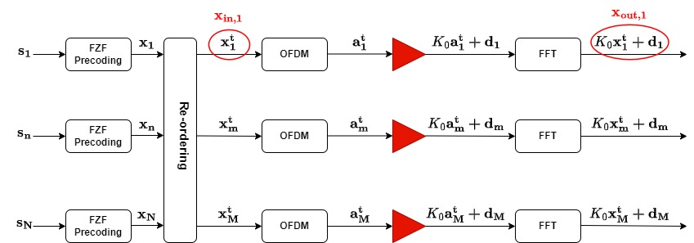






Bussgang Theorem
Bussgang’s theorem
Output of non-ideal hardware is scaled version of $x$ input plus distrotion $d$ that is not correlated with $x$
$$y=K_{0} x+d$$
Scaled input ($K0x$) + uncorrelated distortion ($d$)
$$s_{n}∈ℂ^{Kx1}$$
Symbols associated with the nth subcarrier
$$a_{m}^{t}∈ℂ^{1xN}$$
Time-domain transmitted signal through the m-th antenna
$$x_{n}∈ℂ^{Mx1}$$
N : Number of subcarriers
Precoded data vector to be transmitted over the n-th subcarrier
M : Number of antennas per AP
$$x_{m}^{t}∈ℂ^{1xN}$$
Frequency-domain transmitted signal through the m-th antenna
K : Number of UEs
Notes:
d(t) est complètement décorrélé du signal utile i(t),

Slide 3
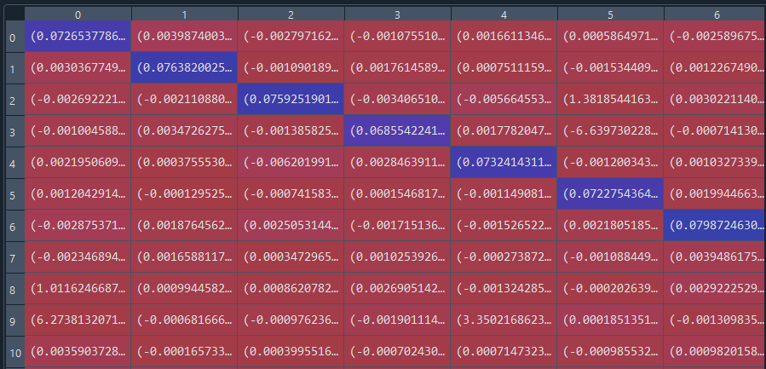
Correlation matrix (Xin,Xout), L=1, M=16, K=15

Slide 4
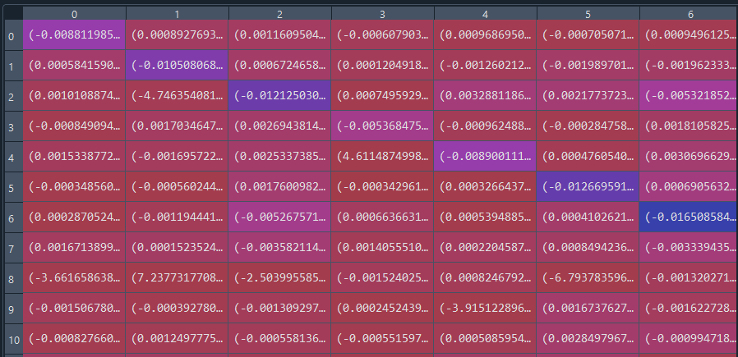
Correlation matrix (Xin,d), L=1, M=16, K=15

Slide 5
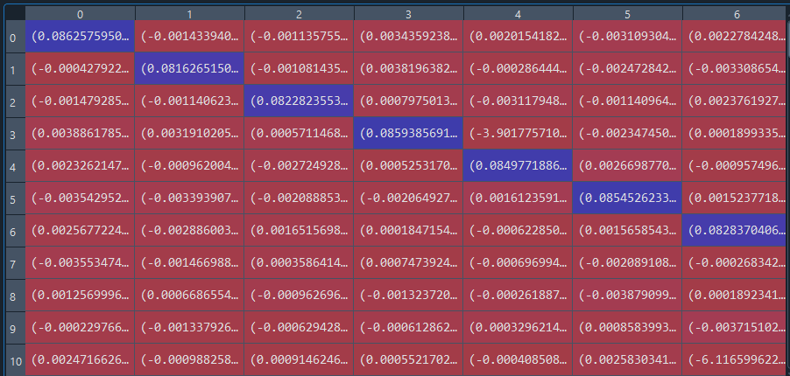
Correlation matrix (Xin,Xout), L=1, M=100, K=15

Slide 6
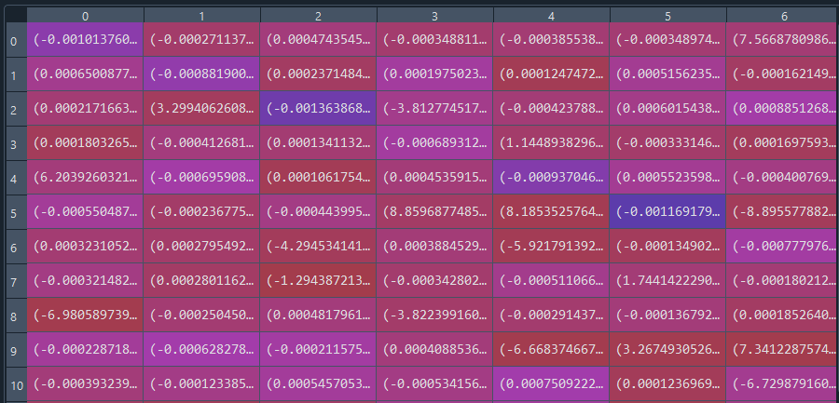
Correlation matrix (Xin,d), L=1, M=100, K=15

Slide 7



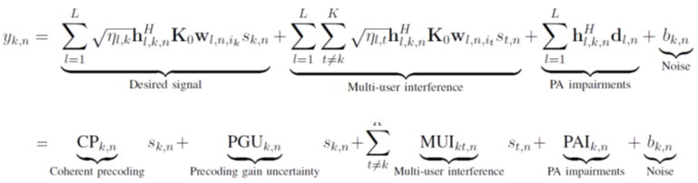


SINR expression
Distributed operation
Channel estimation
Transmit precoding
Power allocation
Data encoding
$$s_{1},…,s_{N}$$
$$H_{l,n}^{H}$$
CPU
AP
T1
T2
T3
T4
T5

Slide 8
Correlation matrix (Ti,Tj), L=1, M=16, K=15
T1 | T2 | T3 | T4 | T5
(1.9046670548270208e-07+0j) | (3.2053437575118266e-12-1.43865118761414e-12j) | (5.018419600390521e-11+3.4697011803216018e-12j) | (-3.6093267808399493e-12-4.311251489624703e-12j) | (1.0027042441232027e-08-6.576279498026842e-09j)
(3.2053437575118266e-12 + 1.43865118761414e-12j) | (2.5659359055086946e-13+0j) | (-1.5449506872781216e-14+1.0537373023012146e-13j) | (6.695301563409465e-15+4.9848620915851315e-15j) | (-3.5686062954611836e-12 -1.2117879335682012e-11j)
(5.018419600390521e-11 - 3.4697011803216018e-12j) | (-1.5449506872781216e-14-1.0537373023012146e-13j) | (6.12091430964231e-12+0j) | (-4.610052646526868e-14+2.6362845669585815e-14j) | (9.451975580200676e-12-2.9094488513903735e-12j)
(-3.6093267808399493e-12 +4.311251489624703e-12j) | (6.695301563409465e-15-4.9848620915851315e-15j) | (-4.610052646526868e-14-2.6362845669585815e-14j) | (6.288618143897667e-13+0j) | (-8.896172166750855e-12-1.0241220023127633e-12j)
(1.0027042441232027e-08+6.576279498026842e-09j) | (-3.5686062954611836e-12+1.2117879335682012e-11j) | (9.451975580200676e-12+2.9094488513903735e-12j) | (-8.896172166750855e-12+1.0241220023127633e-12j) | (1.0376619026406542e-07+0j)
T1
T2
T3
T4
T5

Slide 9
Correlation matrix (Ti,Tj), L=1, M=100, K=15
T1 | T2 | T3 | T4 | T5
(5.909800377689668e-05+0j) | (-1.1396691567903279e-10+1.8513576841979554e-10j) | (-8.717335897855987e-10-1.2540586074313835e-09j) | (-4.132226371207297e-11+3.959018968476257e-11j) | (-2.6931149693271975e-07+1.0477178007919523e-07j)
(-1.1396691567903279e-10-1.8513576841979554e-10j) | (1.91911433667496e-12+0j) | (1.2848872569096113e-13-7.755305664249702e-14j) | (1.2778319102740989e-14+2.8353740193603817e-14j) | (-1.5889888868290784e-11+1.0190663279487865e-11j)
(-8.717335897855987e-10+1.2540586074313835e-09j) | (1.2848872569096113e-13+7.755305664249702e-14j) | (4.145145616459971e-11+0j) | (2.0059637206095955e-15-5.098818709186386e-14j) | (1.4820562779423772e-10+1.766730559689165e-10j)
(-4.132226371207297e-11-3.959018968476257e-11j) | (1.2778319102740989e-14-2.8353740193603817e-14j) | (2.0059637206095955e-15+5.098818709186386e-14j) | (6.169234787957346e-13+0j) | (-1.8744981153829674e-11+1.7594873119612478e-11j)
(-2.6931149693271975e-07-1.0477178007919523e-07j) | (-1.5889888868290784e-11-1.0190663279487865e-11j) | (1.4820562779423772e-10-1.766730559689165e-10j) | (-1.8744981153829674e-11-1.7594873119612478e-11j) | (5.943223780165973e-07+0j)
T1
T2
T3
T4
T5

