Slide 1
Performance of CF-mMIMO systems under HWIs
02/07/2023

Slide 2
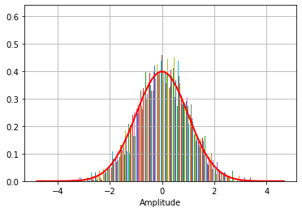

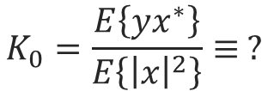

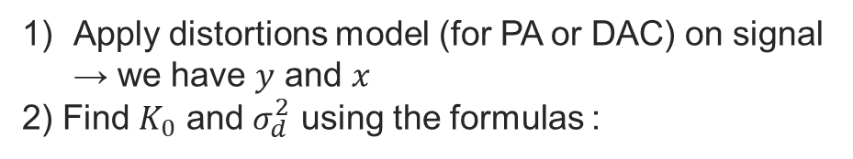
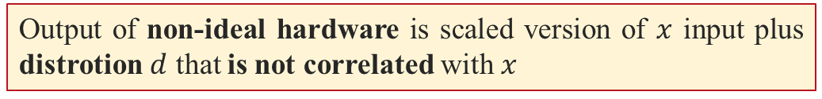
Bussgang
x = OFDM signals
x
y
?
Non-linear function
Bussgang’s theorem
Output of non-ideal hardware is scaled version of $x$ input plus distrotion $d$ that is not correlated with $x$
$$y=K_{0} x+d$$
Scaled input ($K0x$) + uncorrelated distortion ($d$)
How to find analytic expressions of $K_{0}$ and $σ_{d}^{2}$ ?
Apply distortions model (for PA or DAC) on signal → we have $y$ and $x$
2) Find $K_{0}$ and $σ_{d}^{2}$ using the formulas :
$$K_{0}=\frac{E\left\{yx^{∗}\right\}}{E\left\{{\left|x\right|}^{2}\right\}}≡ ?$$
$σ_{d}^{2}=E\left\{|d|²\right\}=E\left\{|y|²\right\}−K_{0}E\left\{{\left|x\right|}^{2}\right\} ≡$ ?

Slide 3



Polynomial approximation of the nonlinear distortion
where g[.] is the HPA transfer function and A(.) and P(.) denote the HPA AM/AM and AM/PM conversions, respectively
Polynomial approximation in order to estimate the nonlinear HPA. In this case, the output of HPA can be represented by

Slide 4
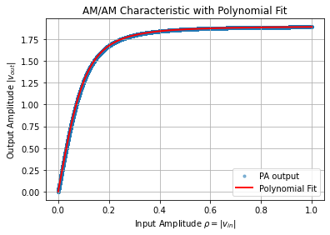
AM/AM characteristics

Slide 5
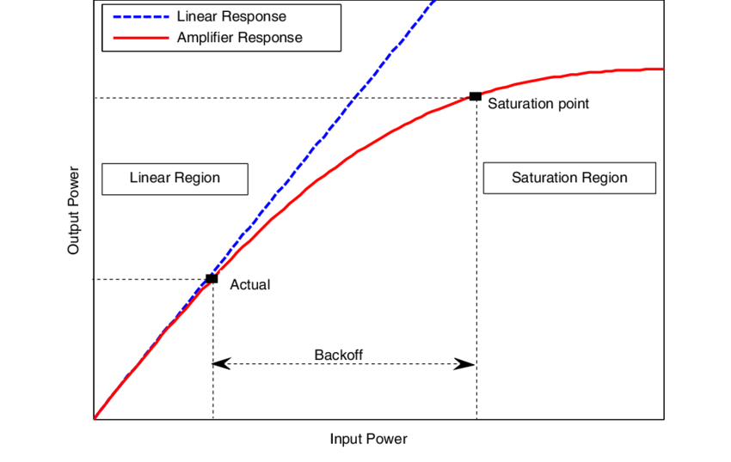



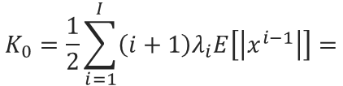
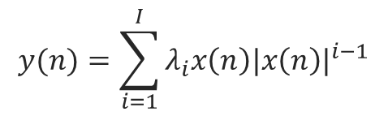


Power amplifier
$$x$$
$$y=K_{0} x+d$$
The nonlinear behavior of the PA can be modeled by the following
full-rank polynomial
$$y(n)=\sum_{i=1}^{I}{λ_{i}x\left(n\right){|x\left(n\right)|}^{i−1}}$$
The closed-form expressions for the non-linear distortion parameters in terms of the model PA parameters {λi}.
$$K_{0}=\frac{1}{2}\sum_{i=1}^{I}{\left(i+1\right)λ_{i}E\left[\left|x^{i−1}\right|\right]=}$$
$$σ_{d}^{2}=\sum_{i=1}^{I}{{|λ_{i}|}^{2}E\left[{\left|x\right|}^{2i}\right]+2\sum_{i,l=1,i≠l}^{L}{ℜ[}}λ_{i}λ_{l}]E\left[{\left|x\right|}^{i+1}\right]−{\left|K\right|}^{2}E\left[{\left|x\right|}^{2}\right]$$
[3] R. Zayani, et al., "Local PAPR-Aware Precoding for Energy-Efficient Cell-Free Massive MIMO-OFDM Systems," in IEEE Transactions on Green Communications and Networking, vol. 7, no. 3, pp. 1267-1284, Sept. 2023, doi: 10.1109/TGCN.2023.3257482

Slide 6


Simulation Setup
System model
Square area 1km x 1km
L : APs equipped with M antennas
CPU
1 km
K single-antenna UEs
The APs are connected to a CPU via an error-free and high-capacity communication links referred to as fronthaul links.
1 km

Slide 7
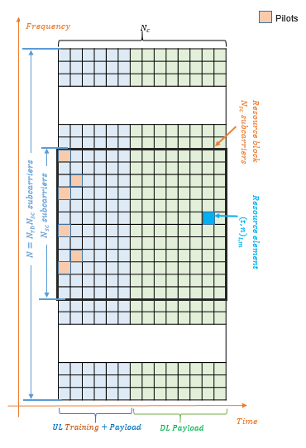











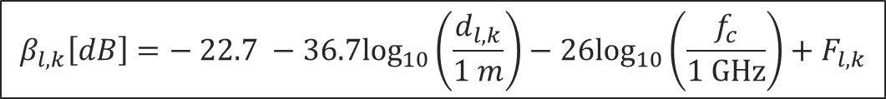
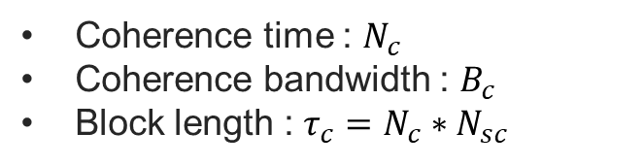
Frame structure & Channel model
Frame structure = Coherence block
$$N_{c}$$
Coherence time : $N_{c}$
Coherence bandwidth : $B_{c}$
Block length : ${τ_{c}=N}_{c}∗N_{sc}$
Pilots$τ_{p}$
UL data: $τ_{u}$
DL data: $τ_{d}$
$$B_{c}$$
$$τ_{u}=ξ(τ_{c}−τ_{p})$$
$$τ_{d}=(1−ξ)(τ_{c}−τ_{p})$$
Channel model
Independent Block Rayleigh fading channel
$${AP}_{l}$$
$$h_{l,k}\sim 𝒩ℂ(0,β_{l,k}I_{M})$$
$$h_{l,k}$$
Large-scale channel gain
$${UE}_{k}$$
$$β_{l,k}\left[dB\right]=− 22.7 −36.7\log_{10}\left(\frac{d_{l,k}}{1 m}\right)−26\log_{10}\left(\frac{f_{c}}{1 GHz}\right)+F_{l,k}$$
Shadow fading
[1] G. Interdonato, et al., "Local Partial Zero-Forcing Precoding for Cell-Free Massive MIMO," in IEEE Transactions on Wireless Communications, vol. 19, no. 7, pp. 4758-4774, July 2020.

Slide 8
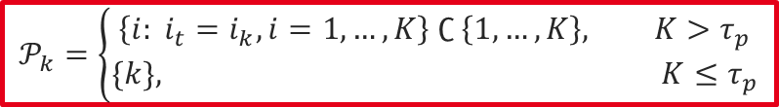


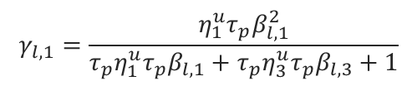
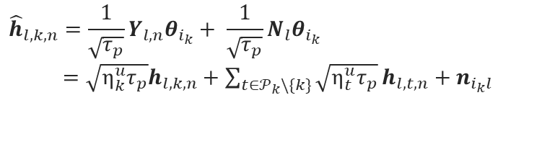



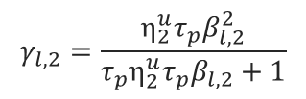









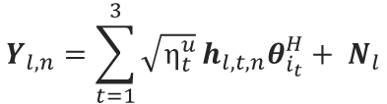


Pilot-based channel estimation
Distributed channel estimation from uplink pilots
Exemple: K=3, $τ_{p}$=2
$$θ_{1}, …,θ_{τ_{p}}∈ ℂ^{τ_{p}×1}$$
$$𝒫_{k}=\left\{\begin{matrix}\left\{i: i_{t}=i_{k}, i=1,…,K\right\} ∁ \left\{1,…,K\right\}, K>τ_{p} \\ \{k\}, K≤τ_{p}\end{matrix}\right.$$
$$Y_{l,n}=\sum_{t=1}^{3}{\sqrt{η_{t}^{u}}}h_{l,t,n}θ_{i_{t}}^{H}+ N_{l}$$
$${AP}_{1}$$
$${AP}_{2}$$
$$θ_{i_{t}}^{H}θ_{i_{k}}=\left\{\begin{matrix}0, t ∉𝒫_{k} \\ τ_{p}, t ∈𝒫_{k}\end{matrix}\right.$$
$$𝒫_{1}=𝒫_{3}=\left\{1,3\right\}$$
Channel estimate for user $k$ at AP $l$ and subcarrier $n$
$$𝒫_{2}=\{2\}$$
$${\hat{h}}_{l,k,n}=\frac{1}{\sqrt{τ_{p}}}Y_{l,n}θ_{i_{k}}+ \frac{1}{\sqrt{τ_{p}}}N_{l}θ_{i_{k}}$$
$=\sqrt{η_{k}^{u}τ_{p}}h_{l,k,n}+\sum_{t∈𝒫_{k}\backslash \{k\}}{\sqrt{η_{t}^{u}τ_{p}}}h_{l,t,n}+n_{i_{k}l}$
$${UE}_{1}$$
$${UE}_{2}$$
$${UE}_{3}$$
$$θ_{1}$$
$$θ_{2}$$
$$θ_{1}$$
${\hat{h}}_{l,2}$=$\sqrt{η_{2}^{u}τ_{p}}h_{l,2}+n_{i_{3}l}$
${\hat{h}}_{l,1}$=$\sqrt{η_{1}^{u}τ_{p}}h_{l,1}+\sqrt{η_{3}^{u}τ_{p}}h_{l,3}+n_{i_{1}l}$
$$γ_{l,2}=\frac{η_{2}^{u}τ_{p}β_{l,2}^{2}}{τ_{p}η_{2}^{u}τ_{p}β_{l,2}+1}$$
Desired channel
Pilot contamination
Noise
$$γ_{l,1}=\frac{η_{1}^{u}τ_{p}β_{l,1}^{2}}{τ_{p}η_{1}^{u}τ_{p}β_{l,1}+τ_{p}η_{3}^{u}τ_{p}β_{l,3}+1}$$
$$γ_{l,k}≜E\left\{{\left[ {\left|{\hat{h}}_{l,k}\right|}^{2}\right]}_{m,n}\right\}= \frac{η_{k}^{u}τ_{p}β_{l,k}^{2}}{τ_{p}\sum_{t∈𝒫_{k}}{η_{t}^{u}τ_{p}β_{l,t}}+1}$$

Slide 9
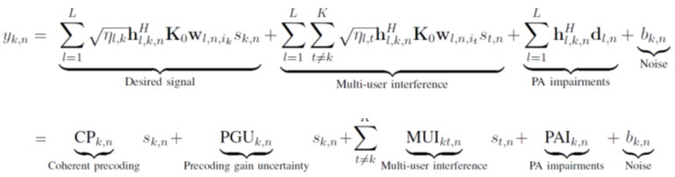













Downlink transmission: Received signal
CPU
$$s_{n}$$
$$s_{n}$$
Precoding Matrix
$$x_{l,n}=W_{l,n}{ P}_{l} s_{n}$$
MRT: Maximum Ratio Transmission
FZF : Full-Pilot Zero-Forcing Precoding
PZF : Partial Zero-Forcing Precoding
RZF : Regularized Zero-Forcing
$$M×1$$
$$K×1$$
$${AP}_{1}$$
$${AP}_{L}$$
OFDM
$$IFFT(x_{l,n})$$
Power allocation:
$$f\left(IFFT\left(x_{l,n}\right)\right)$$
$$s_{1}$$
$$s_{k}$$
$$s_{K}$$
FFT
Bussgang Decomposition
$$z_{l,n}=K_{0}x_{l,n}+d_{l,n}$$

Slide 10
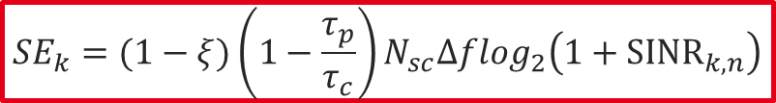
Downlink transmission: Spectral Efficiency
SINR
Coherent precoding
$${SINR}_{k,n}=\frac{E\left\{{|{CP}_{k,n}|}^{2}\right\}}{E\left\{{|{PGU}_{k,n}|}^{2}\right\}+\sum_{t=1,t≠k}^{K}{E\left\{{|{MUI}_{kt,n}|}^{2}\right\}}+E\left\{{|{PAI}_{k,n}|}^{2}\right\}+1}$$
Precoding uncertainty
PA impairements
multi-user interference
SINR : Analytic expression
Per-RB and per-user DL SE [bit/s]
$${SE}_{k}=(1−ξ)\left(1−\frac{τ_{p}}{τ_{c}}\right)N_{sc}Δf\log_{2}\left(1+{SINR}_{k,n}\right)$$

Slide 11
Downlink transmission: CDF of SE
Significant impact of the PA non-linearity on the SE performance, especially for UEs with good channels (i.e., upper SE percentiles) .
Higher sensitivity of the local RZF precoding scheme to the PA non-linearity compared with the FZF one, especially at high SE percentiles.

Slide 12
Thank you for your attention

Slide 13
Downlink transmission: Median Avg DL SE
RZF precoding can be performed by any number of pilots.
In linear case, RZF to achieve much higher SEs in the operation regime in which FZF cannot be implemented.
In nonlinear case, FZF performs better than RZF in its implementable operation regime.

