Slide 1

CS478 Project:
Implementation and analysis of convex hull algorithms
Bilgehan Sandıkcı
21902354

Slide 2


Project Environment
The project is made with:
WebGL
JavaScript
Data visualization:
Matplotlib(Python)

Slide 3
Grahams Scan Algorithm
The pseudocode that is defined in the lecture book will be used[1].
procedure GRAHAMHULL(S)
1. An internal point q will be found using the geometric center of the first 3 points in the set S.
2. Using q, the points in S will be sorted lexicographically by polar angle and distance from q and then will be arranged into a circular doubly-linked list with pointers NEXT and PRED.
3.
begin v:= START; w:= PRED[v];f:= false;
while (NEXT[v] != START or f = false) do
begin if NEXT [v] = w then f:= true;
if (the three points v, NEXT [v], NEXT [NEXT[v]] form a left turn) then v:= NEXT [v]
else begin DELETE NEXT[v];
v:= PRED[v]
end
end
end.
[2]

Slide 4
Jarvis March Algorithm
The Jarvis march algorithms’ pseudocode is derived after studying from the lecture book[1].
procedure JARVISMARCH(S)
1. The point with smallest y value vill be selected as q1.
2. The point with largest y value will be selected as q2.
3.
begin v:= q1;
/*Bottom to top wraping*/
j := 0;
min = q2
while(j > S.length) begin
if( angle between the line qS[i] and positive x-axis is smaller than current min angle) then min := S[j]
end
H.push(min);
/*top to bottom wraping*/
j := 0;
min = q1
while(j > S.length) begin
if( angle between the line qS[i] and negative x-axis is smaller than current min angle) then min := S[j]
end
H.push(min);
end.

Slide 5
Quick Hull Algorithm
The algorithm and the pseudocode as given in the lecture book will be used[1].
1. The line between the leftmost and the rightmost points will divide the set S into two sets and the plane into two halfplanes. One set is under, the other one is over the halfplane. Both sets will be passed into the algorithm QUICKHULL.
procedure QUICKHULL(S, l, r)
begin
if S = {l, r} then
return (l, r) /* lr is an edge of H(S) */
else
h = FURTHEST(S, l, r)
S₁ = points of S on or to the left of lh;
S₂ = points of S on or to the left of hr;
return QUICKHULL(S₁ , l, h) merged with (QUICKHULL(S₂ , h, r) - h)
end
end

Slide 6
Merge Hull Algorithm
The algorithm and pseudo code is derived usign divide-and-conquer philosophy using the lecture book[2].
procedure MERGEHULL(S)
begin
if(S.size ≤ 2) then
return S
S₁ = first S.size/2 points
S₂ = last S.size/2 points
H₁ = MERGEHULL(S₁ ,flag)
H₂ = MERGEHULL(S₂ ,flag)
return H₁ merged with H₁
end

Slide 7
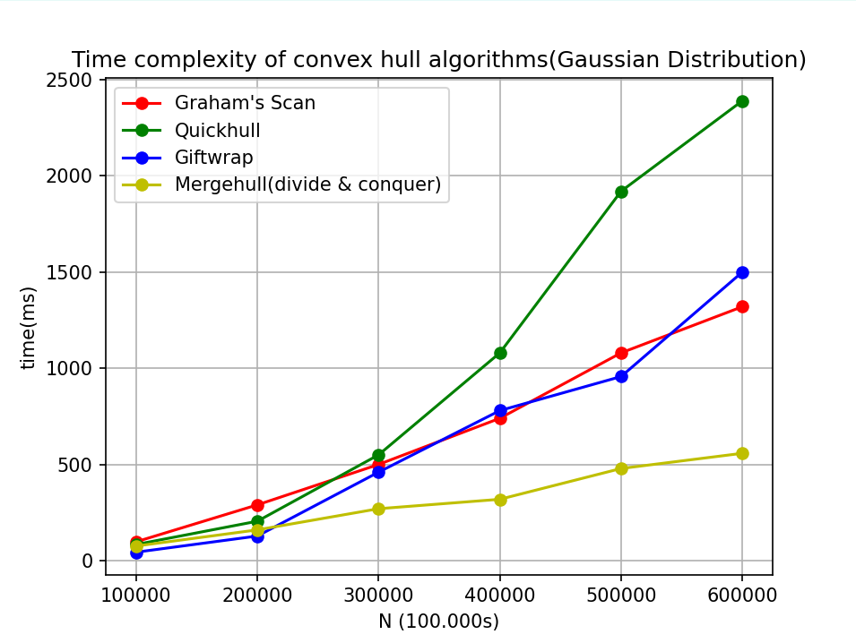

Slide 8
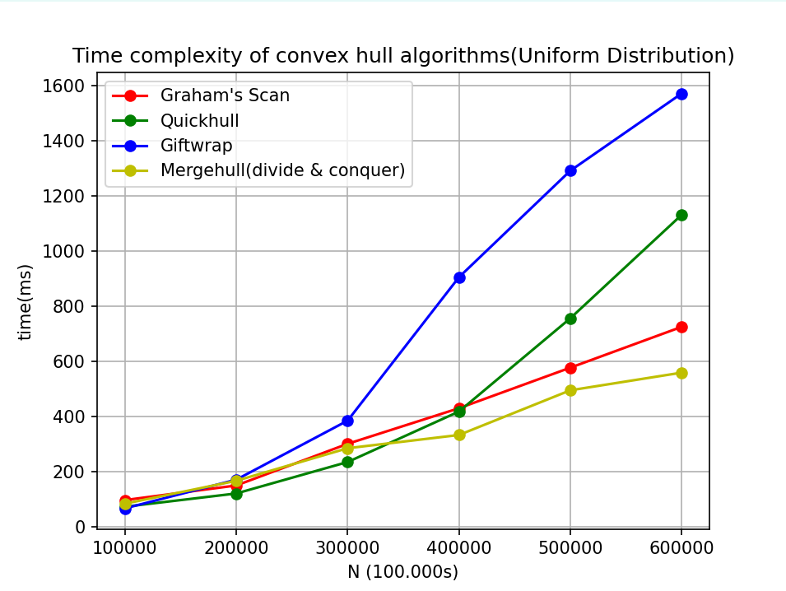

Slide 9
References
[1] F. P. Preparata and M. I. Shamos, Computational Geometry: An Introduction. New York: Springer-verlag.

