Slide 1
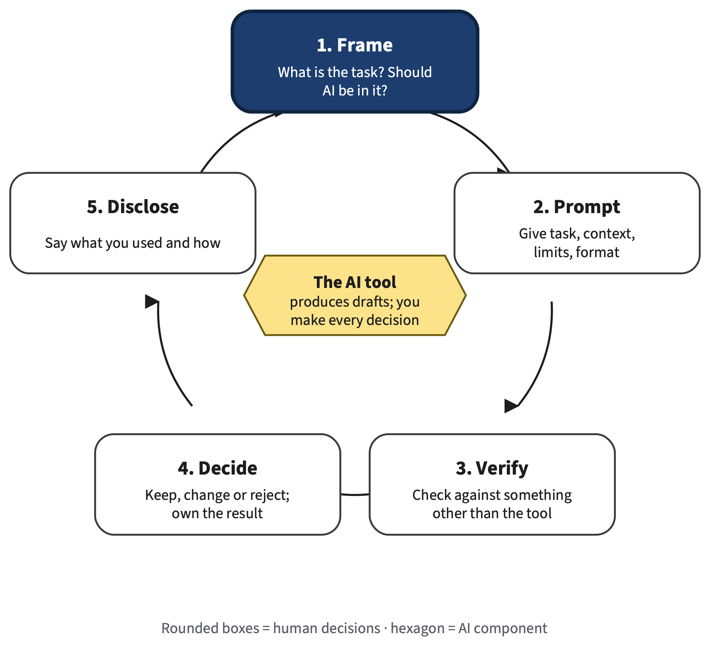
Why AI Changes Study and Work
AI FOR ALL: CAREER-READY AI SKILLS
Chapter 1
Concept session and lab session
Şadi Evren Şeker
Reading: Chapter 1
Recommended: AI Fluency, module 1
Notes:
SAY
Put this slide up while students arrive. Welcome them to AI for All. Tell them this material is for every major and needs no programming. The picture on the right is the AI Work Loop: five decisions a person makes around every AI-assisted task, namely Frame, Prompt, Verify, Decide and Disclose. The tool sits in the middle as a hexagon because it produces drafts; the rounded boxes around it are human decisions. Every chapter of the book opens with this loop and highlights the step that chapter strengthens. In this chapter the highlighted step is Frame: deciding what the task really is and whether AI belongs in it at all. Tell them that by the end of the lab session they will have tested three of their own tasks and found at least one failure, which becomes their first assignment, A1.
INSTRUCTOR BACKGROUND
Chapters and lab sheets are on your course site. Compass, the book's digital companion, is optional and never part of a course grade; no student data moves between a course and Compass. The figure uses the book's fixed shape grammar: rounded box = human decision, hexagon = AI component. The same drawing returns at the start of every chapter with a different step highlighted.
Likely student questions:
• Q: Do I need to pay for an AI tool?
A: No. The book is tool-independent: use a tool your institution provides or approves, or a free tier; no paid subscription is needed.
TIMING AND ACTIVITY
0 min · Concept session (about 75 min)
On screen before class starts.
BOOK
Chapter 1 opening page and @fig-1-2a (AI Work Loop, Frame highlighted).

Slide 2
Chapter 1 at a glance
Session 1 · Concept session
75 min · ideas, live comparison, quick checks
Session 2 · Lab session
75 min · teams of 3–4, individual artifact
3 min
Welcome and objectives
How your course runs
10 min
Lab briefing
Warm-up, Lab 1.2 steps, A1 brief
6 min
Opening case
5,172 support agents and an AI assistant
45 min
Lab 1.2: your baseline
Frame, run, verify three tasks; find a failure
36 min
Concept core, §1.1–1.6
Generation, evidence, frontier, fluency, zones, loop
20 min
Lab 1.1: same question, two answers
The live demonstration, done by you
15 min
Share and critique
Which predictions failed, which tests worked
8 min
Quick checks
Four short checks, answers shown
5 min
Exit step
Summary, key terms, exit ticket
2 min
Before the lab session
Reading and your three tasks
AI for All · Ch 1 · Why AI Changes Study and Work
2
Notes:
SAY
Here is how this chapter works, and how every chapter works. The concept session is where we look at a real case, build the ideas, and you try things live. The lab session is the practice lab: in teams of three or four you apply the ideas to a realistic task and start the chapter's artifact, which you submit on your course site when your instructor sets it. Group work happens in class, but every artifact is individual. If this is the first meeting of your course, keep the welcome short and get to the case quickly. In the lab session you will need three tasks from your own life or major; I will tell you how to choose them at the end of today. The quick checks today are ungraded: they are practice, and you will see the answers right away.
INSTRUCTOR BACKGROUND
Suggested session flow: the concept session is opening case 10, concept core 35, one or two live demonstrations 20, concept check 10; the lab session is lab briefing 10, group practice 45, share and critique 15, exit step 5. For this chapter the "demonstration" slot is Lab 1.1, which the chapter places in the concept session (20 minutes). If your course runs two 75-minute sessions a week, this fits; adjust to your class size. The minutes on this slide are the timings written into the notes of each slide; they add up to about 75 per session. Whether participation or artifacts are graded, and whether they may be revised, is your instructor's decision.
Likely student questions:
• Q: Is the lab session graded?
A: That is your instructor's decision. The lab produces your A1 draft, which your instructor may grade.
• Q: Can we submit as a team?
A: No. In the book's design, group work happens in class and each artifact is individual.
TIMING AND ACTIVITY
2 min · Concept session (about 75 min)
Point to the two columns; do not read every block. Say when A1 is due (your instructor sets it).
BOOK
Chapter 1 time paragraph; How to Use This Book, suggested pacing.

Slide 3
By the end of the lab you will be able to…
CHAPTER 1 · LEARNING OBJECTIVES
Explain how a generative AI tool produces an answer, and why answers differ
Judge assistance versus outsourcing under the three-zone policy
O1
O4
Explain why AI gains at work were uneven, using three studies
Apply the AI Work Loop to a task from your major
O2
O5
Judge whether AI fits a task by testing it; fluent ≠ correct
Produce your AI use baseline (assignment A1)
O3
O6
AI for All · Ch 1 · Why AI Changes Study and Work
3
Notes:
SAY
These are the six things you should be able to do by the end of the chapter. Notice the verbs. Two are "explain": you will understand what these tools do and what the evidence says about them. Two are "judge": you will decide whether a task suits AI, and whether a particular use is help or outsourcing. One is "apply": you will run the AI Work Loop on a task from your own major. The last is "produce": you will make your own baseline, which is assignment A1. I will come back to this list in the lab session so you can check yourself. You do not need to memorize it now; it is printed at the start of Chapter 1.
INSTRUCTOR BACKGROUND
Full wording in the chapter, with tags: O1 explain generation vs. look-up, including search-then-generate tools (LO1); O2 explain uneven gains with three studies (LO1); O3 judge fitness by testing, fluent vs. correct (LO1; AI Fluency Delegation, Discernment); O4 judge assistance vs. outsourcing under the three-zone policy (LO4); O5 apply the AI Work Loop to a task from your major (LO4; Description, Diligence); O6 produce the baseline with an AI Use Declaration (LO4, LO7; Diligence). LO1–LO7 are the book's seven learning outcomes; section 1.7 lists them in plain language. Framework tags refer to the UNESCO AI Competency Framework for Students and the AI Fluency framework.
Likely student questions:
• Q: What are the 'LO' codes I see in the book?
A: The book's seven learning outcomes, LO1–LO7. Section 1.7 lists them in plain language; A1 asks you to tie each of your two goals to one of them.
TIMING AND ACTIVITY
1 min · Concept session (about 75 min)
Ask students to star the objective they think will be hardest; revisit in the lab session.
BOOK
Chapter 1, Learning Objectives; §1.7 box with LO1–LO7 in plain language.

Slide 4
5,172 support agents get an AI assistant
OPENING CASE · BRYNJOLFSSON, LI & RAYMOND (2025)
Before
The tool
Rollout
Comparison
1
2
3
4
Agents answer customer chats on their own
Suggests replies; agents use, change or ignore them
A few agents at a time, over several months
With vs. without the tool, in the same weeks
confirmed
confirmed
confirmed
confirmed
Same weeks, same seasons: a fair comparison
AI for All · Ch 1 · Why AI Changes Study and Work
4
Notes:
SAY
Tell it as a story. Picture a customer-support center for a large software company: agents answer chat messages from business customers all day. Some have worked there for years; others started last month. The company, a Fortune 500 firm that sells business-process software, gave its agents an AI assistant. During each chat it suggested replies, and the agent could use them, change them or ignore them. The company did not switch it on for everyone at once; because training sessions were limited, it reached agents a few at a time over several months. That gave three economists an unusual chance: they could compare agents who had the assistant with similar agents who did not have it yet, in the same weeks. Ask: why does "the same weeks" matter? Because both groups faced the same busy seasons, so a difference between them points to the tool.
INSTRUCTOR BACKGROUND
Source: Brynjolfsson, Li and Raymond (2025), The Quarterly Journal of Economics 140(2). The study followed 5,172 agents. Fortune 500 means one of the 500 largest US companies by revenue. The study does not name the company, and neither does the book; do not guess it. Attribution tier: everything on this slide is confirmed in the primary record (the published study). The research design is a staggered rollout analyzed as a difference-in-differences comparison (Deep 1.A, optional). One caveat the authors address: managers chose which agents attended each training session, so the researchers checked that groups were on similar paths before the tool arrived, and report a small randomized pilot with similar results.
Likely student questions:
• Q: Why not just compare the same agents before and after they got the tool?
A: A before-and-after comparison mixes the tool's effect with everything else that changed over time, such as seasons. Comparing with agents who did not have it yet, in the same weeks, cancels those changes out (Appendix E, Review A5).
TIMING AND ACTIVITY
3 min · Concept session (about 75 min)
Narrate; do not read the cards. Ask the 'same weeks' question and take one or two answers.
BOOK
Opening Case; Case Study 'The Support Center, Revisited'; Deep 1.A for the method.

Slide 5
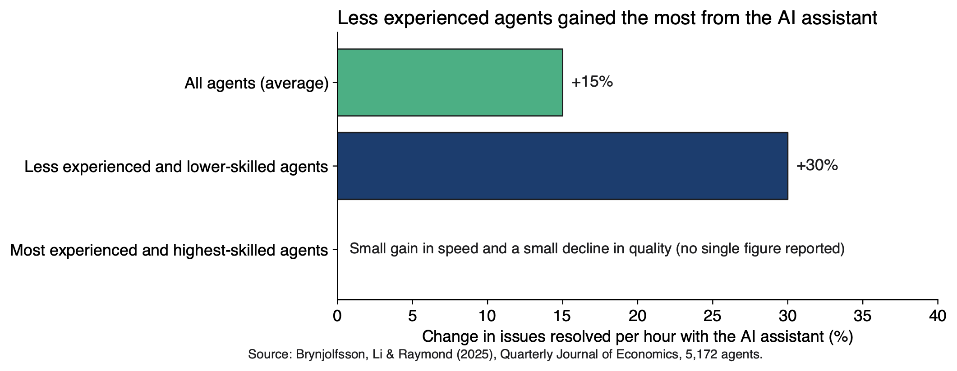
Same tool, uneven gains
OPENING CASE · RESULTS
Puzzle: why did the newest agents gain most — and what does that mean for you?
AI for All · Ch 1 · Why AI Changes Study and Work
5
Notes:
SAY
Here is what happened. On average, access to the assistant raised the number of issues an agent resolved per hour by 15 percent. But the average hides the most interesting part. Less experienced and lower-skilled agents improved by about 30 percent, and the quality of their work went up too. The most experienced, highest-skilled agents gained only a little speed, and their quality dropped slightly. So here is the puzzle for this chapter: the same tool, given to the same team, helped the newest people a lot and the most skilled people hardly at all. Why? And a second question: if a tool helps beginners most at work, what does that mean for you, a beginner in many subjects, while you are still learning? Ask them to keep both questions; we answer them at the end of the lab session.
INSTRUCTOR BACKGROUND
Further documented results (Brynjolfsson et al., 2025): customers were more polite and less likely to ask for a manager, although overall customer satisfaction scores did not change significantly. The researchers found signs that the assistant helped agents learn, and that agents' written English improved, especially for international agents. Gains were largest for moderately rare problems. The chart shows no single figure for the most experienced agents because the study reports a small speed gain and a small quality decline, not one number. The authors' explanation (reported tier: the authors' interpretation) is that the assistant, trained on past chats with extra weight on top performers, carried skilled agents' habits to newcomers; they call their results consistent with this idea rather than proof of it.
Likely student questions:
• Q: Does this mean AI will make experience worthless?
A: Not from this evidence. Experts gained little and lost a little quality; experience still matters for judging outputs, especially on tasks outside the frontier (§1.3; Appendix E, Review C1 guidance).
Misconceptions to watch for:
• M3 'AI helps everyone the same.'
How to address it: Point at the three bars: the same tool gave about +30% to one group and a slight quality dip to another. Averages can mislead.
TIMING AND ACTIVITY
3 min · Concept session (about 75 min)
Pose the puzzle; ask students to write a one-line guess. Return to it on the summary slide in the lab session.
BOOK
Opening Case; §1.2 Study 1 and @fig-1-5; Chapter Summary (puzzle answered).

Slide 6
Same question, different answers
1.1
A generative model writes likely text. It does not look up a stored answer.
Book §1.1 · Lab 1.1 today
Core
AI for All · Ch 1 · Why AI Changes Study and Work
6
Notes:
SAY
First idea of the chapter. You have probably asked an AI tool a question and taken the answer at face value. In this section we look at what actually happens when you press enter. The short version is on the slide: a generative model writes likely text; it does not look up a stored answer. That one sentence explains why two tools give different answers, why the same tool can answer differently twice, and why a confident answer can still be wrong. In about twenty minutes you will test this yourself in Lab 1.1. Keep your phone or laptop handy, and if you prefer not to use AI, there are sample outputs on your course site you can use instead.
INSTRUCTOR BACKGROUND
Section 1.1 is Core. It introduces four terms (generative AI system, prompt, output, model), the one-piece-at-a-time picture of generation, and three tool types (search engine, generative model, search-then-generate). Chapter 2 shows how training works; Chapter 3 shows what happens inside a language model (tokens, sampling); keep today's explanation at the level of the chapter and point forward rather than going deeper.
Misconceptions to watch for:
• M1 'The AI looks the answer up' / 'it knows things.'
How to address it: Use the book's wording: the model produces text one piece at a time, each piece a likely continuation. Avoid verbs like 'knows' or 'thinks' yourself.
TIMING AND ACTIVITY
0.5 min · Concept session (about 75 min)
Transition slide.
BOOK
§1.1 Same Question, Different Answers.

Slide 7
Same prompt, same day, different answers
§1.1 · TWO MODELS, ONE PROVIDER, OCT 17, 2026
Both answers
Only Answer A
Only Answer B
Practice problems, not rereading
Confident tone
No word on how sure
Timed practice exams
Flashcards and spaced review
Prompt: “Three good study strategies for a chemistry exam?”
AI for All · Ch 1 · Why AI Changes Study and Work
7
Notes:
SAY
Here is a small experiment from the book. The same question went to two models made by the same company on the same day: "What are three good study strategies for a chemistry exam?" Both were asked to answer in at most 120 words. The answers overlap: both say practice problems instead of just rereading. But they are not the same. Only one suggests timed practice exams; only the other suggests flashcards and spaced review. And notice the tone: both sound confident, and neither says how sure it is. That is your first clue about what these tools are. If they were looking up one stored answer, you would expect the same answer twice. They are not doing that.
INSTRUCTOR BACKGROUND
Answer A came from Claude Haiku 5.5 and Answer B from Claude Sonnet 5.5, collected October 17, 2026; real, unedited outputs (@fig-1-3). The full text of both answers is in the figure's long description (figures/longdesc/ch01.md), if you want to show or read them. The book labels every model output with model name and date because outputs change across models and over time. Tool neutrality: the book does not endorse a provider; in class, any two tools (or one tool in two new conversations) make the same point.
Likely student questions:
• Q: Which answer is right?
A: Both give reasonable study advice; that is not the point. The point is that the same question produced different content with equal confidence, and neither stated its uncertainty.
TIMING AND ACTIVITY
2 min · Concept session (about 75 min)
Ask: 'Would you have noticed the difference if you only saw one answer?'
BOOK
§1.1 and @fig-1-3 (full text in the long description).

Slide 8
A model writes likely text, piece by piece
§1.1 · HOW GENERATION WORKS
A model turns your prompt into an output
One piece at a time: a word or part of a word
Each piece is a likely continuation, not a looked-up fact
Why answers differ: chance in each pick; different models
Your prompt
Model
Output
Likely is not the same as true
AI for All · Ch 1 · Why AI Changes Study and Work
8
Notes:
SAY
Let's name the parts. A generative AI system is software that produces new content, such as text, images or code, in response to an input. The input you give it is a prompt; what comes back is the output. Inside is a model: a trained mathematical function that turns a prompt into an output. Now the key idea: the model does not look up a stored answer. It produces text one small piece at a time, usually a word or part of a word, and each piece is chosen because it is a likely continuation of what came before. So why did the two answers differ? Ask the same tool twice and it picks each piece with some chance. Ask two tools and they run different models, trained on different data, with different hidden instructions. Likely is not the same as true.
INSTRUCTOR BACKGROUND
Definitions are the book's (§1.1; glossary). The model's internal settings were adjusted by training on huge amounts of existing text and then tuned to follow instructions and give answers people prefer. The sampling step (picking each piece with some chance) is explained in Chapter 3; training in Chapter 2. A common comparison is "autocomplete on your phone, but much bigger." It holds for the basic step (both predict what comes next) and breaks on scale: far more training text, much more of the conversation used as context, and extra training to follow instructions.
Likely student questions:
• Q: If it is just predicting words, how can it write working code or a good summary?
A: Scale. The same prediction step, trained on vastly more text and tuned to follow instructions, can produce summaries, explanations and code that phone autocomplete never could (§1.1). Producing likely text is powerful; it is just not the same as checking truth.
• Q: Can it repeat text it was trained on?
A: Sometimes, almost word for word (§1.1). Either way, it is producing likely text, not checking whether it is true.
Misconceptions to watch for:
• M1 'It knows things.'
How to address it: Model the language: 'the model produces', 'the model generates a likely answer'. Gently correct 'it knows' or 'it thinks' when students use them.
TIMING AND ACTIVITY
3 min · Concept session (about 75 min)
Optional: ask one student to read the prompt aloud and the class to predict the next word; note how many different 'likely' words come up.
BOOK
§1.1 (definitions; 'Why did the two answers differ?'; autocomplete comparison).

Slide 9
Search points to sources; generation writes new text
§1.1 · THREE KINDS OF TOOLS (BOOK FIGURE: SEARCH VS. GENERATION)
Search engine
Your query
Finds existing pages
You choose a source
Generative model
Your prompt
Writes new text
Verify every claim
Search, then generate
Your prompt
Searches, then writes
Check each claim vs. its page
Dashed outline = output may be wrong. Only about half of generated sentences were fully supported by their citations (Liu et al., 2023).
Links show which pages were retrieved, not that each sentence matches them
AI for All · Ch 1 · Why AI Changes Study and Work
9
Notes:
SAY
Compare three kinds of tools. A search engine finds documents that already exist and shows you a ranked list of links; you decide which one to open, and you can see who wrote it. A generative model writes new text for your prompt; no human author stands behind those words, so you check every claim. As of October 2026, many tools do both: they search the web first, then generate an answer with links to the pages they retrieved. Useful, but the answer text is still generated. The links show which pages the tool retrieved; they do not prove that each sentence matches its page. In a 2023 study of generative search engines, only about half of the generated sentences were fully supported by their citations. And the AI summary at the top of a search page? That belongs in the third row, not the first.
INSTRUCTOR BACKGROUND
Liu, Zhang and Liang (2023), Findings of EMNLP 2023, evaluated verifiability in generative search engines. The chapter's table: search engine, check whether the source you open is reliable; generative model with no search, check every claim; search-then-generate tool, including AI summaries on search pages, check whether each claim matches the page it links to. In the figure, the dashed outline means the output may be wrong; the hexagon is the AI component; rounded boxes are you. "As of October 2026" is a dated statement in the chapter; tool features change quickly.
Likely student questions:
• Q: If it gives me links, isn't it basically a search engine?
A: No. The links show what was retrieved; the sentences are still generated, and about half were fully supported in the 2023 study. Check each claim you use against its page.
Misconceptions to watch for:
• M1 '…and if it shows sources, the text came from them.'
How to address it: Contrast row 1 and row 3 of the figure: in row 3 a model writes the text after retrieving pages, so each claim still needs checking against its page.
TIMING AND ACTIVITY
2 min · Concept session (about 75 min)
Ask for a show of hands: who has used an AI summary on a search page this week?
BOOK
§1.1 'Search, generation, and tools that do both', @fig-1-4 and the table under it.

Slide 10
Same question, two answers
LAB 1.1 · IN CLASS NOW · COMPARE
Goal: See how answers differ, and how sure they sound
Choose three questions: one factual, one practical, one from your major
3 min
Deliverable
Comparison table for three questions (feeds A1)
1
Ask each in two tools, or twice in one tool in new conversations
8 min
2
Only one tool, or no AI?
Run each question three times in new conversations, or compare the two sample outputs on your course site
For each pair, record: what is the same · what differs · any sources? · how certain?
7 min
3
Save the full outputs; you reuse them in §1.4 and in A1
2 min
Privacy
No personal, confidential or institutional data in prompts
4
AI for All · Ch 1 · Why AI Changes Study and Work
10
Notes:
SAY
Now you try it; this is the live demonstration, done by you. Work alone or with a neighbor for twenty minutes. Choose three questions: one factual, one practical and one from your own major. Ask each question in two different tools, or twice in the same tool in new conversations. For each pair, write down what is the same, what differs, whether either gives sources, and how certain each sounds. Then save the full outputs, not only your notes, because you will use them again in section 1.4 and in your A1 baseline. If you have only one tool, run each question three times. If you prefer not to use AI, use the two sample outputs on your course site. One rule today and in every lab: no personal, confidential or institutional data in your prompts.
INSTRUCTOR BACKGROUND
From labs/ch01-lab1.md. Expected observations: answers overlap but differ in wording, order and sometimes content; few state their uncertainty. If two runs are identical, suggest a more open question; identical answers are possible and also worth noting. Common problem: students compare only length; prompt them to compare claims. Collect two striking pairs for discussion. Mini-rubric: Exceeds = three complete pairs, differences classified (content vs. wording), sources checked; Meets = three pairs with differences and certainty recorded. Use only free tools or tools your institution provides or approves; check what is available before the session (as of October 2026, for example, some institutions provide an enterprise chat assistant with data protection). Screen-reader users can use the plain-text sample outputs.
Likely student questions:
• Q: Both of my answers were identical. Did I do it wrong?
A: No. Identical answers happen and are worth noting. Try a more open question, or a third run in a new conversation.
Misconceptions to watch for:
• M1 'If the answers differ, one tool must be broken.'
How to address it: Different answers are expected from a system that picks each piece with some chance; ask which differences are in content and which only in wording.
TIMING AND ACTIVITY
20 min · Concept session (about 75 min)
3 min choose questions; 8 min run; 7 min record; 2 min save. Circulate; at minute 18 ask two students to read out a striking pair. Debrief questions (lab sheet): Were the differences in content or only wording? Which answer would you trust more, and what is your reason besides how it sounds? Did any answer cite a source; did you open it?
BOOK
Hands-on Labs, Lab 1.1; labs/ch01-lab1.md.

Slide 11
Quick check: two tools, two plans
QUICK CHECK · §1.1
A classmate pastes the same prompt into two tools and gets two different study plans. Which explanation is best?
(a)
One of the tools is broken.
(b)
One tool looked up a better stored answer than the other.
(c)
The tools run different models and each picks words with some chance.
(d)
The second tool corrected the first tool’s mistakes.
Answer on your own (30 seconds), then vote: hands, cards or a poll
AI for All · Ch 1 · Why AI Changes Study and Work
11
Notes:
SAY
Quick check, ungraded. Read the question and the four options on your own and commit to an answer before anyone votes. This is the kind of question you may meet on a quiz or exam, so it is worth practicing the habit of choosing and then justifying. Give them thirty seconds. Then take a vote by hands or a quick poll. Before you reveal the answer, ask one student who chose (b) and one who chose (c) to explain their reasoning in one sentence each; the contrast between "looked up" and "picks with some chance" is the whole point of section 1.1.
INSTRUCTOR BACKGROUND
Item: Review Questions A1 (O1 · LO1 · Understand). Key and distractor logic from Appendix E: (c) is correct; (a) and (d) assume one "right" answer exists to be corrected; (b) assumes models look up stored answers. The distractors come from misconception M1.
TIMING AND ACTIVITY
1 min · Concept session (about 75 min)
30 s individual, then vote. Then show the answer slide.
BOOK
§1.1; Review Questions A1; Appendix E (Chapter 1).

Slide 12
Answer: two tools, two plans
QUICK CHECK · §1.1
A classmate pastes the same prompt into two tools and gets two different study plans. Which explanation is best?
(a)
One of the tools is broken.
(b)
One tool looked up a better stored answer than the other.
(c)
The tools run different models and each picks words with some chance.
Correct
(d)
The second tool corrected the first tool’s mistakes.
(b) assumes models look up stored answers; (a) and (d) assume there is one right answer to correct
AI for All · Ch 1 · Why AI Changes Study and Work
12
Notes:
SAY
The answer is (c). Two things happen at once: the two tools run different models, trained on different data and given different hidden instructions, and each one picks every piece of its answer with some chance. Option (b) is the tempting one, because it matches how a search engine works, but a generative model does not retrieve a stored answer; it writes likely text. Options (a) and (d) both assume there is one correct answer that a working tool would produce. Ask: so what should your classmate do instead of declaring a tool broken? Compare the two answers, check the claims that matter against a source, and decide what to keep. That is the Verify and Decide part of the loop you will meet in section 1.6.
INSTRUCTOR BACKGROUND
Appendix E, Review B1 model answer: the tool is not broken; generative tools produce likely text and pick each piece with some chance, so two runs can differ; different tools also run different models. The classmate should compare, check what matters against a source, and decide (Verify and Decide).
TIMING AND ACTIVITY
1 min · Concept session (about 75 min)
Reveal; take one follow-up comment.
BOOK
§1.1; Appendix E (Review A1, Review B1).

Slide 13
What the evidence says about AI at work
1.2
The gains were real, and the people who started lower gained more.
Book §1.2 · three studies
Core
AI for All · Ch 1 · Why AI Changes Study and Work
13
Notes:
SAY
You will hear many claims about AI and jobs: that it will replace everyone, or that it is all hype. In this book we treat such claims the way a scientist treats any claim: we ask for evidence. This section looks at three studies of real or realistic work: customer support, professional writing and management consulting. They measured different things, so we cannot add their numbers together. But they share one pattern, and it is on the slide: the gains were real, and the people who started lower gained more. Then we look at why that pattern does not mean what many students first think it means for their own studying.
INSTRUCTOR BACKGROUND
The three studies: Brynjolfsson, Li and Raymond (2025, QJE), customer support, staggered rollout; Noy and Zhang (2023, Science), professional writing, randomized; Dell'Acqua et al. (2023 working paper; 2026 Organization Science version), consulting at Boston Consulting Group (BCG), randomized. Recommended readings: Noy & Zhang, Dell'Acqua et al., and Brynjolfsson et al. Students are not assumed to have read them.
Misconceptions to watch for:
• M3 'AI helps everyone the same.'
How to address it: Preview the pattern: in all three studies the gains differed by starting level.
TIMING AND ACTIVITY
0.5 min · Concept session (about 75 min)
Transition slide.
BOOK
§1.2 What the Evidence Says About AI at Work.

Slide 14
Real gains, unevenly spread
§1.2 · THREE STUDIES, ONE PATTERN
Customer support
Professional writing
Management consulting
5,172 agents
Issues per hour +15%
Newer agents about +30%
Random assignment
Time −40%, quality +18%
Gap between writers narrowed
385 consultants
Quality more than +40%
Below average +43%, above +17%
Different measures: compare the pattern, not the numbers
AI for All · Ch 1 · Why AI Changes Study and Work
14
Notes:
SAY
Three studies, side by side. In customer support, productivity meant issues resolved per hour: up 15 percent on average and about 30 percent for less experienced agents. In professional writing, college-educated professionals did writing tasks like those in their jobs; chance decided who got ChatGPT. With access, time fell by about 40 percent, graders rated quality about 18 percent higher, and the gap between weaker and stronger writers narrowed. In consulting, 385 consultants worked on realistic tasks; some were randomly given GPT-4. Graders rated their work more than 40 percent higher, and consultants who started below average improved by 43 percent against their own earlier scores, compared with 17 percent for those above average. Different measures, so do not compare the numbers directly. Compare the pattern.
INSTRUCTOR BACKGROUND
Random assignment makes the groups alike, on average, in everything except the tool; the control group is the comparison group without the tool. Noy & Zhang (2023): tasks were press releases, short reports, analysis plans and delicate emails, designed for the experiment; graders scored overall, writing and content quality and originality, not factual accuracy, so the study shows faster, better-rated drafts, not more accurate ones. Dell'Acqua et al. (2023): 758 BCG consultants in two experiments; the 385 here worked on tasks the researchers judged inside the AI's capability (e.g., designing a new shoe for an underserved market, segmenting the market, drafting a press release). The other experiment (373 consultants, outside the frontier) is in §1.3.
Likely student questions:
• Q: What is a control group and why does random assignment matter?
A: The control group is the comparison group without the tool. Random assignment uses chance to decide who gets the tool, which makes the groups alike on average in everything except the tool, so a difference can be attributed to the tool (Check Yourself 1.2).
• Q: Did the writing study show the AI drafts were more accurate?
A: No. It did not separately measure factual accuracy; it shows faster drafts with higher quality ratings.
Misconceptions to watch for:
• M3 'AI helps everyone the same.'
How to address it: Point to the third line of each card: who gained most differed by starting level in every study.
TIMING AND ACTIVITY
3 min · Concept session (about 75 min)
Optional faded example from the book (Study 2: how were the groups formed? one limit?) as a 1-minute pair check.
BOOK
§1.2 Studies 1–3, the comparison table, Worked and Faded Examples 'Reading the Evidence'.

Slide 15
Working faster is not the same as learning
§1.2 · THE LEARNER’S QUESTION (BOOK FIGURE: FASTER VS. LEARNING)
Tool answers; you hand it in
You reason; the tool assists
Evidence (Bastani et al., 2025)
Output delivered
Skill not built
Output delivered
Skill built
Unrestricted chatbot: better practice, worse exam
Hints only: no harm, no gain
The assignment can be done while the learning is not
AI for All · Ch 1 · Why AI Changes Study and Work
15
Notes:
SAY
Here you need to be careful. If AI helps beginners most at work, you might conclude that you, as a beginner, should lean on it as much as possible while you study. That conclusion does not follow. At work, the goal of a support chat is to solve the customer's problem; if the suggestion solves it, the job is done. In a course, an assignment exists so that you build a skill you can use without the tool: on an exam, in an interview, or when the tool gives you something wrong. There is evidence for this difference. In a study of high school math students in Türkiye, students who practiced with unrestricted access to a chatbot did better during practice, but worse on an exam without the tool than students who practiced with books and notes. A version designed to give hints instead of answers showed no measurable harm, and no gain either.
INSTRUCTOR BACKGROUND
Bastani et al. (2025), PNAS 122(26), e2422633122 (a recommended reading, used in Chapter 7). Describe it exactly: high school mathematics students in Türkiye; the comparison group practiced with books and notes; the exam at the end of the session was taken without the tool. The hint-based version showed no measurable harm on the exam but did not raise exam scores above the comparison group. Chapter 7 studies tutoring versus answer mode in depth; do not go further today.
Likely student questions:
• Q: So should I not use AI to study?
A: That is not the conclusion. Uses that help you do the thinking (explanations, quizzing yourself, feedback on your draft) are permitted; uses that do the thinking for you can leave you unable to do it on the exam. Section 1.5 and Chapter 7 make this precise.
Misconceptions to watch for:
• M3 '…since novices gain most at work, I should lean on it while I am learning.'
How to address it: Contrast the two goals: output at work, skill in a course. Then give the Bastani result: better in practice, worse on the exam without the tool.
TIMING AND ACTIVITY
2 min · Concept session (about 75 min)
Ask: 'Name one assignment this term where the output is not the point.' Take two answers.
BOOK
§1.2 'Working faster is not the same as learning', @fig-1-13; Chapter 7.

Slide 16
The jagged frontier
1.3
How hard a task looks tells you little about how well AI will do it.
Book §1.3 · signature diagram 2
Core
AI for All · Ch 1 · Why AI Changes Study and Work
16
Notes:
SAY
All three studies measured gains on tasks the AI handled well. This section is about tasks it does not handle well, and about the surprising shape of the boundary between the two. Researchers call it the jagged technological frontier. The idea on the slide is the one to remember: how hard a task looks to you tells you little about how well the tool will do it. Some tasks that look hard are fine; some that look easy fail. That is why, by the end of this section, you will have a method rather than a list: you find the frontier for your task by testing it.
INSTRUCTOR BACKGROUND
The Jagged Frontier Map is signature diagram 2 of the book; it returns in Chapters 7, 12 and 19. The image comes from Dell'Acqua et al. (2023); Chapter 12 examines the consulting study in full.
Misconceptions to watch for:
• M2 'AI is equally good at everything' — or 'there is a fixed list of things it is good at, and newer models handle everything.'
How to address it: Announce that this section replaces the list with a test.
TIMING AND ACTIVITY
0.5 min · Concept session (about 75 min)
Transition slide.
BOOK
§1.3 The Jagged Frontier.

Slide 17
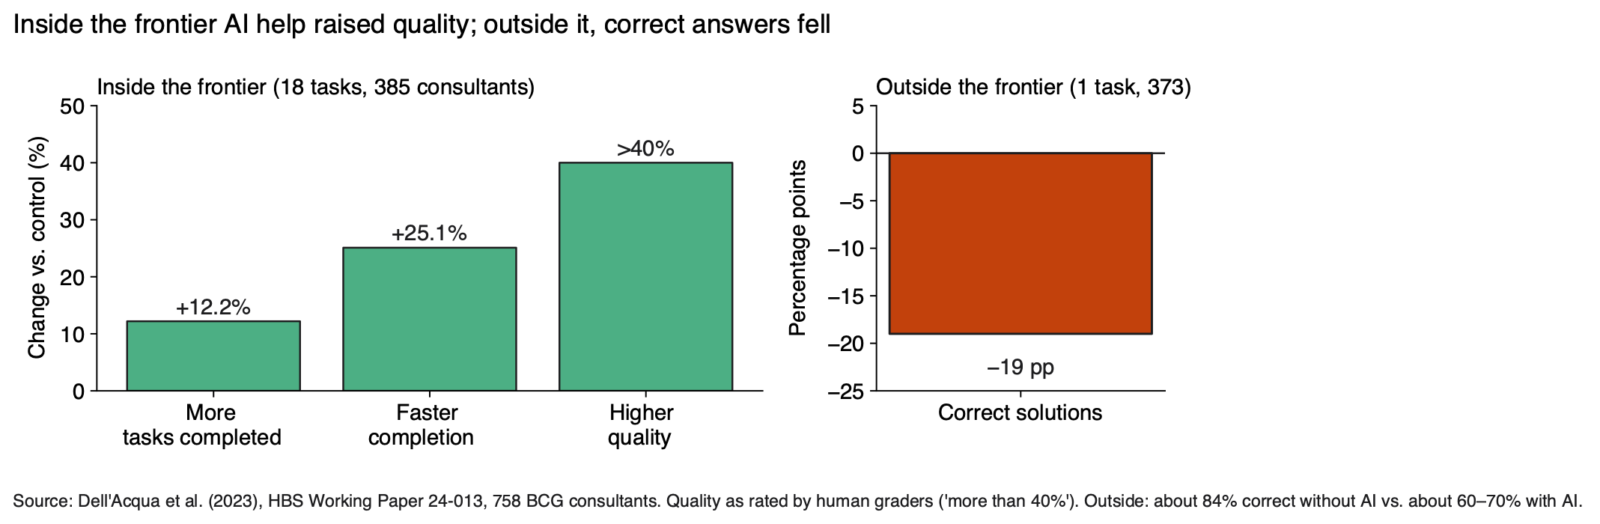
Inside the frontier, AI helped; outside it, results got worse
§1.3 · DELL’ACQUA ET AL. (2023)
Outside: roughly 19 percentage points fewer correct answers, from one task
AI for All · Ch 1 · Why AI Changes Study and Work
17
Notes:
SAY
Back to the consultants. The left panel is the first experiment: on tasks inside what the AI could do, consultants with AI completed more tasks, worked faster and produced work rated more than 40 percent higher. The right panel is the second experiment: 373 consultants got a task the researchers designed to be outside what the AI could do reliably at the time. It was a brand-growth recommendation for a hypothetical company. The spreadsheet looked complete, but interview notes held details that changed the right answer. About 85 percent of consultants without AI got it right, compared with about 60 to 70 percent of those with AI: roughly 19 percentage points fewer. The tool did not just fail to help; it made results worse. Those who did worse tended to adopt the AI's output without questioning it.
INSTRUCTOR BACKGROUND
Dell'Acqua et al. (2023), HBS Working Paper 24-013 (also Organization Science, 2026). Inside panel: 18 tasks, 385 consultants; tasks completed +12.2%, speed +25.1%, human-graded quality more than +40%, all against the control group. A percentage point is the simple difference between two percentages (e.g., 85% minus 66%). Note for the instructor: the chapter text says "about 85%" correct without AI, while the figure's source line and long description say "about 84%"; say "about 85%" as in the text, or avoid the exact figure. Emphasize the limit: the outside result comes from a single task, so treat it as a warning sign rather than a precise measurement.
Likely student questions:
• Q: How can AI help make results worse?
A: The authors found that consultants who did worse tended to adopt the AI's output without questioning it. Because the result comes from one designed task with consultants at one firm, treat it as a warning sign, not a precise measurement (Appendix E, Review A9).
Misconceptions to watch for:
• M2 'AI is equally good at everything.'
How to address it: Same people, same tool, opposite effects depending on the task.
TIMING AND ACTIVITY
2 min · Concept session (about 75 min)
Ask: 'What made the outside task hard for the tool?' (Answer: details in interview notes that changed the right answer.)
BOOK
§1.3 opening paragraphs and @fig-1-6.

Slide 18
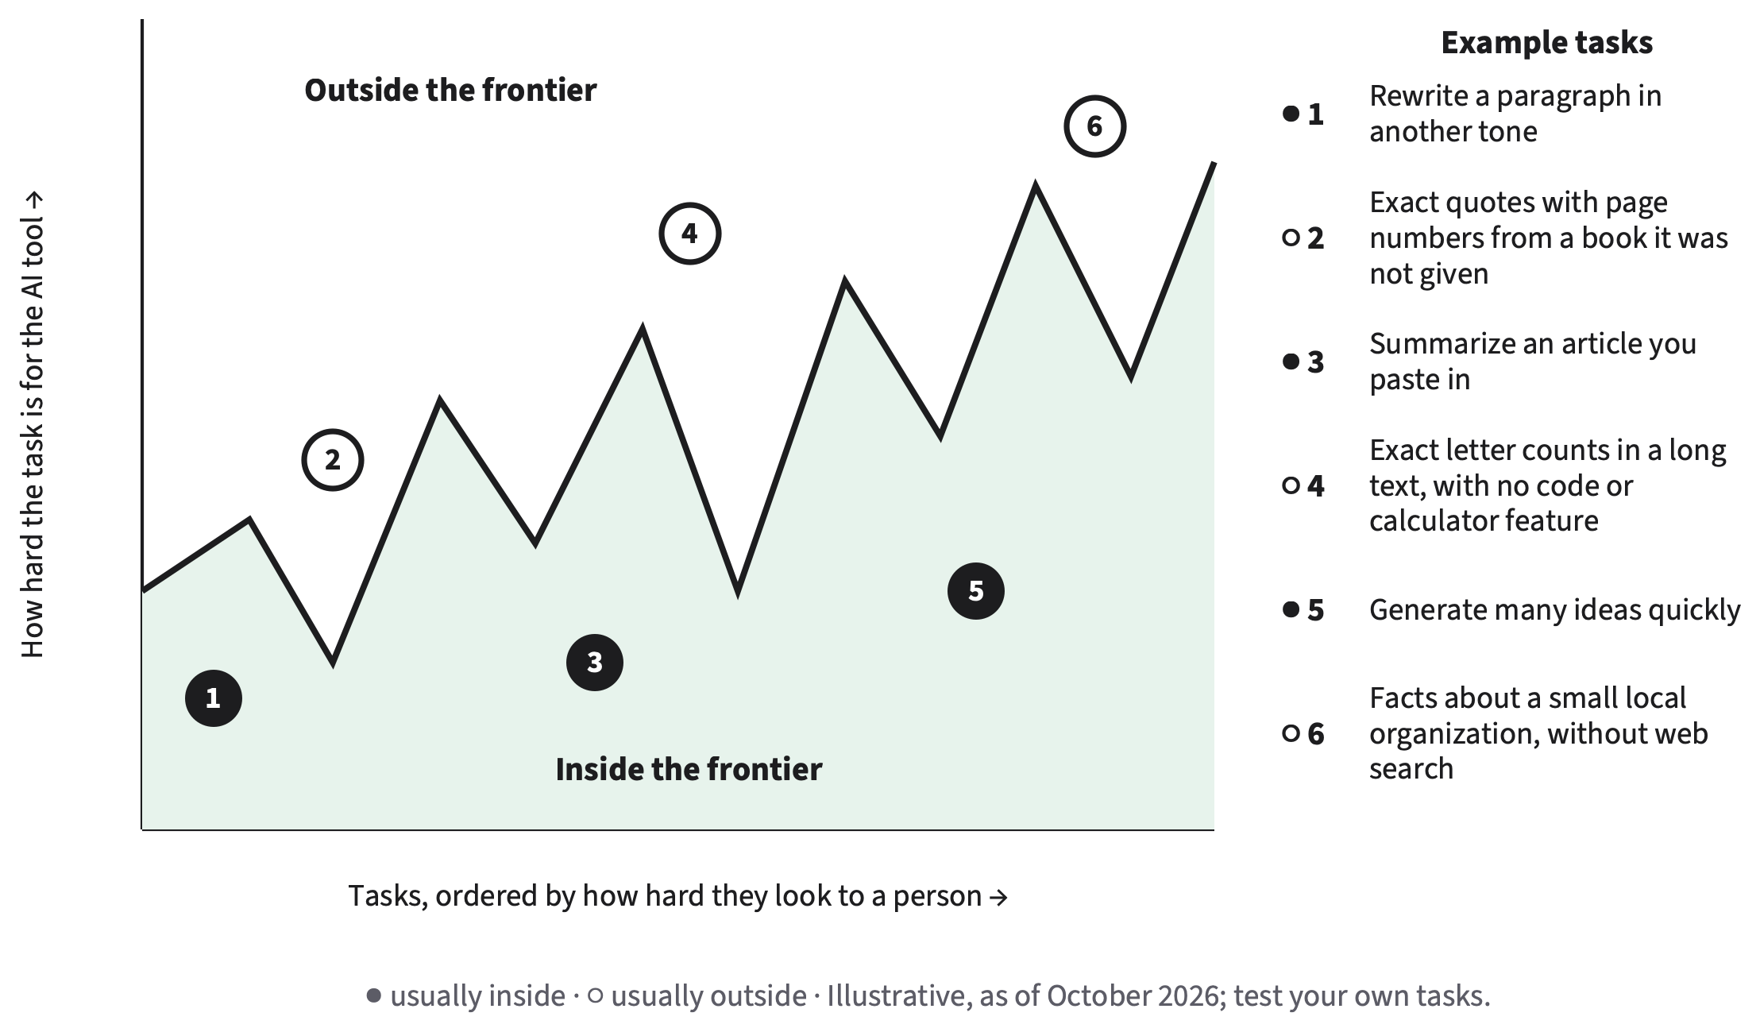
The frontier is jagged, and it moves
§1.3 · SIGNATURE DIAGRAM: THE JAGGED FRONTIER MAP
Hard-looking tasks can sit inside; easy-looking ones outside
It moves with the task, the tool, the date
Test a case where you know the answer
AI for All · Ch 1 · Why AI Changes Study and Work
18
Notes:
SAY
Here is the image the researchers used. Imagine all the tasks you could give an AI tool, arranged by how hard they look to a person. You might expect a smooth line: easy tasks inside the tool's ability, hard tasks outside. The real boundary zigzags. Rewriting a paragraph in a different tone, summarizing an article you paste in, and generating ideas are usually inside. Exact quotations with page numbers from a book the tool was not given, exact letter counts without a calculator or code feature, and facts about a small local organization without web search are usually outside. Three things move the frontier for you: the task, the tool, and the date. So the only reliable way to find it is to test: give the tool a version of the task where you already know the answer.
INSTRUCTOR BACKGROUND
The examples in the figure are illustrative as of October 2026; results vary by tool and date, and the chapter tells students to test their own tasks. The chapter's table adds: often inside = drafting an outline on a familiar topic, explaining a standard concept in simpler words; often outside = recent events when the tool does not search, details that depend on information the tool was never given, long calculations without a calculator feature. Newer models move the frontier, but testing keeps finding new edges: a new model can fix one failure and still miss a task that looks easier.
Likely student questions:
• Q: Won't the next model fix all of this?
A: Newer models move the frontier, but it stays jagged; a new model can fix one failure and miss another. Testing on a known answer is quick and protects you in the meantime (Appendix E, Review C3 guidance).
• Q: Why not just memorize a list of what AI is good at?
A: The list changes with the task, the tool and the date. A test on a case where you know the answer works for any tool on any date (Check Yourself 1.3).
Misconceptions to watch for:
• M2 '…there is a fixed list of things it is good at, and newer models handle everything.'
How to address it: Stress the three movers (task, tool, date) and the testing method; a list is a starting guess, not an answer.
TIMING AND ACTIVITY
3 min · Concept session (about 75 min)
Ask students to name one task from their week and guess which side it is on; write two guesses on the board.
BOOK
§1.3, @fig-1-7, the inside/outside table and the three bullets (task, tool, date).

Slide 19
One change, two results: Hana’s quotations
§1.3 · WORKED EXAMPLE · CONSTRUCTED FOR TEACHING
Test A · essay pasted in
Test B · essay only named
All three quotations found
One page number off by one
Inside, with checking
Two quotations not in the essay
Third real; page number wrong
Outside, this tool, this date
Change one thing; then you know the cause
AI for All · Ch 1 · Why AI Changes Study and Work
19
Notes:
SAY
Here is the testing method in action. Hana, an arts and technology student with a history minor, wants three exact quotations with page numbers from an essay for a history paper. They test the same request twice, changing only one thing: what the tool is given. In Test A the essay is pasted into the prompt. Hana searches the essay for each quotation: all three appear, and one page number is off by one. Verdict: inside the frontier, with checking. In Test B Hana only names the essay. Two of the quotations do not appear anywhere in it; the third exists but the page number is wrong. Verdict: outside the frontier, for this tool, on this date. Because only one thing changed, Hana knows what made the difference: giving the tool the source.
INSTRUCTOR BACKGROUND
Constructed example for teaching (§1.3 Worked Example "One Change, Two Results"). Hana uses they/them pronouns (book character rules). The colors on the slide follow the book's palette, and each card also says its verdict in words. The faded example that follows in the book (Sam's pump: 450 liters per minute to gallons per hour) asks which gallon (US or imperial) and whether one correct answer proves reliability; it is good homework.
Likely student questions:
• Q: Test A worked. Can Hana trust the tool for quotations now?
A: Only with checking: one page number was still off. And one success does not prove reliability; the faded example asks what to test next.
Misconceptions to watch for:
• M2 'AI is equally good at everything.'
How to address it: The same request was inside or outside depending only on whether the source was given.
TIMING AND ACTIVITY
2 min · Concept session (about 75 min)
Ask: 'What was the one thing that changed?' Then point students to Sam's faded example for homework.
BOOK
§1.3 Worked Example 'One Change, Two Results'; Faded Example 'Design the Test'.

Slide 20
Quick check: the jagged frontier
QUICK CHECK · §1.3
Which description of the jagged frontier is most accurate?
(a)
A fixed list of tasks AI can do.
(b)
A boundary that newer models will soon remove.
(c)
An uneven, shifting boundary that you find by testing.
(d)
The line between tasks that are easy and hard for people.
Answer on your own, then vote
AI for All · Ch 1 · Why AI Changes Study and Work
20
Notes:
SAY
Second quick check. Read all four options before you choose. This one tests the idea, not a number, so think about the three words we used: uneven, moving, tested. Give them thirty seconds and then vote. If many students choose (d), that is useful: it shows the intuition the frontier image is designed to break, namely that what is hard for a person is hard for the tool. Ask someone who picked (d) to say why, then ask someone who picked (c) to respond using an example from the map, such as exact letter counts, which look easy but often fail.
INSTRUCTOR BACKGROUND
Item: Review Questions A7 (O3 · LO1 · Understand). Key from Appendix E: (c). (a) and (b) treat the frontier as fixed or about to disappear; (d) describes difficulty for people, not for the tool. Distractors map to misconception M2.
TIMING AND ACTIVITY
1 min · Concept session (about 75 min)
30 s individual, then vote.
BOOK
§1.3; Review Questions A7; Appendix E.

Slide 21
Answer: the jagged frontier
QUICK CHECK · §1.3
Which description of the jagged frontier is most accurate?
(a)
A fixed list of tasks AI can do.
(b)
A boundary that newer models will soon remove.
(c)
An uneven, shifting boundary that you find by testing.
Correct
(d)
The line between tasks that are easy and hard for people.
(a) and (b) treat it as fixed or vanishing; (d) describes difficulty for people, not for the tool
AI for All · Ch 1 · Why AI Changes Study and Work
21
Notes:
SAY
The answer is (c): an uneven, shifting boundary that you find by testing. Uneven, because tasks that look equally hard to a person can fall on different sides. Shifting, because the task, the tool and the date all move it. Found by testing, because no fixed list survives the next update. Option (b) deserves a word: newer models do move the frontier, but so far it stays jagged, and a new model can fix one failure and still miss a task that looks easier. Close with the habit: before you rely on a tool for a kind of task, test it on a case where you already know the right answer, and note the tool and the date.
INSTRUCTOR BACKGROUND
Spaced Review item 1 (Appendix E) applies the same habit: if a friend says the newest model never makes mistakes with numbers, ask them to test it on several number tasks where they already know the answer, including exact counts and long calculations, and to note the tool and the date.
TIMING AND ACTIVITY
1 min · Concept session (about 75 min)
Reveal; one follow-up comment.
BOOK
§1.3; Appendix E (Review A7, Spaced Review 1).

Slide 22
Fluent is not the same as correct
1.4
Fluency is not evidence.
Book §1.4 · the most important habit in this chapter
Core
AI for All · Ch 1 · Why AI Changes Study and Work
22
Notes:
SAY
Testing tells you whether a tool can do a task. But how do you notice a failure in the first place, when every answer sounds equally sure? That is this section. In this book, fluent means smooth, confident and well organized: text that sounds like an expert wrote it. Fluent text is easy to trust, and that is exactly the problem. The idea on the slide is, in the book's words, the most important habit in this chapter: fluency is not evidence. We will practice spotting the red flags, and we will name the first three kinds of failure you will meet.
INSTRUCTOR BACKGROUND
Section 1.4 introduces three first failure terms (hallucination, outdated information, overconfidence) as a preview; Chapter 4 provides the full Failure Taxonomy Tree, and Chapter 8 owns detection and verification methods. Keep today at the level of recognizing red flags.
Misconceptions to watch for:
• M4 'If it sounds confident and fluent, it is probably right.'
How to address it: This whole section is the refutation; name the misconception aloud before the next slide.
TIMING AND ACTIVITY
0.5 min · Concept session (about 75 min)
Transition slide.
BOOK
§1.4 Fluent Is Not the Same as Correct.

Slide 23
Which answer would you trust?
§1.4 · CONSTRUCTED EXAMPLE · NOT HEALTH ADVICE
Answer A
Answer B
Red flags in B
About 2.7 L (women) or 3.7 L (men) a day from drinks and food; needs vary.
“Exactly 3.2 L a day, regardless of climate or activity” (2019 Global Hydration Institute study).
Exact number for what varies
No conditions
Unfindable source
B sounds more precise and deserves less trust
AI for All · Ch 1 · Why AI Changes Study and Work
23
Notes:
SAY
Two answers to the same question: how much water should an adult drink per day? Give students fifteen seconds to pick the one they would trust, then ask for hands. Many pick B, because it sounds more precise: it has a year, an organization and one exact figure for everyone. It is the one you should trust less. Walk through the red flags: an exact number for something that varies; words that remove all conditions, like "regardless of climate or activity"; and a source you cannot find. Search for the "Global Hydration Institute." If you cannot find it, the claim fails its first test. Answer A also gives numbers, but it names a real source, states the conditions and tells you where to check. Those are good signs.
INSTRUCTOR BACKGROUND
Constructed example written for teaching; not a real model output and not health advice (§1.4). Answer A's reference values are from the Institute of Medicine (2005), Dietary Reference Intakes for Water (U.S. National Academies): total water from drinks and food. The "Global Hydration Institute" and its 2019 study are invented inside the example; that is the point. Check Yourself 1.4 asks students to name two red flags in Answer B.
Likely student questions:
• Q: Answer A has numbers too. Why is that fine?
A: It names a real source you can check, states that needs vary with body size, activity, climate and diet, and tells you where to check. Precision is not the problem; precision without conditions or a findable source is.
Misconceptions to watch for:
• M4 'If it sounds confident and fluent, it is probably right.'
How to address it: Make the vote visible first; the gap between the popular choice and the better one is the lesson.
TIMING AND ACTIVITY
2 min · Concept session (about 75 min)
15-second silent choice, show of hands, then reveal the red-flag column.
BOOK
§1.4 (Answers A and B, red flags).

Slide 24
Sounding right and being right are different
§1.4 · FIRST FAILURE WORDS (BOOK FIGURE: FLUENT VS. CORRECT)
Hallucination: fluent, but unsupported by the input or by facts
Outdated information: once correct, no longer
Overconfidence: more certain than the evidence
Correct
Wrong
Sounds fluent
Useful
still verify
Dangerous
nothing warns you
Sounds halting
Useful
needs editing
Easy to spot
reject it
Fluent and wrong: nothing warns you
AI for All · Ch 1 · Why AI Changes Study and Work
24
Notes:
SAY
Here is the idea as a two-by-two grid. Fluent and correct is useful, and you still verify. Halting and correct is useful but needs editing. Halting and wrong is easy to spot. The dangerous corner is fluent and wrong, because nothing on the surface warns you. Professionals have been caught there: in 2023 a federal judge in New York sanctioned two lawyers and their firm for filing a brief citing court decisions that ChatGPT had made up, and they kept defending them when questioned. Three words for now. Hallucination: fluent output not supported by the model's input or by facts. Outdated information: once correct, but no longer. Overconfidence: stated with more certainty than the evidence supports, like Answer B.
INSTRUCTOR BACKGROUND
Why fluency is not evidence (§1.4): a generative model is trained to produce likely text and then tuned to give answers people rate highly; neither step checks whether the answer is true. Mata v. Avianca, Inc. (S.D.N.Y. 2023), sanctions order of June 22, 2023; "sanctioned" means penalized; a brief is a written legal argument; Chapter 8 studies the case. Some researchers use "confabulation" for some of these errors (Farquhar et al., 2024); the book uses "hallucination" because it is more common. Outdated information arises because training data ends at a cutoff date and the tool did not search for newer information, or found old pages. The grid rebuilds the book's figure (@fig-1-9); the risk corner is marked by a thick border and the word "Dangerous" as well as color.
Likely student questions:
• Q: Isn't 'hallucination' anthropomorphic?
A: It is a metaphor, which is why the book defines it precisely (fluent output not supported by the input or by facts) and notes the alternative term 'confabulation'. Use the definition, not the image.
Misconceptions to watch for:
• M4 'If it sounds confident and fluent, it is probably right.'
How to address it: Use the lawyers: trained professionals, fluent made-up citations, real sanctions.
TIMING AND ACTIVITY
3 min · Concept session (about 75 min)
Point to Elif's worked example in the book (tracing the 'Stanford study, 13%' statistic) as reading before the lab session.
BOOK
§1.4, @fig-1-9, the three terms; Worked Example 'Tracing a Confident Statistic'; Chapter 8 (Mata v. Avianca).

Slide 25
Quick check: fluency
QUICK CHECK · §1.4
What does “fluent” mean in this book, and why is fluency not evidence?
Write one sentence for each part, then compare with a neighbor (1 min)
AI for All · Ch 1 · Why AI Changes Study and Work
25
Notes:
SAY
This check is open-ended. Write one sentence for each part of the question: what fluent means, and why it is not evidence. Then compare with your neighbor. You have one minute. While they write, walk around and look for answers that stop at "because it can be wrong"; the stronger answer explains why a confident tone carries no information about truth. The reason is in how these models are made: they are trained to produce likely text and then tuned toward answers people rate highly. Neither of those steps checks whether the answer is true.
INSTRUCTOR BACKGROUND
Check Yourself 1.4, item 1. The answer is in §1.4: fluent = smooth, confident and well organized, text that sounds like an expert wrote it; fluency is not evidence because training produces likely text and tuning rewards answers people rate highly, and neither step checks truth, so a confident tone is not evidence of accuracy.
TIMING AND ACTIVITY
1 min · Concept session (about 75 min)
1 min write and compare, then show the answer slide.
BOOK
§1.4; Check Yourself 1.4.

Slide 26
Answer: fluency
QUICK CHECK · §1.4
What does “fluent” mean in this book, and why is fluency not evidence?
Model answer
Fluent: smooth, confident and well organized; it sounds like an expert wrote it.
Not evidence: the model was trained to produce likely text and tuned toward answers people rate highly. Neither step checks truth.
AI for All · Ch 1 · Why AI Changes Study and Work
26
Notes:
SAY
Here is a model answer. Fluent means smooth, confident and well organized: text that sounds like an expert wrote it. Fluency is not evidence because of how the text is produced: the model was trained to produce likely text and then tuned to give answers people rate highly. Neither step checks whether the answer is true. So the confidence you hear in an answer tells you about the training, not about the facts. Ask students to check their own sentence against both parts. Then connect forward: if tone tells you nothing, you need a check against something other than the tool, which is the Verify step of the loop we meet in section 1.6.
INSTRUCTOR BACKGROUND
The same section gives the practical consequence: look for red flags (exact numbers for things that vary, words that remove all conditions, a source you cannot find) and check claims against something other than the tool. Chapter 4 explains why failures happen; Chapter 8 owns verification methods. Keep this check at the level of the definition and the reason.
TIMING AND ACTIVITY
1 min · Concept session (about 75 min)
Reveal; one or two students read their sentence.
BOOK
§1.4; Check Yourself 1.4.

Slide 27
Your judgment, your responsibility
1.5
AI use is not prohibited; unacknowledged, unverified or outsourced use is not acceptable.
Book §1.5 · the three-zone policy
Core
AI for All · Ch 1 · Why AI Changes Study and Work
27
Notes:
SAY
You now know that AI output can be uneven, fluent and wrong. So when is it acceptable to use it, especially in a course? Students arrive here with two opposite worries. Some think any use of AI is cheating. Others think anything is fine as long as the result is good. Both are wrong, and this book replaces them with a clear policy. If your instructor or institution sets a different AI policy, that policy decides. The principle is on the slide: AI use is not prohibited; unacknowledged, unverified or intellectually outsourced AI use is not acceptable. Read it twice. Every word matters: unacknowledged means not disclosed; unverified means not checked; outsourced means the tool did the thinking you were supposed to do.
INSTRUCTOR BACKGROUND
The principle is stated in §1.5 as the book's policy. The three-zone table in §1.5 includes one data row: entering personal or confidential data (yours or anyone else's) into a public AI tool is not acceptable. Chapter 10 owns disclosure in prose and at work; Chapter 15 explains the data rule in detail.
Misconceptions to watch for:
• M5 'Using AI in a course is cheating' — or 'anything goes if I disclose it.'
How to address it: Name both halves of the misconception now; the next two slides refute each.
TIMING AND ACTIVITY
0.5 min · Concept session (about 75 min)
Ask for a quick hand count: 'Before today, who thought any AI use in a course was cheating?'
BOOK
§1.5 Your Judgment, Your Responsibility.

Slide 28
Three zones of AI use
§1.5 · THE BOOK’S POLICY (BOOK FIGURE: THREE ZONES)
Permitted
With disclosure and verification
Not acceptable
Brainstorming
Explanations
Study help
Feedback on your draft
Drafting
Coding support
Source synthesis
Case and data work
Undisclosed outsourcing
Fabricated sources
AI use in exams
Private data in public tools
Disclosure makes middle-zone uses acceptable, never the off-limits ones
AI for All · Ch 1 · Why AI Changes Study and Work
28
Notes:
SAY
In practice, uses fall into three zones. Permitted: brainstorming, explanations of concepts, study help, feedback on your own draft, formatting, testing prompts. Permitted with disclosure and verification: drafting, coding support, source synthesis, case analysis, data and decision work, provided you disclose, verify and can explain the result. Not acceptable: undisclosed outsourcing, fabricated sources, unsupported claims, submitting work you do not understand, any AI use during examinations, and entering personal or confidential data into a public AI tool. The middle column has a dashed border because it is acceptable only under conditions: you disclose, you verify, and you can explain the result. And the right-hand uses stay off-limits even if you disclose them.
INSTRUCTOR BACKGROUND
Every major artifact carries an AI Use Declaration: tools used and purpose; outputs accepted, rejected or revised; how they were verified; where your own judgment shaped the work. Middle-zone uses must be described in detail; permitted-zone uses are listed briefly. Disclosure is a professional habit, like a scientist reporting methods, not a confession. Fabricated sources remain unacceptable even if admitted. AI use during an exam is not allowed because the exam exists to show what you can do yourself. The slide rebuilds the book's figure (@fig-1-11) with shortened labels: "private data in public tools" stands for the book's "personal or confidential data in public tools"; the book's zone also lists unsupported claims and submitting work you do not understand. The dashed border marks "acceptable only under conditions"; each zone is also named in words, so color is not needed.
Likely student questions:
• Q: Is grammar checking with AI allowed?
A: Yes: feedback on your own draft and formatting are in the permitted zone; list it briefly in your declaration.
• Q: Can I use AI on a take-home exam if I disclose it?
A: Not where AI is not allowed. Any AI use during examinations is not acceptable, and disclosure does not change that (§1.5).
Misconceptions to watch for:
• M5 '…anything goes if I disclose it.'
How to address it: Point at the right-hand zone: these stay off-limits even if disclosed.
TIMING AND ACTIVITY
2 min · Concept session (about 75 min)
Ask students to place 'asking AI to quiz me before an exam' (permitted: study help).
BOOK
§1.5, @fig-1-11 and the zone table.

Slide 29
Assistance or outsourcing?
§1.5 · WHERE THE LINE IS
Assistance
Outsourcing
Helps you think
Explains a concept you then write up yourself
Replaces your thinking
Its answer pasted in as yours, even if correct
Test: could you explain, defend or redo it without the tool?
AI for All · Ch 1 · Why AI Changes Study and Work
29
Notes:
SAY
The key distinction. Assistance helps you do the thinking; outsourcing replaces it. Asking a tool to explain a concept that you then use in your own words is assistance. Pasting its answer in as your own work is outsourcing, even if the answer is correct. The test is what you can do afterward: if you cannot explain, defend or redo the work without the tool, you outsourced it. Drafting is the tricky case. It sits in the middle zone, but it depends on the assignment's purpose. If the assignment exists to build a skill in writing or reasoning itself, like a reflection essay, then having AI draft it is outsourcing unless your instructor explicitly allows it. If the writing serves another purpose, like a newsletter for your project, AI drafting with disclosure and verification can be fine.
INSTRUCTOR BACKGROUND
Recall the support agents (§1.5 closing paragraph): at work the goal was to solve the customer's problem; in a course, the "customer" is your future self, who needs the skill. The book's worked example sorts a student teacher's four uses (fraction ideas: permitted; parent newsletter: disclose and verify; reflection essay submitted unchanged: not acceptable; feedback on her own draft: permitted). The faded example (Marcus, nursing) ends with a real patient's case pasted into a public tool: not acceptable.
Likely student questions:
• Q: If I edit the AI draft a lot, is it still outsourcing?
A: It depends on the purpose. For an assignment that exists to build your own writing or reasoning, an AI first draft is outsourcing unless allowed, even with edits (Appendix E logic for Review B4). Ask before you start, not after.
Misconceptions to watch for:
• M5 'Using AI in a course is cheating.'
How to address it: The left column is fully permitted; the policy wants students to use AI as assistance.
TIMING AND ACTIVITY
2 min · Concept session (about 75 min)
Ask pairs to place 'AI writes my reflection essay; I edit two sentences and declare it' (outsourcing, if AI drafting was not allowed).
BOOK
§1.5 'Assistance versus outsourcing', 'Where drafting ends and outsourcing begins'; Worked and Faded Examples.

Slide 30
Quick check: sort the uses
QUICK CHECK · §1.5
Sort each use: P (permitted), D (disclose and verify) or N (not acceptable)
(i)
Asking for an explanation of a concept you then write up in your own words
(ii)
An AI-drafted club newsletter that you verified and disclosed
(iii)
Citing a source you never opened
(iv)
An AI-drafted reflection essay, with a declaration, when AI drafting is not allowed
Write P, D or N for each, then compare with a neighbor
AI for All · Ch 1 · Why AI Changes Study and Work
30
Notes:
SAY
Last check for today. Four uses; label each P, D or N. Work alone for forty-five seconds, then compare with your neighbor. Where you disagree, decide which zone-table row settles it. Expect the most disagreement on the last one, the reflection essay with a declaration. Students who think "anything goes if I disclose it" will put D. Let that disagreement happen before you show the answer; it is the clearest test of the difference between drafting for another purpose and outsourcing a skill the assignment is meant to build.
INSTRUCTOR BACKGROUND
Item: Review Questions A13, items (i), (ii), (iii) and (vi) of the book's six (renumbered (i)–(iv) here). Appendix E key for the full item: (i) P · (ii) D · (iii) N · (iv) P · (v) N · (vi) N. The two items left out are grammar feedback on your own essay (P) and entering a friend's medical details into a public chatbot (N); use them if time allows.
TIMING AND ACTIVITY
1.5 min · Concept session (about 75 min)
45 s alone, 30 s with a neighbor, then show the answer slide.
BOOK
§1.5; Review Questions A13; Appendix E.

Slide 31
Answer: sort the uses
P = permitted · D = disclose and verify · N = not acceptable
QUICK CHECK · §1.5
Sort each use: P (permitted), D (disclose and verify) or N (not acceptable)
(i)
Asking for an explanation of a concept you then write up in your own words
P
(ii)
An AI-drafted club newsletter that you verified and disclosed
D
(iii)
Citing a source you never opened
N
(iv)
An AI-drafted reflection essay, with a declaration, when AI drafting is not allowed
N
Disclosure cannot rescue (iv): the essay exists to build your own reflection
AI for All · Ch 1 · Why AI Changes Study and Work
31
Notes:
SAY
Here is the key. The explanation you then write up in your own words is permitted: it is assistance. The newsletter is in the middle zone: drafting for a practical purpose, acceptable because it was verified and disclosed. Citing a source you never opened is not acceptable: an unsupported claim, and close to a fabricated source. The reflection essay is not acceptable either, even with a declaration, because the essay exists to build your own reflection and AI drafting was not allowed. Disclosure makes middle-zone uses acceptable; it does not move a use out of the right-hand zone. If time allows, add the two items left out: grammar feedback on your own essay is permitted; a friend's medical details in a public chatbot is not acceptable.
INSTRUCTOR BACKGROUND
The same logic answers Review B4 (personal reflection essay drafted by AI, two sentences edited, declared): outsourcing, because the assignment exists to build the student's own reflection and AI drafting was not allowed. Personal and confidential data never goes into a public tool (the book's data rule; Chapter 15).
TIMING AND ACTIVITY
1 min · Concept session (about 75 min)
Reveal; ask who changed an answer after talking to a neighbor.
BOOK
§1.5; Appendix E (Review A13).

Slide 32
The AI Work Loop
1.6
Five human decisions around every AI-assisted task.
Book §1.6 · signature diagram 1
Core
AI for All · Ch 1 · Why AI Changes Study and Work
32
Notes:
SAY
You now have the pieces: what the tools produce, where they help, where they fail, and what the rules are. This last section puts the pieces into one method, which you will use from here on. Every time you use AI on a task that matters, you make five decisions, whether you notice them or not. The book names them so you can make them on purpose. Together they form the AI Work Loop. You saw it on the title slide; now we walk through it, step by step, on a real-looking task.
INSTRUCTOR BACKGROUND
The AI Work Loop is signature diagram 1; it opens every chapter with that chapter's step highlighted. Chapter 1 highlights Frame, because the first decision is whether and how to use AI at all. Chapter 5 is devoted to the Prompt step; Chapter 8 to Verify; Chapter 10 to Disclose.
TIMING AND ACTIVITY
0.5 min · Concept session (about 75 min)
Transition slide.
BOOK
§1.6 The AI Work Loop.

Slide 33
Five decisions you make every time
§1.6 · SIGNATURE DIAGRAM 1: THE AI WORK LOOP
1. Frame
What is the task? Should AI be in it?
5. Disclose
Say what you used and how
2. Prompt
Give task, context, limits, format
The AI tool
produces drafts; you make every decision
4. Decide
Keep, change or reject; own the result
3. Verify
Check against something other than the tool
Drawn as a circle: verifying often sends you back to Frame or Prompt
AI for All · Ch 1 · Why AI Changes Study and Work
33
Notes:
SAY
One. Frame: decide what the task really is, what a good result looks like, and whether AI belongs in it at all. Is it likely inside the frontier? What would you lose by delegating it? Two. Prompt: give the tool what it needs: the task, the context, the limits, the format. Three. Verify: check the output against something other than the tool: a source, a calculation, your own knowledge, an expert. Fluency is not evidence. Four. Decide: choose what to keep, change or reject, and take responsibility for the result. The tool produces options; you decide. Five. Disclose: say what you used and how, in the way your context requires: an AI Use Declaration here, a note to a manager or client at work. It is a circle because the steps feed each other.
INSTRUCTOR BACKGROUND
Example of the loop feeding back (§1.6): verification often sends you back to framing ("this task is outside the frontier; I need another approach") or to prompting ("I left out the key limit"). The figure's grammar: rounded boxes are human decisions; the central hexagon is the tool, which produces drafts while you make every decision. The section is ordered after §1.5 so the Declaration is taught before the Disclose step.
Likely student questions:
• Q: Do I really need all five steps for a quick question?
A: The loop is for tasks that matter. For a quick low-stakes question the steps can take seconds, but they are still decisions: framing tells you whether you need to verify at all.
TIMING AND ACTIVITY
2 min · Concept session (about 75 min)
Have the class say the five steps aloud once, in order.
BOOK
§1.6, @fig-1-2 and the numbered list.

Slide 34
The loop on an upset customer’s email
§1.6 · WORKED EXAMPLE · BUSINESS
Lucía, customer support: an order arrived broken, again; the customer wants a refund.
1
Frame — Keep the customer. Drafting: inside. The refund decision: not the tool’s.
2
Prompt — Apologize; free express replacement or a refund; promise nothing else.
Step 3 · Verify — coming next
Step 4 · Decide — coming next
Step 5 · Disclose — coming next
AI for All · Ch 1 · Why AI Changes Study and Work
34
Notes:
SAY
Let's run the loop on a real-looking task. Put yourself in Lucía's place: she works part-time in customer support. A customer writes that her order arrived broken, for the second time; she is angry and asks for a refund. Frame first: the goal is to solve the problem and keep the customer. A good reply apologizes, states the fix clearly and follows company policy. Drafting a calm reply is likely inside the frontier. Deciding the refund is not the tool's job: it depends on policy and on this customer's history. Then the prompt: a short, polite reply; apologize; offer a replacement shipped by express at no cost; say a refund is also available if she prefers; do not promise anything else; under 120 words. Notice that the policy details come from the employee, not the tool. Ask: what could still go wrong?
INSTRUCTOR BACKGROUND
Worked example in §1.6, with figure @fig-1-12 (five-step strip). The full prompt in the book: "Draft a short, polite reply to a customer whose order arrived broken for the second time. Apologize, offer a replacement shipped by express at no cost, and say a refund is also available if she prefers. Do not promise anything else. Keep it under 120 words." Lucía is one of the book's five recurring fictional students (accounting).
TIMING AND ACTIVITY
1.5 min · Concept session (about 75 min)
Pause after Prompt; take two predictions of what could go wrong.
BOOK
§1.6 Worked Example 'The AI Work Loop on an Upset Customer's Email', @fig-1-12.

Slide 35
The loop on an upset customer’s email
§1.6 · WORKED EXAMPLE · BUSINESS
Lucía, customer support: an order arrived broken, again; the customer wants a refund.
1
Frame — Keep the customer. Drafting: inside. The refund decision: not the tool’s.
2
Prompt — Apologize; free express replacement or a refund; promise nothing else.
3
Verify — The draft offers a 20% discount: not asked for, not allowed.
4
Decide — Delete it, add the order number, send under your name.
5
Disclose — Company rule: reviewed AI drafts need no note.
The tool produces options; you decide and answer for them
AI for All · Ch 1 · Why AI Changes Study and Work
35
Notes:
SAY
Here is what went wrong. Verify: the draft is good, but it promises "a 20% discount on your next order." The prompt did not ask for that, and policy does not allow it. That sentence is invented, and it sounds perfectly natural, which is why it would slip through without a check. Decide: delete the discount line, add the order number, and send it under your own name, because you are responsible for what it says. Disclose: this company's rule says AI-drafted customer messages are fine if a person reviews them, so no further note is needed. Another company might have a different rule, so you check. The lesson in the bar at the bottom: the tool produces options; you decide, and you answer for what you send.
INSTRUCTOR BACKGROUND
Check Yourself 1.6 item 2 asks which step caught the error (Verify) and what it was (an invented 20% discount that the prompt did not ask for and policy did not allow). The faded example that follows (Marcus rewriting a hospital medication leaflet at a sixth-grade reading level) leaves Verify, Decide and Disclose for students; Review B5 (pharmacy handout) is the same pattern, model answer in Appendix E.
Likely student questions:
• Q: Why not just add 'no discounts' to the prompt?
A: That is a good revision (loop back to Prompt), but it does not remove the need to Verify: a different invented promise could appear. The loop is a circle for exactly this reason.
Misconceptions to watch for:
• M4 'If it sounds confident and fluent, it is probably right.'
How to address it: The invented discount is fluent and plausible; only a check against policy caught it.
TIMING AND ACTIVITY
1.5 min · Concept session (about 75 min)
Ask: 'Which step caught the error?' before revealing the bottom bar.
BOOK
§1.6 Worked Example; Check Yourself 1.6; Faded Example 'The Loop on a Patient Leaflet'.

Slide 36
Bring three tasks of your own
BEFORE THE LAB SESSION
Read Chapter 1 (Core: about 35–50 minutes); recommended: AI Fluency, module 1
List three tasks: one inside, one outside, one unsure
For each, write a test that shows which side it is on
Keep your Lab 1.1 outputs
Your three tasks become the lab and your A1
AI for All · Ch 1 · Why AI Changes Study and Work
36
Notes:
SAY
Before the lab session, three things. First, read Chapter 1. The core sections take about 35 to 50 minutes; the activities add 20 to 30 if you do them at home. A recommended extra is module 1 of the AI Fluency course. Second, and most important: do the Your Turn at the end of section 1.3. List three tasks from your own week: one you expect to be inside the frontier, one outside, and one you are unsure about. For each, write a test that would show which side it is on, ideally a version where you already know the right answer. Bring the list to the lab session; it is the task list for Lab 1.2 and the start of your A1. Third, keep your Lab 1.1 outputs; you will mark them sentence by sentence.
INSTRUCTOR BACKGROUND
Recommended reading: Anthropic Academy, AI Fluency: Framework & Foundations, module 1, "Introduction to AI Fluency" (Anthropic, n.d.). The §1.4 Your Turn uses a saved Lab 1.1 output: students mark each sentence checked-and-correct, checked-and-wrong, or not checked. Students who have never used AI write "I have not used AI yet" for current habits and run their three tasks for the first time in Lab 1.2; students who prefer not to use AI at all use the alternative assignment (§1.7, A1).
Likely student questions:
• Q: What if I can't think of a task that is outside the frontier?
A: Use the patterns in §1.3: exact quotations with page numbers from a text the tool was not given, exact counts in a long text, or facts about a small local organization without web search.
TIMING AND ACTIVITY
2 min · Concept session (about 75 min)
Leave this slide up as students pack.
BOOK
Chapter 1 time paragraph; §1.3 Your Turn; §1.4 Your Turn; §1.7.

Slide 37
Lab session: your baseline
Lab
Test three real tasks, find one failure, start A1.
Book §1.7 · Lab 1.2 · A1 due when your instructor sets it
Lab
AI for All · Ch 1 · Why AI Changes Study and Work
37
Notes:
SAY
Welcome back. Today is the lab session, and it has one goal: by the end of the session you will have tested three of your own tasks, documented at least one failure, and started your first assignment, A1. Find your team of three or four now; you work together, but each of you produces your own baseline. Take out the list of three tasks you made after the concept session: one inside the frontier, one outside, one unsure. If you did not make the list, take two minutes during the warm-up to write it; section 1.3 has examples. We start with a two-minute warm-up from memory.
INSTRUCTOR BACKGROUND
Suggested lab session flow: lab briefing 10, group practice in teams of 3–4 for 45, share and critique 15, exit step 5. Section 1.7 is a Studio section: hands-on work for the lab and the chapter assignment. A1 is due when your instructor sets it, on your course site.
TIMING AND ACTIVITY
0 min · Lab session, Lab 1.2 (about 75 min)
Form teams of 3–4 while this slide is up.
BOOK
§1.7 Your Baseline: Where You Start; Hands-on Labs, Lab 1.2.

Slide 38
Warm-up: the AI Work Loop
LAB SESSION · WARM-UP FROM MEMORY
Name the five steps of the AI Work Loop in order. Why is it drawn as a circle?
No notes, no screens: write it, then check with your team
AI for All · Ch 1 · Why AI Changes Study and Work
38
Notes:
SAY
Warm-up, from memory, no notes and no screens. Write the five steps of the AI Work Loop in order, and one sentence on why it is drawn as a circle rather than a straight line. Then check with your team. Retrieval like this, a couple of days after first meeting an idea, is one of the most effective ways to make it stick, which is why the book uses spaced review and why we start the lab this way. If anyone gets stuck, give a hint: the first step is the one highlighted on the chapter's opening page, and the last one is about what you tell other people.
INSTRUCTOR BACKGROUND
Check Yourself 1.6, items 1 and 3. Answers in §1.6: Frame, Prompt, Verify, Decide, Disclose; drawn as a circle because the steps feed each other: verification often sends you back to framing ("this task is outside the frontier") or to prompting ("I left out the key limit").
TIMING AND ACTIVITY
2 min · Lab session, Lab 1.2 (about 75 min)
1 min write, 1 min team check, then show the answer slide.
BOOK
§1.6; Check Yourself 1.6.

Slide 39
Answer: the AI Work Loop
LAB SESSION · WARM-UP FROM MEMORY
Name the five steps of the AI Work Loop in order. Why is it drawn as a circle?
Model answer
Frame → Prompt → Verify → Decide → Disclose
A circle because the steps feed each other: verifying often sends you back to framing or prompting.
AI for All · Ch 1 · Why AI Changes Study and Work
39
Notes:
SAY
Here are the five steps: Frame, Prompt, Verify, Decide, Disclose. It is drawn as a circle because the steps feed each other. Verification often sends you back to framing, when you realize a task is outside the frontier and you need another approach, or to prompting, when you realize you left out a key limit. Today you will live through exactly that. In Lab 1.2 you frame each task before you touch a tool, you run it, you verify with a real test, and if a test fails you have found the most valuable thing in the lab: a documented failure. Ask: in the concept session's customer email, which step caught the error? (Verify: an invented 20% discount.)
INSTRUCTOR BACKGROUND
Lab 1.2 maps to the loop: step 2 (Frame: write what a good result looks like before using AI), step 3 (Prompt and run), step 4 (Verify with a test), step 5 (Decide: document at least one failure), and the A1 declaration (Disclose).
TIMING AND ACTIVITY
1 min · Lab session, Lab 1.2 (about 75 min)
Reveal; connect each step to a Lab 1.2 step.
BOOK
§1.6; Lab 1.2.

Slide 40
Your baseline: test three real tasks
LAB 1.2 · TEAMS OF 3–4 · INDIVIDUAL BASELINE
Goal: Find where your judgment is needed: at least one documented failure
1
Bring your three tasks: inside · outside · unsure
Deliverable
Lab notes that become A1, parts 1–3
2
Frame: write what a good result looks like, first
5 min
Run each task; save the prompt and the output
15 min
Privacy
No personal, patient, client or institutional data. Use public or invented content.
3
4
Verify each: notes, a source, a calculation, a classmate
15 min
Document a failure; if all passed, make a task harder
5 min
No tool, or prefer not to use AI?
Use the dated sample outputs on your course site for three tasks and design the tests
5
6
Share one surprise; start your A1 draft
5 min
AI for All · Ch 1 · Why AI Changes Study and Work
40
Notes:
SAY
Here is the lab. You have 45 minutes. Step one, take out your three tasks. Step two, Frame: before you use any tool, write what a good result would look like for each task. This is the step people skip, and it is the one that lets you judge the output later. Step three, run each task and save exactly what you asked and what came back. Step four, Verify each output with a test: your notes, a source, a calculation, or a classmate who knows the topic. Step five, document at least one failure. If everything worked, make one task harder until something fails; a failed test is a success in this lab, because it shows where your judgment is needed. Last, share one surprise with your team, then start your A1 draft.
INSTRUCTOR BACKGROUND
From labs/ch01-lab2.md (O3, O5, O6; LO1, LO4, LO7). Expected observations: inside-frontier tasks mostly pass with light checking; outside-frontier tasks produce confident errors. Instructor notes from the lab sheet: circulate during step 4, because most students need help designing a test; keep the group share to 5 minutes or skip it. Accessibility: a screen-reader-friendly template is in Compass and on your course site. The deliverable is scored as part of A1, not separately. Optional Lab 1.3 (Find the Edge, 30 min at home) is for students who want more: find one output that looks right but is wrong and record prompt, output, test, tool and date.
Likely student questions:
• Q: What counts as a test?
A: Anything other than the tool itself: your notes, an original source, your own calculation, the word-processor's search function for a count, or a classmate who knows the topic. Asking the same tool 'are you sure?' is not a test.
• Q: Everything I tried worked. Now what?
A: Make one task harder or remove information from the prompt until something fails (lab step 5), for example ask for exact quotations from a text you did not paste in.
Misconceptions to watch for:
• M2 'AI is equally good at everything.'
How to address it: Ask each team which of their predictions about inside/outside was wrong; there is usually at least one.
TIMING AND ACTIVITY
3 min · Lab session, Lab 1.2 (about 75 min)
3 min briefing on this slide; the 45 min of practice run while the baseline slide is on screen.
BOOK
§1.7; Hands-on Labs, Lab 1.2; labs/ch01-lab2.md.

Slide 41
A1: AI use baseline and personal goals
ASSIGNMENT A1 · O6 · LO4, LO7
Due: When your instructor sets it · on your course site · 1–2 pages · individual
What to submit
Rubric · 10 points
1. Three real tasks: what you asked, what came back, what you did
2. One documented failure and the test that showed it
3. Two goals: specific, observable, tied to an LO
4. An AI Use Declaration for the baseline itself
Criterion | Pts | Full credit
Task | 3 | Three real, varied tasks, clearly described
Process | 3 | Prompt, output and action shown for every task
Verification | 2 | A real failure and the specific test
Declaration | 1 | All five elements
Goals | 1 | Two goals, specific, observable, tied to an LO
Graded on completeness and process, never on how much AI you used before; not used for academic-integrity purposes.
AI for All · Ch 1 · Why AI Changes Study and Work
41
Notes:
SAY
Here is what you submit when your instructor sets the date. A1 is one to two pages with four parts: your three real tasks with what you asked, what came back and what you did with it; one documented failure and the test that showed it; two personal goals for your work with this book, each specific, observable and tied to a learning outcome; and an AI Use Declaration for the baseline itself. The rubric is out of ten: three for the tasks, three for process evidence, two for verification, one for the declaration and one for the goals. Two things to stress. A1 is graded on completeness and the quality of your process, never on how much AI you used before. And it is not used for any academic-integrity purpose: the three-zone policy applies from now on.
INSTRUCTOR BACKGROUND
Full four-level rubric in the chapter (Application Assignment A1); e.g., Verification 2 = real failure with the specific test, 1.5 = test vague, 1 = failure claimed without a test, 0 = none. The book's artifact rubric is 10 points (task 3, process evidence 3, verification 2, declaration and judgment 2); A1 splits the last 2 into Declaration 1 and Goals 1. Alternative assignment (little access to AI, or prefer not to use it): interview someone in a field of interest about how they use or avoid AI, then analyze one dated AI output provided on your course site; same rubric, read for the interview. Late-work and revision rules are your instructor's decision.
Likely student questions:
• Q: What if I have never used AI?
A: That is a good starting point. Write 'I have not used AI yet' for current habits and run your three tasks for the first time in Lab 1.2 (§1.7).
• Q: Will an honest baseline that shows heavy past use hurt me?
A: No. A1 is never graded on how much you used AI before, and the baseline is not used for any academic-integrity purpose (§1.7).
TIMING AND ACTIVITY
2 min · Lab session, Lab 1.2 (about 75 min)
Point to the Verification row: 'the test that showed it' is what earns the 2 points.
BOOK
§1.7; Application Assignment A1 (rubric, grading note, alternative assignment).

Slide 42
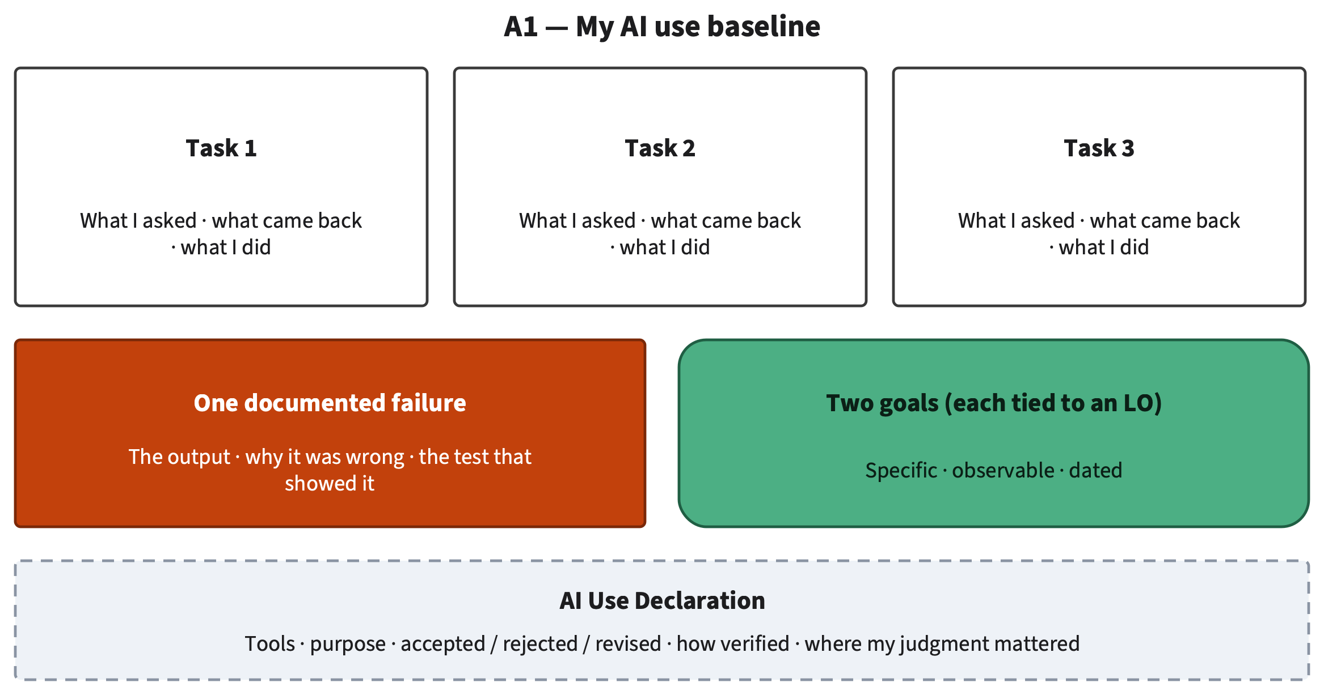
Your baseline: three tasks, one failure, two goals
§1.7 · ON SCREEN DURING GROUP PRACTICE
Weak goal: “Get better at AI.”
Stronger: “Within six weeks, check every statistic an AI tool gives me against an original source (LO3).”
Honest beats impressive
AI for All · Ch 1 · Why AI Changes Study and Work
42
Notes:
SAY
This is the template for your baseline, and it stays on the screen while you work. Three task boxes, each with what you asked, what came back and what you did. One documented failure: the output, why it was wrong, and the test that showed it. Two goals, each tied to a learning outcome. And the AI Use Declaration at the bottom. A word on goals, because they are where students lose the last point. "Get better at AI" is not a goal you can check. A useful goal is specific, observable and tied to a learning outcome, like the example on the slide: within six weeks, check every statistic an AI tool gives me against an original source before I use it, LO3. Why honest? Because athletes record their real starting times; an impressive baseline tells you nothing about your progress.
INSTRUCTOR BACKGROUND
Second stronger goal in the book: "By the end of the term, design one AI-assisted workflow for a real task in my nursing courses, with a step where I verify medical facts (LO6)." The book's sample baseline (Elif, psychology): summary of a reading (inside; revised after comparing with notes), a statistic on international students (unsure; no source found, not used), a keyword count in a 30-page report (outside; the tool's number was wrong, checked with the word processor's search). Her declaration lists tools and date, accepted/revised/rejected outputs, how each was verified, and that her judgment decided what to keep. The documented failure becomes the first entry in the Failure Diary (Chapter 4).
Likely student questions:
• Q: Can my goal be about using AI less?
A: Yes, if it is specific, observable and tied to an outcome, for example an LO4 goal about telling assistance from outsourcing in your own coursework.
TIMING AND ACTIVITY
47 min · Lab session, Lab 1.2 (about 75 min)
2 min to introduce, then 45 min group practice (Lab 1.2). Circulate during the Verify step; most students need help designing a test. At minute 40 give a 5-minute warning for 'share one surprise'.
BOOK
§1.7 'Writing a useful goal', @fig-1-14, Worked Example 'A Sample Baseline', Faded Example 'Write the Declaration'.

Slide 43
What did your tests show?
SHARE AND CRITIQUE · 15 MIN
Which inside / outside prediction was wrong?
Which test was most useful, and why?
What would you change in your Frame step?
Think · 2 min
One line each
Team · 5 min
Pick the best surprise and test
Share · 8 min
Report; class critiques tests
AI for All · Ch 1 · Why AI Changes Study and Work
43
Notes:
SAY
Time to share and critique. On your own, answer the three questions in one line each: which of your inside or outside predictions was wrong, which test was most useful and why, and what you would change in your Frame step next time. Then, as a team, pick your best surprise and your best test. In the last eight minutes each team reports, and the rest of us critique the test, not the person: would that test really catch the error? Is there a cheaper or stronger one? This is the habit this book builds: deciding on evidence, not on how an answer sounds.
INSTRUCTOR BACKGROUND
Debrief questions come from labs/ch01-lab2.md. What to listen for: tests that rely on asking the same tool again (not a test); tests that compare against a source the student opened (strong); counts checked with a search function (strong). Collected failures feed Chapter 4's Failure Diary; the optional Lab 1.3 adds a class gallery of edges in Compass (optional, ungraded).
Misconceptions to watch for:
• M4 'If it sounds confident and fluent, it is probably right.'
How to address it: When a team reports a confident wrong output, ask what on the surface warned them. Usually nothing did.
TIMING AND ACTIVITY
15 min · Lab session, Lab 1.2 (about 75 min)
Think 2 · team 5 · share 8. Call on teams with different kinds of tests.
BOOK
Lab 1.2 debrief; §1.3–1.4.

Slide 44
What you can do now
CHAPTER SUMMARY (BOOK FIGURE: SUMMARY CARD)
Explain: generation writes likely text, even when it cites sources
Judge: fluent is not the same as correct
O1
O3
Explain: gains from AI at work are real but uneven
Judge: assistance vs. outsourcing (three zones)
O2
O4
Judge: test a task; the frontier is jagged and moves
Apply: Frame → Prompt → Verify → Decide → Disclose
O3
O5
At work, a faster result can be the goal. In a course, the goal is the skill.
AI for All · Ch 1 · Why AI Changes Study and Work
44
Notes:
SAY
Back to the puzzle from the concept session. Why did the assistant help the newest agents most? The authors' evidence suggests it carried the habits of top performers to people who did not have them yet; the most experienced agents already worked that way, so they gained little, and their quality dipped slightly. The second question matters just as much. At work, a faster result can be the goal. In a course, the goal is the skill, and a tool that helps beginners produce better output does not automatically help them learn. The card shows what you can do now: explain how generation works and why gains are uneven, judge tasks by testing, tell fluent from correct, judge assistance versus outsourcing, and apply the AI Work Loop.
INSTRUCTOR BACKGROUND
Chapter Summary in the book. Attribution: the explanation of the puzzle is the authors' interpretation (reported tier), which they describe as consistent with their results rather than proof. Revisit the Warm-up questions from the chapter's opening: where did your last AI answer really come from; is your "task AI does badly" a fixed fact or something you could test; what did you guess about AI use in your course?
TIMING AND ACTIVITY
1 min · Lab session, Lab 1.2 (about 75 min)
Ask two students: 'What was your guess about the puzzle in the concept session, and was it right?'
BOOK
Chapter Summary, @fig-1-15; Warm-up revisit.

Slide 45
Key terms
AI Use Declaration
AI Work Loop
assistance
outsourcing
baseline
generative AI system
model
prompt
output
fluent
hallucination
overconfidence
frontier (jagged technological frontier)
productivity
control group
random assignment
percentage point
difference-in-differences (Deep)
staggered rollout (Deep)
Definitions: Chapter 1 and the glossary. (Deep) terms are optional and not on exams.
AI for All · Ch 1 · Why AI Changes Study and Work
45
Notes:
SAY
These are the key terms for the chapter. They may appear on a quiz or exam that asks for terms and concepts, so make sure you can define each one in a sentence in your own words. A quick self-test: cover the slide and define three of them for your neighbor. Pay special attention to the pairs: assistance and outsourcing; fluent and correct; control group and random assignment. The two terms marked Deep come from an optional section on how economists measure effects; they are not on the exams, but they help you read any study about AI at work.
INSTRUCTOR BACKGROUND
Key Terms list from the chapter (19 terms). Definitions are in the chapter text and docs/glossary.md, worded identically. Examinable scope is Core sections only; Deep sections are not examinable (book decision D20).
TIMING AND ACTIVITY
1 min · Lab session, Lab 1.2 (about 75 min)
30-second pair self-test: each partner defines two terms.
BOOK
Chapter Summary, Key Terms; glossary.

Slide 46
Exit ticket
EXIT TICKET
Why does “AI helps beginners most at work” not mean “beginners should let AI do their coursework”?
1
Which task surprised you, and what test showed it?
2
Which Work Loop step will you watch most in A1?
3
3 min · index card or online form · ungraded
AI for All · Ch 1 · Why AI Changes Study and Work
46
Notes:
SAY
Last three minutes: the exit ticket. Answer the three questions on an index card or in an online form; it is not graded, and it tells me what to reteach next time. The first question checks the most important idea of the chapter. The second and third are about you: what surprised you in your own tests, and which step of the loop you will watch most closely while you write A1. Before you leave: A1 is due when your instructor sets it, on your course site, and next we open with another case, the Amazon recruiting tool, and ask how machines learn from data.
INSTRUCTOR BACKGROUND
Question 1 is Check Yourself 1.2, item 3. Good answer (§1.2): at work, the goal is the output, so faster is better; in a course, an assignment exists to build a skill you can use without the tool, so if the tool produces the reasoning the assignment is done but the learning is not; evidence: the Türkiye mathematics study (Bastani et al., 2025). Next: Chapter 2, opening case the Amazon recruiting tool; how machines learn from data, then what a language model is.
TIMING AND ACTIVITY
3 min · Lab session, Lab 1.2 (about 75 min)
3 min; collect cards at the door or close the online form when time is up.
BOOK
§1.2 (question 1); §1.7; Chapter 2.

Slide 47
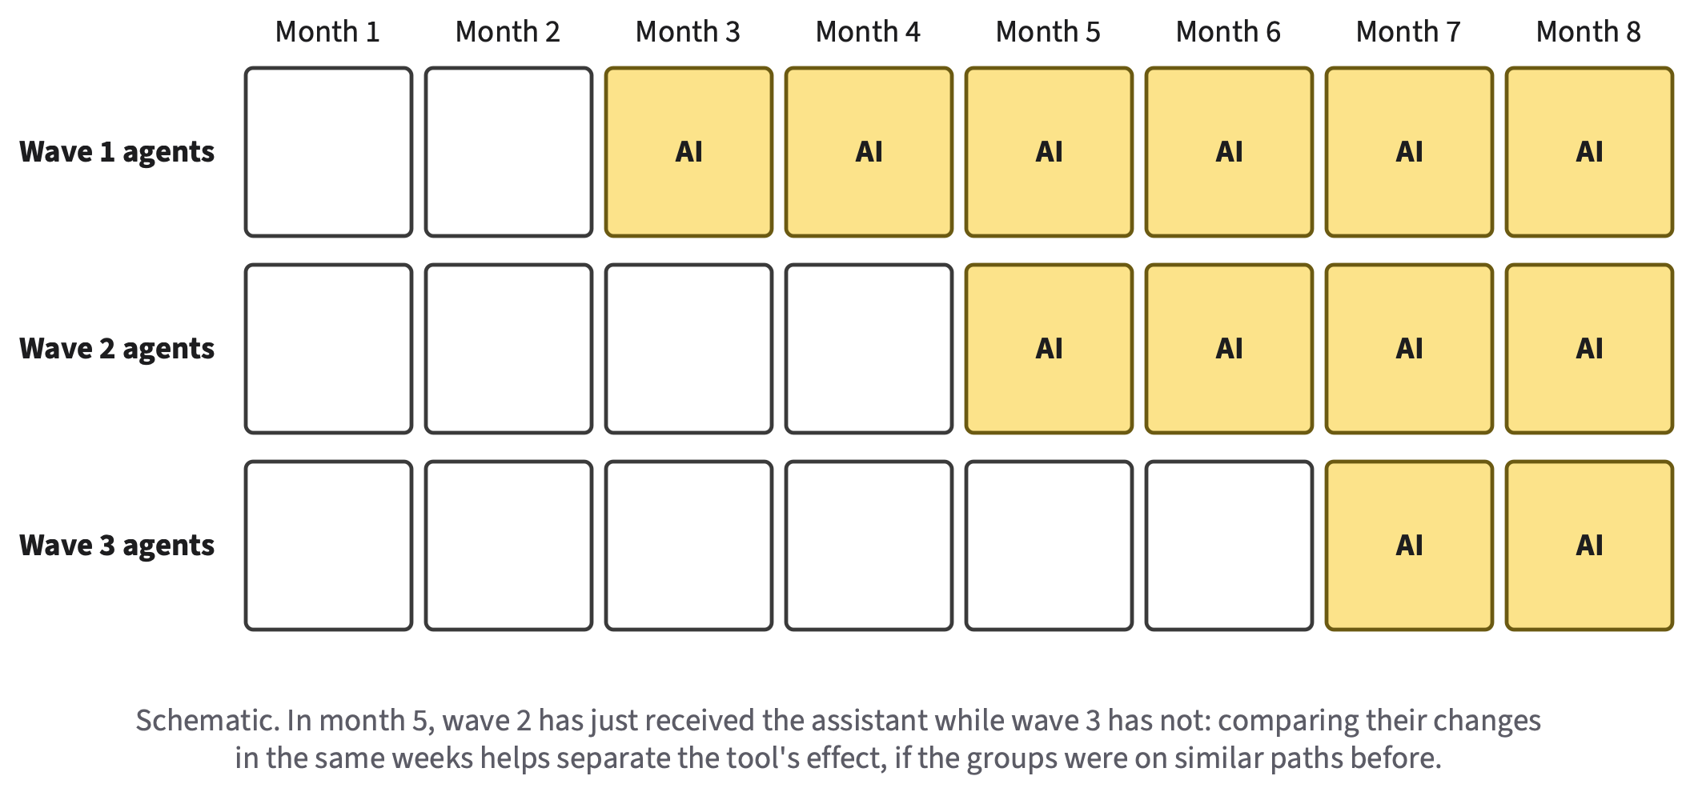
Going deeper: a staggered rollout as an experiment
Going deeper · optional · not on exams
DEEP 1.A · HOW ECONOMISTS MEASURED THE EFFECT
Groups got the tool at different times
Compare recently treated with not-yet-treated, in the same weeks: difference-in-differences
Works only if groups were on parallel paths before
Ask of any AI study: compared with whom? Measured how? In what setting?
AI for All · Ch 1 · Why AI Changes Study and Work
47
Notes:
SAY
Use this slide only if there is time or a student asks how anyone can know the assistant caused the 15 percent gain. The assistant did not reach every agent on the same day: it arrived a few at a time over several months, a staggered rollout. At any moment, some agents had the tool and similar agents did not yet. The analysis compares the change in performance for agents who just received it with the change, over the same weeks, for agents still waiting. Anything that affected everyone, like a seasonal rush, shows up in both groups and cancels out. That is a difference-in-differences comparison. It works only if, without the tool, the groups would have moved in parallel; researchers check that the groups were on similar paths before the tool arrived.
INSTRUCTOR BACKGROUND
Deep 1.A (optional, not examinable). The check matters here because managers chose which agents attended each training session. The authors report several checks, including similar effects across groups that started at different times and a small randomized pilot with similar results (Brynjolfsson et al., 2025). Limits: one company, one kind of job, one tool; productivity measured as issues resolved per hour (a different measure, such as long-term customer loyalty, might tell a different story). The writing and consulting studies used random assignment but designed tasks. The figure is schematic (three waves over eight months), not the study's actual schedule.
Likely student questions:
• Q: Is a randomized experiment always better?
A: Random assignment makes groups alike on average, but those studies used tasks designed for the experiment, which may differ from real jobs. Each design trades realism against control (Deep 1.A).
TIMING AND ACTIVITY
no class time (reference) · reference slides (not presented)
Optional; not part of the 75-minute plan.
BOOK
Deep 1.A How Economists Measure AI's Effect at Work, @fig-1-16.

Slide 48
References (1 of 2)
Anthropic. (n.d.). AI fluency: Framework & foundations [Online course]. Anthropic Academy.
Bastani, H., Bastani, O., Sungu, A., Ge, H., Kabakcı, Ö., & Mariman, R. (2025). Generative AI without guardrails can harm learning: Evidence from high school mathematics. PNAS, 122(26), e2422633122. https://doi.org/10.1073/pnas.2422633122
Brynjolfsson, E., Li, D., & Raymond, L. (2025). Generative AI at work. The Quarterly Journal of Economics, 140(2), 889–942. https://doi.org/10.1093/qje/qjae044
Dell’Acqua, F., McFowland, E., III, Mollick, E., et al. (2023). Navigating the jagged technological frontier (Harvard Business School Working Paper No. 24-013). https://ssrn.com/abstract=4573321
Farquhar, S., Kossen, J., Kuhn, L., & Gal, Y. (2024). Detecting hallucinations in large language models using semantic entropy. Nature, 630, 625–630. https://doi.org/10.1038/s41586-024-07421-0
AI for All · Ch 1 · Why AI Changes Study and Work
48
Notes:
SAY
Reference slide; not presented in class. These are the sources cited on the slides and in the speaker notes, in short APA form, copied from the chapter's reference list. Students do not need to read them; the chapter is written to be fully understandable without them. If a student wants to go further, point them to Brynjolfsson, Li and Raymond (2025) first: the book notes that its introduction is readable without economics training. The Dell'Acqua study also appeared in 2026 in Organization Science; the full entry is in the chapter. Noy and Zhang (2023) is short, and Bastani et al. (2025) previews Chapter 7.
INSTRUCTOR BACKGROUND
Full entries (including the 2026 Organization Science version of Dell'Acqua et al. and all authors) are in the chapter's References section, which was fact-checked (docs/factcheck/ch01.csv). Recommended readings: Anthropic AI Fluency, Bastani et al., Mata v. Avianca, Noy & Zhang, Dell'Acqua et al. and Brynjolfsson et al. (the 2023 NBER version).
TIMING AND ACTIVITY
no class time (reference) · reference slides (not presented)
Not presented.
BOOK
Chapter 1, References; Further Reading and Compass Links.

Slide 49
References (2 of 2)
Institute of Medicine. (2005). Dietary reference intakes for water, potassium, sodium, chloride, and sulfate. The National Academies Press. https://doi.org/10.17226/10925
Liu, N. F., Zhang, T., & Liang, P. (2023). Evaluating verifiability in generative search engines. In Findings of EMNLP 2023 (pp. 7001–7025). https://doi.org/10.18653/v1/2023.findings-emnlp.467
Mata v. Avianca, Inc., 678 F. Supp. 3d 443 (S.D.N.Y. 2023).
Noy, S., & Zhang, W. (2023). Experimental evidence on the productivity effects of generative artificial intelligence. Science, 381(6654), 187–192. https://doi.org/10.1126/science.adh2586
AI for All · Ch 1 · Why AI Changes Study and Work
49
Notes:
SAY
(References continued.)
TIMING AND ACTIVITY
no class time (reference) · reference slides (not presented)
BOOK
Chapter 1, References; Further Reading and Compass Links.

