Slide 1
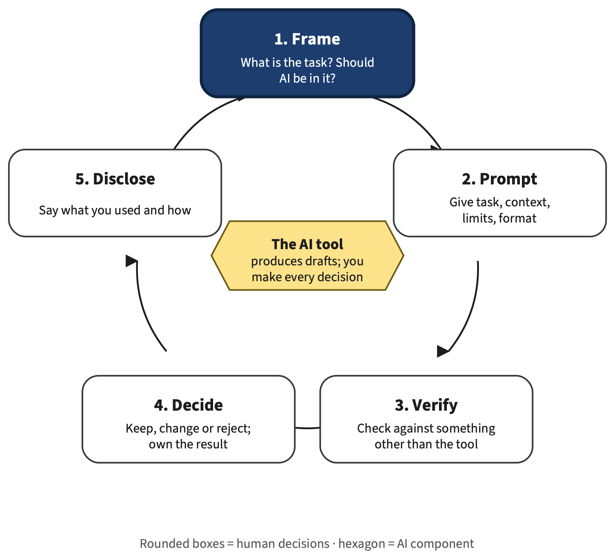
Layout gallery for AI for All lecture decks
AI FOR ALL: CAREER-READY AI SKILLS
Chapter 0
Week N · Tue and Thu
CS 2V95.001 · Spring 2027
Instructor name
Reading: Chapter N
Notes:
SAY
layout: title. Navy background, optional figure on a white card at right.
TIMING AND ACTIVITY
no class time (reference) · Tuesday concept session
BOOK
—

Slide 2
session_plan: the week at a glance
Tuesday · Concept session
75 min
Thursday · Practice lab
75 min
10 min
Opening case
Detail line
10 min
Lab briefing
35 min
Concept core
Detail line
45 min
Group practice
20 min
Demonstration
Detail line
15 min
Share and critique
10 min
Concept check
Detail line
5 min
Exit step
AI for All · Ch 0 · Layout gallery
2
Notes:
SAY
layout: session_plan. Two columns of timed blocks; the colored strip is decorative, minutes are written as text.
TIMING AND ACTIVITY
no class time (reference) · Tuesday concept session
BOOK
—

Slide 3
objectives: up to six coded cards
OBJECTIVES
Verb and a short objective in plain words
Verb and a short objective in plain words
O1
O3
Verb and a short objective in plain words
Verb and a short objective in plain words
O2
O4
Optional takeaway bar (used on the summary slide)
AI for All · Ch 0 · Layout gallery
3
Notes:
SAY
layout: objectives.
TIMING AND ACTIVITY
no class time (reference) · Tuesday concept session
BOOK
—

Slide 4
section: divider for a subsection
N.1
The one core idea of the subsection, in one sentence.
Book §N.1 · signature diagram if any
Core
AI for All · Ch 0 · Layout gallery
4
Notes:
SAY
layout: section.
TIMING AND ACTIVITY
no class time (reference) · Tuesday concept session
BOOK
—

Slide 5
concept: bullets, optional figure, optional flow and takeaway
CONCEPT
First bullet, at most about 12 words
Second bullet
A sub-bullet
Human step
AI component
Step
Uncertain output
Takeaway bar: the one sentence to remember
AI for All · Ch 0 · Layout gallery
5
Notes:
SAY
layout: concept with flow strip.
TIMING AND ACTIVITY
no class time (reference) · Tuesday concept session
BOOK
—

Slide 6
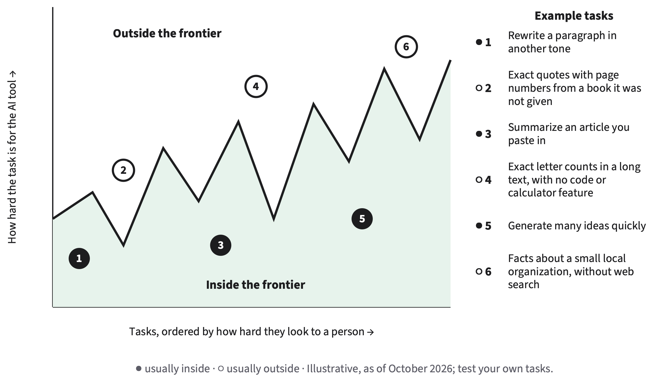
concept: bullets beside a book figure
CONCEPT WITH FIGURE
Figure width is automatic (up to 62%)
Alt text comes from figures/longdesc
AI for All · Ch 0 · Layout gallery
6
Notes:
SAY
layout: concept with figure.
TIMING AND ACTIVITY
no class time (reference) · Tuesday concept session
BOOK
—

Slide 7
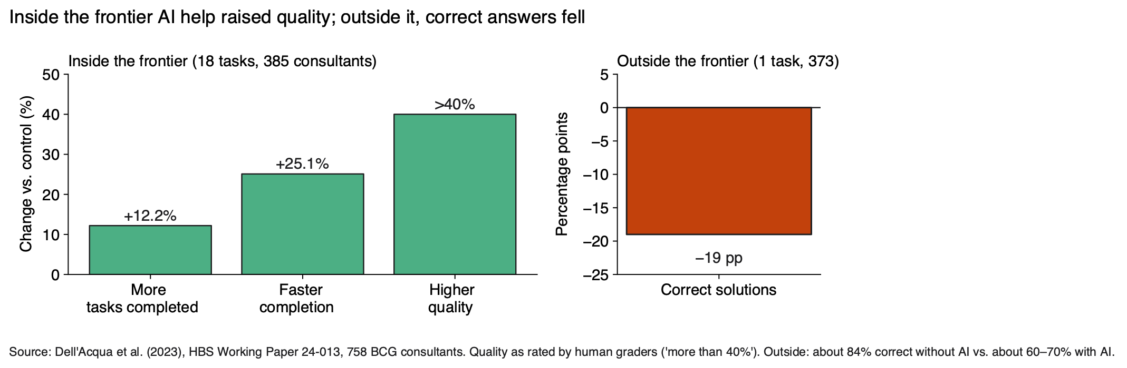
figure: one book figure, as large as possible
FIGURE
Optional caption line (source, date)
Optional takeaway bar
AI for All · Ch 0 · Layout gallery
7
Notes:
SAY
layout: figure.
TIMING AND ACTIVITY
no class time (reference) · Tuesday concept session
BOOK
—

Slide 8
compare: two or three cards with role colors
COMPARE
verified
neutral, dashed
risk
Role colors come from figlib
Headings say the meaning in words
Dashed = conditional or inferred
Risk cards get a thick border
Optional takeaway bar
AI for All · Ch 0 · Layout gallery
8
Notes:
SAY
layout: compare.
TIMING AND ACTIVITY
no class time (reference) · Tuesday concept session
BOOK
—

Slide 9
matrix: a 2 × 2 grid, optional bullets
MATRIX
Optional definitions at left
Column A
Column B
Row 1
Good
detail
Danger
detail
Row 2
Neutral
detail
Soft
detail
AI for All · Ch 0 · Layout gallery
9
Notes:
SAY
layout: matrix.
TIMING AND ACTIVITY
no class time (reference) · Tuesday concept session
BOOK
—

Slide 10
lanes: rows of book-grammar flows
LANES
Row label
You
AI step
Check
Row label
You
Step
Result
Optional caption, including a legend for dashed outlines
AI for All · Ch 0 · Layout gallery
10
Notes:
SAY
layout: lanes.
TIMING AND ACTIVITY
no class time (reference) · Tuesday concept session
BOOK
—

Slide 11
loop: signature diagram 1, drawn natively
LOOP
highlight: one step or a list
Optional bullets at left
1. Frame
What is the task? Should AI be in it?
5. Disclose
Say what you used and how
2. Prompt
Give task, context, limits, format
The AI tool
produces drafts; you make every decision
4. Decide
Keep, change or reject; own the result
3. Verify
Check against something other than the tool
AI for All · Ch 0 · Layout gallery
11
Notes:
SAY
layout: loop.
TIMING AND ACTIVITY
no class time (reference) · Tuesday concept session
BOOK
—

Slide 12
timeline: a case as a story
TIMELINE
Event 1
Event 2
Event 3
1
2
3
What happened
What the AI system did
The book's reading
confirmed
reported
inferred
Tier pills: confirmed · reported · inferred (dashed)
AI for All · Ch 0 · Layout gallery
12
Notes:
SAY
layout: timeline.
TIMING AND ACTIVITY
no class time (reference) · Tuesday concept session
BOOK
—

Slide 13
worked: steps revealed across slides
WORKED EXAMPLE
Context line: who, field, situation
Step one — What you do
1
Step 2 · Step two — coming next
Step 3 · Step three — coming next
AI for All · Ch 0 · Layout gallery
13
Notes:
SAY
layout: worked.
TIMING AND ACTIVITY
no class time (reference) · Tuesday concept session
BOOK
—

Slide 14
worked: steps revealed across slides
WORKED EXAMPLE
Context line: who, field, situation
Step one — What you do
1
Step two — What you do
2
Step three — What you do
3
Rule or answer, shown on the last reveal
AI for All · Ch 0 · Layout gallery
14
Notes:
SAY
(Continued from the previous slide.)
TIMING AND ACTIVITY
0 min · Tuesday concept session
BOOK
—

Slide 15
Quick check: multiple choice
QUICK CHECK
Question text from the chapter's Check Yourself or an odd-numbered review item?
(a)
Option a
(b)
Option b
(c)
Option c
(d)
Option d
Answer alone, then vote
AI for All · Ch 0 · Layout gallery
15
Notes:
SAY
layout: quiz (question slide).
TIMING AND ACTIVITY
no class time (reference) · Tuesday concept session
BOOK
—

Slide 16
Answer: multiple choice
QUICK CHECK
Question text from the chapter's Check Yourself or an odd-numbered review item?
(a)
Option a
(b)
Option b
Correct
(c)
Option c
(d)
Option d
Why the distractors fail
AI for All · Ch 0 · Layout gallery
16
Notes:
SAY
layout: quiz (answer slide).
TIMING AND ACTIVITY
1 min · Tuesday concept session
BOOK
—

Slide 17
Quick check: open question
QUICK CHECK
An open Check Yourself question?
Write, then compare
AI for All · Ch 0 · Layout gallery
17
Notes:
SAY
layout: quiz, open.
TIMING AND ACTIVITY
no class time (reference) · Tuesday concept session
BOOK
—

Slide 18
Answer: open question
QUICK CHECK
An open Check Yourself question?
Model answer
Model answer, first sentence.
Second sentence.
AI for All · Ch 0 · Layout gallery
18
Notes:
SAY
answer.
TIMING AND ACTIVITY
1 min · Tuesday concept session
BOOK
—

Slide 19
tps: think · pair · share
THINK · PAIR · SHARE
The main prompt
A second prompt line
Think · 1 min
On your own, in writing
Pair · 2 min
Compare with a neighbor
Share · 2 min
A few pairs report out
AI for All · Ch 0 · Layout gallery
19
Notes:
SAY
layout: tps.
TIMING AND ACTIVITY
no class time (reference) · Tuesday concept session
BOOK
—

Slide 20
lab: briefing with timed steps
LAB
Goal: One-line goal
Step with a time
5 min
Deliverable
What students hand in
1
Bold step
10 min
Privacy
Data rule
2
Step without a time
No-device route
Alternative
3
AI for All · Ch 0 · Layout gallery
20
Notes:
SAY
layout: lab.
TIMING AND ACTIVITY
no class time (reference) · Thursday practice lab
BOOK
—

Slide 21
assignment: brief, due date, rubric
ASSIGNMENT
Due: Mon, date, 11:59 p.m. on eLearning
What to submit
Rubric
1. Part one
2. Part two
3. Part three
Criterion | Pts | Full credit
Task | 3 | Full-credit descriptor
Process | 3 | Full-credit descriptor
Verification | 2 | Full-credit descriptor
Declaration | 2 | Full-credit descriptor
Grading note
AI for All · Ch 0 · Layout gallery
21
Notes:
SAY
layout: assignment.
TIMING AND ACTIVITY
no class time (reference) · Thursday practice lab
BOOK
—

Slide 22
key_terms: chips
term one
term two
a longer term (with a gloss)
deep term (Deep)
(Deep) terms are drawn muted
AI for All · Ch 0 · Layout gallery
22
Notes:
SAY
layout: key_terms.
TIMING AND ACTIVITY
no class time (reference) · Thursday practice lab
BOOK
—

Slide 23
Exit ticket
EXIT TICKET
First question?
1
Second question?
2
Third question?
3
3 min · index card or eLearning · ungraded
AI for All · Ch 0 · Layout gallery
23
Notes:
SAY
layout: exit_ticket.
TIMING AND ACTIVITY
no class time (reference) · Thursday practice lab
BOOK
—

Slide 24
deep: one optional going-deeper slide
Going deeper · optional · not on exams
DEEP
Same as concept, with a badge
AI for All · Ch 0 · Layout gallery
24
Notes:
SAY
layout: deep.
TIMING AND ACTIVITY
no class time (reference) · after
BOOK
—

Slide 25
References
Author, A. (2025). Title in italics. Publisher.
Author, B., & Author, C. (2024). Article title. Journal, 1(2), 3–4.
AI for All · Ch 0 · Layout gallery
25
Notes:
SAY
layout: references.
TIMING AND ACTIVITY
no class time (reference) · after
BOOK
—

