Slide 1
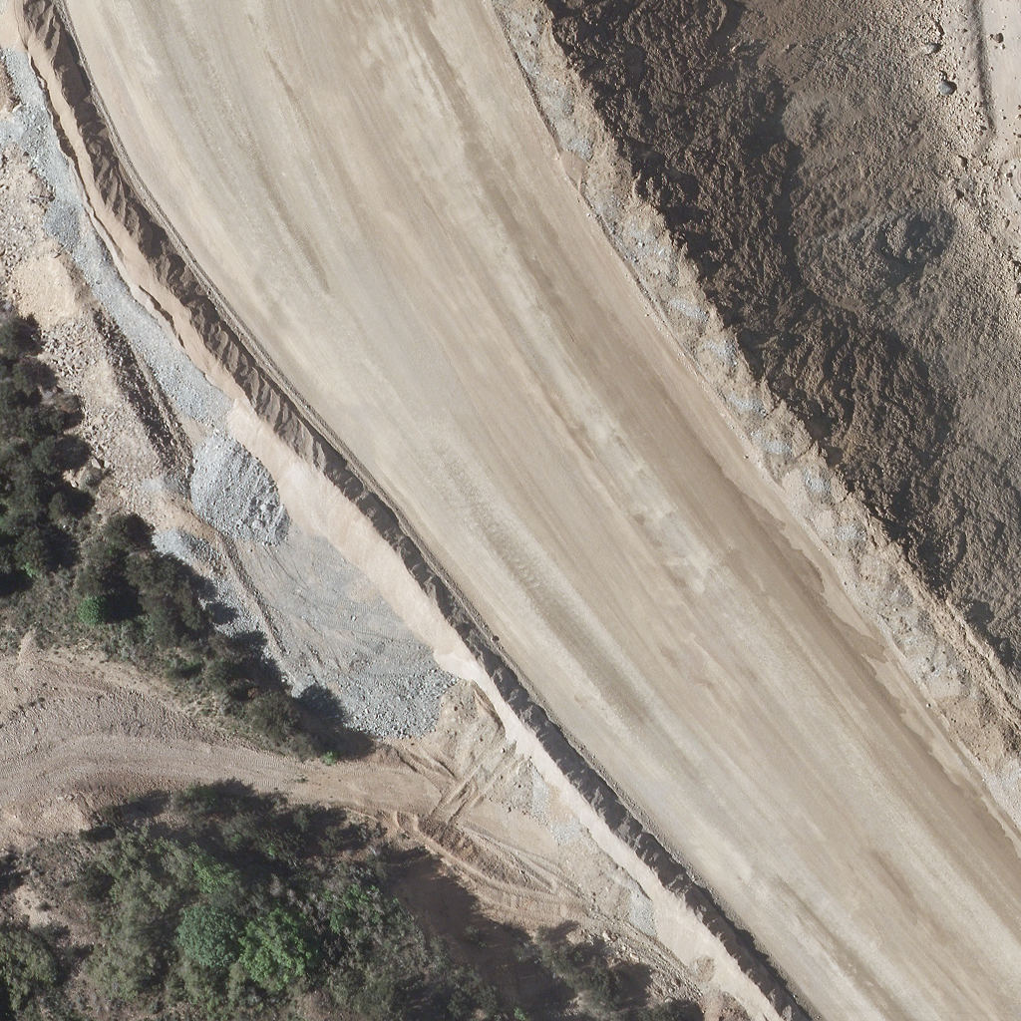
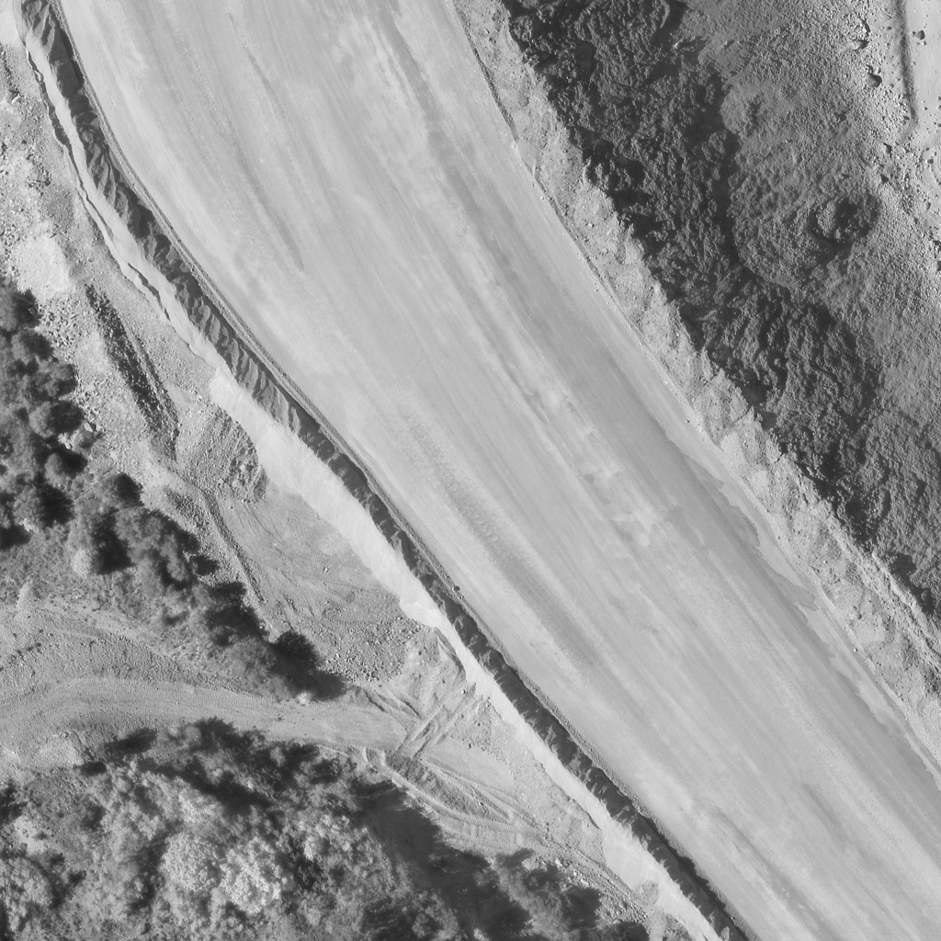
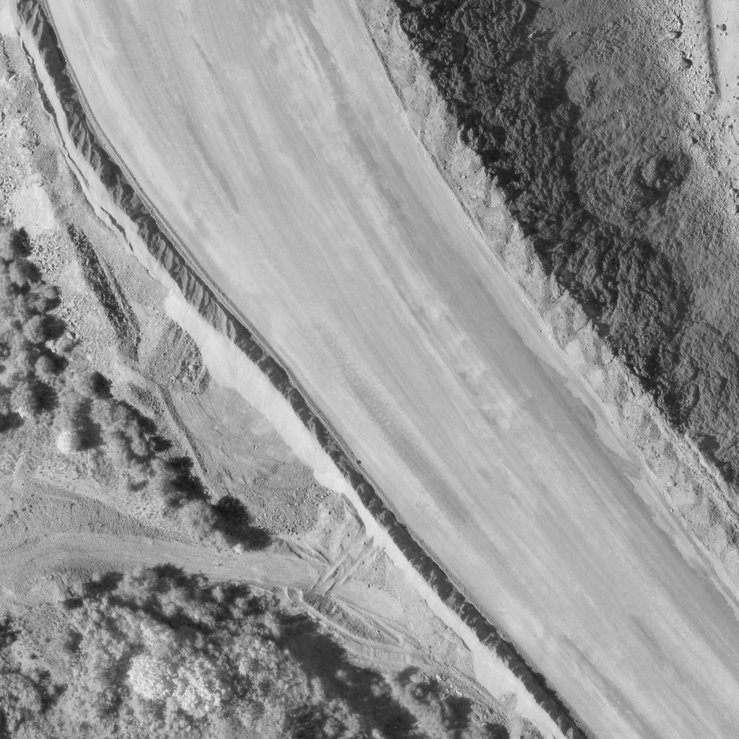
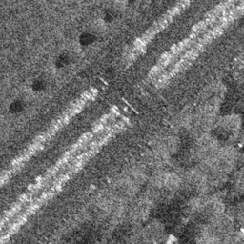
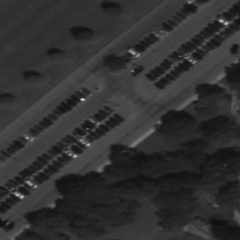
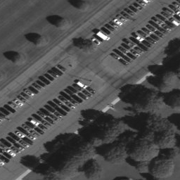
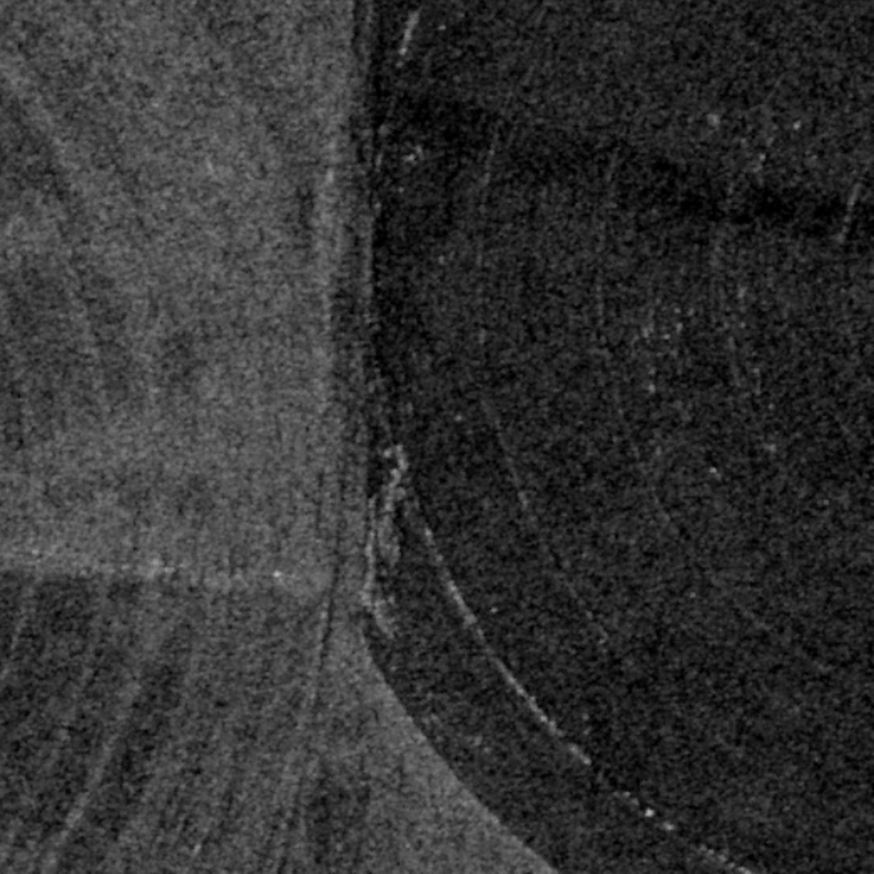
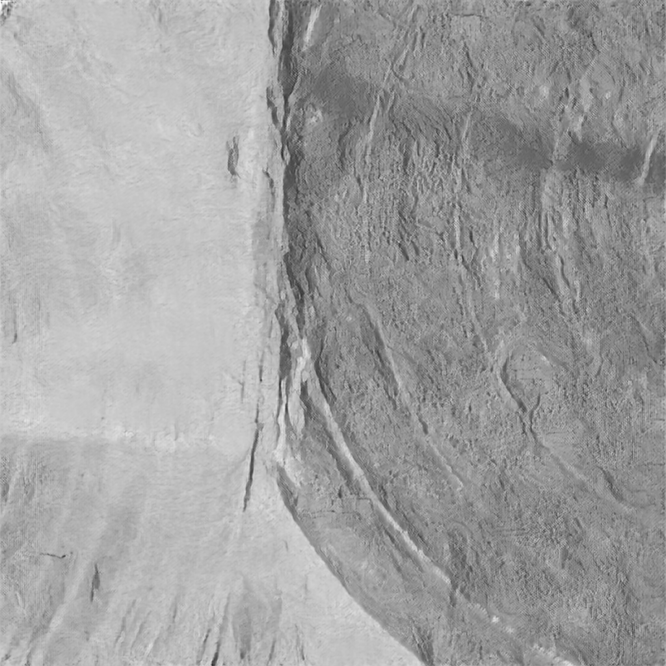
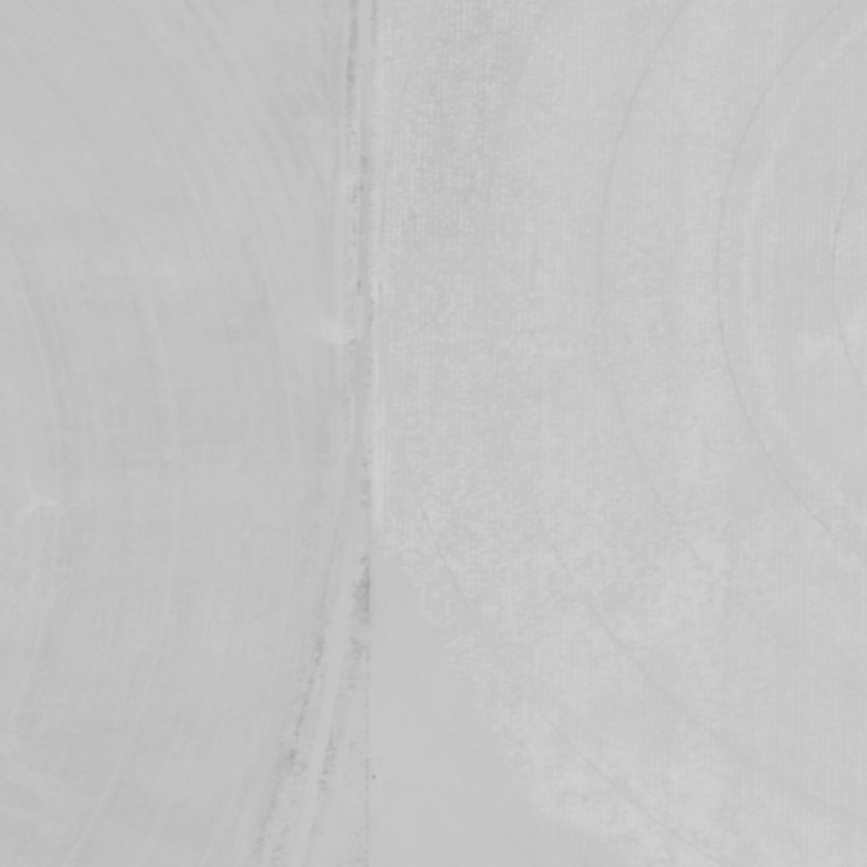
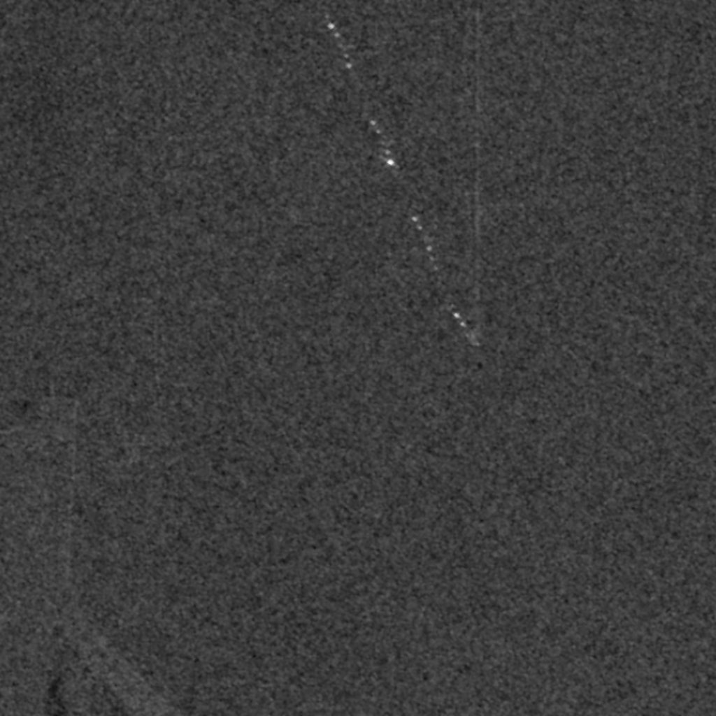
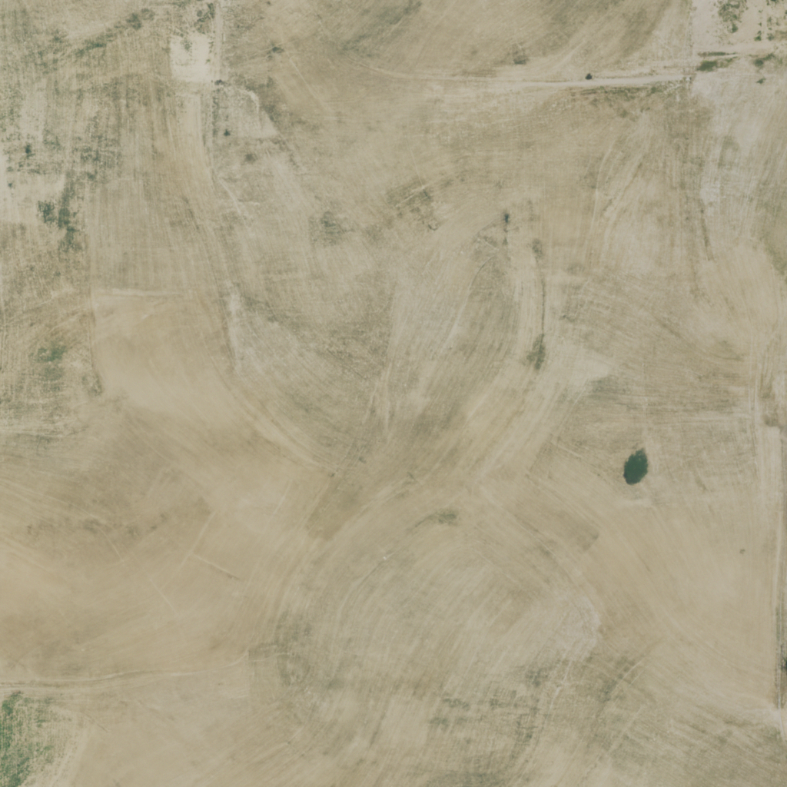
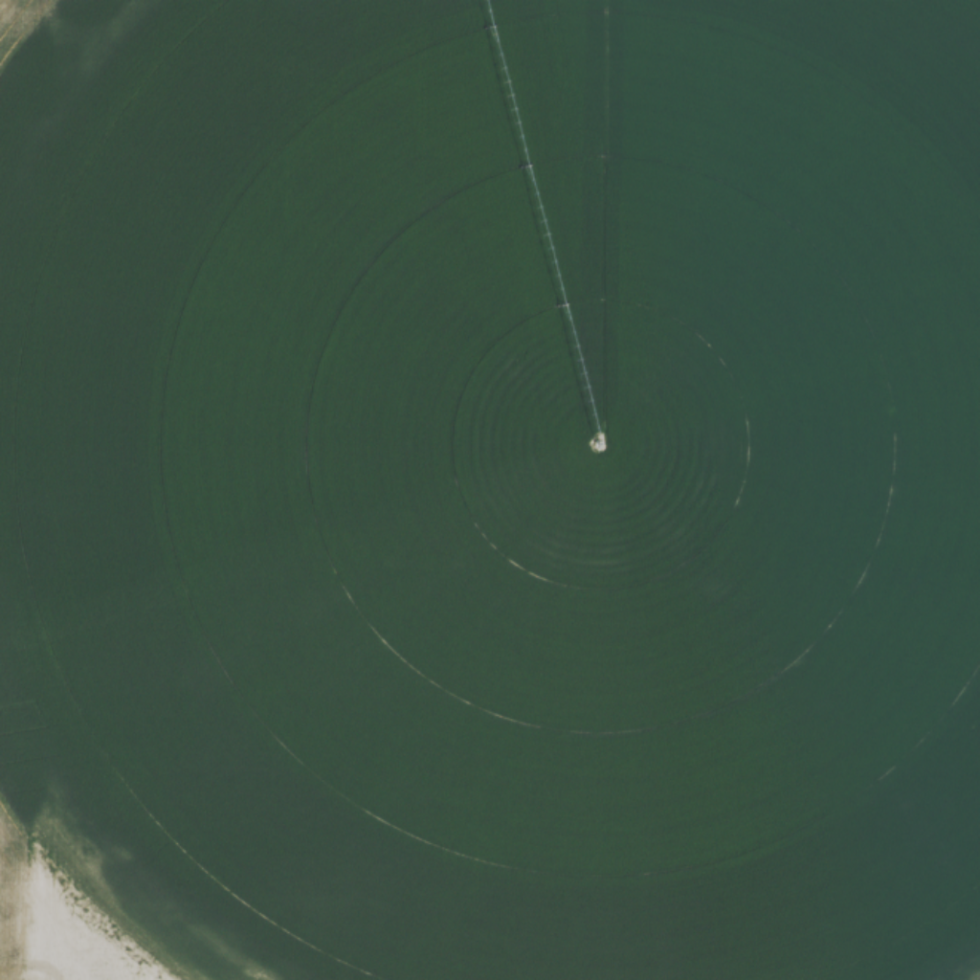
Input
Generated
Ground Truth
Input
Generated
Ground Truth
Placeholder
Placeholder
Placeholder
Placeholder
Placeholder
Placeholder
a) RGB → IR
b) SAR → EO
Input
Generated
Ground Truth
Input
Generated
Ground Truth
Placeholder
Placeholder
Placeholder
Placeholder
Placeholder
Placeholder
c) SAR → IR
d) SAR → RGB
Notes:
Figure 1. Teaser: The proposed EarthBridge framework for multi-modal aerial-view image translation across Electro-Optical (EO), Infrared(IR), and Synthetic Aperture Radar (SAR) modalities. Our method accurately bridges the domain gap, preserving structural integrity while synthesizing high-fidelity target textures

Slide 2
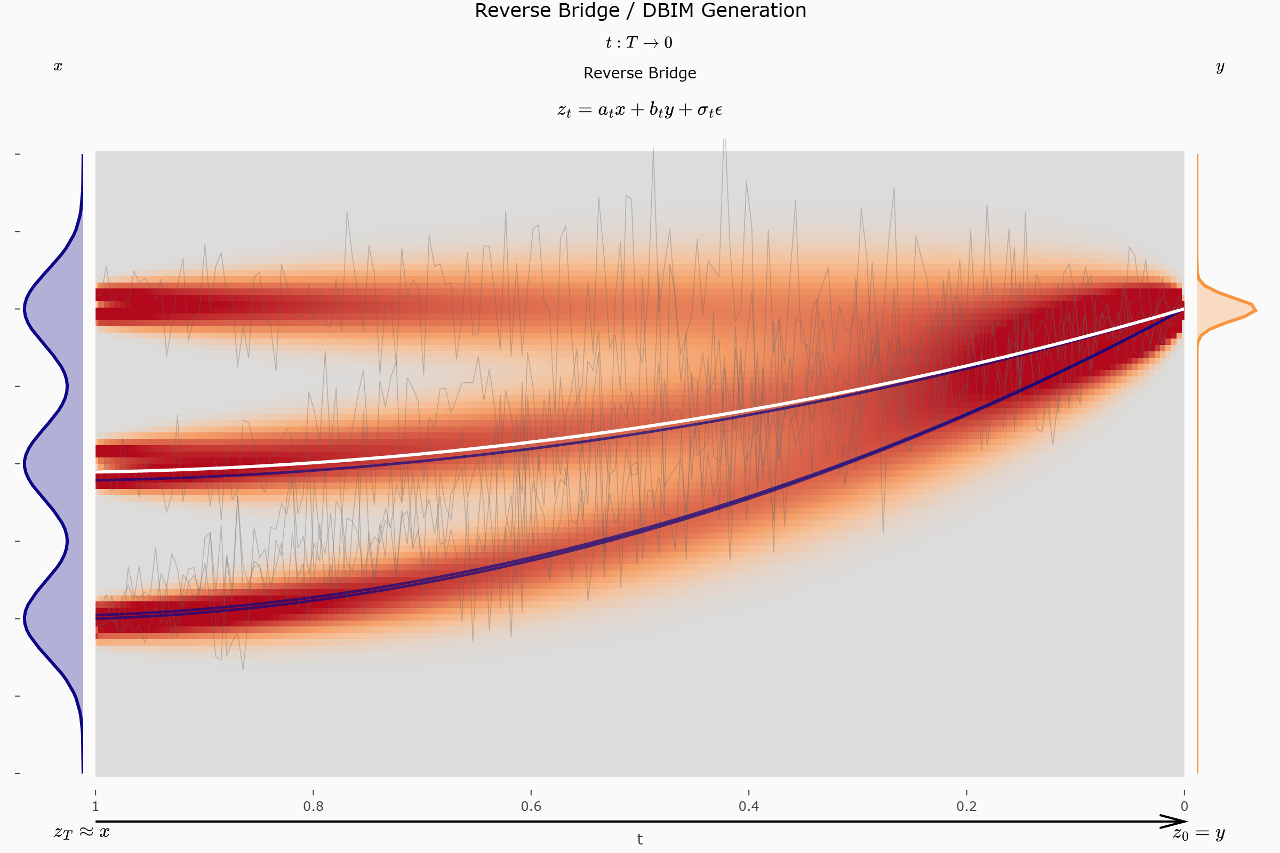
Source distribution
Target distribution
Place-holder
Place-holder
Place-holder
Place-holder

Slide 3
×2
Embed Input
ResBlock
×2
Average Pool
ResBlock
×2
Average Pool
ResBlock
×2
Average Pool
ResBlock
×2
Average Pool
ResBlock
SelfAttention
×2
Down 0
(512 × 512)
Average Pool
ResBlock
SelfAttention
×2
Down 1
(256 × 256)
Average Pool
ResBlock
SelfAttention
Down 2
(128 × 128)
Down 3
(64 × 64)
Down 4
(32 × 32)
Down 5
(16 × 16)
ResBlock
SelfAttention
ResBlock
Down 6
(8 × 8)
Mid
(8 × 8)
Up 6
(8 × 8)
Up 4
(32 × 32)
Up 5
(16 × 16)
Average Pool
ResBlock
SelfAttention
Up 3
(64 × 64)
Average Pool
ResBlock
SelfAttention
Up 2
(128 × 128)
Average Pool
ResBlock
SelfAttention
Up 1
(256 × 256)
Average Pool
ResBlock
Up 0
(512 × 512)
Average Pool
ResBlock
×2
Average Pool
ResBlock
Embed Input
ResBlock
×2
×2
×2
×2
×2
×2
Notes:
DBIM Unet Architecture for RGB2IR/SAR2RGB/SAR2IR

Slide 4
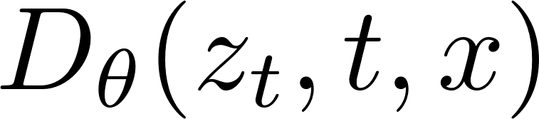

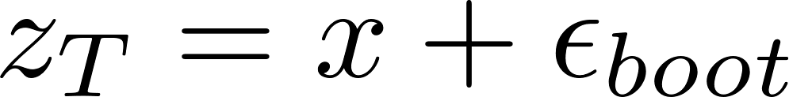
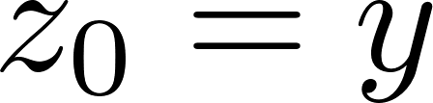
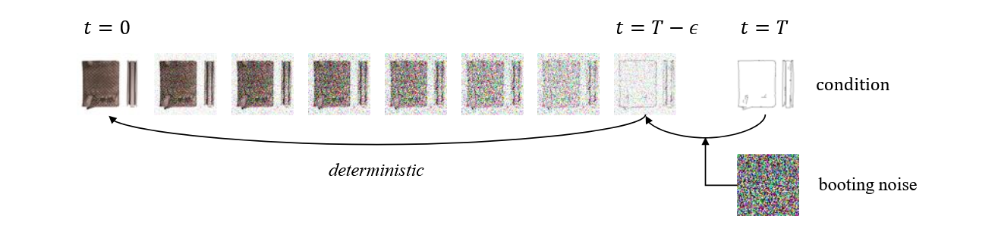
×T
Placeholder
Placeholder
Target
U-Net Denoiser

Slide 5
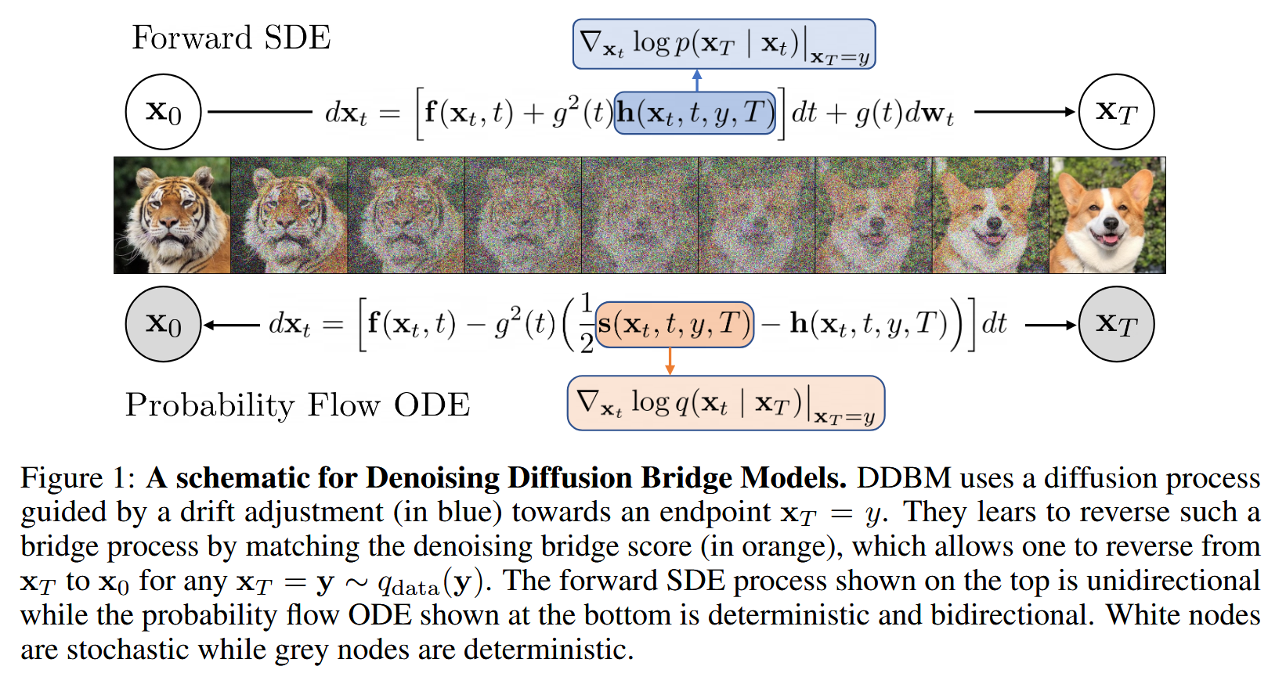

Slide 6
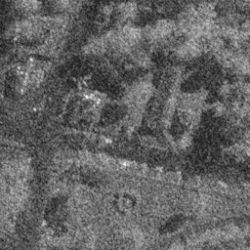
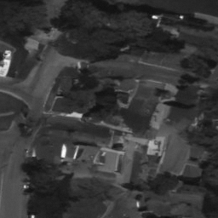
Input
Generated
Input
Generated
Placeholder
Placeholder
Placeholder
Placeholder
a) RGB → IR
b) SAR → EO
Input
Generated
Input
Generated
Placeholder
Placeholder
Placeholder
Placeholder
c) SAR → IR
d) SAR → RGB
Notes:
Figure 1. Teaser: The proposed EarthBridge framework for multi-modal aerial-view image translation across Electro-Optical (EO), Infrared(IR), and Synthetic Aperture Radar (SAR) modalities. Our method accurately bridges the domain gap, preserving structural integrity while synthesizing high-fidelity target textures

