Slide 1
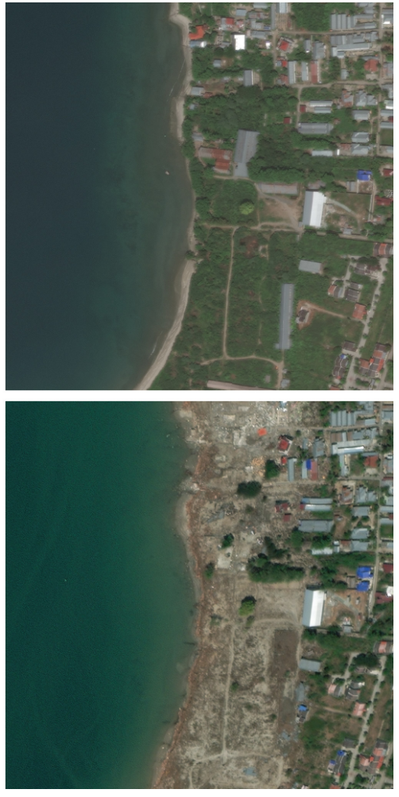
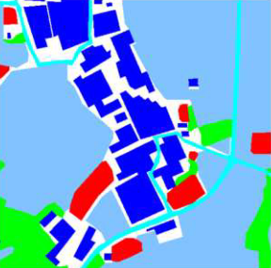
xBD
Pre-event
SAM
Post-event

Slide 2
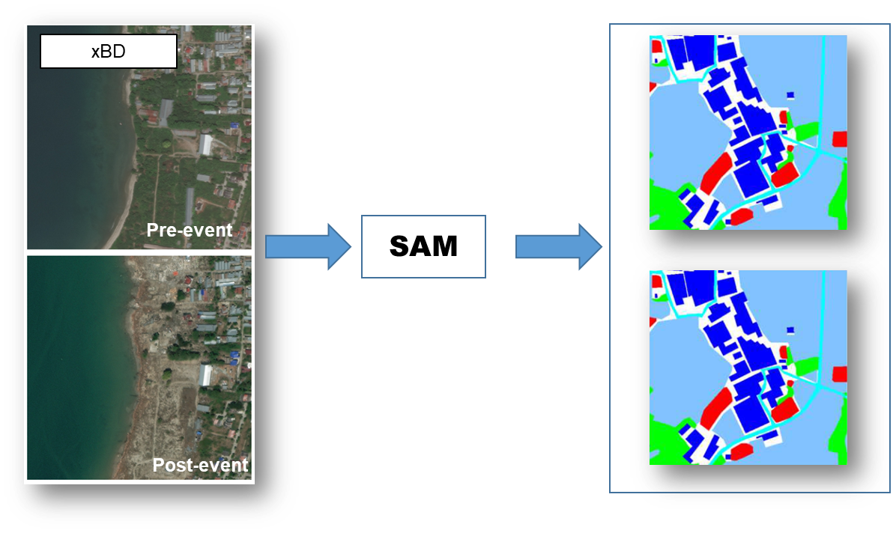
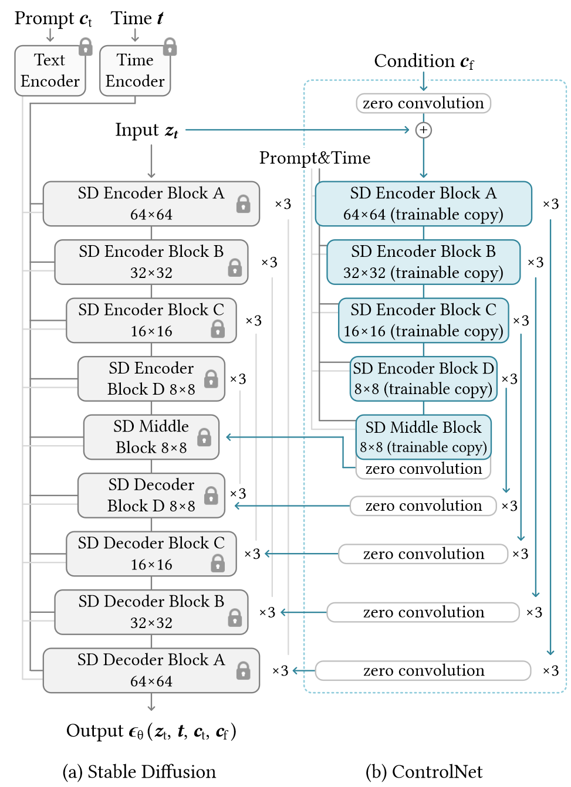

Slide 3
prompt1 prompt2 prompt3 prompt4 …
sd2
sdxl
sdxl turbo
sd3
flux.1-schnell
flux.1-dev
our model
Figure 0. Text-to-Image Generation?

Slide 4
pre-event (predicted) pre-event (ground truth) post-event (ground truth) post-event (predicted)
SDEdit
DiffEdit
CycleDiffusion
Prompt2Prompt
Our Model(pix2pix)
Figure 1. Pre/Post-event Image Generation
(given a edit prompt: “make the road being flooded”/”recover the destroyed building”)

