Slide 1

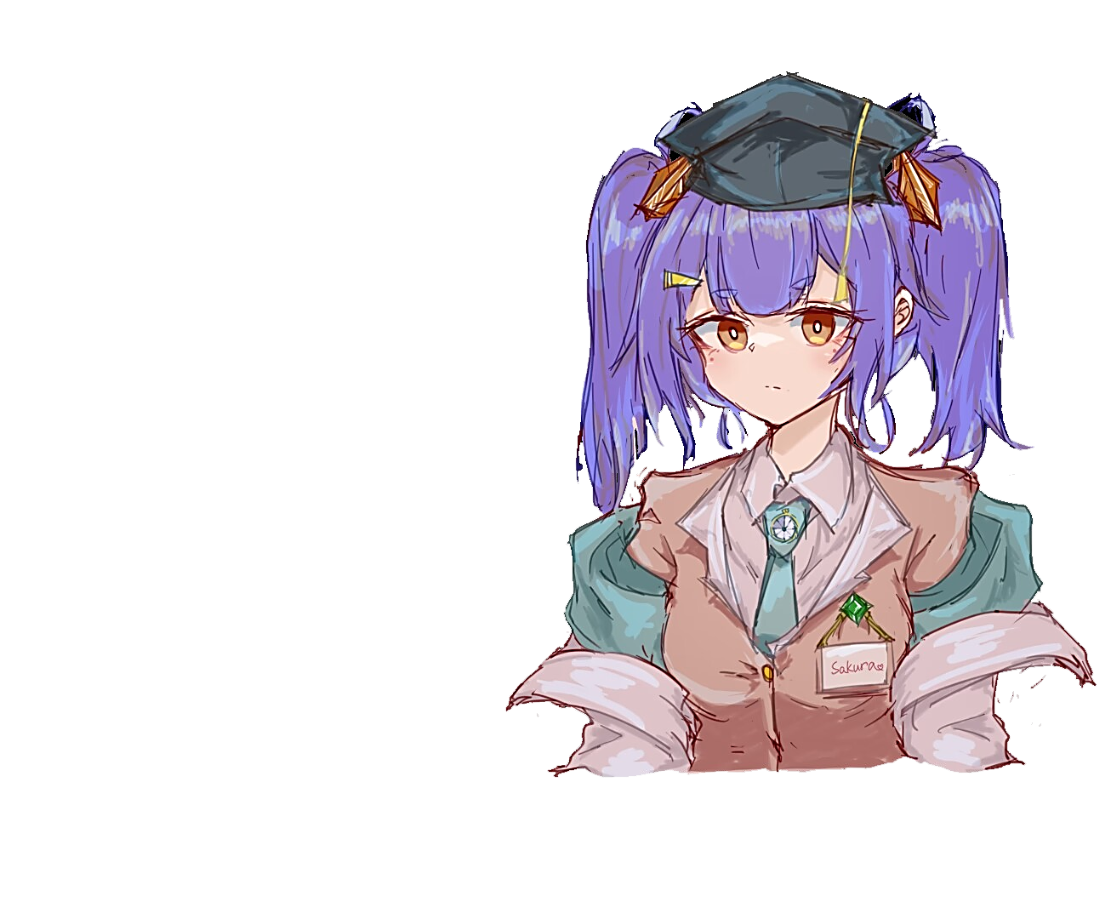
Introduction to Stable Diffusion - GIS Lab 2024 Short-term Course
Presentor: Sakura (Chen Zhenyuan) M.Eng.
Department: School of Earth Science, Zhejiang University
Contact me: bili_sakura@zju.edu.cn
Date: July 14, 2024
© Sakura, 2024. All rights reserved.

Slide 2
Outline
Overview
Evolution of Stable Diffusion
Latent Diffusion Model (LDM)
Stable Diffusion
Stable Diffusion XL
Stable Diffusion 3
Quick Start with Stable Diffusion with Diffusers
Model Card
File Structures
Installation
Deployment
Further Explore Diffusers
© Sakura, 2024. All rights reserved.

Slide 3
Overview
© Sakura, 2024. All rights reserved.

Slide 4
Evolution of Stable Diffusion
© Sakura, 2024. All rights reserved.

Slide 5
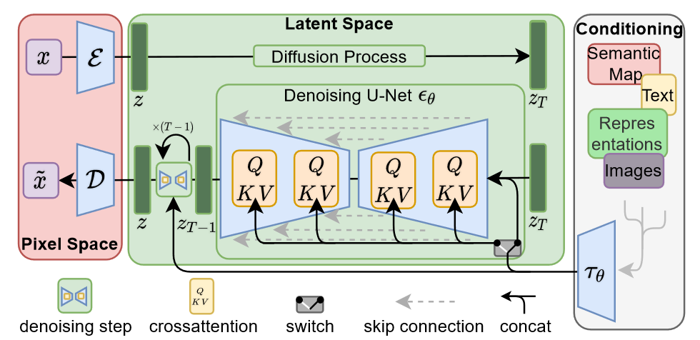
Latent Diffusion Model (LDM)
Architecture of LDM (Rombach et al., 2022)
Rombach, R., Blattmann, A., Lorenz, D., Esser, P., & Ommer, B. (2022). High-Resolution Image Synthesis With Latent Diffusion Models. 10684–10695.
© Sakura, 2024. All rights reserved.

Slide 6
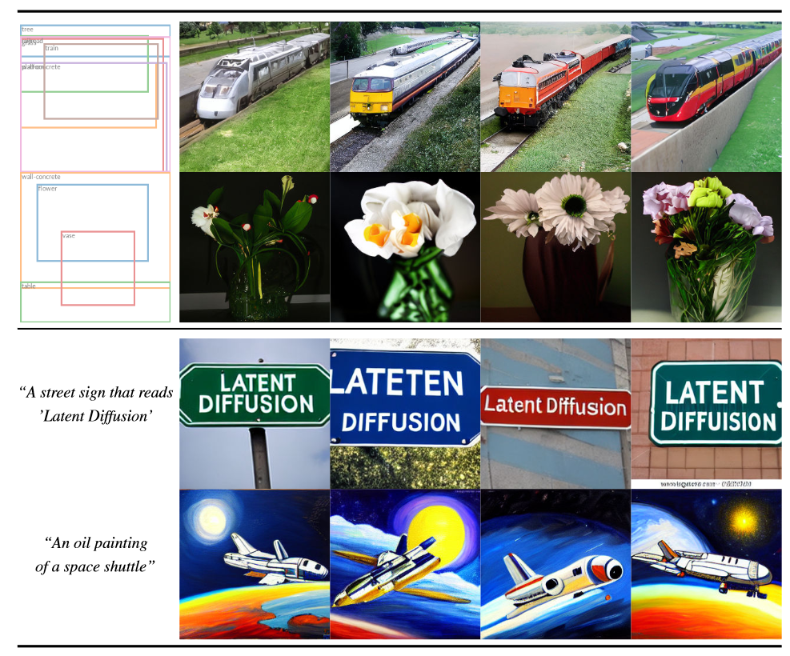
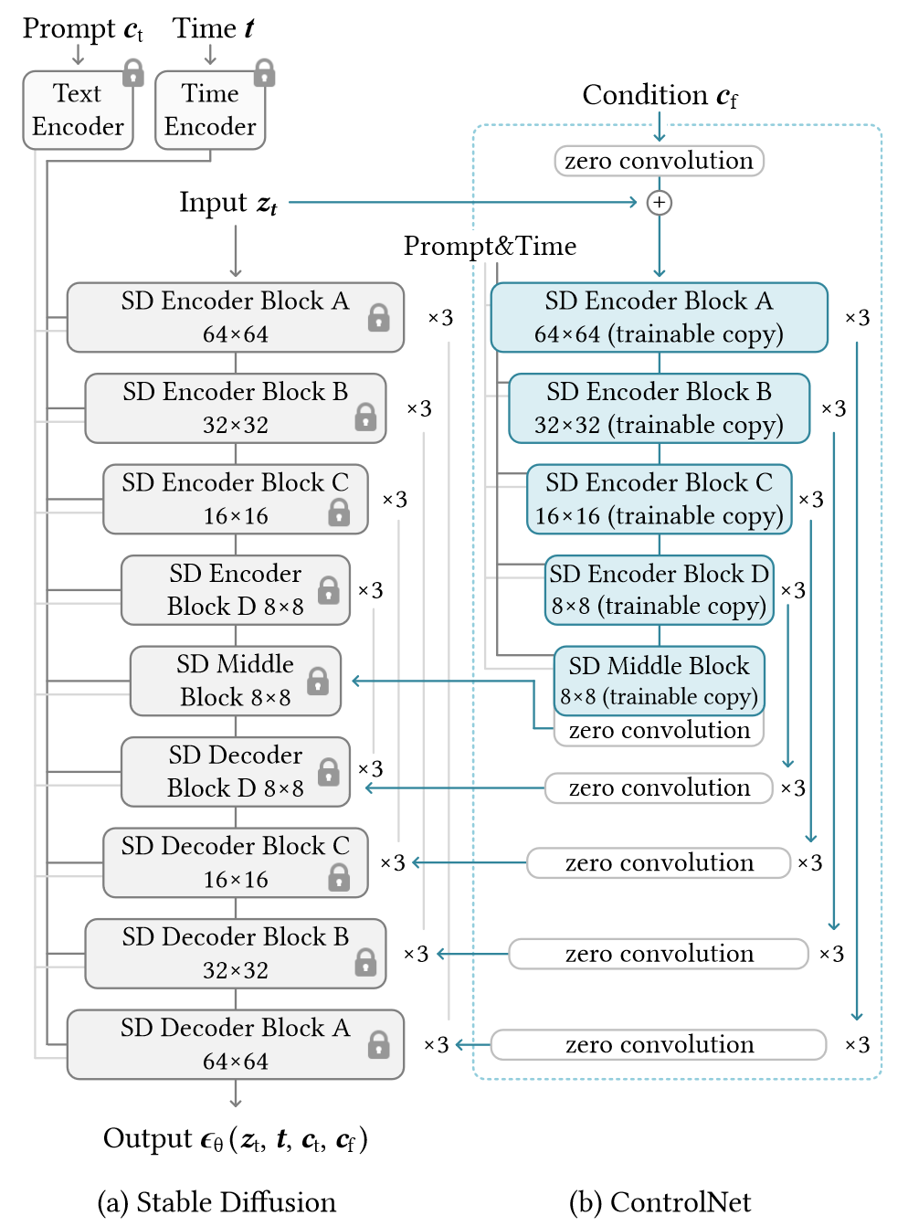
Latent Diffusion Model (LDM)
Top: Samples from our LDM for layout-to-image synthesis.
Bottom: Samples from our text-to-image LDM model for userdefined text prompts.
Architecture of Stable Diffusion (LDM)
with ControlNet(Zhang et al., 2023)
Rombach, R., Blattmann, A., Lorenz, D., Esser, P., & Ommer, B. (2022). High-Resolution Image Synthesis With Latent Diffusion Models. 10684–10695.
Zhang, L., Rao, A., & Agrawala, M. (2023). Adding Conditional Control to Text-to-Image Diffusion Models. 2023 IEEE/CVF International Conference on Computer Vision (ICCV), 3813–3824. https://doi.org/10.1109/ICCV51070.2023.00355
© Sakura, 2024. All rights reserved.

Slide 7
Stable Diffusion v1-v1.4
Owned by CompVis at the Ludwig Maximilian University of Munich
For the first version 4 model checkpoints are released. Higher versions have been trained for longer and are thus usually better in terms of image generation quality then lower versions. More specifically:
stable-diffusion-v1-1: The checkpoint is randomly initialized and has been trained on 237,000 steps at resolution 256x256 on laion2B-en. 194,000 steps at resolution 512x512 on laion-high-resolution (170M examples from LAION-5B with resolution >= 1024x1024).
stable-diffusion-v1-2: The checkpoint resumed training from stable-diffusion-v1-1. 515,000 steps at resolution 512x512 on "laion-improved-aesthetics" (a subset of laion2B-en, filtered to images with an original size >= 512x512, estimated aesthetics score > 5.0, and an estimated watermark probability < 0.5. The watermark estimate is from the LAION-5B metadata, the aesthetics score is estimated using an improved aesthetics estimator).
stable-diffusion-v1-3: The checkpoint resumed training from stable-diffusion-v1-2. 195,000 steps at resolution 512x512 on "laion-improved-aesthetics" and 10 % dropping of the text-conditioning to improve classifier-free guidance sampling
stable-diffusion-v1-4: The checkpoint resumed training from stable-diffusion-v1-2. 195,000 steps at resolution 512x512 on "laion-improved-aesthetics" and 10 % dropping of the text-conditioning to improve classifier-free guidance sampling.
stable-diffusion-v1-4 Resumed from stable-diffusion-v1-2.225,000 steps at resolution 512x512 on "laion-aesthetics v2 5+" and 10 % dropping of the text-conditioning to improve classifier-free guidance sampling.
Rombach, R., Blattmann, A., Lorenz, D., Esser, P., & Ommer, B. (2022). High-Resolution Image Synthesis With Latent Diffusion Models. 10684–10695.
© Sakura, 2024. All rights reserved.

Slide 8
Stable Diffusion v1.5
Owned by Runway
The Stable-Diffusion-v1-5 checkpoint was initialized with the weights of the Stable-Diffusion-v1-2 checkpoint and subsequently fine-tuned on 595k steps at resolution 512x512 on "laion-aesthetics v2 5+" and 10% dropping of the text-conditioning to improve classifier-free guidance sampling.
More Training Data
Better Text Encoder
Rombach, R., Blattmann, A., Lorenz, D., Esser, P., & Ommer, B. (2022). High-Resolution Image Synthesis With Latent Diffusion Models. 10684–10695.
© Sakura, 2024. All rights reserved.

Slide 9
Stable Diffusion v2.1
Owned by Stability AI
March 24, 2023 - Stable UnCLIP 2.1
New stable diffusion finetune (Stable unCLIP 2.1, Hugging Face) at 768x768 resolution, based on SD2.1-768. This model allows for image variations and mixing operations as described in Hierarchical Text-Conditional Image Generation with CLIP Latents, and, thanks to its modularity, can be combined with other models such as KARLO. Comes in two variants: Stable unCLIP-L and Stable unCLIP-H, which are conditioned on CLIP ViT-L and ViT-H image embeddings, respectively. Instructions are available here.
A public demo of SD-unCLIP is already available at clipdrop.co/stable-diffusion-reimagine
December 7, 2022 - Version 2.1
New stable diffusion model (Stable Diffusion 2.1-v, Hugging Face) at 768x768 resolution and (Stable Diffusion 2.1-base, HuggingFace) at 512x512 resolution, both based on the same number of parameters and architecture as 2.0 and fine-tuned on 2.0, on a less restrictive NSFW filtering of the LAION-5B dataset. Per default, the attention operation of the model is evaluated at full precision when xformers is not installed. To enable fp16 (which can cause numerical instabilities with the vanilla attention module on the v2.1 model) , run your script with ATTN_PRECISION=fp16 python <thescript.py>
November 24, 2022 - Version 2.0
New stable diffusion model (Stable Diffusion 2.0-v) at 768x768 resolution. Same number of parameters in the U-Net as 1.5, but uses OpenCLIP-ViT/H as the text encoder and is trained from scratch. SD 2.0-v is a so-called v-prediction model.
The above model is finetuned from SD 2.0-base, which was trained as a standard noise-prediction model on 512x512 images and is also made available.
Added a x4 upscaling latent text-guided diffusion model.
New depth-guided stable diffusion model, finetuned from SD 2.0-base. The model is conditioned on monocular depth estimates inferred via MiDaS and can be used for structure-preserving img2img and shape-conditional synthesis.
A text-guided inpainting model, finetuned from SD 2.0-base.
Rombach, R., Blattmann, A., Lorenz, D., Esser, P., & Ommer, B. (2022). High-Resolution Image Synthesis With Latent Diffusion Models. 10684–10695.
© Sakura, 2024. All rights reserved.

Slide 10
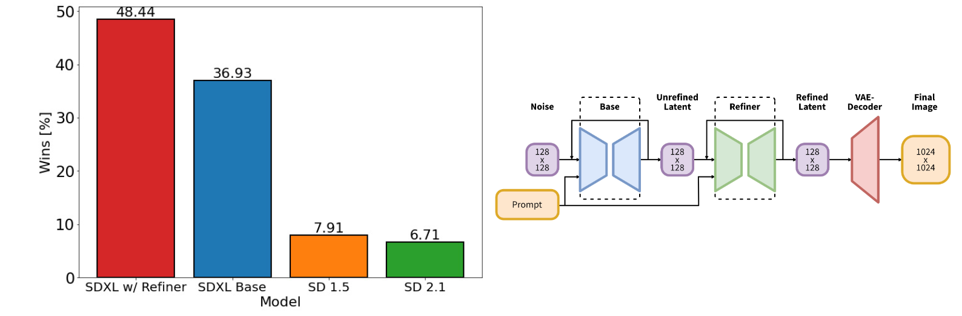
Stable Diffusion XL
Left: Comparing user preferences between SDXL and Stable Diffusion 1.5 & 2.1. While SDXL already clearly outperforms Stable Diffusion 1.5 & 2.1, adding the additional refinement stage boosts performance. Right: Visualization of the two-stage pipeline: We generate initial latents of size 128 × 128 using SDXL. Afterwards, we utilize a specialized high-resolution refinement model and apply SDEdit on the latents generated in the first step, using the same prompt. SDXL and the refinement model use the same autoencoder (Podell et al., 2023).
Podell, D., English, Z., Lacey, K., Blattmann, A., Dockhorn, T., Müller, J., Penna, J., & Rombach, R. (2023, October 13). SDXL: Improving Latent Diffusion Models for High-Resolution Image Synthesis. The Twelfth International Conference on Learning Representations.
© Sakura, 2024. All rights reserved.

Slide 11
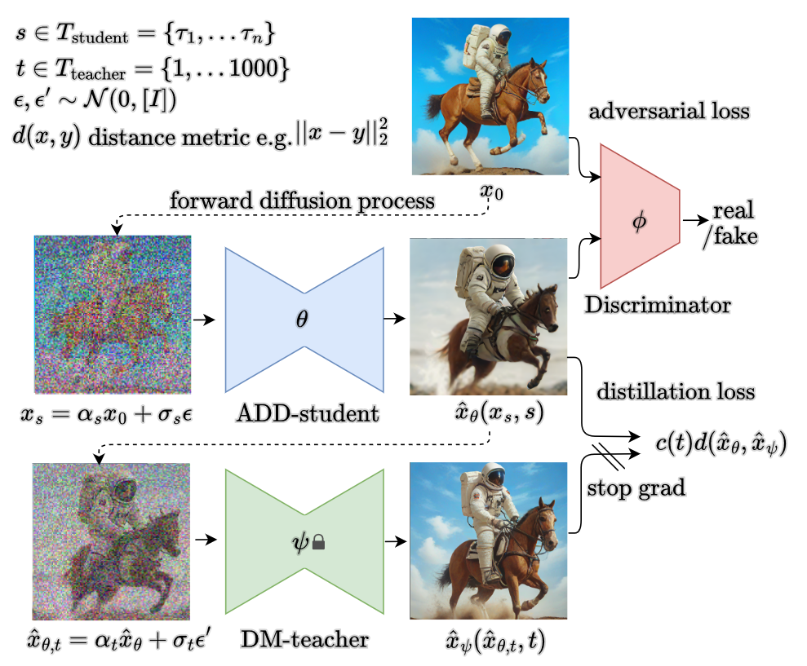
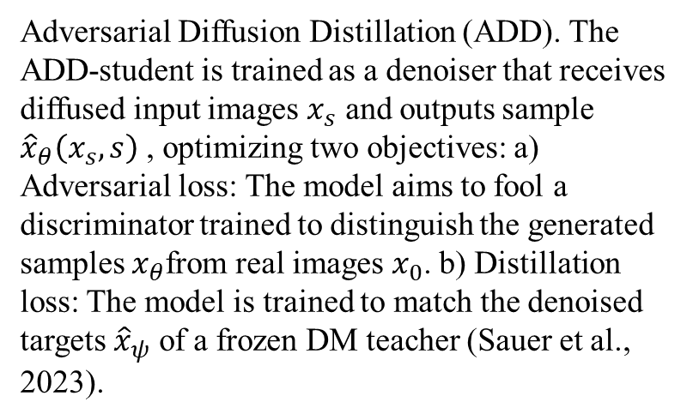
Stable Diffusion XL Turbo
Adversarial Diffusion Distillation (ADD). The ADD-student is trained as a denoiser that receives diffused input images $x_{s}$​ and outputs sample ${\hat{x}}_{θ}\left(x_{s}, s\right)$ , optimizing two objectives: a) Adversarial loss: The model aims to fool a discriminator trained to distinguish the generated samples $x_{θ}$from real images $x_{0}$. b) Distillation loss: The model is trained to match the denoised targets ${\hat{x}}_{ψ}$ of a frozen DM teacher (Sauer et al., 2023).
Sauer, A., Lorenz, D., Blattmann, A., & Rombach, R. (2023). Adversarial Diffusion Distillation (arXiv:2311.17042).
© Sakura, 2024. All rights reserved.

Slide 12
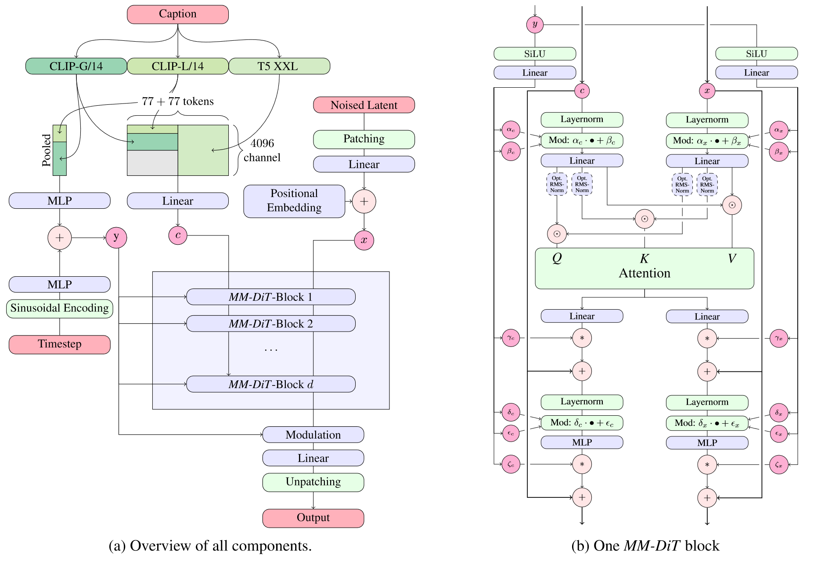
Stable Diffusion 3
Our model architecture. Concatenation is indicated by ⊙ and element-wise multiplication by ∗.
The RMS-Norm for Q and K can be added to stabilize training runs. Best viewed zoomed in (Esser et al. 2024).
Esser, P., Kulal, S., Blattmann, A., Entezari, R., Müller, J., Saini, H., Levi, Y., Lorenz, D., Sauer, A., Boesel, F., Podell, D., Dockhorn, T., English, Z., & Rombach, R. (2024, June 6). Scaling Rectified Flow Transformers for High-Resolution Image Synthesis. Forty-first International Conference on Machine Learning.
© Sakura, 2024. All rights reserved.

Slide 13
Quick Start with Stable Diffusion with Diffusers
© Sakura, 2024. All rights reserved.

Slide 14
Model Card – SD v2.1
@InProceedings{Rombach_2022_CVPR,
author = {Rombach, Robin and Blattmann, Andreas and Lorenz, Dominik and Esser, Patrick and Ommer, Bj\"orn},
title = {High-Resolution Image Synthesis With Latent Diffusion Models},
booktitle = {Proceedings of the IEEE/CVF Conference on Computer Vision and Pattern Recognition (CVPR)},
month = {June},
year = {2022},
pages = {10684-10695}
}
Model Details
Developed by: Robin Rombach, Patrick Esser
Model type: Diffusion-based text-to-image generation model
Language(s): English
License: CreativeML Open RAIL++-M License
Model Description: This is a model that can be used to generate and modify images based on text prompts. It is a Latent Diffusion Model that uses a fixed, pretrained text encoder (OpenCLIP-ViT/H).
Resources for more information: GitHub Repository.
Model Card (part of full version) of Stable Diffusion v2-1 (Rombach et al., 2022).
Rombach, R., Blattmann, A., Lorenz, D., Esser, P., & Ommer, B. (2022). High-Resolution Image Synthesis With Latent Diffusion Models. 10684–10695.
© Sakura, 2024. All rights reserved.

Slide 15
File Structures
Architecture of LDM (Rombach et al., 2022)
Rombach, R., Blattmann, A., Lorenz, D., Esser, P., & Ommer, B. (2022). High-Resolution Image Synthesis With Latent Diffusion Models. 10684–10695.
© Sakura, 2024. All rights reserved.

Slide 16
Installation
Architecture of LDM (Rombach et al., 2022)
Rombach, R., Blattmann, A., Lorenz, D., Esser, P., & Ommer, B. (2022). High-Resolution Image Synthesis With Latent Diffusion Models. 10684–10695.
© Sakura, 2024. All rights reserved.

Slide 17
Deployment
Architecture of LDM (Rombach et al., 2022)
Rombach, R., Blattmann, A., Lorenz, D., Esser, P., & Ommer, B. (2022). High-Resolution Image Synthesis With Latent Diffusion Models. 10684–10695.
© Sakura, 2024. All rights reserved.

Slide 18
References and Related Works
Esser, P., Kulal, S., Blattmann, A., Entezari, R., Müller, J., Saini, H., Levi, Y., Lorenz, D., Sauer, A., Boesel, F., Podell, D., Dockhorn, T., English, Z., & Rombach, R. (2024, June 6). Scaling Rectified Flow Transformers for High-Resolution Image Synthesis. Forty-first International Conference on Machine Learning. https://openreview.net/forum?id=FPnUhsQJ5B
Podell, D., English, Z., Lacey, K., Blattmann, A., Dockhorn, T., Müller, J., Penna, J., & Rombach, R. (2023, October 13). SDXL: Improving Latent Diffusion Models for High-Resolution Image Synthesis. The Twelfth International Conference on Learning Representations. https://openreview.net/forum?id=di52zR8xgf
Rombach, R., Blattmann, A., Lorenz, D., Esser, P., & Ommer, B. (2022). High-Resolution Image Synthesis With Latent Diffusion Models. 10684–10695. https://openaccess.thecvf.com/content/CVPR2022/html/Rombach_High-Resolution_Image_Synthesis_With_Latent_Diffusion_Models_CVPR_2022_paper.html
Sauer, A., Lorenz, D., Blattmann, A., & Rombach, R. (2023). Adversarial Diffusion Distillation (arXiv:2311.17042). arXiv. https://doi.org/10.48550/arXiv.2311.17042
Zhang, L., Rao, A., & Agrawala, M. (2023). Adding Conditional Control to Text-to-Image Diffusion Models. 2023 IEEE/CVF International Conference on Computer Vision (ICCV), 3813–3824. https://doi.org/10.1109/ICCV51070.2023.00355
© Sakura, 2024. All rights reserved.

