Slide 1
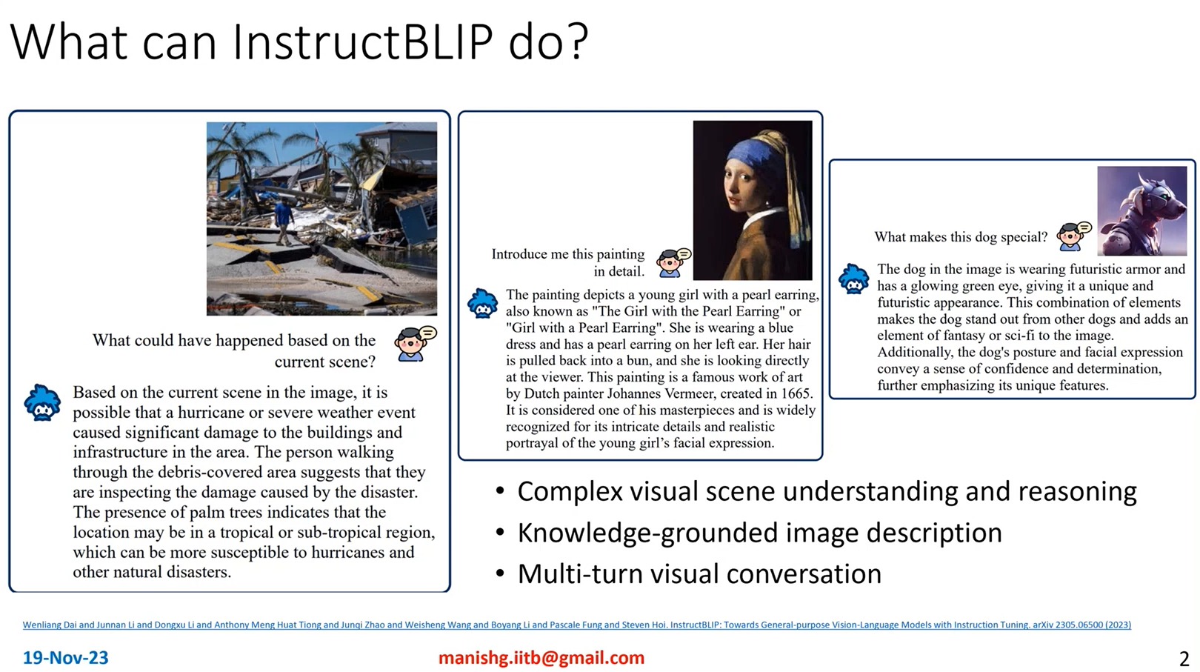
Data Science Gems (Director). (2023, November 19). InstructBLIP: Vision-Language Models with Instruction Tuning [Video recording]. https://www.youtube.com/watch?v=QlHjqh0XNAg

Slide 2
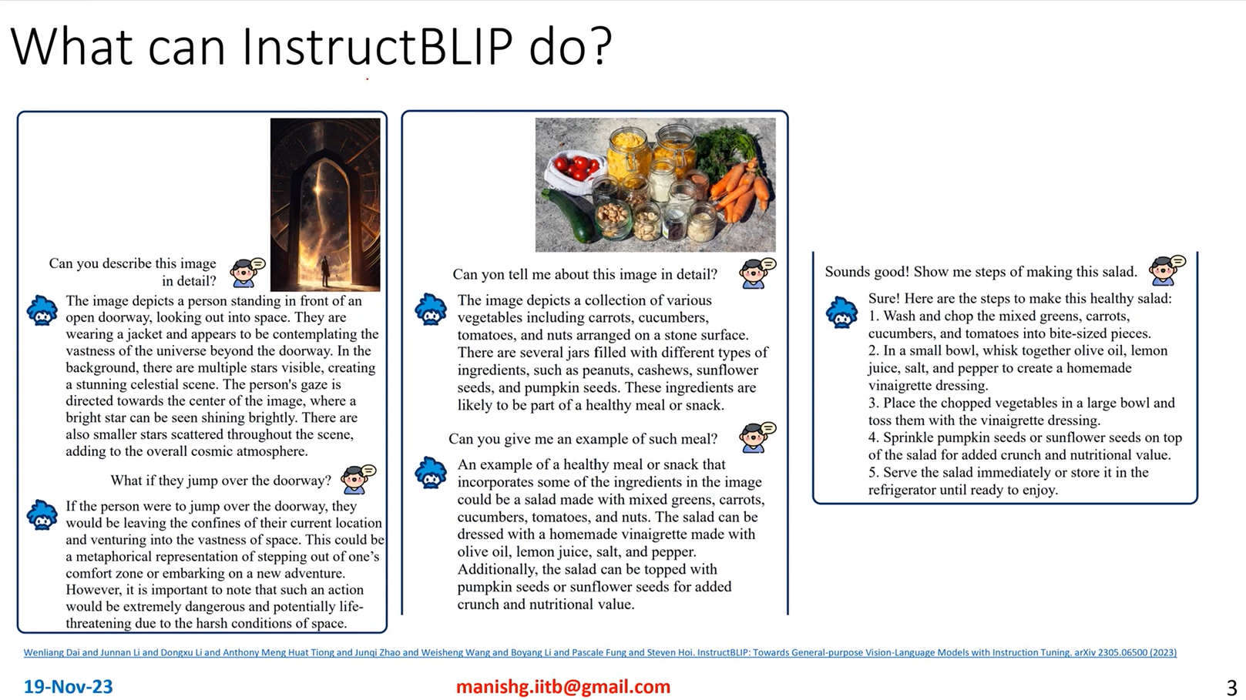
Data Science Gems (Director). (2023, November 19). InstructBLIP: Vision-Language Models with Instruction Tuning [Video recording]. https://www.youtube.com/watch?v=QlHjqh0XNAg

Slide 3
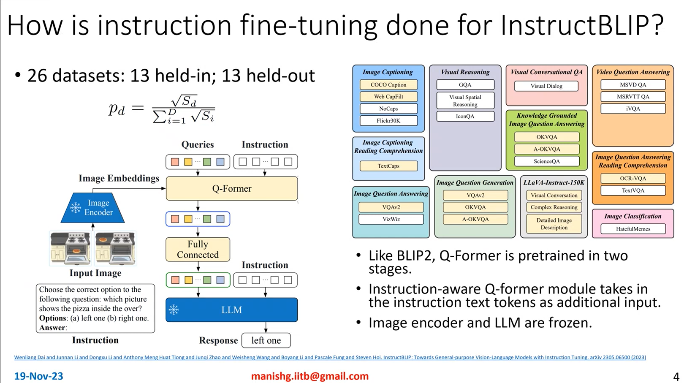
Data Science Gems (Director). (2023, November 19). InstructBLIP: Vision-Language Models with Instruction Tuning [Video recording]. https://www.youtube.com/watch?v=QlHjqh0XNAg

Slide 4
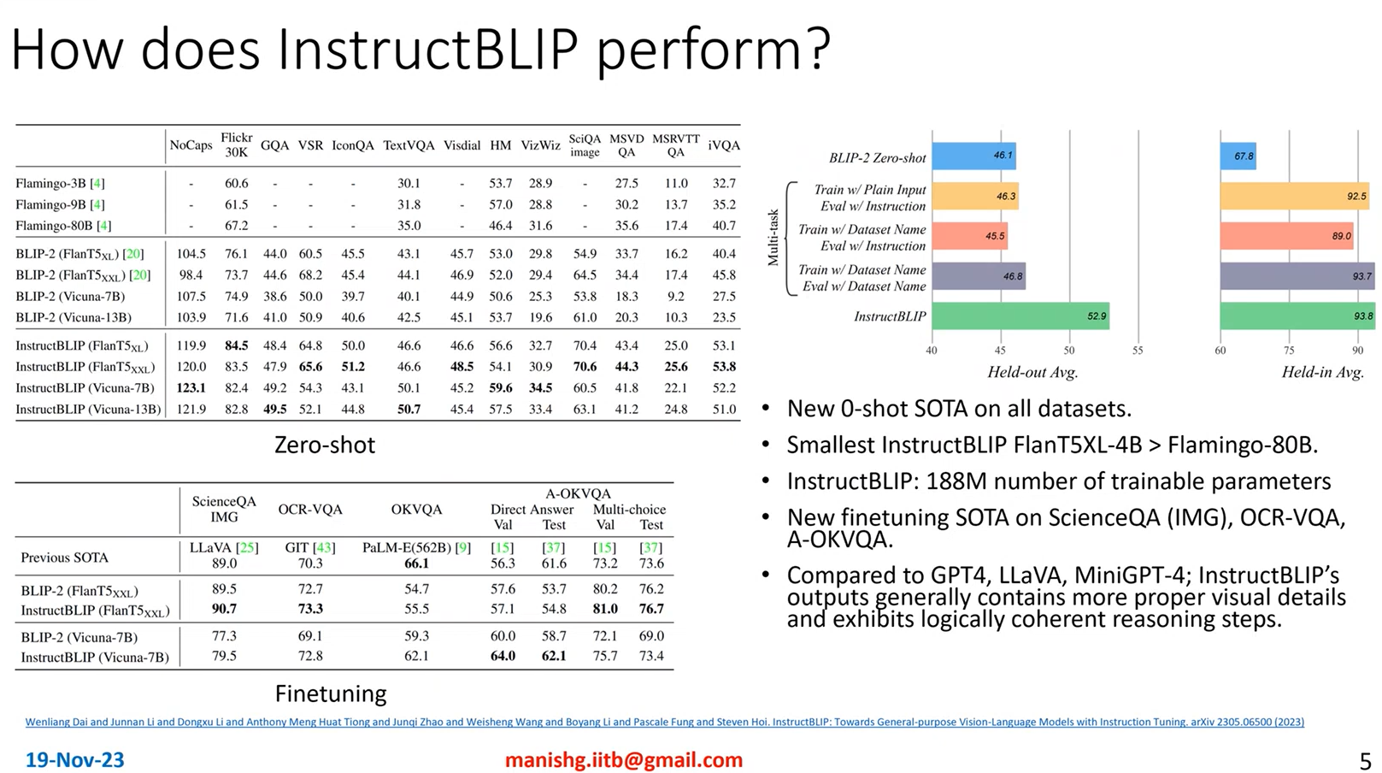
Data Science Gems (Director). (2023, November 19). InstructBLIP: Vision-Language Models with Instruction Tuning [Video recording]. https://www.youtube.com/watch?v=QlHjqh0XNAg

